Slide 1
Modern Database Management
Chapter 1A: The Database Environment
Chapter 1A
The Database Environment
Modern Database Management
12th Edition
Hoffer, Ramesh, and Topi

Slide 2
Learning Points
Modern Database Management
Chapter 1A: The Database Environment
Definition of terms
Explain advantages and elements of database approaches
List components of database environment
Identify five categories of databases

Slide 3
Definitions
Database: organized collection of logically related data.
Data: stored representations of meaningful objects and events.
Information: data processed to increase knowledge in the person using the data.
Metadata: data that describes the properties and context of user data

Slide 4
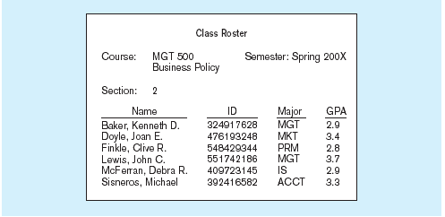
Data in Context

Slide 5
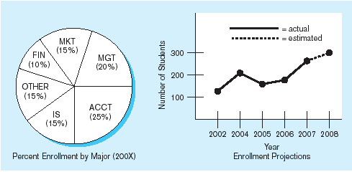
Summarized Data
Graphical displays turn data into useful information

Slide 6
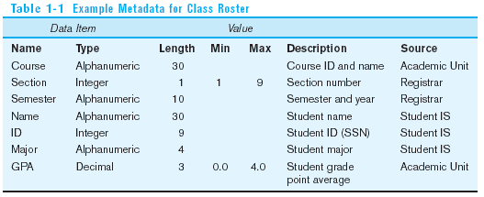
Metadata
Data item name, data types, field sizes, allowable values

Slide 7
The DATABASE Approach
Emphasizes the integration and sharing of data.
Central repository of shared data.
Data is managed by a controlling agent.
Stored in a standardized, convenient form.

Slide 8
Database Management System
Order Filing
System
Central database
Contains employee,
order, inventory,
pricing, and
customer data
Invoicing
System
DBMS
Payroll
System
A database management system (DBMS) is a software system that is used to create, maintain, and provide controlled access to user databases.

Slide 9
Elements of the Database Approach
A database (DB) is a system intended for easily organizing, storing and retrieving large amounts of data.
A database management system (DBMS) is actually the whole system used for managing databases, and thus make it easy to create, manipulate, and maintain data.
In today’s world, a database itself is useless if there is no DBMS associated with it. Thus, increasingly, the term Database is used as shorthand for Database Management System.

Slide 10
Advantages of the Database Approach
Program-data independence: allows data to change without changing the application programs.
Planned data redundancy: enables the designer to control the type and amount of redundancy.
Improved data consistency: greatly reduce the opportunities for inconsistency.
Improved data sharing: users are granted permission to use the database.
Increased application development productivity: reduces the cost and time for developing new business applications.

Slide 11
Advantages of the Database Approach (cont.)
Enforcement of standards: provides powerful tools for enforcing data standards.
Improved data quality: provides tools and processes to improve data quality.
Improved data accessibility and responsiveness: users can often retrieve and display data.
Reduced program maintenance: easy to change data formats.
Improved decision support: some are designed expressly for decision support applications.

Slide 12

Elements of the Database Approach
Relational Databases
  Database technology involving tables (relations) representing entities and primary/foreign keys representing relationships.
Data models
  Graphs capturing the nature of and relationships among data.
  Are used at different levels of abstraction as a database is conceptualized and designed.

Slide 13
Elements of the Database Approach
Entities
  Is like a noun in that it describes a person, place, object, event, or concept in the business environment for which information must be recorded and retained.
Attributes
  Is a property or characteristic that is used to describe an entity.
Relationships
  Refers to how one entity is connected to others.
  Also known as cardinality relationship in database domain.

Slide 14
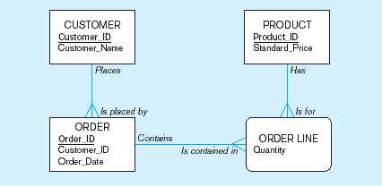
Enterprise Data Model Example

Slide 15
Components of the Database Environment
Computer-Aided Software Engineering (CASE) Tools–design databases and application programs.
Repository–centralized knowledge base for all data definitions, data relationships, report formats, etc.
DBMS–software for managing the database.
Database–storehouse of the data.
Application Programs–software using the data.

Slide 16
Components of the Database Environment (cont.)
User Interface–text and graphical displays to users.
Data/Database Administrators–personnel responsible for maintaining the database.
System Developers–personnel responsible for designing databases and software.
End Users–people who use the applications and databases.

Slide 17
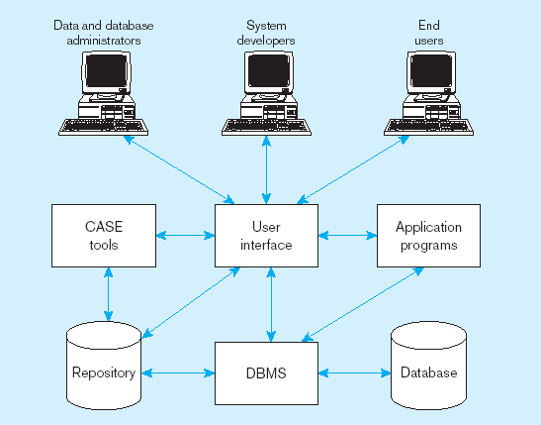
Components of the Database Environment (cont.)

Slide 18
The Range of Database Applications
Personal databases
Workgroup databases
Departmental/divisional databases
Enterprise databases
Web-enabled databases

Slide 19
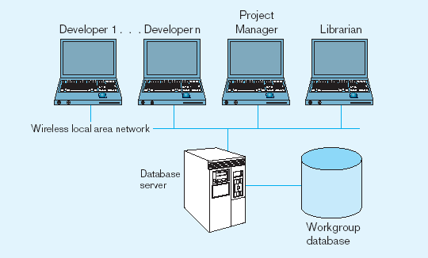
Workgroup Database

Slide 20
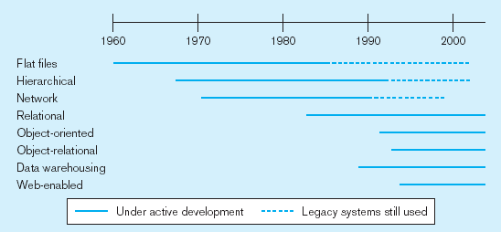
Evolution of DB Systems

