Slide 1
The Database Development Process
Chapter 1B
Modern Database Management
12th Edition
Hoffer, Ramesh, and Topi

Slide 2
Learning Points
Basic Concepts of Database Development
Describe System Development Life Cycle
Explain Prototyping Approach
Explain CASE and Three Schemas
Explain Three-Tiered Architectures

Slide 3
Enterprise Data Modeling
Enterprise data modeling:
First step in database development.
Specifies scope and general contents.
Creates an overall picture of organizational data at high level of abstraction.
Analyzes the nature of the business areas to be supported.

Slide 4

Information Systems Architecture
Information systems architecture is the conceptual blueprint for organization’s desired information systems structure; consists of:
  Data
  Processes–manipulate data; presented by data flow diagrams.
  Network–transport data around the organization.
  People–perform process; use data.
  Events and points in time–when processes are performed.
  Reasons for events and rules that govern the processing of data.

Slide 5
Information Engineering
Information engineering:
A data-oriented methodology to create and maintain information systems.
Emphasizes the importance of understanding relevant data.
Top-down planning: specific information systems are deduced from a broad understanding of information needs.
Includes four steps:
  Planning, Analysis, Design, Implementation.

Slide 6
Information Systems Planning
IS planning aligns information technology with organization’s business strategies; involves three steps:
    Identify strategic planning factors
    Identify corporate planning objects
    Develop an enterprise model

Slide 7
Identify Strategic Planning Factors
Strategic Planning Factors
  Organization goals–what we hope to accomplish.
  Critical success factors–what MUST work in order for us to survive.
  Problem areas–weaknesses we now have.

Slide 8
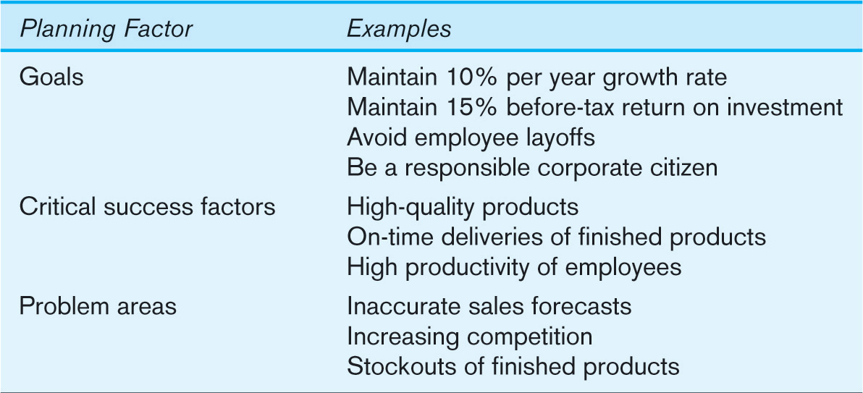
Example of Planning Factors

Slide 9
Identify Corporate Planning Objects
Corporate Planning Objects
  Organizational units–departments.
  Organizational locations.
  Business functions–groups of business processes.
  Entity types–the things we are trying to model for the database.
  Information systems–application programs.

Slide 10
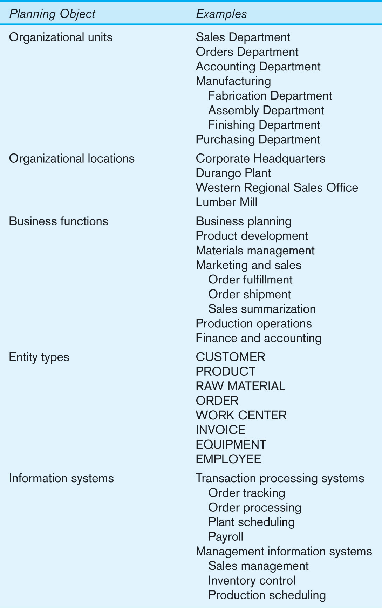
Example of Corporate Planning Objects

Slide 11
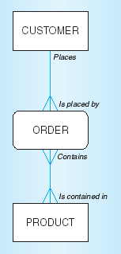
Develop an Enterprise Model
Functional decomposition
  Process of breaking organizational functions into greater levels of detail.
Enterprise data model
Planning matrixes
  Describe interrelationships
  between planning objects.

Slide 12
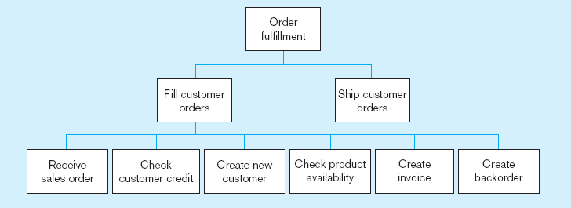
Example of Process Decomposition
Decomposition = breaking large tasks into smaller tasks in a hierarchical structure chart

Slide 13
Types of Planning Matrixes
Location-to-function – indicates which business functions are being performed at which business locations.
Unit-to-function – identifies which business functions are performed by or are the responsibility of which business units.
IS-to-data entity – explains how each IS interacts with each data entity.
Supporting function-to-data entity – identifies which data are captured, used, updated, or deleted within each function.
IS-to-objective – shows which IS support each business objective.

Slide 14
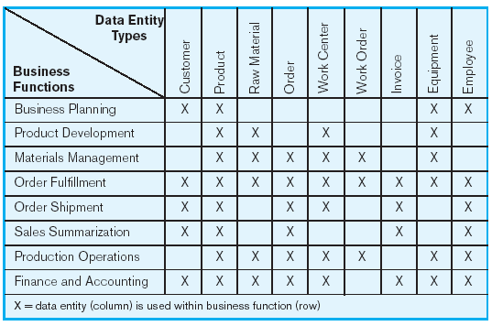
Function-to-Data Entity Matrix

Slide 15
Two IS Development Approaches
System Development Life Cycle (SDLC)
  Detailed, well-planned development process.
  Time-consuming, but comprehensive.
Prototyping
  Rapid application development (RAD).
  Requirements are converted to a working system.
  Iterative process with new prototype versions.

Slide 16
Systems Development Life Cycle
Planning
Analysis
Logical Design
Physical Design
Implementation
Maintenance

Slide 17
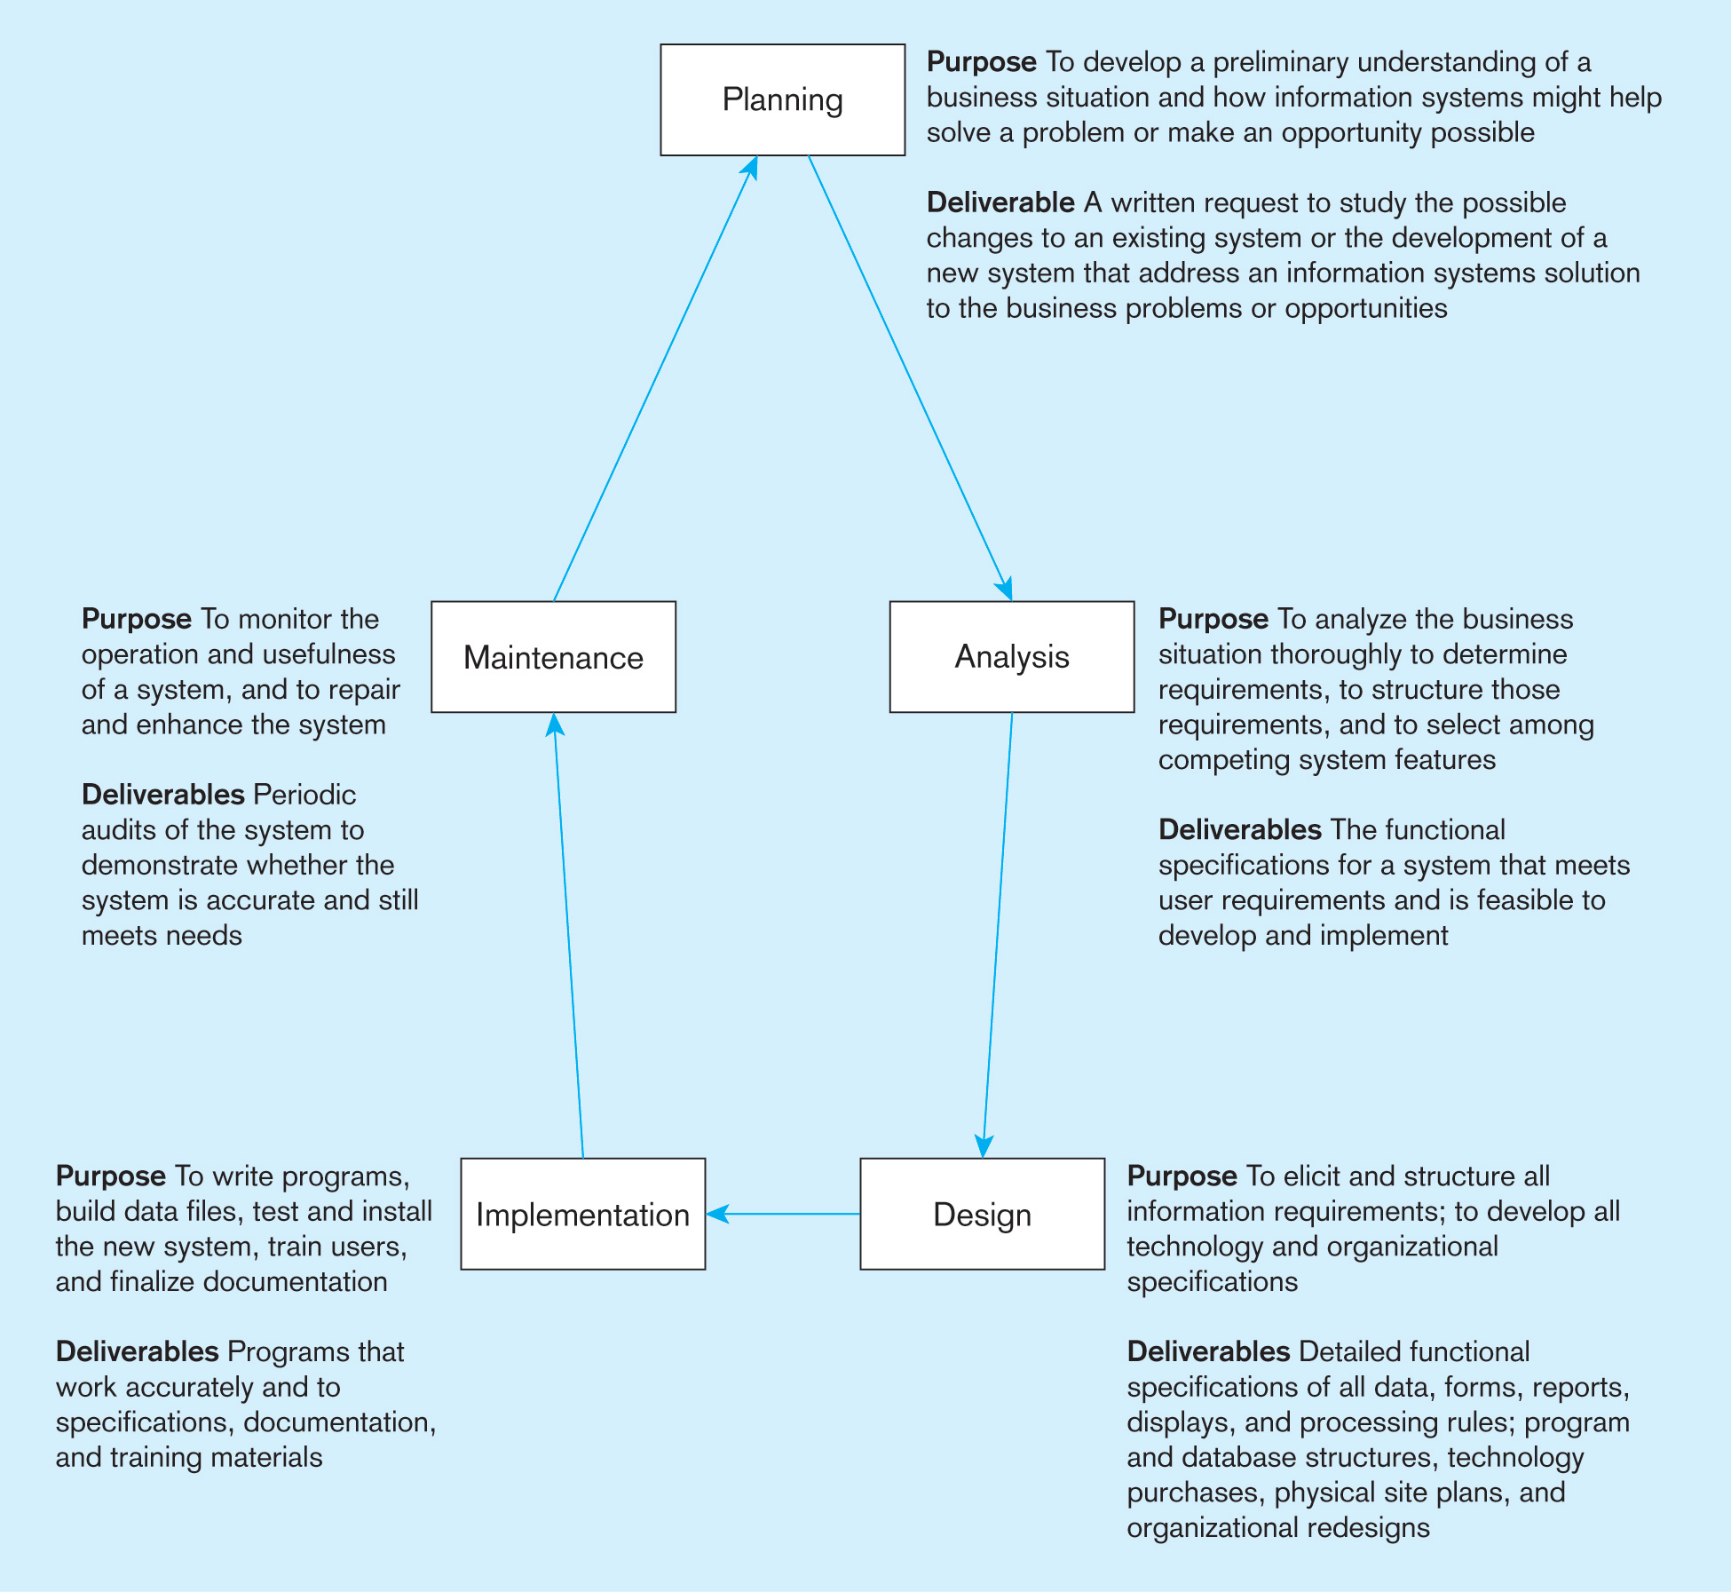
Details of SDLC

Slide 18
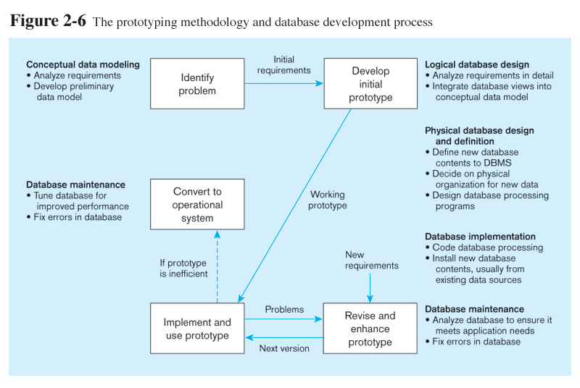
Prototyping Database Methodology

Slide 19
Packaged Data Models
Packaged Data Models involve:
Model components that can be purchased, customized, and assembled into full-scale data models.
Advantages
  Reduced development time.
  Higher model quality and reliability.
Two types:
  Universal data models.
  Industry-specific data models.

Slide 20
CASE
Computer-Aided Software Engineering (CASE)–software tools providing automated support for systems development.
Three database features:
  Data modeling–drawing entity-relationship diagrams.
  Code generation–SQL code for table creation.
  Repositories–knowledge base of enterprise information.

Slide 21
Managing Projects
Project is a planned undertaking of related activities to reach an objective that has a beginning and an end.
Involves use of review points for:
  Validation of satisfactory progress
  Step back from detail to overall view
  Renew commitment of stakeholders
Incremental commitment–project is reviewed after each phase and continuation of the project is rejustified.

Slide 22
Managing Projects: People Involved
Business analysts
Systems analysts
Database analysts and data modelers
Users
Programmers
Database architects
Data administrators
Project managers
Other technical experts

Slide 23
Schemas
Conceptual schema is a detailed specification of the overall structure of organizational data.
Logical schema is the representation of data for a type of data management technology.
Physical schema is a set of specifications describing how data from a logical schema are stored in a computer.

Slide 24
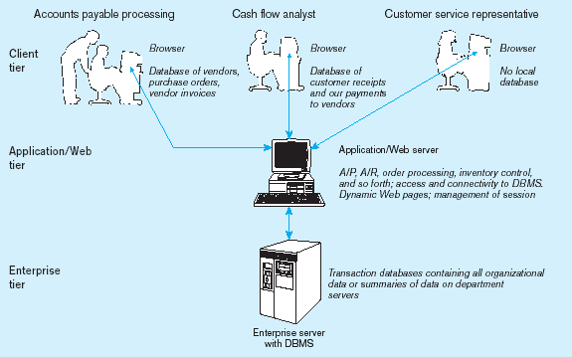
Three-Tiered Client/Server Database Architecture

Slide 25
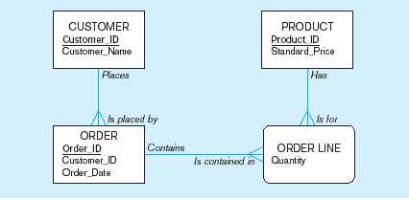
Pine Valley Furniture Data Model

Slide 26
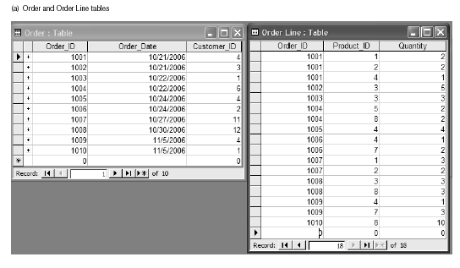
Pine Valley Furniture 4 Tables

Slide 27
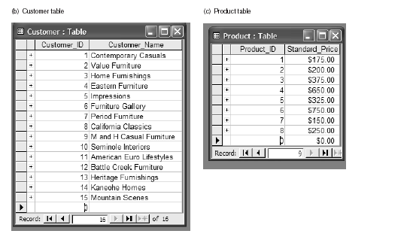
Pine Valley Furniture 4 Tables (cont.)

