Slide 1
Modeling Data in the Organization
Chapter 2
Modern Database Management
12th Edition
Hoffer, Ramesh, and Topi

Slide 2
Learning Points
Definition of Business Rules and Data
E-R Model Constructs – Entity, Attribute, and Relationship
E-R Diagram and Notation
Degree and Cardinality of Relationship

Slide 3

Business Rules
Business rules
  Derived from policies, procedures, events, functions, and other business objects.
  State constraints on the organization.
  Assert business structure.
  Influence business behavior.
  Determine how firms respond to their environment.
  Expressed in terms familiar to end users.

Slide 4
Examples of Business Rules
A student may register for a section of a course only if he or she has successfully completed the prerequisites for that course.
A preferred customer qualifies for a 10 percent discount, unless he has an overdue account balance.

Slide 5
Data Name
Related to business, not technical characteristics.
Meaningful and self-documenting.
Unique.
Readable.
Composed of words from an approved list.
Repeatable.

Slide 6
Data Definitions
Guidelines for good data definition
  Gathered in conjunction with systems requirements.
  Accompanied by diagrams.
  Iteratively created and refined.
  Achieved by consensus.

Slide 7
Examples of Data Definitions
A course is a module of instruction in a particular subject area.
A customer may request a model of car from a rental branch on a particular date.

Slide 8
E-R Model Constructs – Entity
An entity is a person, place, object, event, or concept in the user environment about which the organization wishes to maintain data.
An entity type is a collection of entities that share common properties or characteristics; often corresponds to a table.
An entity instance is a single occurrence of an entity type; often corresponds to a row in a table.
Notes:
2

Slide 9
Entity Example
Entity type: EMPLOYEE
Attributes | Attribute Data type | Example Instance | Example Instance
Employee_Number | CHAR(10) | 642-17-8360 | 534-10-1971
Name | CHAR(25) | Michelle Brady | David Johnson
Address | CHAR(30) | 100 Pacific Avenue | 450 Redwood Drive
City | CHAR(20) | San Francisco | Redwood City
State | CHAR(2) | CA | CA
Zip_Code | CHAR(9) | 98173 | 97142
Date_Hired | DATE | 03-21-1992 | 08-16-1994
Birth_Date | DATE | 06-19-1968 | 09-04-1975
Notes:
2

Slide 10
Strong vs. Weak Entities
Strong entities
  Exist independently of other types of entities.
  Instances of a strong entity type always have a unique characteristic.
Weak entities
  Depend on some other entity type (called the identifying owner).
  Has no business meaning in an E-R diagram without the entity on which it depends.
  Does not have a unique identifier (only a partial identifier).

Slide 11
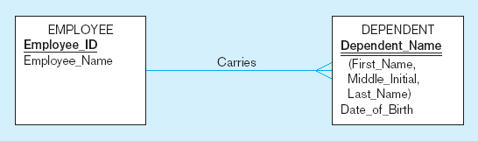
Example of Strong and Weak Entities
Strong entity
Identifying owner
Weak entity
Identifying relationship

Slide 12
E-R Model Constructs – Attribute
An attribute is a property or characteristic of an entity type that is of interest to the organization (often corresponds to a field in a table).
An attribute often has a noun name.
Use an initial capital letter followed by lowercase letters to name attributes; if necessary, use an underscore character to connect the words.
Notes:
2

Slide 13
Classifications of attributes
Required attribute must be present for each entity instance.
Optional attribute may not have a value for an entity instance.
Composite attribute is an attribute, such as Address, that has meaningful component parts.
Simple attribute is an attribute that cannot be broken down into smaller components.
Notes:
5

Slide 14
Example of Attributes
Entity type: STUDENT
Attributes | Attribute Data Type | Required or Optional | Example Instance | Example Instance
Student_ID | CHAR (10) | Required | 876-24-8217 | 822-24-4456
Student_Name | CHAR (40) | Required | Michael Grant | Melissa Kraft
Home_Address | CHAR (30) | Required | 314 Baker St. | 1422 Heft Ave
Home_City | CHAR (20) | Required | Centerville | Miami
Home_State | CHAR (2) | Required | OH | FL
Home_Zip_Code | CHAR (9) | Required | 45459 | 33321
Major | CHAR (3) | Optional | MIS
Notes:
2

Slide 15
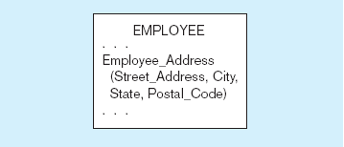
Example of Composite Attribute
An attribute broken into component parts
Notes:
12

Slide 16
Classifications of attributes (cont.)
Single-Valued attribute has only one value.
Multivalued attribute may take on more than one value of a given entity instance.
Stored attribute can not be calculated or derived from other related attribute values.
Derived attribute is an attribute whose values can be calculated or derived from related attribute values.
Notes:
5

Slide 17
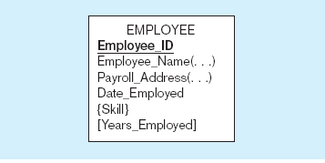
Example of Multivalued and Derived Attributes
Entity with multivalued attribute (Skill)
and derived attribute (Years_Employed)
Multivalued
an employee can have
more than one skill
Derived
from date employed and current date
Notes:
12

Slide 18
Identifiers (Keys)
Identifier (Key) is an attribute (or combination of attributes) that uniquely distinguishes individual instances of an entity type.
Composite identifier consists of more than one attributes.
Candidate Identifier is an attribute that satisfies the requirements for being an identifier.
Key will not change in value and can not be null.
Notes:
6

Slide 19
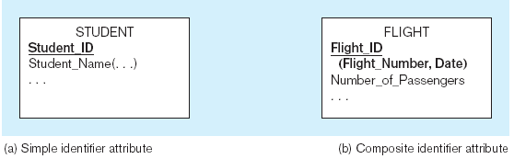
Example of Identifier/Key
The identifier is boldfaced and underlined
Notes:
14

Slide 20
E-R Model Constructs – Relationship
A relationship is an association representing an interaction among the instances of one or more entity types that is of interest to the organization.
A relationship instance is a link between entity instances (corresponds to primary key-foreign key equivalencies in related tables).
Notes:
2

Slide 21
Cardinality Constraint of Relationships
Cardinality Constraints - the number of instances of one entity that can or must be associated with each instance of another entity.
Minimum Cardinality is the minimum number of instances of entity B that may be associated with each instance of entity A.
  If zero, then optional; if one or more, then mandatory.
Maximum Cardinality is the maximum number of instances of entity B that may be associated with each instance of entity A.
Notes:
29

Slide 22
Three Cardinality Relationships
One-to-One
  Each entity in the relationship will have exactly one related entity.
One-to-Many
  An entity on one side of the relationship can have many related entities, but an entity on the other side will have a maximum of one related entity.
Many-to-Many
  Entities on both sides of the relationship can have many related entities on the other side.

Slide 23
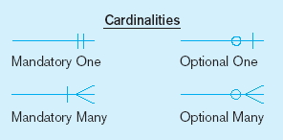
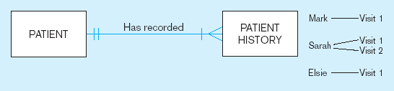
Mandatory Cardinalities
A patient history is recorded for one and only one patient
A patient must have recorded at least one history, and can have many
Notes:
1

Slide 24
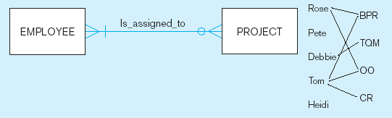
One optional, One mandatory
A project must be assigned to at least one employee, and may be assigned to many.
An employee can be assigned to any number of projects, or may not be assigned to any at all.
Notes:
1

Slide 25
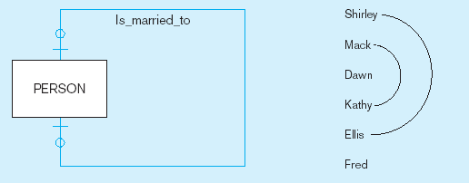
Optional Cardinality
A person is married to at most one other person, or may not be married at all.
Notes:
1

Slide 26
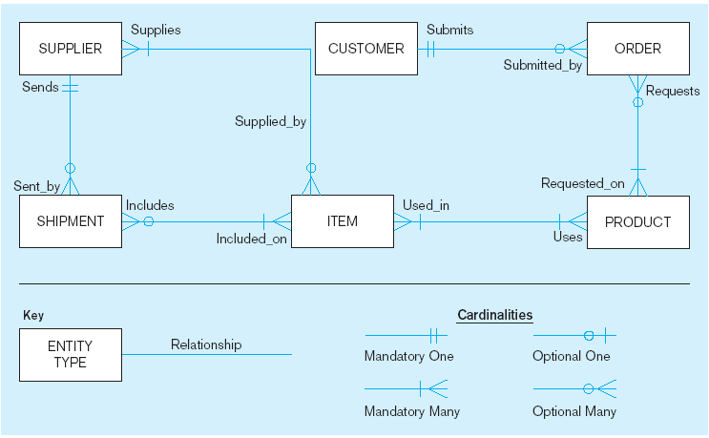
Sample E-R Diagram
Notes:
3

Slide 27
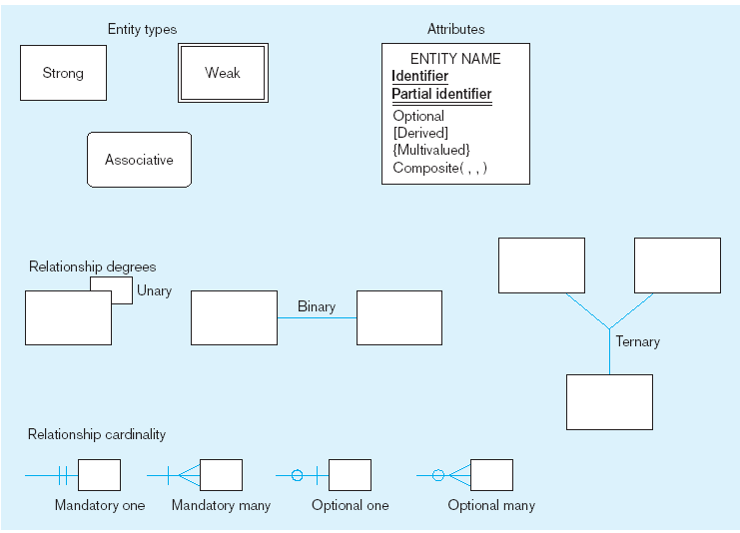
Basic E-R notation
Entity symbols
Attribute symbols
A special entity that is also a relationship
Relationship symbols
Relationship degrees specify number of entity types involved
Relationship cardinalities specify how many of each entity type is allowed
Notes:
8

Slide 28
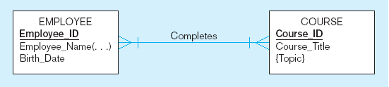
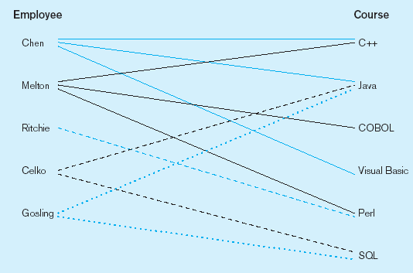
Example Regarding Relationship
a) Relationship
b) Relationship instances
Notes:
17

Slide 29
Associative Entities
An associative entity associates the instances of one or more entity types and contains attributes that are peculiar to the relationship between those entity instances.
  All relationships for the associative entity should be “many”.
  The associative entity has independent meaning.
  The associative entity preferably has one or more attributes other than the key.
  The associative entity may participate in relationships other than the entities of the associated relationship.

Slide 30
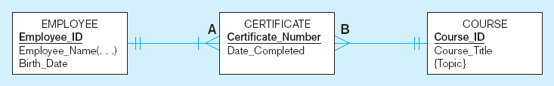
An Associative Entity
The many-to-many cardinality between entities in the figure has been replaced by two one-to-many relationships with the associative entity.
Notes:
21

Slide 31
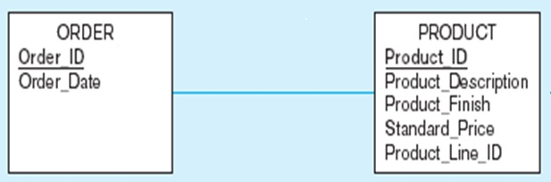
Example of A Many-to-Many Relationship

Slide 32
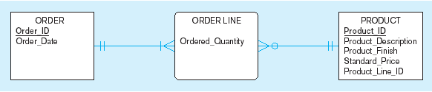
Example of an Associative Entity
An associative entity

Slide 33
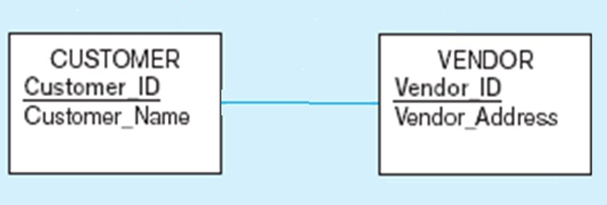
Another Example of A Many-to-Many Relationship

Slide 34

Another Associative Entity Example
SHIPMENT associative entity

Slide 35
Degree of Relationships
Degree of a relationship is the number of entity types that participate in that relationship.
  Unary Relationship is a relationship between the instances of a single entity type.
  Binary Relationship is a relationship between the instances of two entity types.
  Ternary Relationship is a simultaneous relationship among the instances of three entity types.
Notes:
16

Slide 36
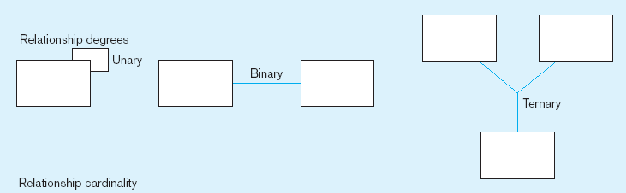
Degree of Relationships Example
Entities of two different types related to each other
One entity related to another of the same entity type
Entities of three different types related to each other
Notes:
8

Slide 37
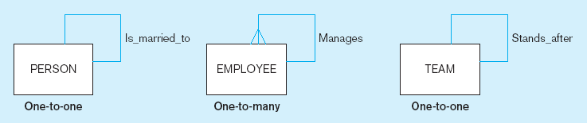
Unary Relationships
Notes:
22

Slide 38
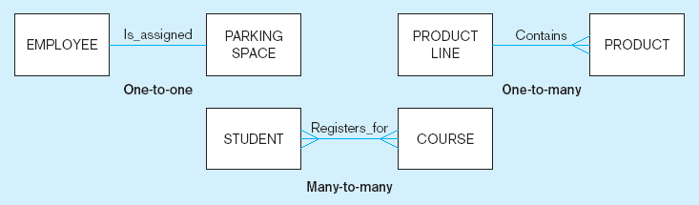
Binary Relationships
Notes:
22

Slide 39
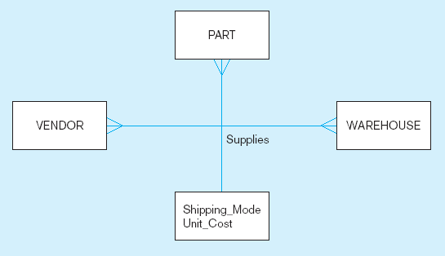
Ternary Relationship
Note: a relationship can have attributes of its own
Notes:
22

Slide 40
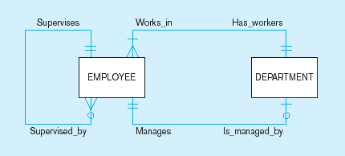
Multiple Relationships
Entities can be related to one another in more than one way.
Notes:
40

Slide 41
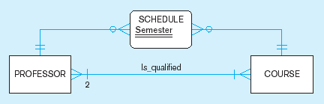
Multiple Relationships (cont.)
Here, min cardinality constraint is 2
Notes:
40

Slide 42
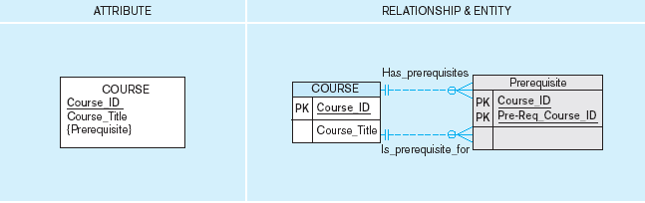
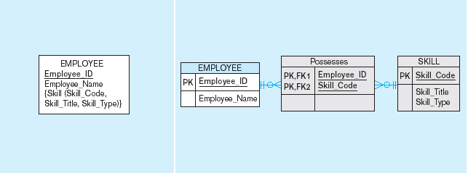
Represent Multivalued Attributes as Relationships
composite

Slide 43
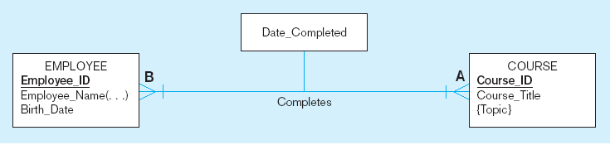
A binary Relationship with an Attribute
Here, the date completed attribute pertains specifically to the employee’s completion of a course; it is an attribute of the relationship.
Notes:
20

Slide 44
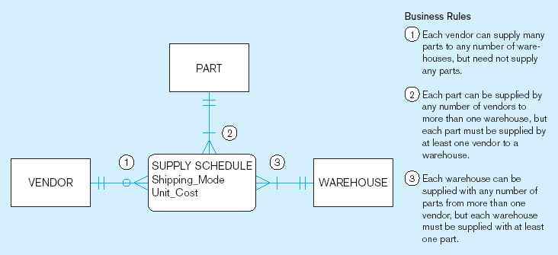
Ternary Relationship as an Associative Entity
Notes:
36

