Slide 1
The Enhanced ER Model
Chapter 3
Modern Database Management
12th Edition
Hoffer, Ramesh, and Topi

Slide 2
Learning Points
Supertype and Subtype Relationships
Generalization and Specialization Techniques
Completeness and Disjointness Constraints
Supertype/Subtype Hierarchies
Develop Entity Clusters
Representing and Enforcing Business Rules

Slide 3

Supertypes and Subtypes
A subtype is a subgrouping of the entities in an entity type that is meaningful to the organization.
A supertype is a generic entity type that has a relationship with one or more subtypes.
Attribute Inheritance:
  Subtype entities inherit values of all attributes of the supertype.
  An instance of a subtype is also an instance of the supertype.

Slide 4
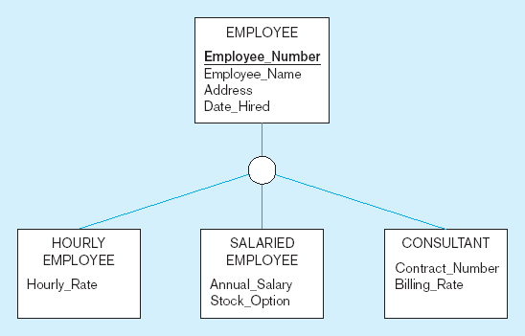
Supertype/Subtype Example
All employee subtypes will have emp nbr, name, address, and date-hired
Each employee subtype will also have its own attributes

Slide 5
Relationships and Subtypes
Relationships at the supertype level indicate that all subtypes will participate in the relationship.
The instances of a subtype may participate in a relationship unique to that subtype. In this situation, the relationship is shown at the subtype level.

Slide 6
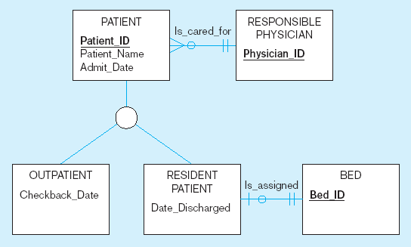
Supertype/Subtype Relationships in a Hospital
Both outpatients and resident patients are cared for by a responsible physician.
Only resident patients are assigned to a bed.

Slide 7
Generalization and Specialization
Generalization: The process of defining a more general entity type from a set of more specialized entity types. BOTTOM-UP
Specialization: The process of defining one or more subtypes of the supertype and forming supertype/subtype relationships. TOP-DOWN

Slide 8
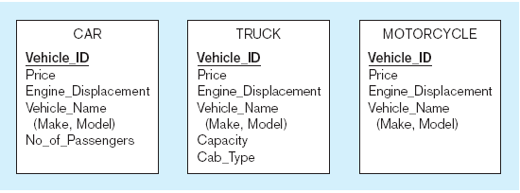
Example of Generalization
All these types of vehicles have common attributes.

Slide 9
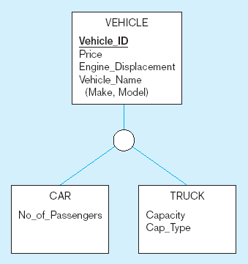
Example of Generalization (cont.)
So we put the shared attributes in a supertype.
Note: no subtype for motorcycle, since it has no unique attributes

Slide 10
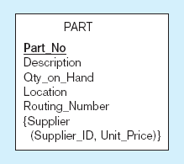
Example of Specialization
Only applies to manufactured parts
Applies only to purchased parts

Slide 11
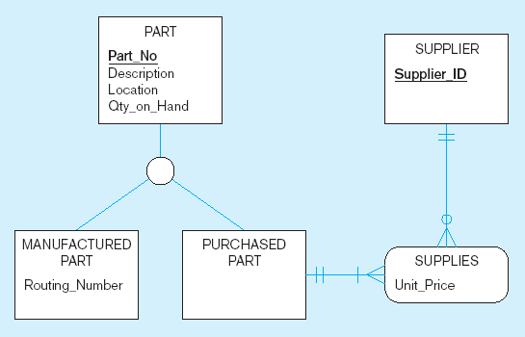
Example of Specialization (cont.)
Created 2 subtypes
Note: multivalued attribute was replaced by an associative entity relationship to another entity

Slide 12
Completeness Constraint
Completeness Constraint addresses whether an instance of a supertype must also be a member of at least one subtype.
Total specialization rule specifies that each entity instance of the supertype must be a member of some subtype in the relationship (double line).
Partial specialization rule specifies that an entity instance of the supertype is allowed not to belong to any subtype (single line).

Slide 13
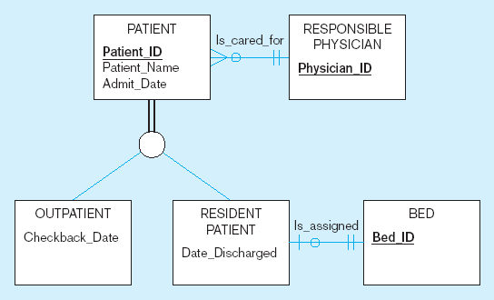
Example of Completeness Constraint
A patient must be either an outpatient or a resident patient

Slide 14
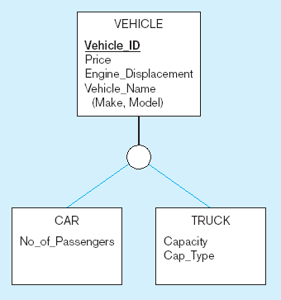
Examples of Completeness Constraint (cont.)
A vehicle could be a car, a truck, or neither.

Slide 15
Disjointness Constraint
Disjointness Constraint address whether an instance of a supertype may simultaneously be a member of two (or more) subtypes.
  Disjoint Rule: An instance of the supertype can be only ONE of the subtypes.
  Overlap Rule: An instance of the supertype could be more than one of the subtypes.

Slide 16
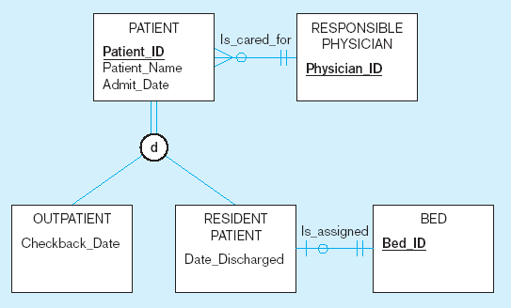
Examples of Disjointness Constraint
A patient can either be outpatient or resident, but not both.

Slide 17
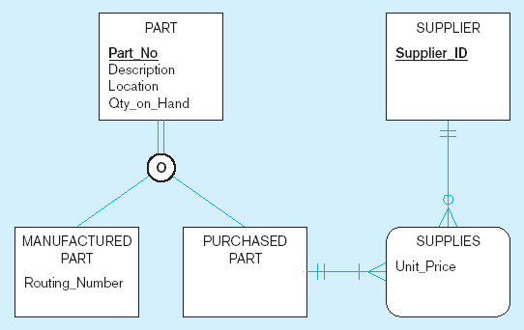
Examples of Disjointness Constraint (cont.)
A part may be both purchased and manufactured.

Slide 18
Supertype/Subtype Hierarchy
A supertype/subtype hierarchy is a hierarchical arrangement of supertypes and subtypes, where each subtype has only one supertype.
  Attributes are assigned at the highest logical level that is possible in the hierarchy.
  Subtypes that are lower in the hierarchy inherit attributes not only from their immediate supertype, but from all supertypes higher in the hierarchy, up to the root.

Slide 19
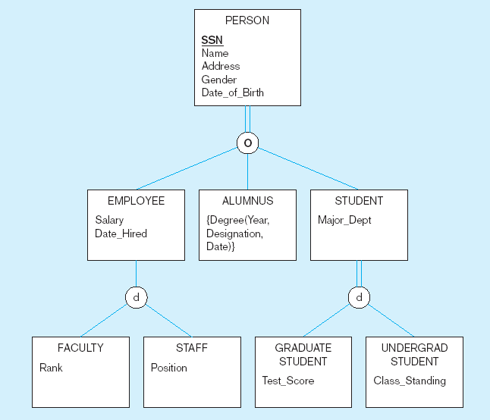
Example of Supertype/Subtype Hierarchy

Slide 20
Entity Clusters
EER diagrams are difficult to read when there are too many entities and relationships.
Solution: Group entities and relationships into entity clusters.
Entity cluster: A set of one or more entity types and associated relationships grouped into a single abstract entity type.

Slide 21
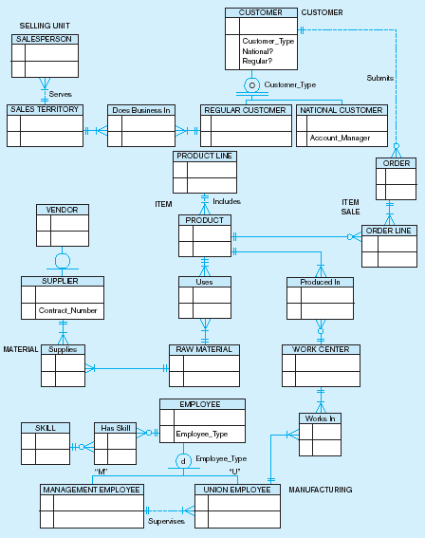
EER Diagram for Pine Valley Furniture Company
Related groups of entities could become clusters.

Slide 22
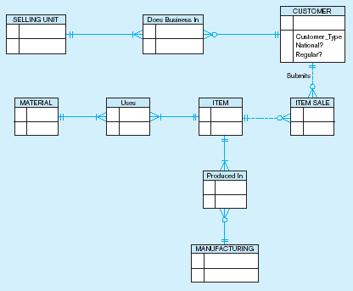
Entity clusters of EER Diagram for PVF
More readable, isn’t it?

Slide 23
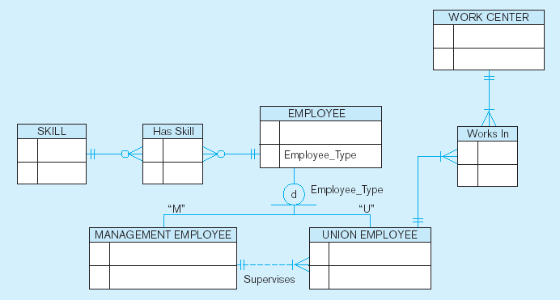
Manufacturing Entity Cluster
Detail for a single cluster

Slide 24
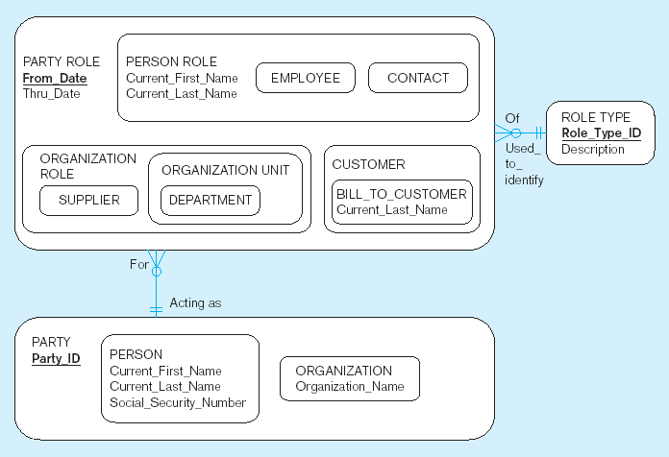
Packaged data models provide generic models that can be customized for a particular organization’s business rules.

Slide 25
Business Rules
Define or constrain some aspect of the business.
Classification of business rules:
  Structural assertion: rule expressing static structure; is stated either as a term or a fact.
  Derivation: rule derived from other knowledge such as mathematical or logical inference involving literals and facts.
  Action assertion: rule expressing constraints/control of organizational actions; states under what conditions a particular action can be performed on which business rules.

Slide 26
Structural Assertions
A course is a module of instruction in a particular subject area.
Student name is an attribute of student.
A student may register for many sections, and a section may be registered for by many students.
A faculty is an employee of the university.

Slide 27
Derivation
Student_GPA = Quality_Points/Total_Hours_Taken; where Quality_Points = sum [for all courses attempted], that is, sum of (Credit_Hours*Numberical_Grade).
In this example, Student_GPA is derived from other base and derived facts. Quality_Points and Total_Hours are also derived facts.

Slide 28
Action Assertions
A course must have a course name; the action is updating the course name property of a course.
A student must have a value of 2.0 or greater for Student_GPA to graduate; the action is checking GPAs for students want to graduate.

Slide 29
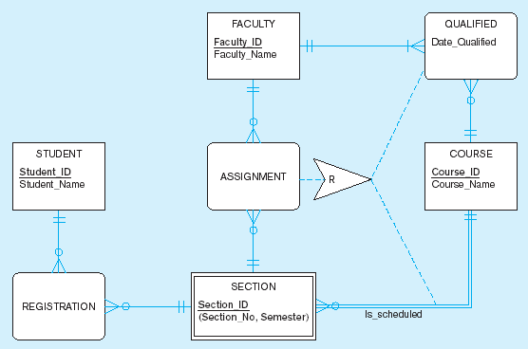
Corresponding object
In this case, the action assertion is a Restriction
Action assertion
Corresponding object
Business Rule: For a faculty member to be assigned to teach a section of a course, the faculty member must be qualified to teach the course for which that section is scheduled.

