Slide 1
Logical Database Design and the Relational Model
Chapter 4
Modern Database Management
12th Edition
Hoffer, Ramesh, and Topi

Slide 2
Learning Points
The Concept of Relation and Its Components
Transforming EER Diagrams into Relations
Introduction to Data Normalization

Slide 3
Relation
A relation is a named, two-dimensional table of data.
Table consists of rows (records) and columns (attribute or field).
Requirements for a table to qualify as a relation:
  It must have a unique name.
  Every attribute value must be atomic (not multivalued, not composite).
  Every row must be unique (can’t have two rows with exactly the same values for all their fields).
  Attributes (columns) in tables must have unique names.

Slide 4
Correspondence with E-R Model
Relations (tables) correspond with entity types.
Rows correspond with entity instances.
Columns correspond with attributes.
NOTE: The word relation (in relational database) is NOT the same as the word relationship (in E-R model).

Slide 5
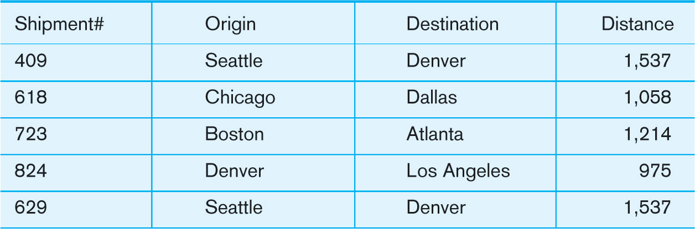
A Relation of Shipment
Shipment:

Slide 6
Key Fields
A primary key is an attribute (or combination of attributes) that uniquely identifies each row in a relation.
  Designate a primary key by underlining the attribute name; examples include employee numbers, social security numbers, etc.
A foreign key is an attribute (possibly composite) in a relation of a database that serves as the primary key of another relation in the same database.
Keys can be simple (a single field) or composite (more than one field).

Slide 7
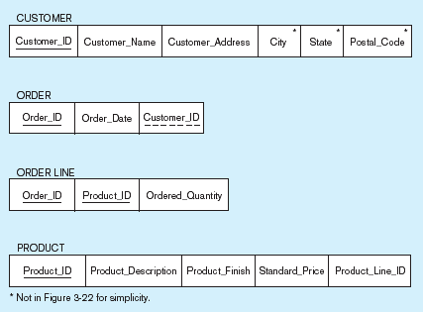
Keys
Primary Key
Foreign Key
Composite primary key, individually they are foreign keys.

Slide 8
Integrity Constraints
A domain is the set of values that may be assigned to an attribute.
Entity integrity ensures that every relation has a primary key and primary key attribute is not null.
Referential integrity maintains consistency among the rows of two relations.
  If there is a foreign key in one relation, either each foreign key value must match a primary key value in another relation, or the foreign key value must be null.

Slide 9
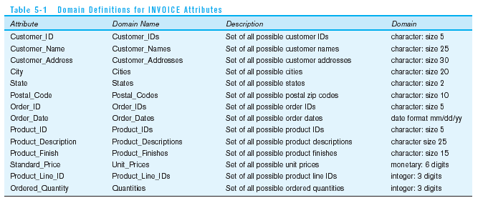
Domain definitions enforce domain integrity constraints

Slide 10
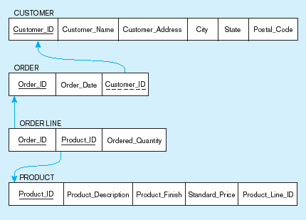
Referential Integrity
Referential integrity constraints are drawn via arrows from dependent to parent table

Slide 11

Referential Integrity (cont.)
Delete rules for foreign key:
  Restrict – don’t allow delete of “parent” side if related rows exist in “dependent” side.
  Cascade – automatically delete “dependent” side rows that correspond with the “parent” side row to be deleted.
  Set-to-Null – set the foreign key in the dependent side to null if deleting from the parent side; not allowed for weak entities.

Slide 12
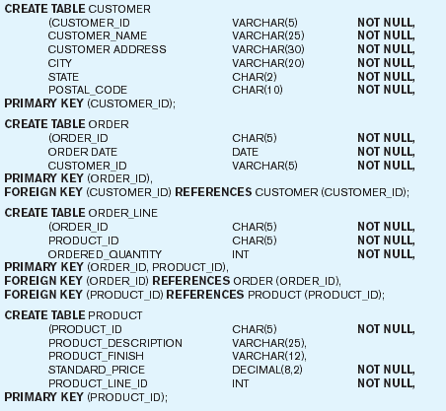
Creating Relational Table

Slide 13
Transforming EER Diagrams into Relations – Step 1
Mapping Regular Entities to Relations
  Simple attributes: E-R attributes map directly onto the relation.
  Composite attributes: only simple component attributes are included in the new relation.
  Multivalued Attribute: becomes a separate relation with a foreign key taken from the superior entity.

Slide 14


Mapping a Regular Entity
(a) CUSTOMER entity type with simple attributes
(b) CUSTOMER relation

Slide 15


Mapping a Composite Attribute
(a) CUSTOMER entity type with composite attribute
(b) CUSTOMER relation with address detail

Slide 16

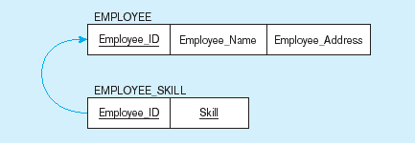
Mapping an Entity with a Multivalued Attribute
(a)
Multivalued attribute becomes a separate relation with foreign key;
One–to–many relationship between original entity and new relation
(b)

Slide 17
Transforming EER Diagrams into Relations – Step 2
Mapping Weak Entities
  Becomes a separate relation with a foreign key taken from the superior entity.
  Primary key consists of:
    Partial identifier of weak entity.
    Primary key of identifying relation (strong entity).

Slide 18
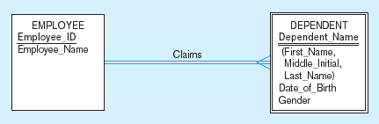
Example of Mapping a Weak Entity

Slide 19
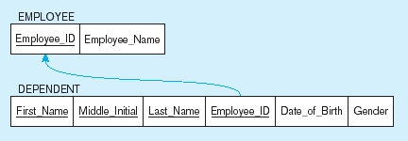
Example of Mapping a Weak Entity (cont.)
NOTE: the domain constraint for the foreign key should NOT allow null value if DEPENDENT is a weak entity.
Foreign key
Composite primary key

Slide 20
Transforming EER Diagrams into Relations – Step 3
Mapping Binary Relationships
  One-to-Many – Primary key on the one side becomes a foreign key on the many side.
  Many-to-Many – Create a new relation with the primary keys of the two entities as its primary key.
  One-to-One – Primary key on the mandatory side becomes a foreign key on the optional side.

Slide 21
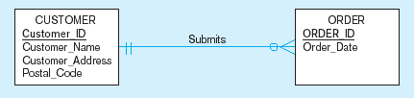
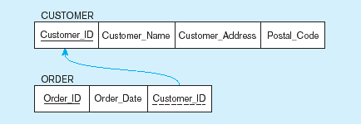
Example of Mapping a 1:M Relationship
Note the mandatory one
Mapping the relationship
No null value in the foreign key because of the mandatory minimum cardinality
Foreign key

Slide 22
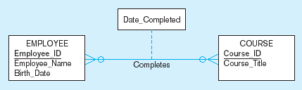
Example of Mapping an M:N Relationship
Completes relationship (M:N)
The Completes relationship will need to become a separate relation.

Slide 23
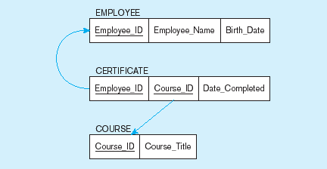
Example of Mapping an M:N Relationship (cont.)
Composite primary key
New intersection relation
Foreign key
Foreign key
Three resulting relations

Slide 24
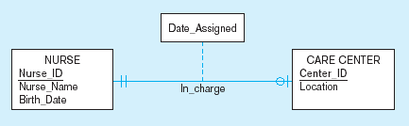
Example of Mapping a Binary 1:1 Relationship
Often in 1:1 relationships, one direction is optional.

Slide 25
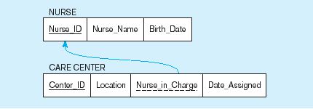
Example of Mapping a Binary 1:1 Relationship (cont.)
Resulting relations
Foreign key goes in the relation on the optional side,
matching the primary key on the mandatory side.

Slide 26
Transforming EER Diagrams into Relations – Step 4
Mapping the associative entity involves the same steps as mapping an M:N relationship.
If an identifier is not assigned, the default primary key for the association relation consists of the primary keys of the other two entities.
If an identifier is assigned, the primary key for the association relation is the identifier; the primary keys for the other two entities are then included as foreign keys in the associative relation.

Slide 27
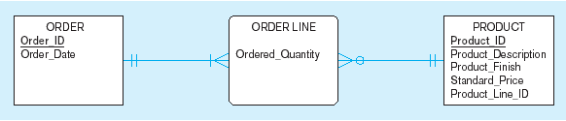
Example of Mapping an Associative Entity
An associative entity

Slide 28
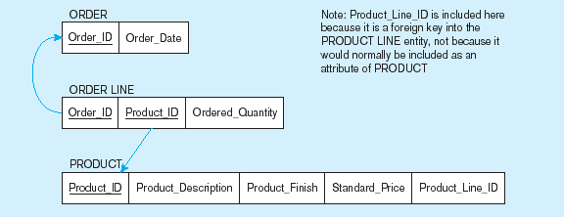
Example of Mapping an Associative Entity (cont.)
Three resulting relations
Composite primary key formed from the two foreign keys

Slide 29

Mapping an Associative Entity with an Identifier
SHIPMENT associative entity

Slide 30
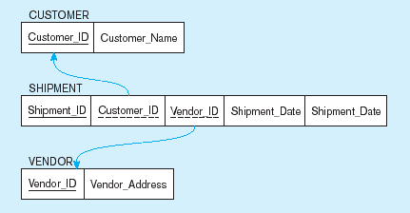
Mapping an Associative Entity with an Identifier(cont.)
Primary key differs from foreign keys
b) Three resulting relations

Slide 31
Transforming EER Diagrams into Relations – Step 5
Mapping unary relationships
  In unary one-to-many relationships, a foreign key attributes is added within the same relation that references the primary key values.
    A recursive foreign key is a foreign key in a relation that references the primary key values of that same relation.
  In unary many-to-many relationships, two relations are created:
    One for the entity, and
    One for the many-to-many relationship; its primary key has two attributes, both taken from the primary key of the other relation.

Slide 32
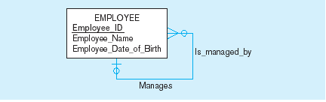

Mapping a Unary 1:N Relationship
EMPLOYEE entity with unary relationship
EMPLOYEE relation with recursive foreign key

Slide 33
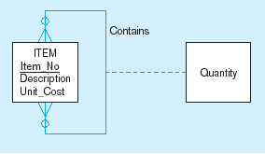
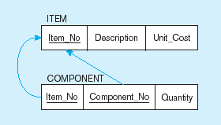
Mapping a Unary M:N Relationship
Bill-of-materials relationships (M:N)
ITEM and COMPONENT relations

Slide 34
Transforming EER Diagrams into Relations – Step 6
Mapping Ternary (and n-ary) Relationships
  One relation for each entity and one for the associative entity.
  The default primary key of the associative entity consists of the three primary key attributes for the participating entity types.

Slide 35
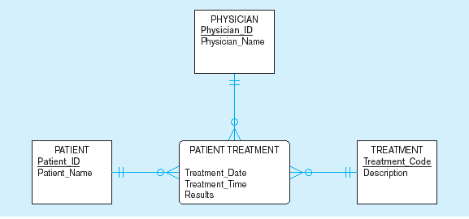
Mapping a Ternary Relationship
PATIENT TREATMENT Ternary relationship with associative entity

Slide 36
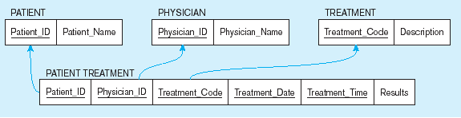
Mapping a Ternary Relationship (cont.)
Mapping the ternary relationship PATIENT TREATMENT
Treatment date and time are included to make the composite primary key.
This makes a very cumbersome key.
It would be better to create a surrogate key like Treatment#.

Slide 37
Transforming EER Diagrams into Relations – Step 7
Mapping Supertype/Subtype Relationships
  One relation for supertype and for each subtype.
  Supertype common attributes go into supertype relation.
  Subtype attributes go into each subtype; primary key of supertype relation also becomes primary key of subtype relation.
  Assign one (or more) attributes of the supertype to function as the subtype discriminator.

Slide 38
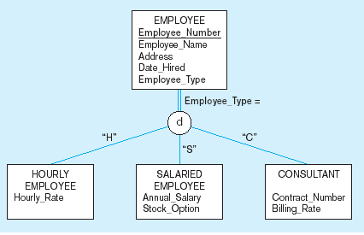
Supertype/Subtype Relationships

Slide 39
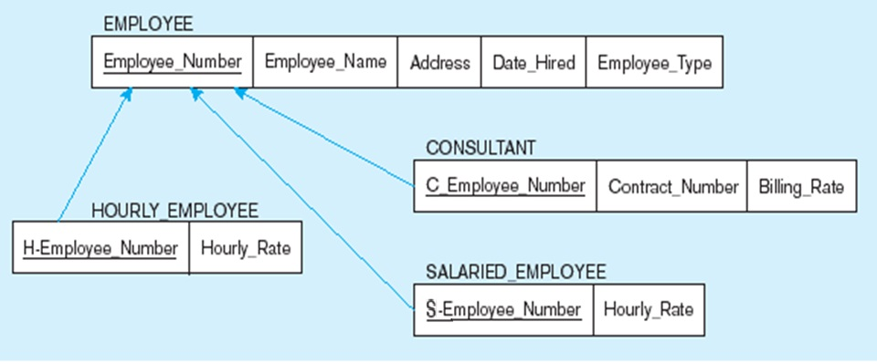
Mapping Supertype/subtype Relationships to Relations
  One-to-one relationships are established between supertype and each subtype, with supertype as primary table.

Slide 40
Data Normalization
Data normalization is:
Primarily a tool to validate and improve a logical design so that it satisfies certain constraints that avoid unnecessary duplication of data.
The process of decomposing relations with anomalies to produce smaller, well-structured relations.

Slide 41
Well-Structured Relations
A well-structured relation:
Contains minimal data redundancy and allows users to insert, delete, and update rows without causing data inconsistencies.
Avoids anomalies:
  Insertion Anomaly–adding new rows forces user to create duplicate data.
  Deletion Anomaly–deleting rows may cause a loss of data that would be needed for other future rows.
  Modification Anomaly–changing data in a row forces changes to other rows because of duplication.
Rule of thumb: A table should not pertain to more than one entity type!

Slide 42
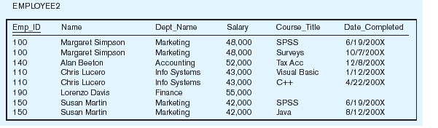
An Example of Non-Well-Structured Relation
Is this a relation?
What’s the primary key?

Slide 43
Anomalies in the Table
Insertion–can’t enter a new employee without having the employee take a class.
Deletion–if we remove employee 140, we lose information about the existence of a Tax Acc class.
Modification–giving a salary increase to employee 100 forces us to update multiple records.
Why do these anomalies exist?
Because there are two themes (entity types) in this one relation. This results in data duplication and an unnecessary dependency between the entities.

Slide 44
Functional Dependencies and Keys
Functional dependency: The value of one attribute (the determinant) determines the value of another attribute.
A candidate Key is always a determinant; each non-key field is functionally dependent on every candidate key.

Slide 45
Examples of Functional Dependencies
SSN → Name, address, birthdate.
  A person’s name, address and birthdate are functionally dependent on that person’s SSN.
VIN → Make, model, color.
  The make, model, and color of a vehicle are functionally dependent on VIN.
ISBN → Title, author name, publisher.
  The title of a book, the author name, and the publisher are functionally dependent on the book’s International Standard Book Number (ISBN).

Slide 46
Steps in Normalization
First normal form (1NF) – any multivalued attributes have been removed.
Second normal form (2NF) – any partial functional dependencies have been removed.
Third normal form (3NF) – any transitive dependencies have been removed.
A normal form is a state of a relation that results from applying simple rules regarding functional dependencies to that relation.

Slide 47
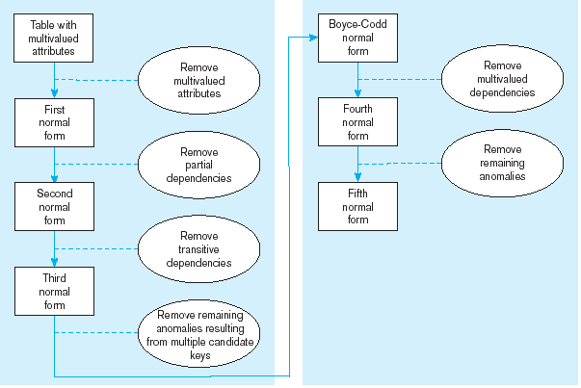
Steps in Normalization (cont.)

Slide 48
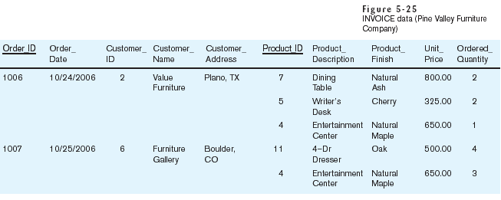
An Example Relation
Note: this relation is not in first normal form.

Slide 49
Convert to First Normal Form
There are no repeating groups in the relation; there is a single fact at the intersection of each row and column of the table.
A primary key has been defined, which uniquely identifies each row in the relation.

Slide 50
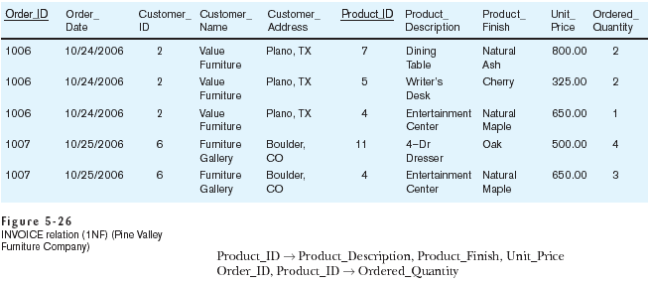
The Example in 1st Normal Form
Note: this relation is in 1NF but not well-structured.

Slide 51
Anomalies in the Current Example
Insertion – if new product is ordered for order 1007 of existing customer, customer data must be re-entered, causing duplication.
Deletion – if we delete the Dining Table from Order 1006, we lose information concerning this item's finish and price.
Update – changing the price of product ID 4 requires update in several records.
Why do these anomalies exist?
Because there are multiple themes (entity types) in one relation. This results in duplication and an unnecessary dependency between the entities.

Slide 52
Second Normal Form
A relation is in 2NF if it is in 1NF and contains no partial dependencies.
A partial functional dependency exists when a nonkey attribute is functionally dependent on only part of the primary key.

Slide 53
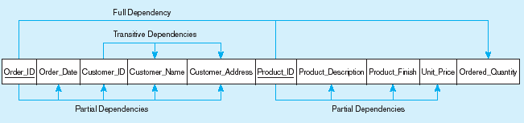
Partial Functional Dependency for INVOICE
Order_ID ➔ Order_Date, Customer_ID, Customer_Name, Customer_Address
Customer_ID ➔ Customer_Name, Customer_Address
Product_ID ➔ Product_Description, Product_Finish, Unit_Price
Order_ID ➔ Order_Date
Order_ID, Product_ID ➔ Order_Quantity
Therefore, NOT in 2nd Normal Form

Slide 54
Convert to Second Normal Form
To convert a relation with partial dependencies to 2NF, the following steps are required:
  Create a new relation for each primary key attribute that is a determinant in a partial dependency.
  Move the nonkey attributes that are dependent on this primary key attribute from the old relation to the new relation.

Slide 55
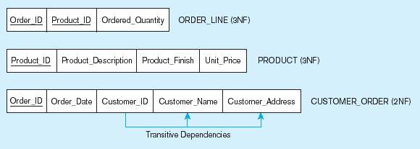
Removing Partial Dependencies from the Example
Getting it into 2NF
Partial dependencies are removed, but there are still transitive dependencies.

Slide 56
Third Normal Form
A relation is in 3NF if it is in 2NF and no transitive dependencies exist.
A transitive dependency in a relation is a functional dependency between two (or more) nonkey attributes.
Removing transitive dependencies:
  Nonkey determinant with transitive dependencies go into a new relation;
  Nonkey determinant becomes primary key in the new relation and stays as foreign key in the old relation.

Slide 57
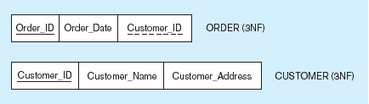
Removing Transitive Dependencies
Getting it into 3NF
Transitive dependencies are removed.

