Slide 1
Introduction to SQL
Chapter 6
Modern Database Management
12th Edition
Hoffer, Ramesh, and Topi

Slide 2
Learning Points
General Discussion of SQL
SQL Environment and Data Type
Develop Database with SQL
Manipulate Database with SQL

Slide 3
SQL Overview
SQL – Structured Query Language.
The standard language for creating and querying relational databases.
Relational DBMS: A database management system that manages data as a collection of tables in which all relationships are represented by common values in related tables.

Slide 4
Purpose of SQL Standard
Specify syntax/semantics for data definition and manipulation.
Define data structures and basic operations.
Enable portability between conforming DBMSs.
Specify minimal and complete standards.
Provide initial standard for later enhancement.

Slide 5
Benefits of a Standardized Relational Language
Reduced training costs
Increase productivity
Application portability
Application longevity
Reduced dependence on a single vendor
Cross-system communication

Slide 6
SQL Environment
Catalog contains a database and describes any object that is a part of the database.
Schema is a collection of related objects (e.g., base tables, views, constraints).
Data definition language (DDL) commands are used to create, alter, and drop tables.
Data manipulation language (DML) commands are used for updating, inserting, modifying, and querying the data.
Data control language (DCL) commands help control a database (e.g., access privilege control, store/remove transaction).

Slide 7
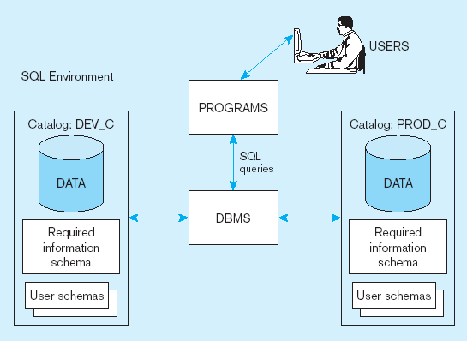
A Simplified SQL Environment

Slide 8
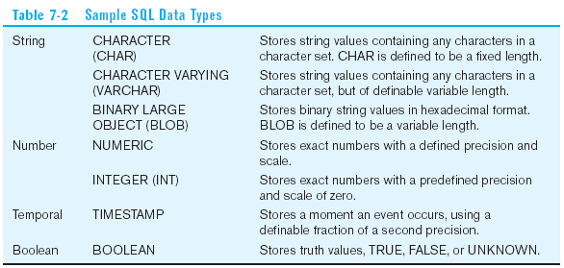
Some SQL Data Types

Slide 9
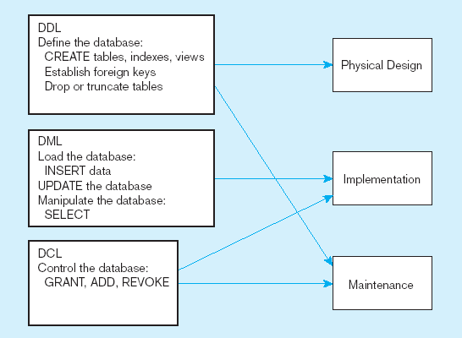
DDL, DML, DCL, and Database Development

Slide 10

SQL Database Definition
Major DDL CREATE statements:
  CREATE SCHEMA/USER–defines a portion of the database owned by a particular user.
  CREATE TABLE–defines a table and its columns.
  CREATE VIEW–defines a logical table from one or more tables or views.

Slide 11
Table Creation
Steps in table creation:
Identify data types for attributes.
Identify columns that can and cannot be null.
Identify columns that must be unique (candidate keys).
Identify primary key–foreign key mates.
Determine default values.
Identify constraints on columns (domain specifications).
Create the table and associated indexes.

Slide 12
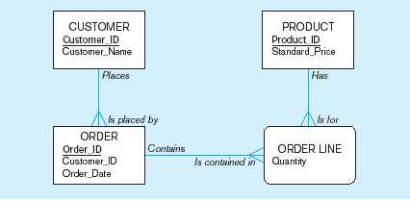
A Data Model Example

Slide 13
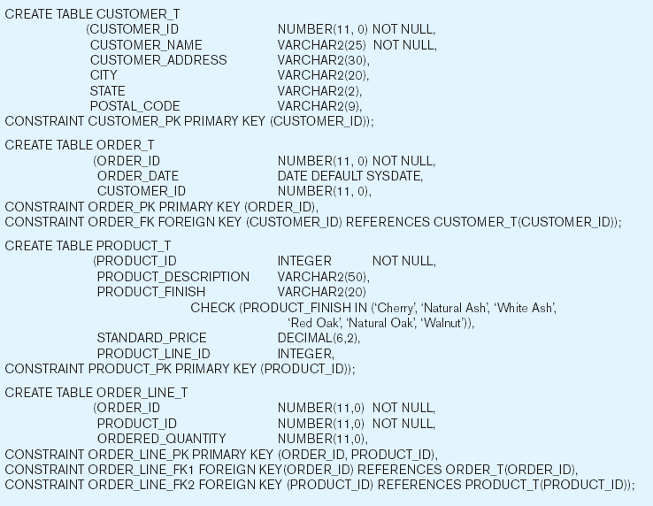
Create Four Tables for the Model

Slide 14
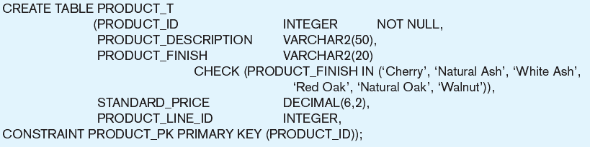
Defining Attributes and Their Data Types

Slide 15
Non-Nullable Specification
Primary keys can never have NULL values
Identifying primary key

Slide 16
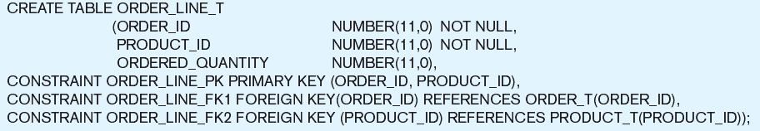
Composite Primary Key
Non-nullable specifications
Primary key
Some primary keys are composite– composed of multiple attributes

Slide 17
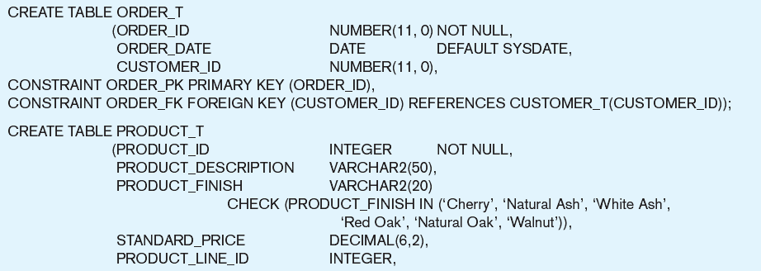
Controlling the Values in Attributes
Default value
Domain constraint

Slide 18
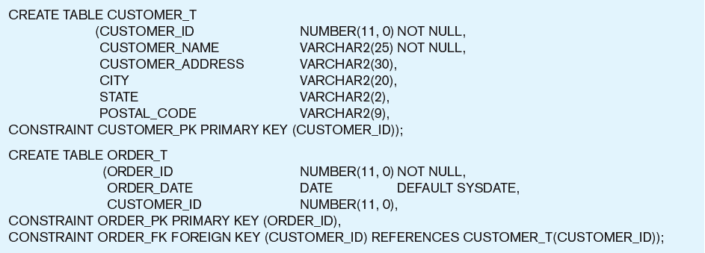
Identifying Foreign Keys and Establishing Relationships
Primary key of parent table
Foreign key of dependent table

Slide 19
Data Integrity Controls
Referential integrity ensures that foreign key values of a table must match primary key values of a related table in 1:M relationships.
Referential integrity solutions:
  Update/Delete restrict – any updates that would delete or change a primary key value will be rejected.
  Update cascade – pass the change through to the child tables.
  Update/Delete set null – change the involved values in child tables to NULL.

Slide 20
ALTER Command - 1
ALTER TABLE command may be used to:
  Add new columns to an existing table.
  Include keywords such as ADD, RENAME, MODIFY, or DROP and allow the column’s names, data type, length, and constraints to be changed.
ALTER TABLE Customer_T ADD COLUMN Customer_Type VARCHAR(20);

Slide 21
ALTER Command - 2
ALTER Table Customer_T RENAME Column Customer_Name TO User_Name;
ALTER Table Customer_T MODIFY Customer_Address VARCHAR(50);
ALTER Table Customer_T DROP Column User_Name;

Slide 22
Changing and Removing Tables
DROP TABLE statement allows you to remove tables from your schema:
DROP TABLE Customer_T

Slide 23
Insert Statement
Inserting a row of data into a table
  INSERT INTO Customer_T VALUES (001, ‘Contemporary Casuals’, ‘1355 S. Himes Blvd.’, ‘Gainesville’, ‘FL’, 32601);
Inserting a record with some null attributes into a table
  INSERT INTO Customer_T (Customer_ID, Customer_Name, Customer_State) VALUES (030, ‘Jone Kaser’, ‘CA’);

Slide 24
Insert Statement
Inserting a record with wrong attributes into a table
  INSERT INTO Product_T (Product_ID, Product_Description,Product_Finish, Standard_Price, Product_On_Hand) VALUES (1, ‘End Table’, ‘Cherry’, 175, 8);
Inserting records from another table
  INSERT INTO CA_Customer_T SELECT * FROM Customer_T WHERE State = ‘CA’;

Slide 25
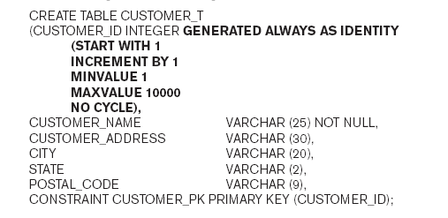
Creating Tables with Identity Columns
Inserting into a table does not require explicit customer ID entry
  INSERT INTO Customer_T VALUES ( ‘Contemporary Casuals’, ‘1355 S. Himes Blvd.’, ‘Gainesville’, ‘FL’, 32601);

Slide 26
Delete Statement
DELETE command removes rows from a table.
Delete certain rows:
  DELETE FROM Customer_T WHERE Customer_State = ‘HI’;
Delete all rows from CUSTOMER table:
  DELETE FROM Customer_T;

Slide 27
Update Statement
UPDATE command updates data in a table.
Modifies data in existing rows:
  UPDATE Product_T SET Standard_Price = 775 WHERE Product_ID = 7;

Slide 28
Schema Definition
Techniques to control schema for processing and storage efficiency:
  Choosing to index primary and/or secondary keys.
  Selecting file organizations for base tables.
  Selecting file organizations for indexes.
  clustering Data to store related rows close.
  Maintaining statistics about tables and their indexes.

Slide 29
Creating Indexes
Indexes are created to provide rapid random and sequential access to base-table data.
Makes an index for the CUSTOMER_NAME field of the CUSTOMER_T table:
  CREATE INDEX Name_IDX ON Customer_T (Customer_Name)
Removes the index:
  DROP INDEX NAME_IDX

Slide 30
SELECT Statement
SELECT command queries the data in tables.
Major clauses in SELECT statement:
  SELECT – List the columns from base tables or views.
  FROM – Indicate from which table(s) data will be obtained.
  WHERE – Include the conditions for row selection.
  ORDER BY – Sorts results according to specified criteria.
  GROUP BY – Categorizes results according to specified criteria.
  HAVING – Used following a GROUP BY to specify a condition.

Slide 31
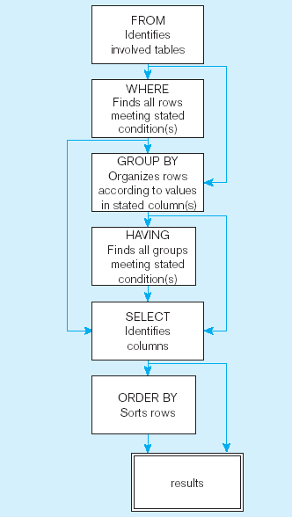
  SQL Statement Processing Order

Slide 32
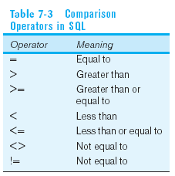
SELECT Example
Find products with standard price less than $275:
  SELECT Product_Name, Standard_Price
  FROM Product_T
  WHERE
  Standard_Price < 275;
Comparison Operators in SQL

Slide 33
Alias - 1
Alias allows users to temporarily assign another name to a table or column.
AS command is used to specify an alias.
    SELECT Customer_Name AS Name,
    Customer_Address AS Address
    FROM Customer_T
    WHERE Name = ‘Home Furnishings’;

Slide 34
Alias - 2
Alias allows users to reduce the amount of code required for a query and to make queries generally simpler to understand.
SELECT Customer_Name, Customer_Address
FROM Customer_T AS C;

Slide 35
SELECT Example Using a Function
Using the COUNT aggregate function to find totals:
  SELECT COUNT(*) FROM Order_Line_T
  WHERE Order_ID = 1004;
Other aggregate functions – MIN, MAX, SUM, and AVG.

Slide 36
Examples of Aggregate Function
Using MAX aggregate function to find the highest product price:
  SELECT MAX (Standard_Price) FROM Product_t;
Using MIN aggregate function to find alphabetically, the first product description in the Product table:
  SELECT MIN (Product_Description) FROM Product_t;

Slide 37
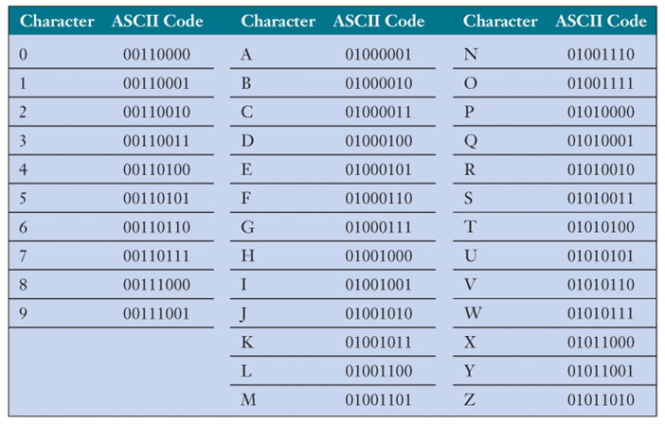
ASCII Code

Slide 38
Boolean Operators
AND – Join two or more conditions and returns results only when all conditions are true.
OR – Join tow or more conditions and returns results when any conditions are true.
NOT – Negates an expression.

Slide 39
SELECT Example–Boolean Operators
The LIKE operator compares strings using wildcards.
The wildcard character, %, represents any collection of characters; the underscore, _, represents exactly one character.
  SELECT Product_Description, Product_Finish, Standard_Price FROM Product_T
  WHERE (Product_Description LIKE ‘%Desk’
  OR Product_Description LIKE ‘%Table’)
  AND Standard_Price > 300;
  The % wildcard in ‘%Desk’ indicates that all strings that have any number of characters preceding the word “Desk” will be allowed.

Slide 40
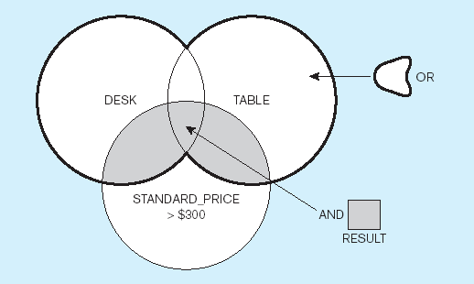
Diagram from Previous Query

Slide 41
SELECT Example – IN and ORDER BY Clause
Use IN to match a list of states.
Use ORDER BY to Sort the results first by STATE, and within a state by CUSTOMER_NAME.
  SELECT Customer_Name, Customer_City, Customer_State FROM Customer_T
  WHERE Customer_State IN (‘FL’, ‘TX’, ‘CA’, ‘HI’)
  ORDER BY Customer_State, Customer_Name;

Slide 42
SELECT Example – GROUP BY Clause
GROUP BY clause groups rows in an intermediate results table where the values in those rows are the same for one or more columns.
  SELECT Customer_State, COUNT(Customer_State)
  FROM Customer_T
  GROUP BY Customer_State;

Slide 43
SELECT Example – HAVING Clause
HAVING clause:
Is used with GROUP BY,
Acts like a WHERE clause, but it identifies groups that meet a criterion, rather than rows.
  SELECT Customer_State,
  COUNT(Customer_State)
  FROM Customer_T
  GROUP BY Customer_State
  HAVING COUNT(Customer_State) > 1;

Slide 44
VIEW
VIEW provides users controlled access to tables.
VIEW has a name and is based on a SELECT statement.
CHECK_OPTION works only for updateable views.
  CREATE VIEW Expensive_Stuff_V AS
  SELECT Product_ID, Product_Name, Unit_Price
  FROM Product_T WHERE Standard_Price >300
  WITH Check_Option;

