Slide 1
Advanced SQL
Chapter 7
Modern Database Management
12th Edition
Hoffer, Ramesh, and Topi

Slide 2
Learning Points
Approaches to joining tables
Processing Multiple Tables Using Subqueries
Conditional Expressions and Combining Queries
Transaction Integrity and Data Dictionary
Triggers and Routines

Slide 3
Processing Multiple Tables–Joins
JOIN – brings together data from two or more related tables into one resultant table.
INNER JOIN – also known as equi-join; the joining condition is based on equality between values in the common columns.
OUTER JOIN – rows that do not have matching values in common columns are also included in the result table.

Slide 4
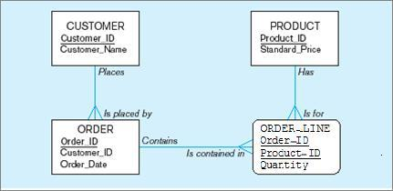
A Data Model

Slide 5
Inner Join Example - 1
For each customer who placed an order, what are the names of all customers who have placed orders?
SELECT Customer_T.Customer_ID, Order_T.Customer_ID,
  Customer_T.Customer_Name, Order_T.Order_ID
  FROM Customer_T INNER JOIN Order_T ON
  Customer_T.Customer_ID = Order_T.Customer_ID;
Only 10 rows will be returned from this INNER JOIN.

Slide 6
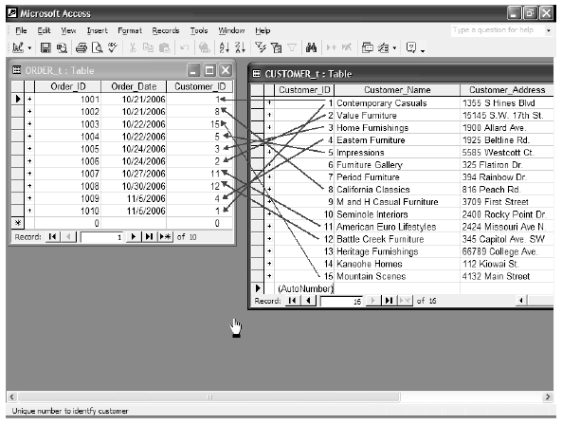
These tables are used in queries that follow

Slide 7
Outer Join Example
List the customer name, ID number, and order number for all customers.
SELECT Customer_T.Customer_ID,
  Customer_Name, Order_ID
  FROM Customer_T LEFT OUTER JOIN Order_T
  ON Customer_T.Customer_ID = Order_T.Customer_ID;
Unlike INNER join, the results of this query include customer information even for customers that do not have an order.

Slide 8
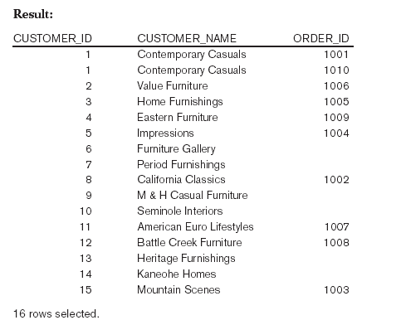
Unlike INNER join, this will include customer rows with no matching order rows.

Slide 9
Inner Join Example - 2
For customers who have placed an order, write a SQL statement to display their IDs and names, and the Product_ID and Product_Description of the products on their orders.
SELECT Customer_T.Customer_ID, Customer_Name,
Product_t.Product_ID, Product_Description FROM (((Customer_T INNER JOIN Order_T ON
  Customer_T.Customer_ID=Order_T.Customer_ID)
  INNER JOIN Order_Line_T ON
  Order_T.Order_ID=Order_Line_T.Order_ID)
  INNER JOIN Product_T ON
  Order_Line_T.Product_ID=Product_T.Product_ID);

Slide 10
Join Tables Using WHERE Clause – 1
For each customer who placed an order, what are the names of all customers who have placed orders?
SELECT Customer_T.Customer_ID, Order_T.Customer_ID,
  Customer_T.Customer_Name, Order_T.Order_ID
  FROM Customer_T, Order_T
  WHERE Customer_T.Customer_ID = Order_T.Customer_ID;
Only 10 rows will be returned from this INNER JOIN.

Slide 11
Join Tables Using WHERE Clause – 2
For customers who have placed an order, write a SQL statement to display their IDs and names, and the Product_ID and Product_Description of the products on their orders.
SELECT Customer_T.Customer_ID, Customer_Name,
Product_t.Product_ID, Product_Description
FROM Customer_T, Order_T, Order_Line_T, Product_T
WHERE Customer_T.Customer_ID=Order_T.Customer_ID
  AND Order_T.Order_ID=Order_Line_T.Order_ID
  AND Order_Line_T.Product_ID=Product_T.Product_ID;

Slide 12
Join Tables Using WHERE Clause – 3
Write a SQL query to display customer ID, name, and order date for order number 1006.
SELECT Customer_T.Customer_ID,
  Customer_Name,
  Order_Date
  FROM Customer_T, Order_T
  WHERE Customer_T.Customer_ID=Order_T.Customer_ID
  AND Order_ID=1006;
Three pieces of information are selected.
Two tables are involved.
Two criteria are used to filter data; that is, the selected data must fulfill these conditions.

Slide 13
Multiple Table Join Example
Assemble all information necessary to create an invoice for order number 1006.
SELECT Customer_T.Customer_ID, Customer_Name, Customer_Address,
  Customer_City, Customer_State, Postal_Code, Order_T.Order_ID,
  Order_Date, Ordered_Quantity, Product_Description,
  Standard_Price, (Quantity * Standard_Price)
  FROM Customer_T, Order_T, Order_Line_T, Product_T
  WHERE Customer_T.Customer_ID = Order_T.Customer_ID
  AND Order_T.Order_ID = Order_Line_T.Order_ID
  AND Order_Line_T.Product_ID = Product_T.Product_ID
  AND Order_T.Order_ID = 1006;
Four tables involved

Slide 14
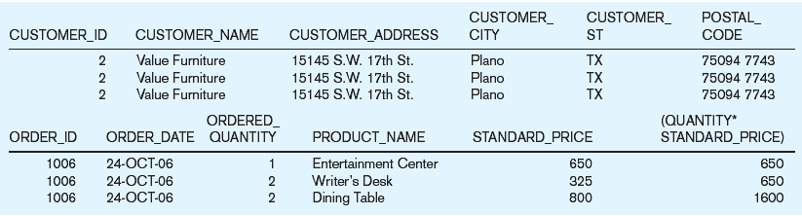
Results From a Four-Table Join
From CUSTOMER_T table
From ORDER_T table
From PRODUCT_T table

Slide 15

Processing Multiple Tables Using Subqueries
Subquery – placing an inner query (SELECT statement) inside an outer query.
Subquery can be nested multiple times.
Inner query can be placed:
  In a condition of the WHERE clause;
  As a “table” of the FROM clause;
  Within the HAVING clause.

Slide 16
Subquery Example 1
Write a SQL query to display customer ID, name, and order date for order number 1006.
SELECT Customer_ID, Customer_Name, Order_Date,
FROM Customer_T
WHERE Customer_t.Customer_ID = (SELECT Customer_ID
FROM Order_t WHERE Order_ID=1006);

Slide 17
Subquery Example – 2
Show all customers who have placed an order
  SELECT Customer_Name FROM Customer_T
  WHERE Customer_ID IN
  (SELECT DISTINCT Customer_ID FROM Order_T);
The IN operator will test the CUSTOMER_ID value.
Subquery is embedded in parentheses. In this case it returns a list that will be used in the WHERE clause of the outer query.

Slide 18
Correlated vs. Noncorrelated Subqueries
Noncorrelated subqueries:
  Do not depend on data from the outer query.
  Execute once for the entire outer query.
Correlated subqueries:
  Make use of data from the outer query.
  Execute once for each row of the outer query.

Slide 19
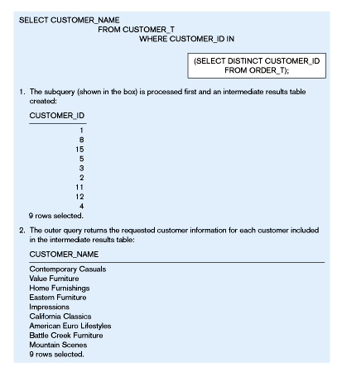
The subquery executes and returns the customer IDs from the ORDER_T table.
The outer query on the results of the subquery.
No reference to data in outer query, so subquery executes once only
These are the only customers that have IDs in the ORDER_T table

Slide 20
Correlated Subquery Example
Show all orders that include furniture finished in natural ash.
  SELECT DISTINCT Order_ID FROM Order_Line_T
  WHERE EXISTS
  (SELECT * FROM Product_T
  WHERE Product_ID = Order_Line_T.Product_ID
  AND Product_Finish = ‘Natural ash’);
The EXISTS operator will return a TRUE value if the subquery resulted in a non-empty set, otherwise it returns a FALSE
The subquery is testing for a value that comes from the outer query.

Slide 21
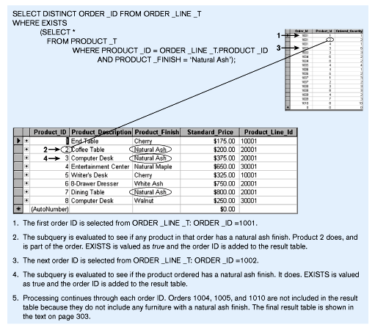
Sub-query refers to outer-query data, so sub-query executes once for each row of outer query.
Note: only the orders that involve products with Natural Ash will be included in the final results.

Slide 22
Subquery Example – 3
Show Product_Description and Standard_Price for the products whose standard price is higher than the average price.
  SELECT Product_Description, Standard_Price
  FROM Product_T
  WHERE Standard_Price > (SELECT
  AVG(Standard_Price) FROM Product_T);

Slide 23
Subquery Example – 4
Show all products whose standard price is higher than the average price.
  SELECT Product_Description, Standard_Price, AVGPRICE
  FROM (SELECT AVG(Standard_Price) AS AVGPRICE
  FROM Product_T), Product_T
  WHERE Standard_Price > AVGPRICE;
Subquery has an aggregate function with an alias name, that is referred to in the outer query.
The WHERE clause normally cannot include aggregate functions, but because the aggregate is performed in the subquery its result can be used in the outer query’s WHERE clause.

Slide 24
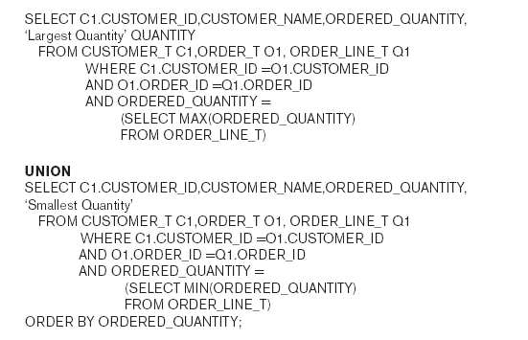
Union Queries
UNION - combine the output into a single result table.
First query
Combine
Second query

Slide 25
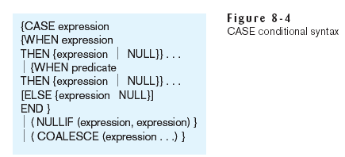
Conditional Expressions – CASE Syntax
CASE clause establishes IF-THEN-ELSE logical processing.

Slide 26
CASE Example
Use CASE clause to address “What products are included in Product_Line 1?”
SELECT (CASE WHEN Product_Line_ID = 1
THEN Product_Description
ELSE ‘####’ END) AS Product_Description
FROM Product_T;

Slide 27
CASE Example Results
PRODUCT_DESCRIPTION
-----------------------------------------
End Table
####
####
####
Writers Desk
####
####
####

Slide 28

Ensuring Transaction Integrity
Transaction is a discrete unit of work that must be completely processed or not processed at all.
  May involve multiple updates.
  If any update fails, then all other updates must be cancelled.
SQL commands for transactions:
  BEGIN TRANSACTION/END TRANSACTION – marks boundaries of a transaction.
  COMMIT – Makes all updates permanent.
  ROLLBACK – Cancels updates since the last COMMIT.

Slide 29
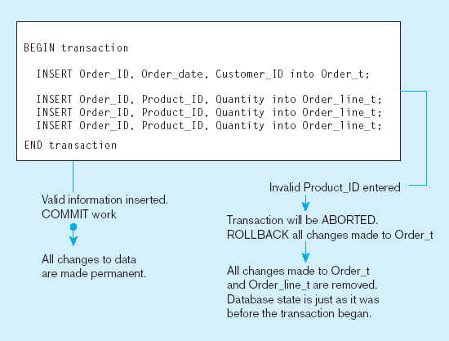
A SQL Transaction Example

Slide 30
Triggers
Triggers are a special type of stored procedure and run only in response to an INSERT, UPDATE, or DELETE command.
Triggers have three parts: the event, the condition, and the action.
  CREATE TRIGGER Standard_Price_Update AFTER
  UPDATE OF Standard_Price ON Product_T
  FOR EACH ROW INSERT INTO Price_Updates_T VALUES
  (‘Product_Description’, SYSDATE, Standard_Price);

Slide 31
Routines
Routines are program modules (functions or procedures) that execute on demand.
  Functions return one value and has only input parameters.
  Procedures do not return values and may have both input and output parameters.
CREATE PROCEDURE Product_Line_Sale AS BEGIN
UPDATE Product_T SET Standard_Price = 0.90*Standard_Price
WHERE Standard_Price >= 400;
UPDATE Product_T SET Standard_Price = 0.85*Standard_Price
WHERE Standard_Price < 400;
END;

Slide 32
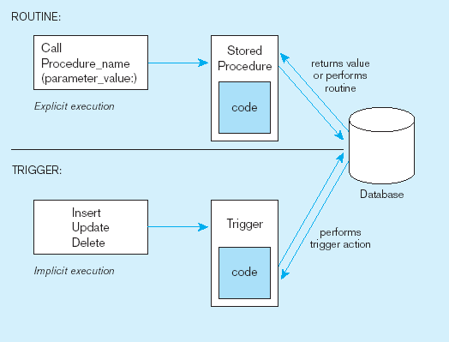
Routines and Triggers
Procedures are called explicitly.
Source: adapted from Mullins, 1995.
Triggers are event-driven.

Slide 33
Embedded and Dynamic SQL
Embedded SQL
  Including hard-coded SQL statements in a program written in another language such as C or Java.
Dynamic SQL
  Ability for an application program to generate SQL code on the fly, as the application is running.

