Slide 1
Database Application Development
Chapter 8
Modern Database Management
12th Edition
Hoffer, Ramesh, and Topi

Slide 2
Learning Points
Introduction to Client/Server Architecture
Explain Three-Tier Architecture
Application Partitioning and Middleware
Database Application Example
Internet-Related Languages
Web Server and Client-Side Extensions
Dynamic Web Site Components

Slide 3
Client/Server Systems
Networked computing model.
Processes distributed between clients and servers.
Client requests and uses a service.
Server provides a service.
For DBMS, server is a database server.

Slide 4
Three Components of Application Logic
Presentation Logic
  Formatting and presenting data
  Input and Output
GUI Interface
Processing Logic
  data processing
  Applying business rules
  Data management
Procedures, functions,
algorithms
Storage Logic
  Data storage and retrieval
DBMS activities

Slide 5
Client/Server Architectures
Client does extensive processing
File Server Architecture
Database Server Architecture
Three-tier Architecture
Client does little processing

Slide 6

File Server Architecture
All processing is done at the PC that requests the service.
Entire files are transferred from the server to the client for processing.
Problems:
  Huge amount of data transfer on the network.
  Each client must contain full DBMS.
  Heavy resource demand on clients.

Slide 7
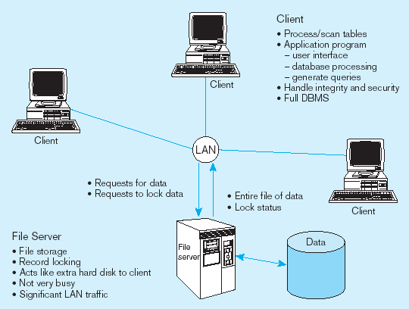
File Server Architecture (cont.)
FAT CLIENT

Slide 8
Two-Tier Database Server Architecture
Client is responsible for
  I/O processing logic.
  Some business rules logic.
Database server performs all database storage, access, and processing.
DBMS is only on database server.

Slide 9
Advantages of Two-Tier Database Server
Performance improves for compiled SQL statements.
Network traffic greatly reduces.
Improved data integrity since it is all processed centrally.
Data integrity improves as applications access the same stored procedures.

Slide 10
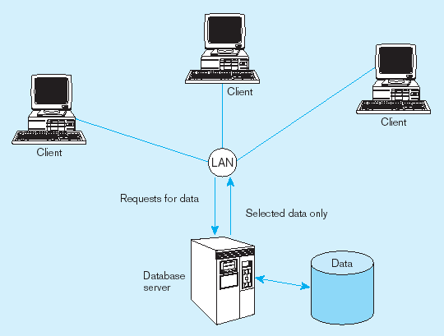
Two-Tier Database Server Architecture Example
Thinner clients
DBMS only on server

Slide 11
Three-Tier Architecture
Client
GUI interface
(I/O processing)
Browser
  Application server
Web Server
Business rules
  Database server
Data storage
DBMS
Thin Client
  PC just for user interface and a little application processing. Limited or no data storage.

Slide 12
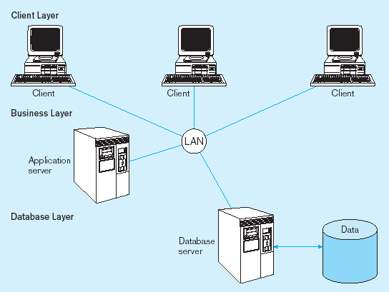
Three-Tier Architecture Example
Thinnest clients
DBMS only on DB server
Business rules on separate server

Slide 13
Advantages of Three-Tier Architecture
Scalability – more scalable than two-tier architecture.
Technological flexibility – easy to change DBMS engines.
Long-term cost reduction.
Better match of systems to business needs.
Improved customer service – multiple interfaces on different clients.
Competitive advantage.
Reduced risk – implement and combine small modules of code with vendors’.

Slide 14

Application Partitioning
Application partitioning is the process of assigning portions of application code to client or server to achieve better performance and interoperability.
Advantages:
  Improved performance
  Improved interoperability
  Balanced workloads

Slide 15
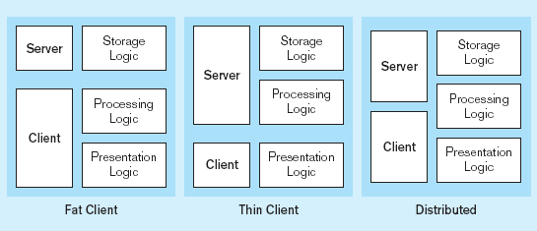
Common Logic Distributions
Two-tier client-server environments

Slide 16
Middleware
Middleware is:
Software that allows an application to interoperate with other software.
Holds together client/server applications.
No need for user to code low-level operations.

Slide 17
Middleware for Database – 1
Database-oriented middleware is any middleware that facilitates communications with a database, whether from an application or between databases.
For example, to extract data from an Oracle database, users may invoke database-oriented middleware to log on to the database and request data.

Slide 18
Middleware for Database – 2
Database-oriented middleware offers application program interface (API) access to a database.
APIs are sets of routines that an application program uses to request services from an operating system or other application (e.g. database).
In achieving access to a database, an API calls library routines that route SQL commands from the front-end client application to the database server.

Slide 19
Database Middleware
ODBC–Open Database Connectivity
  For Windows-based applications;
  Supported by most DB vendors.
OLE-DB
  Microsoft’s enhancement of ODBC.
JDBC–Java Database Connectivity
  Special Java classes that allow Java applications/applets to connect to databases.

Slide 20
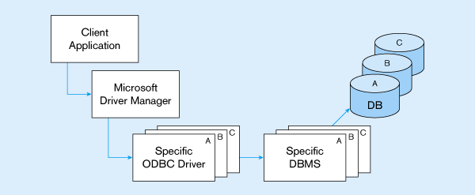
ODBC Architecture
Client does not need to know anything about the DBMS
API provides common interface to all DBMSs
Each DBMS has its own ODBC-compliant driver.

Slide 21
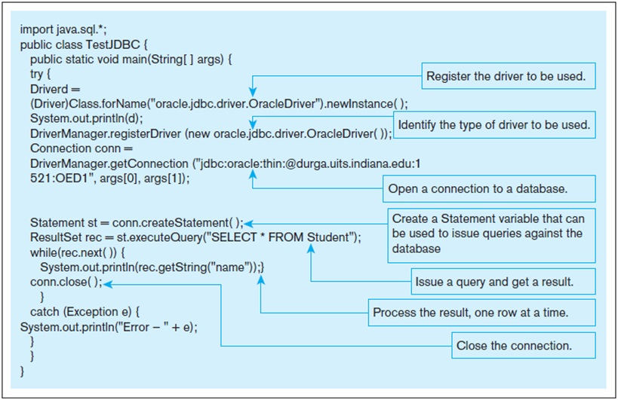
A Java Example
Notes:
Here’s the Java code for doing these steps. The “driver” is the middleware program that provides the link to the DBMS. At the “open a connection” step you can see the connection string. And further down, you see the query. The data returned from the query is in a “result set”, and your program can loop through this result set to obtain that data.
The three JDBC classes that you will likely use in a Java database program are DriverManager, Connection, Statement, and ResultSet. Each of these are classes in the Java JDBC API.
The textbook also shows a VB .NET example, which you’d typically have in a Microsoft operating system. There are similar classes in the .NET API (for establishing connections, creating commands and queries, and processing the results of queries).

Slide 22
World Wide Web Consortium
World Wide Web Consortium:
Is also known as W3C and the chief standards body for HTTP and HTML.
An international consortium of companies working to develop open standards that foster the development of Web conventions so that Web documents can be consistently displayed on all platforms.

Slide 23
Internet-Related Languages
Hypertext Markup Language (HTML) – is a scripting language; defines Web document structure and layout; uses tags.
Extensible Markup Language (XML) – allows customized tags; are useful for attaching legacy data to the Web.
Extensible HTML (XHTML) – extends HTML code to make it XML compliant.
Java – Object-oriented general-purpose programming language; download from a Web server to the client and run in a Java-compatible Web browser.

Slide 24
Internet-Related Languages (cont.)
JavaScript – share many of the features and structures of Java; developed by Netscape independently; introduce dynamic content.
VBScript – similar to JavaScript; is based on Visual Basic; enables interactivity.
Cascading Style Sheets (CSS) – developed by the W3C and added to HTML; help create style sheets that define the appearance of different elements.
XSL – used to develop style sheets from XML documents; describe how an XML document will be displayed.

Slide 25
Web Server Interfaces
Common Gateway Interface (CGI)
Specify the transfer of information between Web server and CGI program.
May be written in C, C++, Perl, Java or Visual Basic.
CGI scripts are stored on the Web server.
Must be executed each time a user makes a request.

Slide 26
CGI Example
Example of Common Gateway Interface (CGI)
When a user fills out a form on a Web page and sends it in, it usually needs to be processed by an application program.
The Web server typically passes the form information to a small CGI program that processes the data and may send back a confirmation message.
This method for passing data back and forth between the server and the application is known as CGI.

Slide 27
Web Server Interfaces (cont.)
Java Servlets
Can be viewed as a more powerful CGI.
Are stored on the server rather than client.
Are small in file size.
Once started, they remain in active memory and can fulfill multiple requests.
Are more efficient and ideal for small Internet applications.

Slide 28
Web Server Interfaces (cont.)
Application Program Interface (API)
Is a software-to-software interface.
Is also more efficient than CGI.
Resides on the Web server.
Code is resident in active memory and can be called dynamically as needed.
APIs can share a connection to a database.

Slide 29
API Example
Example of Application Program Interface (API)
With APIs, applications talk to each other without any user knowledge or intervention.
When you buy movie tickets online and enter your credit card information, the movie ticket Web site uses an API to send your credit card information to a remote application that verifies if your information is correct.
Once payment is confirmed, the remote application sends a response back to the movie ticket Web site saying it's OK to issue the tickets.

Slide 30
Web Servers
Web servers:
Provide HTTP service.
Serve many users at once via multithreading and multiprocessing.
Load balancing approaches:
  Domain Name Server (DNS) balancing: one DNS corresponding to multiple IP addresses.
  Software/hardware balancing: distribute requests more evenly across servers; one IP address.

Slide 31
Client-Side Extensions
Client-side extensions add functionality to the browser; some of them are plug-ins and ActiveX.
Plug-ins are hardware or software modules that extend browser capabilities by adding features or services (e.g. encryption, animation, wireless access).
ActiveX is developed by Microsoft and most commonly written in C++ or VB, and allows the manipulation of data inside the browser.

Slide 32
Components for Dynamic Web Sites
DBMS – Oracle, Microsoft SQL Server, Informix, Sybase, DB2, Microsoft Access, MySQL.
Web server – Apache is the most commonly used, Microsoft IIS.
Programming languages and development technologies – used for developing dynamic websites and Web-based applications; ASP.NET, PHP, ColdFusion, Coral Web Builder.

Slide 33
Components for Dynamic Web Sites (cont.)
Web browser – Microsoft Internet Explorer, Netscape Navigator, Mozilla Firefox, Apple’s Safari, Opera.
Text editor – Notepad, BBEdit, Macromedia’s Dreamweaver.
FTP capabilities – SmartFTP, WS_FTP.

