Slide 1
Data Warehousing
Chapter 9
Modern Database Management
12th Edition
Hoffer, Ramesh, and Topi

Slide 2
Learning Points
Definitions and Key Terms
Reasons for Need of Data Warehousing
Describe Data Warehouse Architectures
Introduce Three-Layer Data Architecture

Slide 3
Definitions
Data Warehouse is a subject-oriented, integrated, time-variant, non-updatable collection of data used in support of management decision-making processes and business intelligence.
Data warehousing is the process whereby organizations create and maintain data warehouses and extract meaning and inform decision making from their informational assets through these data warehouses.

Slide 4
Key Terms
Subject-oriented: A data warehouse is organized around the key subjects of the enterprise (e.g., customers, patients, students, products).
Integrated: Data are defined using consistent naming conventions, formats, encoding structures, and related characteristics.
Time-variant: Data contain a time dimension and can be used to study trends and changes.
Nonupdatable: Data are loaded and refreshed from operational systems and can’t be updated by end users.

Slide 5
Need for Data Warehousing
Major factors drive the need for data warehousing:
A business requires an integrated, company-wide view of high-quality information.
The IS department must separate informational from operational systems to improve data management performance.

Slide 6
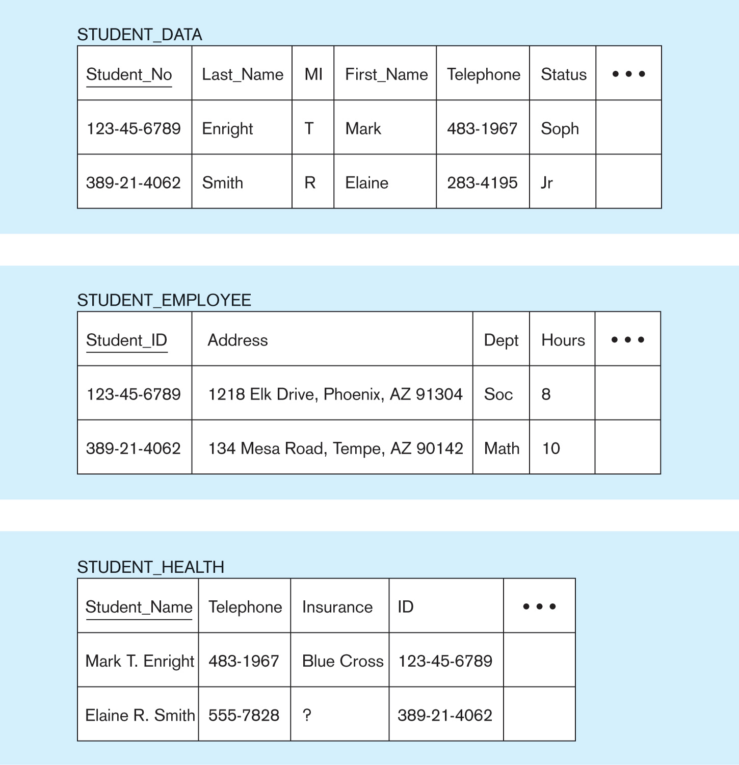
Example of Separate Student Records

Slide 7
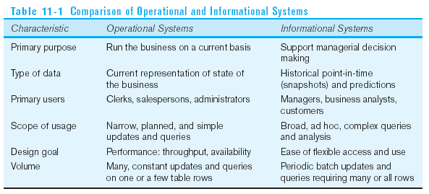
Operational and Informational Systems

Slide 8
Data Mart
A data mart is a data warehouse that is limited in scope, customized for the decision-making applications of a particular end-user group.
Its contents are obtained either from independent ETL processes or are derived from the data warehouse.
It is designed to optimize the performance for well-defined and predicable uses.

Slide 9
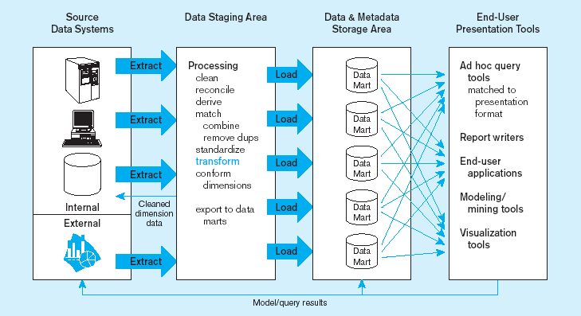
Data Mart Example
Data marts:
Mini-warehouses, limited in scope
L
T
E
Separate ETL for each independent data mart
Data access complexity due to multiple data marts

Slide 10
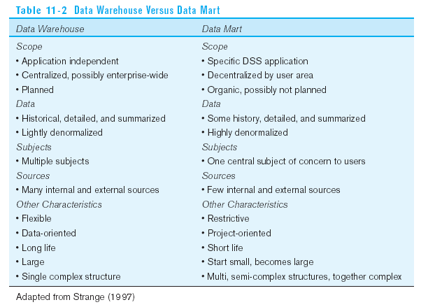
Source: adapted from Strange (1997).

Slide 11

Generic Two-Level Data Warehouse Architecture
Generic two-level architecture are (1) source data systems and (2) consolidated data and metadata storage area.
Four basic steps to build this architecture:
  Extract data from internal and external source system files and databases.
  Transform and integrate the data.
  Organize the data warehouse.
  Users access the data warehouse.

Slide 12
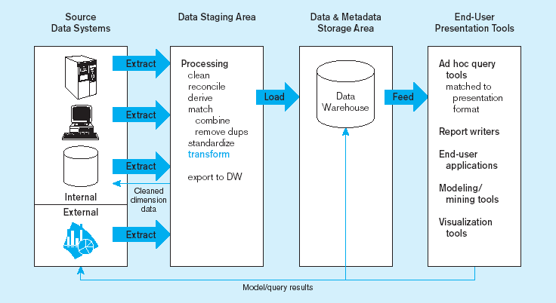
Example of Two-Level Architecture
L
T
One, company-wide warehouse
E
Periodic extraction ➔ data is not completely current in warehouse

Slide 13
Three-Level Data Warehouse Architecture
Three-level architecture are (1) source data systems, (2) operational data store, and (3) consolidated data and metadata storage area.
Operational data store is an intergrated, subject-oriented, updatable, current-valued, organizationwide, detailed database designed to serve operational users as they do decision support processing.

Slide 14
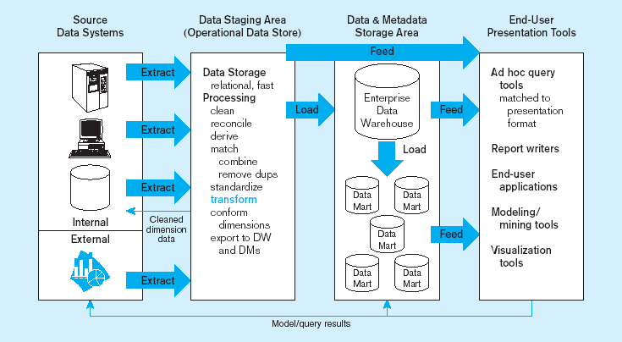
ODS provides option for obtaining current data
L
T
E
Single ETL for enterprise data warehouse (EDW)
Dependent data marts loaded from EDW

Slide 15
Three-Layer Data Architecture
Three-layer data architecture includes:
Operational data stored in operational systems of record.
Reconciled data stored in the enterprise data warehouse and operational data store.
Derived data stored in each of the data marts.

Slide 16
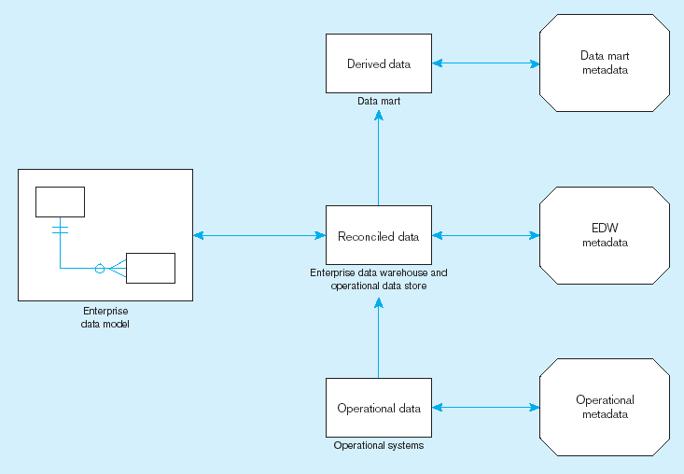
Three-Layer Data Architecture (cont.)

Slide 17
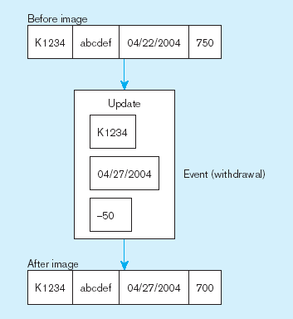
Status vs. Event Data
Status
Event = a database action (create/update/delete) that results from a transaction
Status

Slide 18
Transient vs. Periodic Data
Transient data are data in which changes to existing records are written over previous records, thus destroying the previous data content.
Periodic data are data that are never physically altered or deleted once added to the store.

Slide 19
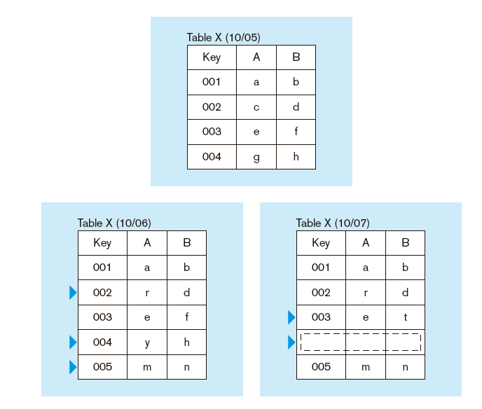
Transient Data

Slide 20
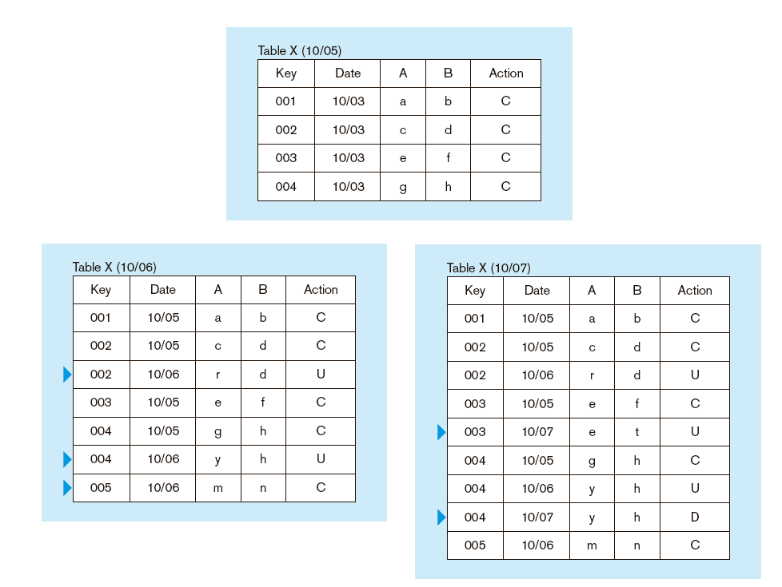
Periodic Data

Slide 21
Operational Data
Typical operational data is:
Transient; not periodic.
Not normalized.
Restricted in scope; not comprehensive.
Sometimes poor quality with inconsistencies and errors.

Slide 22
Reconciled Data
Reconciled data should be:
Detailed; not summarized.
Historical; periodic or point-in-time.
Normalized; 3rd normal form or higher.
Comprehensive; enterprise-wide perspective.
Timely; data should be current enough.
Quality controlled; accurate with full integrity.

