Slide 1
Big Data and Analytics
Chapter 11
Modern Database Management
12th Edition
Hoffer, Ramesh, and Topi

Slide 2
Learning Points
Big Data
NoSQL DBMS
Hadoop
Analytics

Slide 3
Introduction
Big Data
  Data that exist in very large volumes and many different varieties (data types) and that need to be processed at a very high velocity (speed).
Notes:
This chapter is primarily about these two new advances in data technologies and approaches.
Traditional data management technologies were created to ensure accurate and efficient transaction processing. As we saw from chapter 9, later database structures were created to support decision-making and overall understanding of the business. We called these data warehouses. Big data and analytics takes us further down this road.

Slide 4
Characteristics of Big Data – I
The Five Vs of Big Data
  Volume – much larger quantity of data than typical for relational databases
  Variety – lots of different data types and formats.
  Velocity – data comes at very fast rate (e.g. mobile sensors, web click stream)
  Veracity – traditional data quality methods don’t apply; data quality issues are challenging.
  Value – big data is valuable to the bottom line, and for fostering good organizational actions and decisions.

Slide 5

Characteristics of Big Data - II
  Schema on Read, rather than Schema on Write
  Schema on Write– the data model is predefined and changing it later is difficult; like relational databases.
  Schema on Read – the reporting, analysis organization, and data model determined later at the time of using it (XML, JSON).
  Capture and store the data, and worry about how you want to use it later.
  Data Lake
  A large integrated repository for internal and external data that does not follow a predefined schema.
  Capture everything, dive in anywhere, flexible access.
Notes:
Big data processing is done in batch mode, and may take hours to sift through the huge volume of data for an analytical task.
Big Data processing via Hadoop is good for long analytical tasks but not so good for exploring individual cases and their relationships. For this, relational databases and data warehouses are better.

Slide 6
NoSQL
NoSQL = Not Only SQL
A category of recently introduced data storage and retrieval technologies not based on the relational model.
Scaling out by using a large number of commodity servers.
Natural for a cloud environment
Supports schema on read instead of write
Largely open source

Slide 7
NoSQL Classifications
Key-value stores – A simple pair of a key and an associated collection of values. Key is usually a string. Database has no knowledge of the structure or meaning of the values.
Document stores – Like a key-value store, but “document” goes further than “value”. Document is structured so specific elements can be manipulated separately.
Wide-column stores – Rows and columns. Distribution of data based on both key values (records) and columns, using “column groups/families”
Graph-oriented database – Maintain information regarding the relationships between data items. Nodes with properties, Connections between nodes (relationships) can also have properties.

Slide 8
Class Notes-may 25th
Kay-values storage:
(101,(John, 255 Carlos Dr., johnc@gmail.com, ITM))
101---key, Rest----values
(102,(Johnson, 189 Main ST., Marketing))
File Storage :
No need to specify the key
(John, 255 Carlos Dr., johnc@gmail.com, ITM)
(Johnson, 189 Main ST., Marketing)
Wide-column: using column family
For example: student family has three items: Name, Id and Address; Course family has three items as well: Titles, Units, Department
Wide column table:
Student |  |  | Course
Name | Id | Address | Title | Units | Department

Slide 9
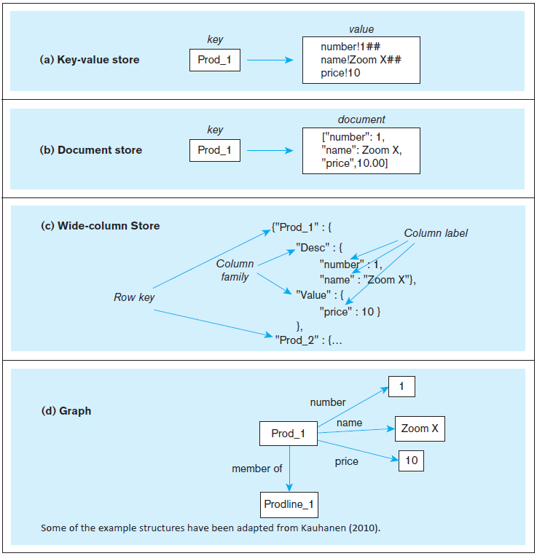
Illustrating NoSQL Databases
Notes:
As you can see, these are very different from relational databases. But you still have the notion of a unique entity, identified by its key, and the notion that this entity has attributes. Also remember from chapter 5 that key-value storage is nothing new. Remember hashed file organizations?
Last one will have 4 columns: product number, p.name, p.price and prodline_l

Slide 10
Class Notes-may 25th
Graph oriented storage: node (like entity), properties (attributes) and

Slide 11
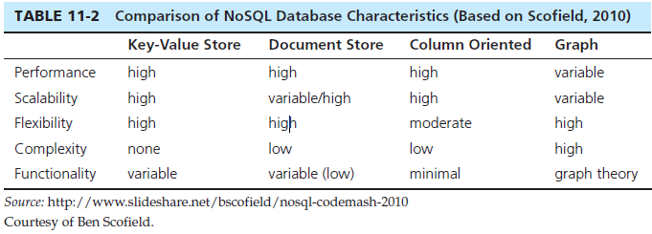
NoSQL Comparison
Notes:
NoSQL brings an exciting new dimension to the database profession.
Note that “NoSQL” does not mean “No SQL”. It means “Not Only SQL”. SQL will be a part of database systems for some time to come.

Slide 12
NoSQL Examples
NoSQL Examples
Redis – Key-value store DBMS
MongoDB – document store DBMS
Apache Cassandra – wide-column store DBMS
Neo4j – graph DBMS
Notes:
NoSQL brings an exciting new dimension to the database profession.
Note that “NoSQL” does not mean “No SQL”. It means “Not Only SQL”. SQL will be a part of database systems for some time to come.

Slide 13
Hadoop
Hadoop is an open source technology for big data management and analytics.
Has two key components: Hadoop Distributed File System (HDFS) and MapReduce.
Hadoop is the most widely used Big-Data management product today.
Hadoop is a good way to take a big problem and allow many computers to work on it simultaneously.
Notes:
A key feature of big data is highly distributed processing. The internet allows you to do this, by sharing tasks across hundreds or thousands of computers. Hadoop is made up of MapReduce and HDFS.
Hadoop’s essence is in processing very large amounts (terabytes or petabytes) of data by distributing the data and processing tasks among a large number of low-cost commodity servers. That means plain old PCs and servers.

Slide 14
HDFS - I
HDFS
Is the foundation of the data management infrastructure of Hadoop.
Is not a relational database management system or any type of DBMS.
Is a file system designed for managing a large number of potentially very large files in a highly distributed environment.
Notes:
A key feature of big data is highly distributed processing. The internet allows you to do this, by sharing tasks across hundreds or thousands of computers. Hadoop is made up of MapReduce and HDFS.
Hadoop’s essence is in processing very large amounts (terabytes or petabytes) of data by distributing the data and processing tasks among a large number of low-cost commodity servers. That means plain old PCs and servers.

Slide 15
HDFS - II
Breaks data into blocks and distributes them on various computers (nodes) throughout a Hadoop cluster.
Each cluster consists of a NameNode (master server) and some DataNodes (slaves).
Overall control through YARN (“yet another resource allocator”).
No updates to existing data in files, just appending to files.

Slide 16
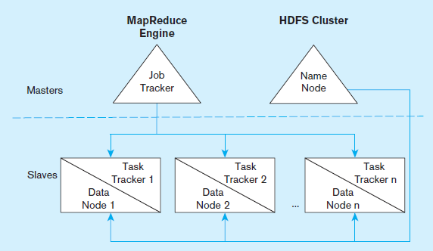
Illustrating HDFS
Notes:
Hadoop is made up of the MapReduce engine and HDFS clusters. We’ll talk about each of these next. Note that the MapReduce engine includes an overall job tracker to manage activity on the entire cluster in the master server, and task trackers for each slave of the cluster. Each slave is a data node, and the master is a name node.

Slide 17
MapReduce - I
MapReduce
Is an algorithm for massive parallel processing of various types of computing tasks.
Enables parallelization of data storage and computational problem solving in an environment consisting of a large number of commodity servers.
Uses job tracker and task tracker to manage the process.
Notes:
A key feature of big data is highly distributed processing. The internet allows you to do this, by sharing tasks across hundreds or thousands of computers. Hadoop is made up of MapReduce and HDFS.
Hadoop’s essence is in processing very large amounts (terabytes or petabytes) of data by distributing the data and processing tasks among a large number of low-cost commodity servers. That means plain old PCs and servers.

Slide 18
MapReduce - II
Core idea – divide a computing task so that a multiple nodes can work on it at the same time.
Each node works on local data doing local processing.
Two stages:
  Map stage – divide the entire dataset into multiple subsets for local processing.
  Reduce stage – integrate the results of the individual map processes.
Notes:
Parallel programming has existed before MapReduce, but it is very complicated. MapReduce purports to simplify this a lot.

Slide 19
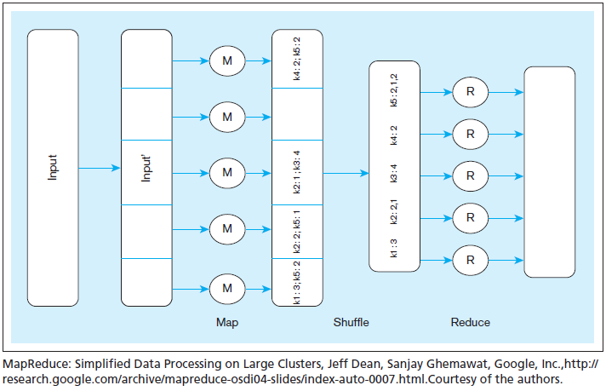
Illustrating MapReduce
Notes:
In this example, the form of this data is in key-value pairs. So, the keys in the figure are k1, k2, etc. Assume that the problem is to get an overall count of how many times the key appears in the data. For example, consider that the keys are customer IDs and the values are individual orders for each customer. So, we’re trying to figure out how many orders each customer made. Also assume that the original input data is very, very, very large. In other words, bigger than what a single relational DBMS can handle.
The original input data is received at the master and then divided into subsets, each of which goes to an individual slave node. So, each slave node gets some number of sales orders. This is the map process. There may be hundreds of these nodes.
Each node works on its subset of the data. Its task is to find out how many orders for each customer. So for example, the node at the bottom found 3 k1 orders and 2 k5 orders. Note that multiple nodes may have found examples of the same key. For instance, k2 is found in two of the nodes.
The shuffle step is at the end of mapping, and merges all the map outputs and packages them for the reduce phase. At this point, we’ve collected all results and grouped them by key value.
The reduce stage integrates the results of each of the map processes, creating the final result
It is up to the developer to define the mapper and the reducer so that they together get the work done. So, MapReduce programming involves writing code to do the mapping and writing code to do the reducing.

Slide 20
Other Hadoop Components
Pig
  A tool that integrates a scripting language and an execution environment intended to simplify the use of MapReduce.
  Useful development tool
Hive
  An Apache project that supports the management and querying of large data sets using HiveQL, an SQL-like language that provides a declarative interface for managing data stored in Hadoop.
  Useful for ETL tasks
HBase
  A wide-column store database that runs on top of HDFS.
  Not as popular as Cassandra
Notes:
Pig and Hive help to make Hadoop more accessible to traditional developers.

Slide 21
Integrated Analytics and Data Science Platforms
Some vendors are bringing together traditional data warehousing and big data capabilities, examples:
  HP HAVEn – Hewlett Packard technologies combined with Hadoop open source and an analytics engine.
  Teradata Aster – integrate SQL, graph analysis, MapReduce, R.
  IBM Big Data Platform – combine IBM technologies with Hadoop, JSON Query Language (JAQL),DB2, Netezza.

Slide 22
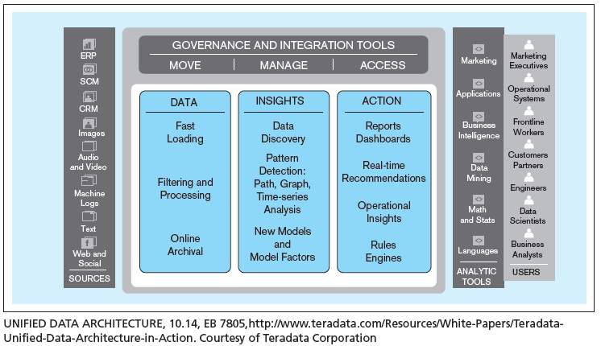
Teradata Unified Data Architecture – Logical View
Notes:
This is Teradata’s model of how various elements of a modern data management environment belong together. Here we see a logical view. Data sources are at one end and users at another. In between are three core activities: data, insights, and actions.

Slide 23
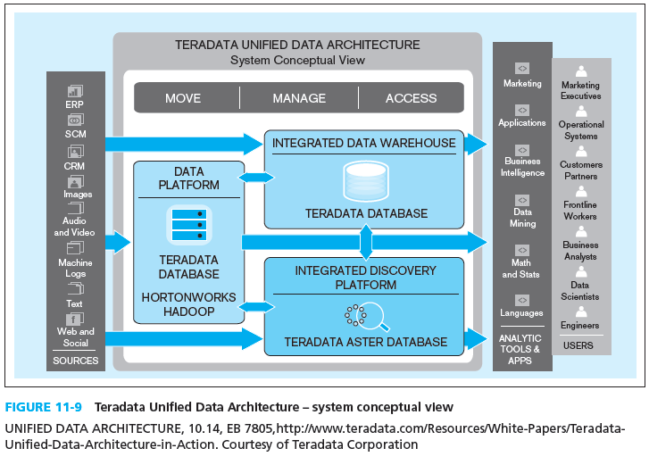
Teradata Unified Data Architecture – System Conceptual View
Notes:
Here we see the system conceptual view. Notice the intersection of Teradata’s proprietary database engine with Hadoop, and the use of Aster for discovery. The Data Platform allows for capturing data from the sources and prepare and store it for analytical purposes.

Slide 24
Analytics
Analytics
  Systematic analysis and interpretation of data;
  Typically using mathematical, statistical, and computational tools;
  To improve our understanding of a real-world domain.
Notes:
This chapter is primarily about these two new advances in data technologies and approaches.
Traditional data management technologies were created to ensure accurate and efficient transaction processing. As we saw from chapter 9, later database structures were created to support decision-making and overall understanding of the business. We called these data warehouses. Big data and analytics takes us further down this road.

Slide 25
History of Analytics
Historical precedents to analytics:
  Management information systems (MIS) ➔ Decision Support Systems (DSS) ➔ Executive Information Systems (EIS)
  DSS idea evolved into Business Intelligence (BI)
Business Intelligence – a set of methodologies, processes, architectures, and technologies that transform raw data into meaningful and useful information.
Notes:
The IT field is full of jargon and buzzwords whose names change over time. In one book or article, you may read that BI is an umbrella term and includes analytics as a component. Others describe them in exactly the opposite relationship. And some say that BI and analytics are exactly the same thing.

Slide 26
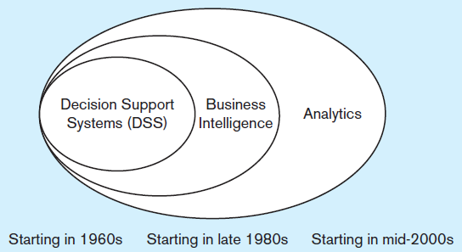
Analytics
Analytics encompasses more than BI
  Umbrella term that includes BI
  Transform data to useful form
  Infrastructure for analysis
  Data cleanup processes
  User interfaces
Notes:
The IT field is full of jargon and buzzwords whose names change over time. In one book or article, you may read that BI is an umbrella term and includes analytics as a component. Others describe them in exactly the opposite relationship. And some say that BI and analytics are exactly the same thing.

Slide 27
Types of Analytics
Descriptive analytics – describes the past status of the domain of interest using a variety of tools through techniques such as reporting, data visualization, dashboards, and scorecards.
Predictive analytics – applies statistical and computational methods and models to data regarding past and current events to predict what might happen in the future.
Prescriptive analytics –uses results of predictive analytics along with optimization and simulation tools to recommend actions that will lead to a desired outcome.
Notes:
With descriptive analytics we ask what happened already (last week, last year, etc.). With predictive analytics we ask what’s going to happen in the future and how will it affect us. With prescriptive analytics, we ask what is the best decision to make.

Slide 28
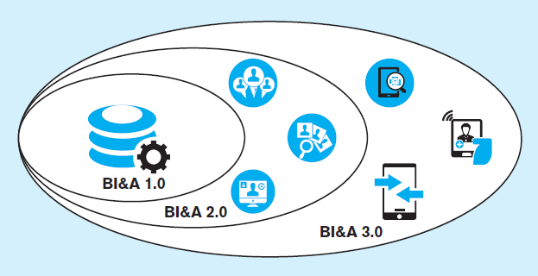
Generations of Business Intelligence and Analytics
BI&A 1.0
Focus on structured quantitative data largely from relational databases.
BI&A 2.0
Include data from the Web (web interaction logs, customer reviews, social media).
BI&A 3.0
Include data from mobile devices, (location, sensors, etc.) as well as Internet of Things.
Notes:
BI&A has evolved along with other elements of information technology. It should be noted that there is far more unstructured and semistructured data (characteristic of Web and mobile technology) than there is structured data (typically found in relational databases). And although all data (structured and unstructured alike) is increasing in volume over time, the rate of growth is largest in the unstructured space.

