Slide 1
Data and Database Administration
Chapter 12
Modern Database Management
12th Edition
Hoffer, Ramesh, and Topi

Slide 2
Learning Points
Define Data and Database Administration
Describe Issues for Security
Managing Data Integrity
Discuss Techniques for Database Recovery
Approaches to Concurrency Control

Slide 3
Administration Definitions
Data Administration: A high-level function that is responsible for the overall management of data resources in an organization, including maintaining corporate-wide definitions and standards.
Database Administration: A technical function responsible for database design and for dealing with technical issues such as security enforcement, database performance, and backup and recovery.

Slide 4
Evolving Approaches to Administration
Blend data and database administration into one role.
Fast-track development – control development process.
Procedural DBAs – managing triggers and procedures.
eDBA – managing Internet-enabled database.
PDA DBA – personal database management
Data warehouse administration.

Slide 5
Open-Source DBMSs
An open-source DBMS is:
Free or nearly free database software whose source code is publicly available.
An alternative to proprietary packages.
Less expensive (e.g., MySQL).
Competitive against PC-oriented package (e.g., Microsoft Access).

Slide 6
Database Security
Database Security is the protection of the data from accidental or intentional threats to their integrity and access.
Increased difficulty due to Internet access and mobile computing device access.
Database administration is responsible for administering database security.

Slide 7
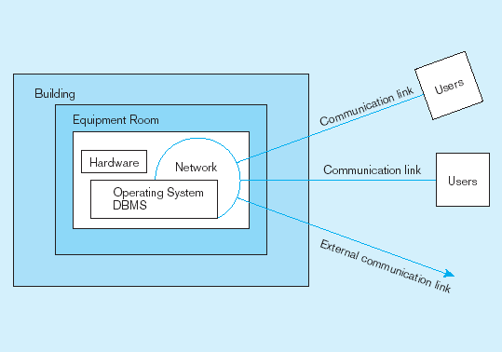
Secure All Parts of the System

Slide 8

Threats to Data Security
Accidental losses
  Caused by human error.
  Or due to software and hardware failure.
  Policy and procedures may help.
Theft and fraud
  Perpetrated by people.
  Physical security is needed.
  Firewall should be established.

Slide 9
Threats to Data Security (cont.)
Loss of privacy or confidentiality
  Loss of protection of personal data or corporate data.
  Relevant state and federal laws now exist.
Loss of data integrity
  Data is invalid or corrupted.
Loss of availability
  Maybe due to virus-related sabotage of hardware, networks, or application.
  Antivirus software must be installed.

Slide 10
Server Security
Servers should be:
located in a secure area.
Physically accessible only to authorized administrators and supervisors.
Protected with logical access control.
Tied with security standards (e.g., password lengths, password naming conventions, frequency of password changes).

Slide 11
Client/Server Network Security
Client/Server network security involves:
Encryption of data so that attacker can not read them.
Authentication of the client workstation.

Slide 12
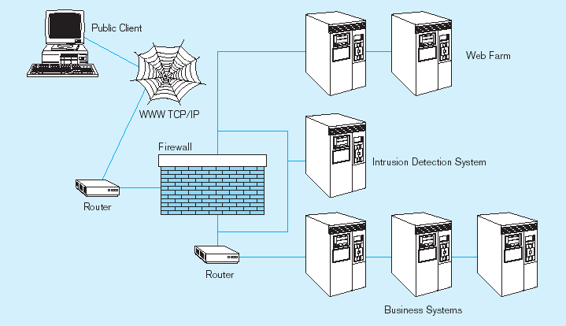
Establishing Internet Security

Slide 13
Web Security
Place Web files in protected directories on server.
Make Web files readable but not published.
Keep Web files on server accessible through intranet.
Restrict number of users and open ports.
Remove unnecessary programs that load automatically when setting up the server.

Slide 14
W3C Web Privacy Standard
Platform for Privacy Preferences (P3P) is created by W3C and communicates a website’s stated privacy policies and compare the statement with the user’s own policy preferences.
Addresses the following:
  Who collects data?
  What data is collected and for what purpose?
  Who will share the data?
  Can users control access to their data?
  How are disputes resolved?
  What are policies for retaining data?
  Where are the website’s policies in readable form?

Slide 15
Integrity Controls
Integrity Controls
Protect data from unauthorized use and update.
Limit the values a field may hold and the actions can be performed on data.
Use domain, a way to create a user-defined data type.
Use assertions to enforce database conditions.
User triggers for security purposes.
Notes:
A data domain specifies the data range or possible values for the data.

Slide 16
Use Domain for Integrity
Once a domain is defined, any field can be assigned that domain as its data type.
For example, PriceChange domain can be used by database field – PriceIncrease to limit the amount that standard prices can be augmented in one transaction.
Changing domain will change all relevant fields automatically.
CREATE DOMAIN PriceChange AS DECIMAL
CHECK (VALUE BETWEEN .01 and .15);
PriceIncrease PriceChange NOT NULL;

Slide 17
Use Assertion for Integrity
Assertions are constraints enforcing certain desirable database conditions.
Assertions are checked automatically by the DBMS when transactions are run involving fields on which assertions exist.
For example, a company rule is that no employee may supervise his or her spouse; Employee (EmpID, EmpName, Supervisor ID, and SpouseID).
CREATE ASSERTION SpousalSupervision
CHECK (SupervisorID<>SpouseID);

Slide 18
Use Trigger for Security
A trigger can:
Prohibit inappropriate actions (e.g., changing a salary value outside of the normal business day).
Cause special handling procedures to be executed (e.g., a penalty is added to the account balance for delayed payment).
Cause a row to be written to a log file (e.g., the log can record which user initiated a salary change for which employee).

Slide 19
Authorization Rules
Authorization rules
Are controls incorporated in the data management system;
Restrict access to data;
Restrict the actions that people can take on data.

Slide 20
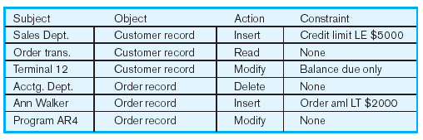
Authorization Matrix

Slide 21
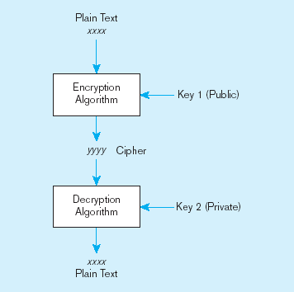
Basic Two-Key Encryption
Encryption – the coding or scrambling of data so that humans cannot read them.
Public key is used by the encryption algorithm to transform a plain-text message into an encrypted message.
Private key is used by the decryption algorithm to convert the encrypted message back to plain text.
Notes:
Encryption technology often involves two keys: a public key for encryption and a private key for decryption.

Slide 22
Database Recovery
Database recovery is the mechanism for restoring a database quickly and accurately after loss or damage.
Recovery facilities:
  Backup Facilities
  Journalizing Facilities
  Checkpoint Facility
  Recovery Manager

Slide 23
Back-Up Facilities
Back-up facilities provide periodic back-up copies of portions of or the entire database.
DBMS normally provides a COPY utility.
Back-up facilities also create a copy of related database objects (e.g., catalog, index).
A back-up copy is produced at least once per day.

Slide 24
Journalizing (Log) Facilities
Journalizing (log) facilities produce an audit trail of transactions and database changes.
In case of failure, a consistent database state can be reestablished using the log and most recent backup copy.
Transaction log contains a record of each transaction processed against the database.
Database change log contains before- and after-values of records modified by transactions.

Slide 25
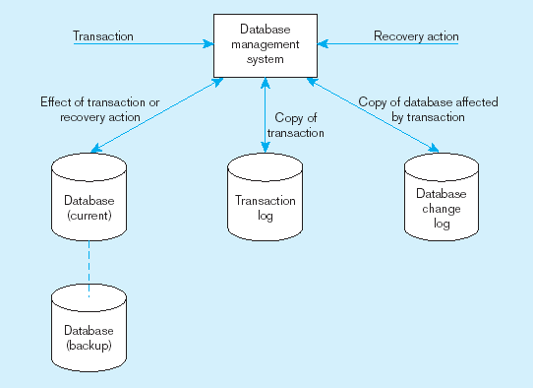
Database Audit Trail
From the backup and logs, databases can be restored in case of damage or loss.

Slide 26
Checkpoint Facilities
Checkpoint facilities allow DBMS to periodically suspend all processing and synchronize its files and journals to establish a recovery point.
At this point, system is in a quiet state, and database and transaction logs are synchronized.
DBMS writes a checkpoint record to the log file; the record contains information necessary to restart the system.

Slide 27
Recovery Manager
A recovery manager allows the DBMS to restore the database to a correct condition and restart processing transactions.
The recovery manager uses the logs to restore the database.
Disk mirroring – at least two copies of the database must be kept and updated simultaneously; when failure occurs, processing is switched to the duplicate copy of the database.

Slide 28
Restore/Rerun Technique
Restore/rerun technique involves reprocessing the day’s transactions (up to the point of failure) against the back-up copy of the database or portion of the database being recovered.
The database is shut down and the most recent copy of the database is mounted.
All transactions that have occurred since that copy are rerun.

Slide 29
Backward Recovery
Backward Recovery – DBMS back out of or undo unwanted changes to the database.
Database is returned to an earlier state; unwanted changes are eliminated.
Backward recovery is used to reverse the changes made by transactions that have aborted, or terminated abnormally.

Slide 30
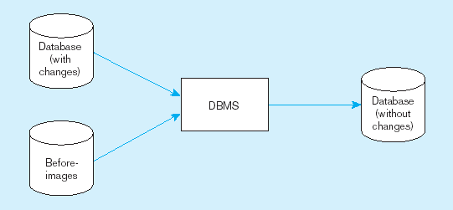
Backward Recovery (cont.)

Slide 31
Forward Recovery
Forward Recovery – DBMS start with an earlier copy of the DBMS and apply good transactions to the database.
Database is moved forward to a later state.
Only the most recent, “good” results of applying the transaction are used.

Slide 32
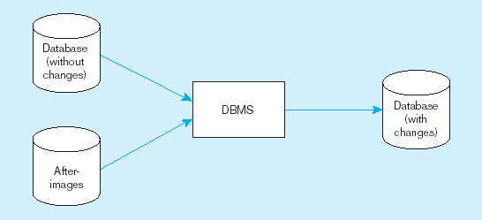
Forward Recovery (cont.)

Slide 33
Types of Database Failure
Aborted transactions – a transaction in progress that terminates abnormally; backward recovery is preferred.
Incorrect data – database has been updated with incorrect, but valid, data; backward recovery or restart from checkpoint.
System failure – some component of the system fails; mirrored database or restart from checkpoint and forward recovery.
Database destruction – database is lost, or destroyed, or cannot be read; mirrored database or restart from checkpoint and forward recovery.

Slide 34
Concurrency Control
Problem: In a multi-user environment, simultaneous access to data can result in interference and data loss.
Solution: Concurrency control is the process of managing simultaneous operations against a database so that data integrity is maintained and the operations do not interfere with each other in a multi-user environment.

Slide 35
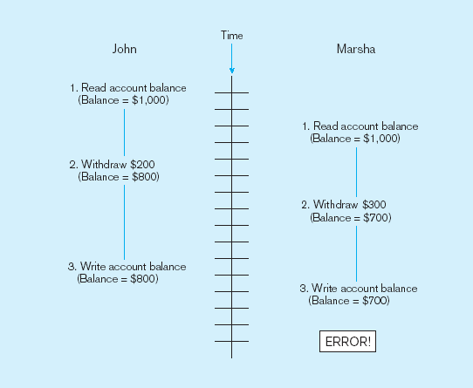
Example of Lost Update
Simultaneous access causes John’s updates to be lost.

Slide 36
Concurrency Control Techniques
Locking mechanism
The most common way for concurrency control.
Data that are retrieved by a user for updating must be locked, or denied to other users, until the update is complete or aborted.
No other users can perform update until the data are unlocked.

Slide 37
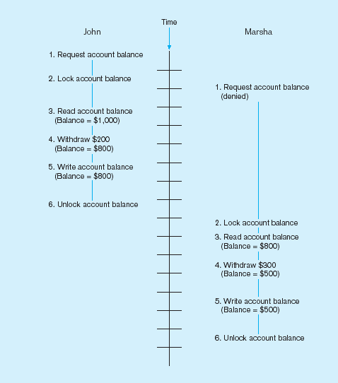
Example of Locking
This prevents the lost update problem.

Slide 38
Locking Mechanism
Locking level:
Database – used during database updates.
Table – relevant entire table is locked.
Block – most commonly implemented.
Record – only requested row is locked.
Field – seldom used.

Slide 39
Locking Mechanism (cont.)
Types of locks:
Shared lock – allow other transactions to read but not update a record or other resource. Used when just reading to prevent another user from placing an exclusive lock on the record.
Exclusive lock – prevent another transaction from accessing a record until it is unlocked. Used when preparing to update a record.

Slide 40
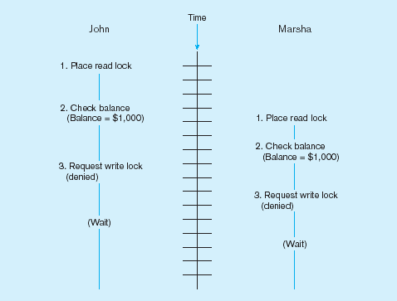
Deadlock
An impasse that results when two or more transactions have locked a common resource, and each must wait for the other to unlock that resource.
John and Marsha will wait forever for each other to release their locked resources!

Slide 41
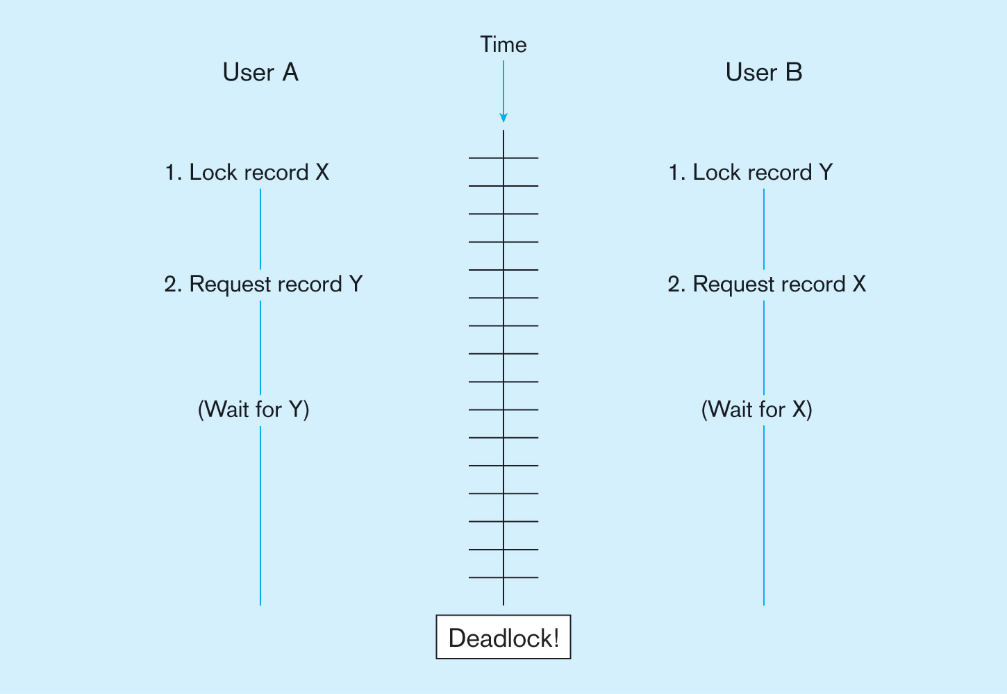
Deadlock (cont.)

Slide 42
Managing Deadlock
Deadlock prevention:
  User programs must lock all records they will require at the beginning of a transaction.
Deadlock resolution:
  Allow deadlocks to occur but build mechanisms into DBMS for detecting and breaking the deadlocks.

Slide 43
Data Dictionary
Data dictionary stores metadata including attribute names and definitions for each table.
Data dictionary is usually a part of the system catalog that describes all database objects, including table-related data.
An active data dictionary is managed automatically by the database management software.
A passive data dictionary is managed by users and is modified whenever database structure is changed.

Slide 44
Information Repository
Information repository stores metadata, manages the total information processing environment, and combines information about an organization’s business information and its application portfolio.
Information repository is an essential component of both the development environment and the production environment.
Information repository dictionary system (IRDS) is a computer software tool used to manage and control access to the information repository.

