Slide 1
Distributed Databases and Object-Oriented Data Modeling
Chapter 13 and 14
Modern Database Management
12th Edition
Hoffer, Ramesh, and Topi

Slide 2
Learning Points
Definition of Distributed Databases
Location Transparency and Local Autonomy
Advantages and Disadvantages of Distributed Databases
Describe Object-Oriented Database
Characteristics of Object-Oriented Database
Introduction to Object Definition Language

Slide 3
Distributed Database
Distributed Database
A single logical database spreads physically across computers in multiple locations that are connected by a data communications network.
Provides ease of access to data for users at many different locations.

Slide 4
Location Transparency
Distributed database system must provide location transparency.
Location transparency means user does not have to know the location of the data.
Data requests automatically forwarded by the system to appropriate sites.
All data in the network appear as a single logical database stored at one site.

Slide 5
Local Autonomy
Distributed database systems make local autonomy possible.
Local autonomy is the capability to administer a local database and to operate independently when network connections fail.
With local autonomy, each site has the capability to control local data, administer security, log transactions, and perform system recovery.

Slide 6
Advantages of Distributed Database
Increased reliability and availability
Local control over data
Modular growth
Lower communication costs
Faster response for certain queries

Slide 7
Disadvantages of Distributed Database
Software cost and complexity
Processing overhead
Data integrity issue
Slower response for certain queries

Slide 8
Options for Distributing a Database
Data replication – copies of data distributed to different sites.
Horizontal partitioning – different rows of a table distributed to different sites.
Vertical partitioning – different columns of a table distributed to different sites.
Combinations of the above

Slide 9
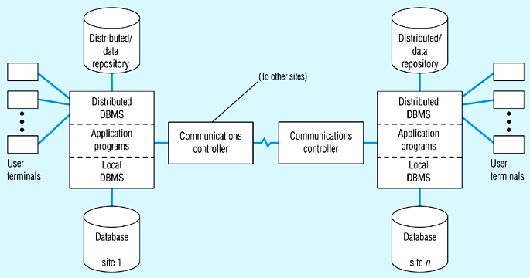
Distributed DBMS Architecture

Slide 10
Distributed DBMS Transparency Objectives
Location Transparency – user/application does not need to know where data reside.
Replication Transparency – user/application treat a data item as if it were a single item at a single location.
Failure Transparency – either all or none of the actions of a transaction are committed.
Concurrency transparency – although a distributed system runs many transactions, it appears that a given transaction is the only activity in the system.

Slide 11
Object-Oriented Data Model
Object-oriented data model
Centers around objects and classes.
Involves inheritance.
Encapsulates both data and behavior.
Is not only for data modeling, but also for process modeling.

Slide 12
OO vs. EER Data Modeling
Object Oriented
EER
Class
Entity type
Object
Entity instance
Association
Relationship
Inheritance of attributes
Inheritance of attributes
Inheritance of behavior
No presence of behavior
Object-oriented modeling is typically represented using the Unified Modeling Language (UML)

Slide 13

Classes
A class is an entity that has a well-defined role in the application domain about which the organization wishes to maintain state, behavior, and identity.
  Tangible or visible: person, place, or thing.
  Concept or event: department, performance, marriage, registration.
  Artifact of the design process: user interface, controller, scheduler.

Slide 14
Classes and Objects
An object is an instance of a class that encapsulates the data and behavior we need to maintain about that object.
A class of objects shares a common set of attributes and behaviors.
The state of an object encompasses its properties (attributes and relationships) and the values those properties have.
The behavior represents how an object acts and reacts.

Slide 15
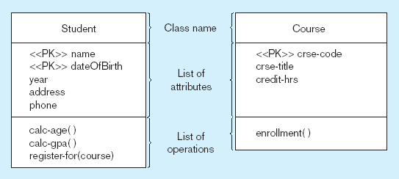
UML Class and Object Diagram
Class diagram shows the static structure of an object-oriented model: object classes, internal structure, relationships.

Slide 16
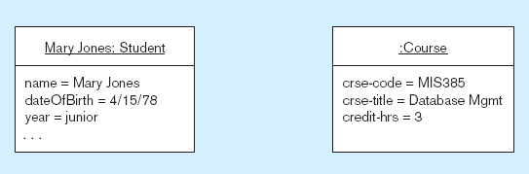
Object Diagram with Two Instances
Object diagram shows instances that are compatible with a given class diagram.

Slide 17
Operation and Encapsulation
An operation is a function or service that is provided to all instances of a class.
  For example, calculate GPA in Student.
  It is only through operation the users can access or manipulate the information stored in an object.
An encapsulation is the technique of hiding the internal implementation details of an object from its external view.

Slide 18
Association
An association is a named relationship between or among instances of object classes.
Association role is the role of an object in an association
Multiplicity indicates how many objects participate in an association (cardinality).

Slide 19
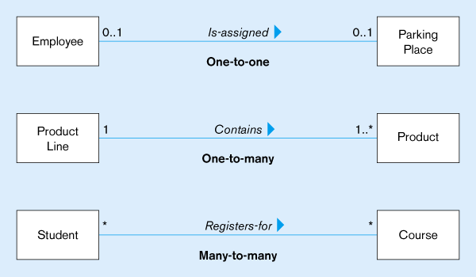
Examples of Association Relationships

Slide 20
Abstract and Concrete Class
An abstract class is a class that has no direct instances, but whose descendants may have direct instances.
A concrete class is a class that can have direct instances.
For example, Outpatient and Resident Patient can have direct instances, but Patient can not have any direct instances of its own.

Slide 21
Multiple Classification and Inheritance
Multiple Classification: An object is an instance of more than one class.
Multiple Inheritance: A class inherits features from more than one superclass.

Slide 22
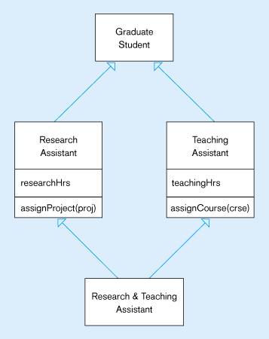
An Example of Multiple Classification and Inheritance

Slide 23
Object Definition Language (ODL)
Object definition language
  Corresponds to SQL’s DDL (Data Definition Language).
  Specifies the logical schema for an object-oriented database.
In ODL, A class is specified using the class keyword, and an attribute is specified using the attribute keyword.

Slide 24
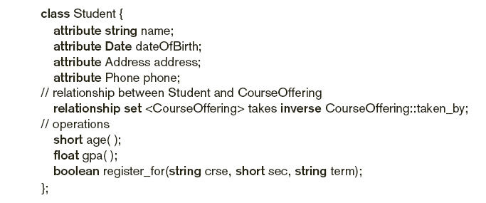
Defining a Class
See page 558

Slide 25
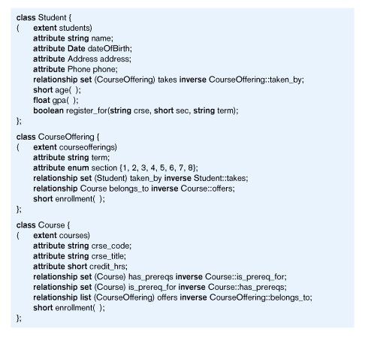
ODL Schema for University Database

