Slide 1
Analysis of Variance

Slide 2
Introductory Example
Chemitech developed a new filtration system for municipal water suppliers. The components for the new filtration system will be purchased from several suppliers, and Chemitech will assemble the components at its Columbia, SC plant. The industrial engineering group is responsible for determining the best assembly method for the new filtration system. After considering a variety of possible approaches, the group narrows the alternative to three: method A, method B, and method C. These methods differ in the sequence of steps used to assemble the system. Managers want to determine which assembly method can produce the greatest number of filtration systems per week.

Slide 3
Introductory Example
Here, assembly method is the independent variable, also called factor. The three assembly methods that correspond to this factor are called three treatment. The Chemitech problem is an example of single-factor experiment, involving one qualitative factor (method of assembly).
The three assembly methods or treatments define the three populations: one population is all employees who use method A, another is those who use method B, and the third is those who use method C.
For each population, the dependent or response variable is the number of filtration systems assembled per week.
The primary statistical objective is to determine whether the mean # of units produced per week is the same for all three populations or methods.

Slide 4
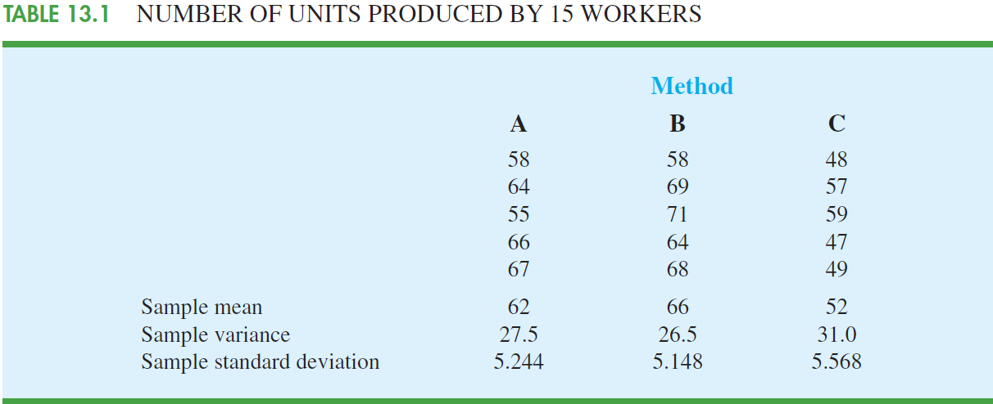
Introductory Example
Suppose that 15 workers are randomly selected and assigned to each of the three methods equally (5 workers per method or treatment). And the following data is collected:

Slide 5
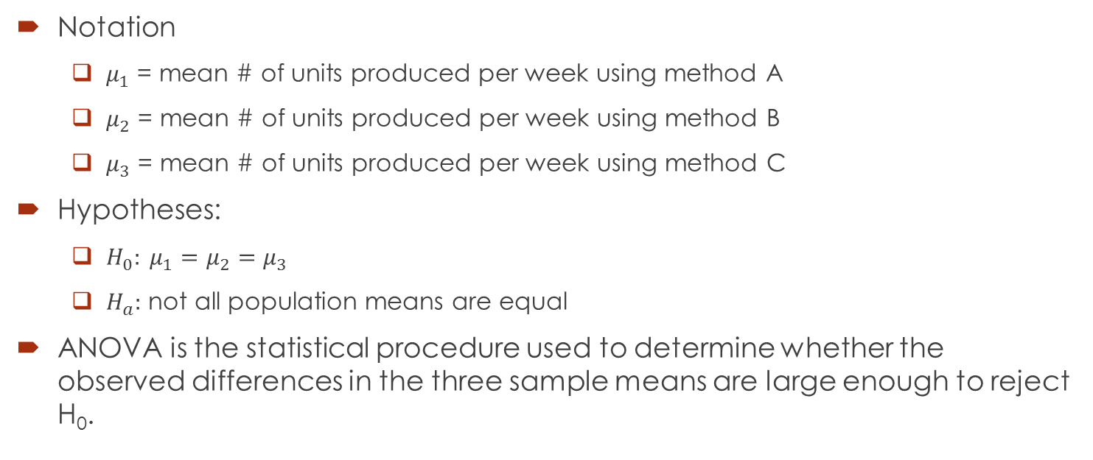
Introductory Example
Notation
$μ_{1}$ = mean # of units produced per week using method A
$μ_{2}$ = mean # of units produced per week using method B
$μ_{3}$ = mean # of units produced per week using method C
Hypotheses:
$H_{0}: μ_{1}=μ_{2}=μ_{3}$
$H_{a}:$ not all population means are equal
ANOVA is the statistical procedure used to determine whether the observed differences in the three sample means are large enough to reject H₀.

Slide 6
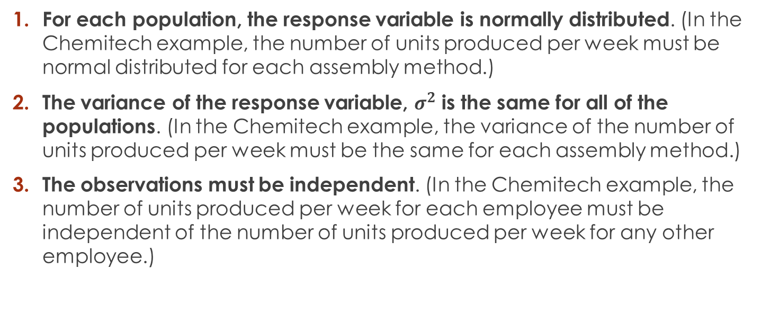
Assumptions for ANOVA
For each population, the response variable is normally distributed. (In the Chemitech example, the number of units produced per week must be normal distributed for each assembly method.)
The variance of the response variable, $σ^{2}$ is the same for all of the populations. (In the Chemitech example, the variance of the number of units produced per week must be the same for each assembly method.)
The observations must be independent. (In the Chemitech example, the number of units produced per week for each employee must be independent of the number of units produced per week for any other employee.)

Slide 7
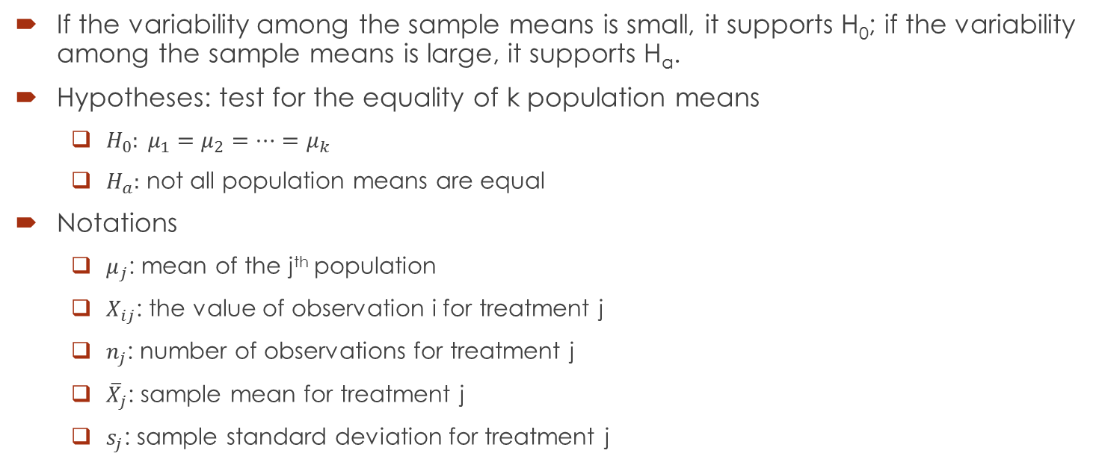
General ANOVA with Completely Randomized Design
If the variability among the sample means is small, it supports H₀; if the variability among the sample means is large, it supports H_{a}.
Hypotheses: test for the equality of k population means
$H_{0}: μ_{1}=μ_{2}=⋯=μ_{k}$
$H_{a}:$ not all population means are equal
Notations
$μ_{j}$: mean of the j^{th} population
$X_{ij}$: the value of observation i for treatment j
$n_{j}$: number of observations for treatment j
${\overline{X}}_{j}$: sample mean for treatment j
$s_{j}$: sample standard deviation for treatment j

Slide 8
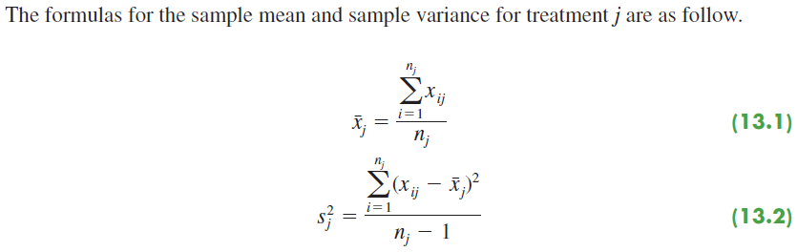
General ANOVA with Completely Randomized Design

Slide 9
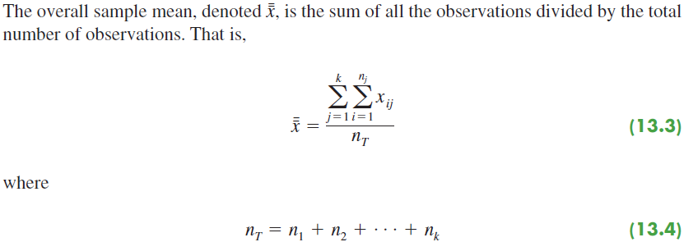
General ANOVA with Completely Randomized Design

Slide 10
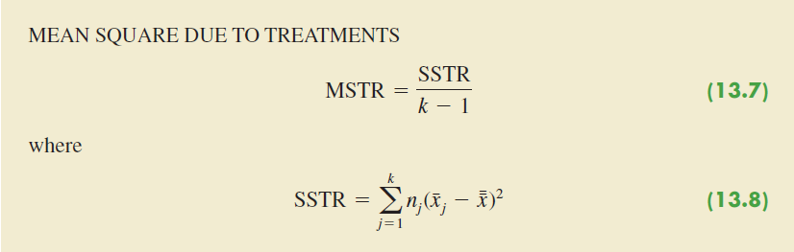
General ANOVA with Completely Randomized Design

Slide 11
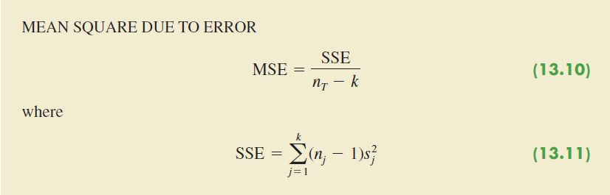
General ANOVA with Completely Randomized Design

Slide 12
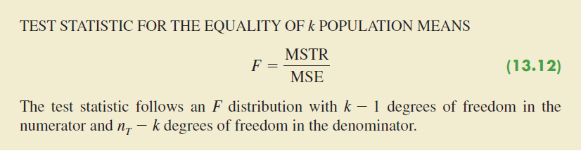
General ANOVA with Completely Randomized Design

Slide 13
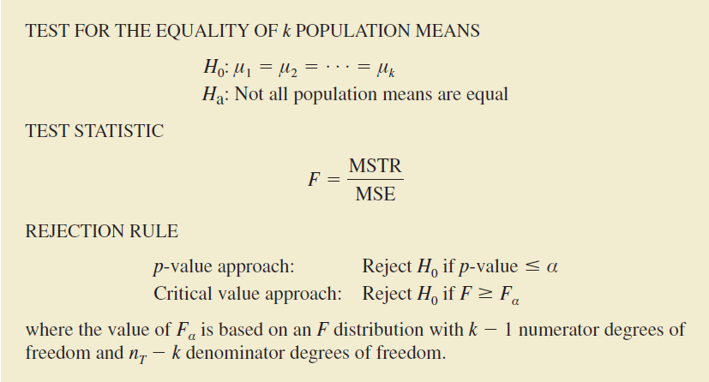
General ANOVA with Completely Randomized Design

Slide 14
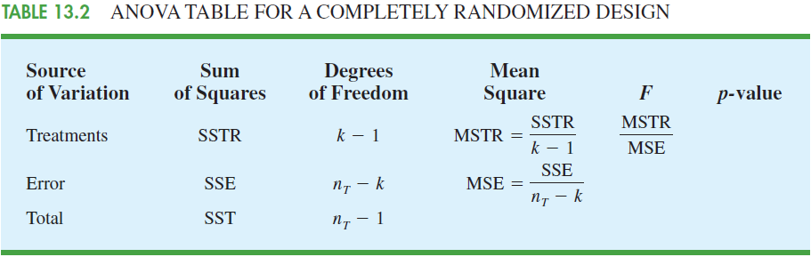
General ANOVA with Completely Randomized Design

