Slide 1
Analysis of Variance
Two-Factor ANOVA

Slide 2
Example
To improve students’ performance on the GMAT, a university is considering offering the following three GMAT preparation programs.
A three-hour review session covering the types of questions generally asked on the GMAT.
A one-day program covering relevant exam material, along with the taking and grading of a sample exam.
An intensive 10-week course involving the identification of each student’s weakness and the setting up of individualized programs for improvement.

Slide 3
Example (Cont’d)
The GMAT is usually taken by students from three colleges: the College of Business, the College of Engineering, and the College of Arts and Sciences.
The factorial design for this experiment to evaluate the effectiveness of the preparation programs thus has two factors:
Factor A, preparation programs have three treatment: 3-hr review, 1-day program, and 10-wk course.
Factor B, the colleges also have three treatment: COB, COE, COAS.
Therefore, a total of 3*3 = 9 treatments.

Slide 4
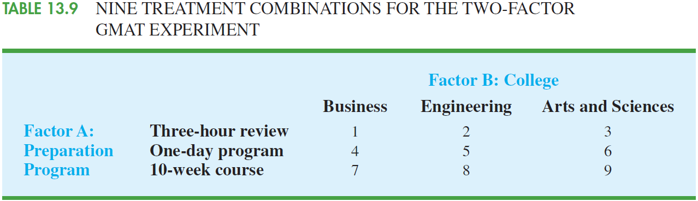
Example (Cont’d)

Slide 5
Example (Cont’d)
Assume that a sample of TWO (quite small sample size) students will be selected corresponding to each of the nine treatment combinations.
In experimental design terminology, the sample size of two for each treatment combination indicates that there are two replications.
Remark: what if the number of replications is different for different treatment combinations? Can you handle that?

Slide 6
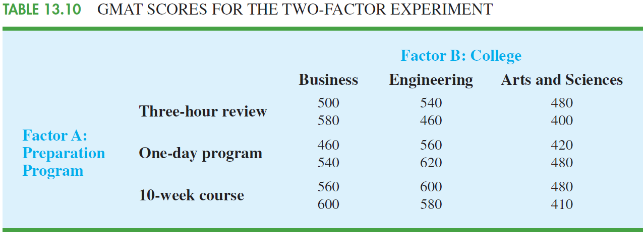
Example (Cont’d)

Slide 7
Example (Cont’d)
Two-factor ANOVA can provide the answers to the following questions:
Main effect (factor A): Do the preparation programs differ in terms of effect on GMAT scores?
Main effect (factor B): Do the colleges differ in terms of effect on GMAT scores?
Interaction effect (factors A and B): Do students in some colleges do better on one type of preparation program whereas others do better on a different type of preparation program?

Slide 8
Example (Cont’d): ANOVA Procedure
ANOVA procedure requires us to partition the SST into four groups:
SST = SSA + SSB + SSAB + SSE
Notations:
a = number of levels (treatments) of factor A
b = number of levels (treatments) of factor B
r = number of replications in each treatment combination
n_{T} = total number of observations; n_{T} = abr.

Slide 9
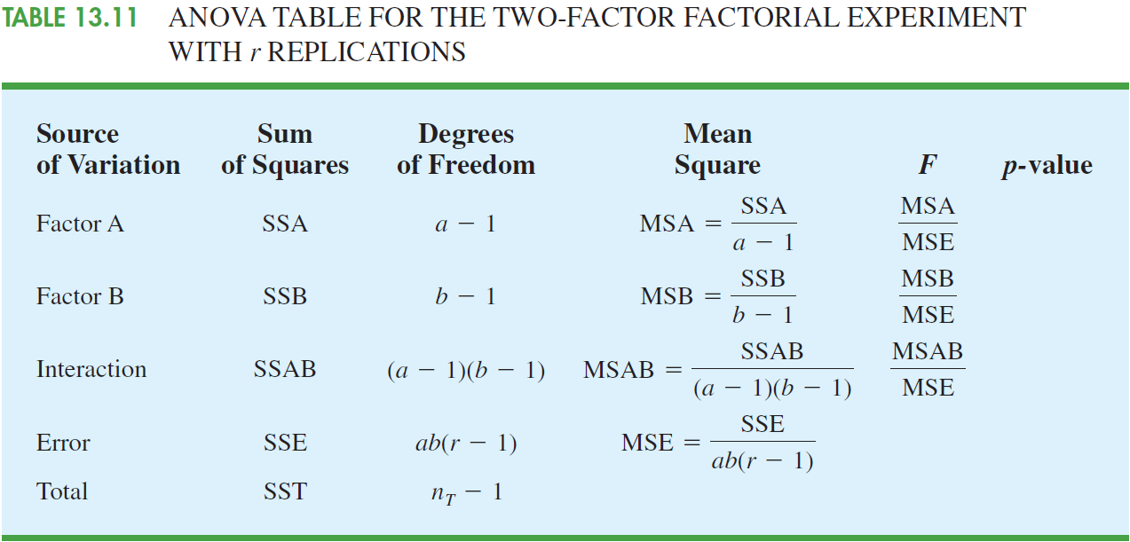
Example (Cont’d)

Slide 10
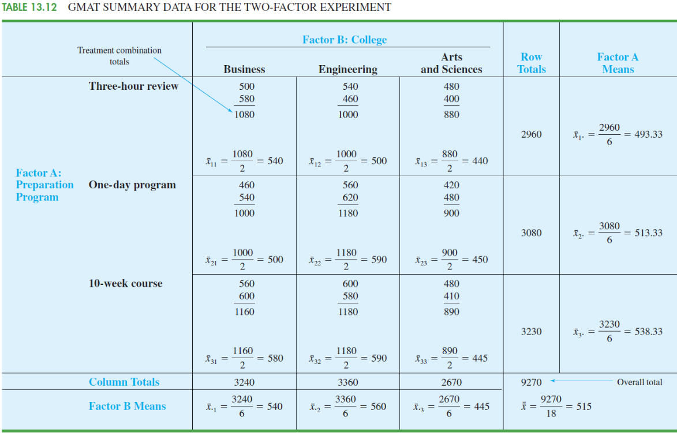
Example (Cont’d)

Slide 11
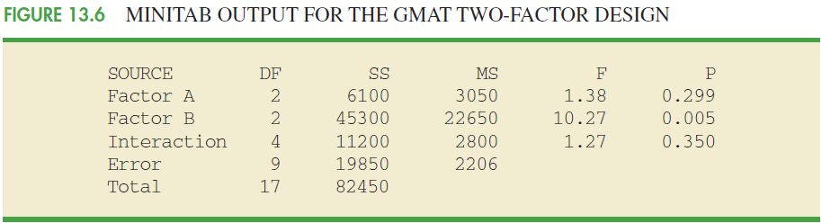
Example (Cont’d)

