Slide 1

CompletableFuture
Azat Satklichov
azats@seznam.cz,
http://sahet.net/htm/java.html,
https://github.com/asatklichov/multithreading-java-vs-nodejs
Notes:
JSLint can be found at http://www.JSLint.com/.
JavaScript statements are composed of: Values, Operators, Expressions, Keywords, and Comments.
JavaScript programs (and JavaScript statements) are often called JavaScript code.
var x, y, z; // Statement 1 x = 5; // Statement 2 y = 6; // Statement 3
var x = 5 * 10; //Statement 4
JavaScript uses the var keyword to declare variables.
An expression is a combination of values, variables, and operators, which computes to a value. E.g. 5 * 10 or x * 10
JavaScript variables are containers for storing data values.
All JavaScript variables must be identified with unique names. JavaScript identifiers are case-sensitive.
Creating a variable in JavaScript is called "declaring" a variable.
var carName;
Difference Between Unicode and UTF-8: Unicode is a character set. UTF-8 is encoding.
Unicode is a list of characters with unique decimal numbers (code points). A = 65, B = 66, C = 67, ....
This list of decimal numbers represent the string “ahello": 97 104 101 108 108 111
Encoding is how these numbers are translated into binary numbers to be stored in a computer:
UTF-8 encoding will store "hello" like this (binary): 01101000 01100101 01101100 01101100 01101111
Encoding translates numbers into binary . Character sets translates characters to numbers.

Slide 2
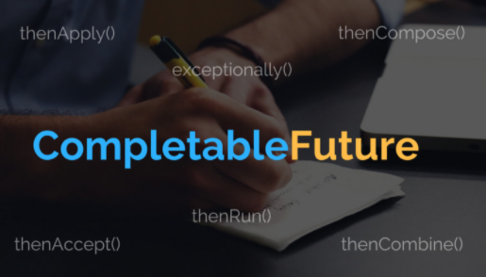
CompletableFuture https://docs.oracle.com/en/java/javase/15/docs/api/java.base/java/util/concurrent/CompletableFuture.html https://docs.oracle.com/en/java/javase/15/docs/api/java.base/java/util/concurrent/class-use/CompletableFuture.html
Composing Futures - CompletableFuture(Java 8, 9) support non-blocking operations
Java v.1.8 (18-March 2014)
Java v.1.9 (21-September 2017 ) newIncompleteFuture(), defaultExecutor(), delayedExecutor, failedFuture, …
Java v.12 (19-March 2019 ) Exception handling in CompletionStage – exceptionallyAsync (2x), exceptionallyComposeAsync,
Concepts behind the CompletableFuture (uses ForkJoinPool by default (designed for this purpose). ) and reactive programming are
reaching parallelism using non-blocking operations, It understands tasks depend on other tasks, so avoids blocking threads, and
changing (context switch expensive) threads. It is an ideal candidate to write asynchronous systems.
In the case of asynchronous computation (it is usually multi steps), actions represented as callbacks tend to be either scattered
across the code or deeply nested inside each other. Things get even worse when we need to handle errors that might occur during one of the steps.

Slide 3
Different ways to implement asynchronous programming in Java
1- Executor Service framework, Java Concurrency API (java.util.concurrent). In Core Thread API – on demand created thread dies when the task is completed, non reusable.
ExecutorService – async exec mechanism, gives a task (Runnable, Callable), then gets a Future
Future – represents result of an asynchronous computation when asynchronous task is created
Cached Thread Pool – creating threads starting with 0 and max to 2^31-1. Task should not wait (SynchronousQueue) for execution. Limitation: system resources availability. Removes idle threads after 1-min. Good for a lot short-lived tasks.
Fixed Thread Pool – keeps adding more tasks to the queue (LinkedBlockingQueue) in case all threads are busy. Good to control resource consumption, stack size, and tasks with unpredictable execution times.
Scheduled Thread Pool - schedule commands to run after a given delay, or to execute periodically.
Single Thread Executor - used for the purpose of executing tasks sequentially. For testing or using as event-loop.
ForkJoinPool - ForkJoin provides parallel mechanism for CPU intensive tasks, uses work stealing alg. CompletableFuture, Parallel Streams uses it by default.
Guava – via MoreExecutors class also daemon threads
Customizable Thread Pools - to control .. resource consumption use ThreadPoolExecutor or ScheduledThreadPoolExecutor
LSP: LangServerBootstrap(Launcher.Builder-newCachedThreadPool), AbstractDataBusBroker-fixed-pool(10), ServerCommunications(scheduled-pool(5), LangServerBootstrapTest (singleExecutor),
Since Java 5, the Future represents the result of an async-computation but it lacks methods to chain/combine the computation steps or handle possible errors, can’t be manually completed, and get() method is blocked.
You can not attach a callback function to the Future, and have it called automatically once Future’s result is ready
2- Java 8, CompletableFuture class 3-@Async SpringBoot, etc…

Slide 4
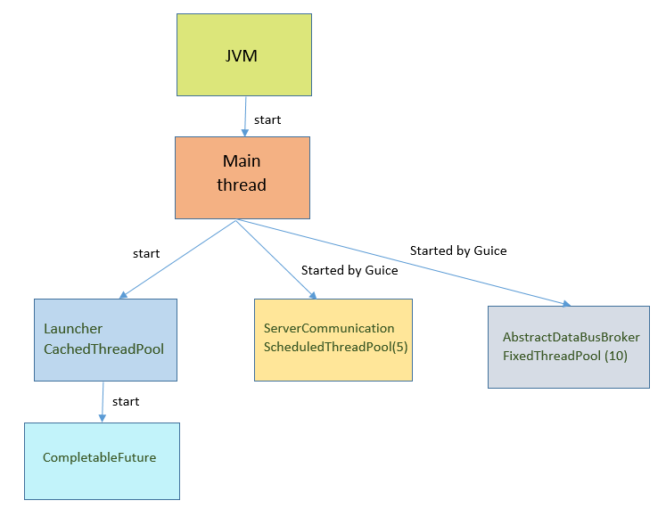
Thread Pools in LSP Cobol
LangServerBootstrap [Launcher](cached thread pool)
AbstractDataBusBroker (fixed thread pool)
ServerCommunications (scheduled thread pool)
CompletableFuture (forkjoin common pool)
LangServerBootstrapTest (single thread executor)
New one in CobolTextDocumentService (cached thread pool)
- MyThreadPoolExecutor (custom pool)
ServerCommunications (scheduled thread pool)
CompletableFuture (forkjoin common pool) –
providing manageable executor?

Slide 5
CompleteableFuture is like PROMISES in JS. Node.js uses libuv, whereas web browser runtimes use browser-provided APIs
for the async I/O tasks. The event loop works pretty much the same in Node.js and in web browser JavaScript runtimes.
You can make a Promise and it's up to you to keep it ;)
When someone else makes you a promise you must wait to see if they honour it in the Future. CompletableFuture ;)
The Java 8 CompletableFuture and the Guava SettableFuture (ListenableFuture) can be thought of as promises, because their value can be set ("completed"), they also implement the Future interface, therefore there is no difference for the client.
The CompletableFuture implements both Future and CompletionStage interfaces, it can combine (pipeline) multiple
asynchronous computations, handle possible errors and offers much more capabilities. CompletionStage lets you
attach callbacks that will be executed on completion. CompeletableFuture is all about coordination ..
Around 70 methods for composing, combining, and executing asynchronous computation steps and handling errors.
Methods to chain CompletionStage (step of a chain, may trigger other task) Task: What kind of task? Function(apply), Consumer(accept), Runnable(run) - 3 types of methods, one for each type of task Operation: What kind of operation does it support? 4 types Chaining (1:1) Composing (1:1) Combining, waiting for both result (2:1) Combining, triggered on the first available result (2:1) e.g. Operation – you can chain, compose, or combine(&&, ||) | Thread: In which thread can be executed? 3 types In the same executor as caller (main thread), In new executor, passed as parameter (executor), Asynchronously (ForkJoinPool) 1:1 patterns thenApply, thenApplyAsync, thenAccept, thenRunAsync, .. thenComposeAsync, .. 2:1 patterns (*Both*, *Combine* and *Either*) thenCombineAsync(CS, BiFunction), .. thenAcceptBoth(CS, BiConsumer), .. applyToEither(CS, Function), acceptEitherAsync, .. So: 3*4*3=36 methods for chain, factory methods(?) exception related(?), complete(?), fail(?),delay(?), timeout(?)

Slide 6
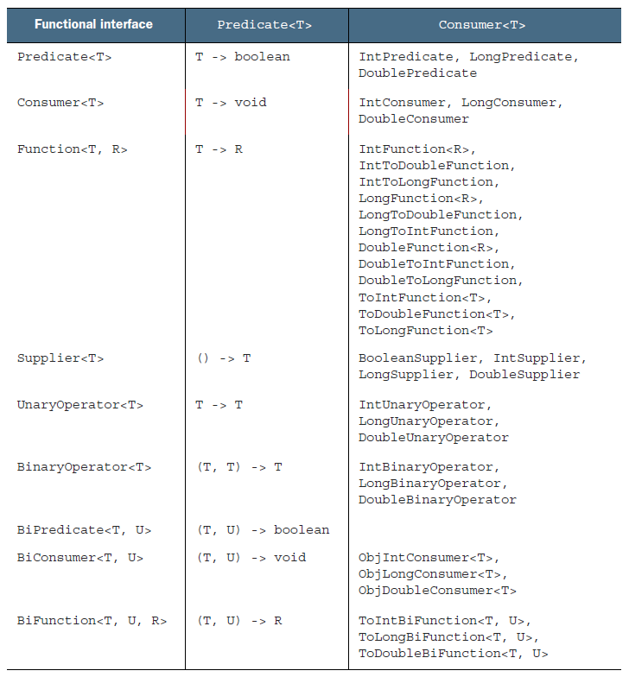
Functional Interfaces
TASKS
Runnable () -> void, run() CF: ➔ thenRun()
Consumer T -> void accept() CF: ➔ thenAccept()
Callable () -> T, call()
Supplier () -> T, get() CF: ➔ supplyAsync
Function T -> R, apply(), CF ➔ thenApply()
Callable is more specialized than Supplier. If you are not dealing with another thread or your task is very unlikely to throw an exception, Supplier is recommended.

Slide 7
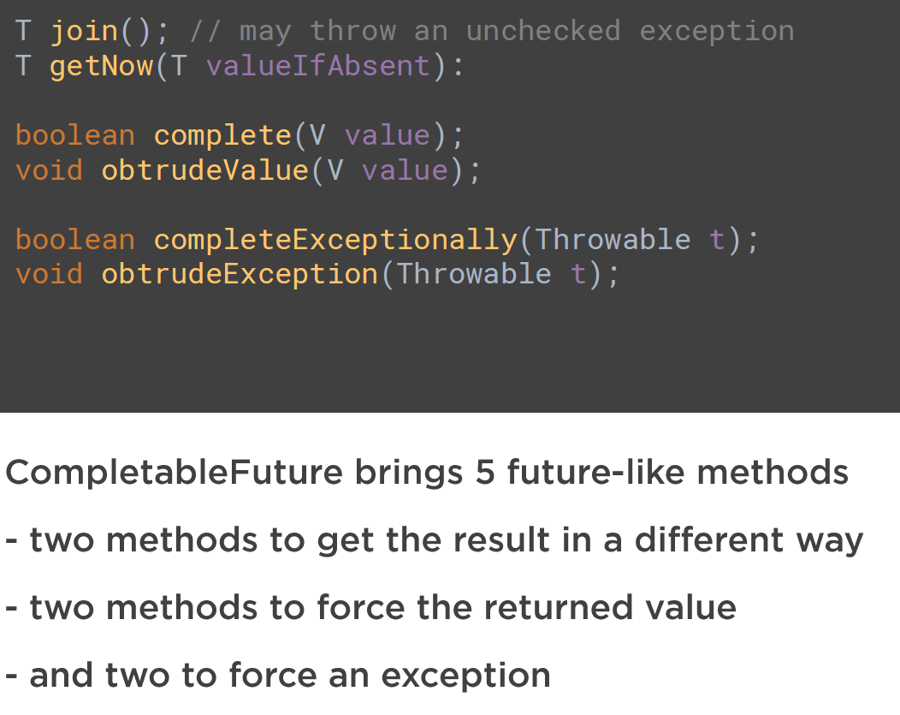
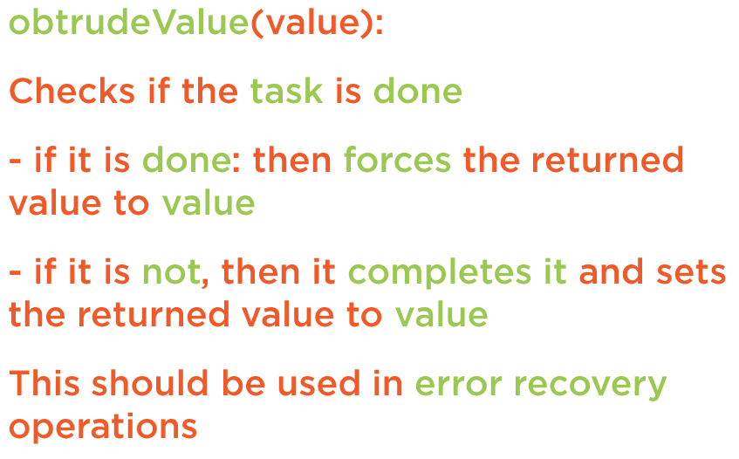
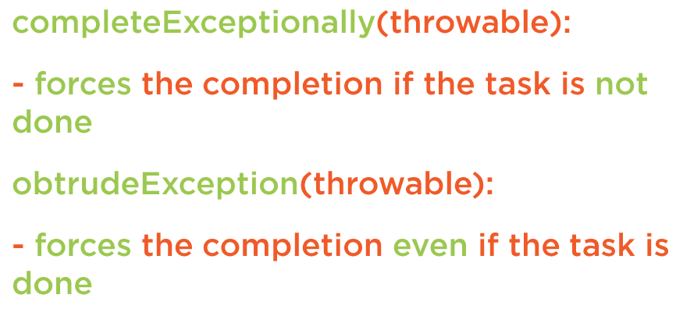

Slide 8
Completions (as a Simple Future or explicit): complete, obtrudeValue, get, join, getNow, completeExceptionally, ..
CompletableFuture with Encapsulated Computation Logic: runAsync(Runnable, ..), supplyAsync(Supplier, ..), completeAsync ***
Processing Results (attach callbacks): thenApply(Function), thenApplyAsync(), thenAccept(Consumer), thenRun(Runnable),
Manual completion: completedFuture, completeExceptionally, obtrudeException
cancel() is equivalent to completeExceptionally(new CancellationException()) , isCompletedExceptionally, idDone. It is not a bug, but a design decision.
Combining Futures(Consume PrevStageRes) thenCompose(Function), thenCombine(CS, ..), thenAcceptBoth(CS, .), acceptEither
(Monadic design pattern) Difference Between thenApply()[nested] and thenCompose(). Analogous to … map and flatMap
Running Multiple Futures in Parallel: allOf(CompletableFuture<?>... Cfs), anyOf, join
Handling Errors: exceptionally(e), handle(r,e). , whenComplete(Unlike handle) .
Async Methods – help to parallelize: ***, thenApplyAsync(), thenComposeAsync() [.. ThreadPoolExecutor, shutdownNow()],
JDK 12 CompletionStage new methods: exceptionallyAsync, exceptionallyCompose, exceptionallyComposeAsync
JDK 9 CompletableFuture API: New factory methods added, Support for delays and timeouts. Improved support for subclassing. So API comes with 8 new instance methods: newIncompleteFuture()[virtual constructor], copy()[defensive copying], minimalCompletionStage(), completeAsync()-2x, defaultExecutor(), orTimeout(), completeOnTimeout() [delay]
and 5 new static utility methods: delayedExecutor()-2x [delay - schedule CF], completedStage(), failedStage(), failedFuture()
In LSP Cobol: failedFuture(Java 9), completedFuture, complete, runAsync, supplyAsync, whenComplete, thenApply

Slide 9
References
https://medium.com/modern-mainframe/multithreading-in-java-vs-node-js-c558d59050c9
https://www.baeldung.com/java-completablefuture
https://github.com/vsilaev/tascalate-concurrent
https://dzone.com/articles/completablefuture-cant-be
https://www.nurkiewicz.com/2015/03/completablefuture-cant-be-interrupted.html
https://github.com/vsilaev/tascalate-concurrent
https://www.nurkiewicz.com/2014/05/interruptedexception-and-interrupting.html
https://www.jesperdj.com/2015/09/21/listen-to-the-future-with-google-guava/
https://dzone.com/articles/20-examples-of-using-javas-completablefuture
https://github.com/antlr/antlr4/pull/2610
https://docs.oracle.com/javase/tutorial/essential/concurrency/interrupt.html
https://codeahoy.com/java/How-To-Stop-Threads-Safely/
Source code:
https://github.com/asatklichov/multithreading-java-vs-nodejs

Slide 10

THANK YOU

