Slide 1

Taxi Management Database System Project Group Number : 5

Slide 2

INTRODUCTION
The taxi rental service market has developed significantly in recent years, driven by increased urbanization and rising
1. Database-Driven Efficiency: Implementing a database system to enhance operational efficiency across taxi booking, dispatch, monitoring, and invoicing processes.
2. Optimized Fleet Management: Streamlining the management of taxi fleets to ensure better utilization, maintenance, and allocation of resources.
3. Elevated Customer Experience: Focused on enhancing customer satisfaction by improving service quality and responsiveness through efficient management and booking systems.
4. Empowered Driver Management: Providing tools and systems for effective driver management, leading to better service delivery and driver satisfaction.
Ultimately, the goal is to revolutionize the taxi rental service industry by leveraging a sophisticated database management system, thus empowering service providers, enhancing customer experiences, and fostering operational excellence amid intense market competition.

Slide 3
DESIGN DECISIONS
For fleet management: We have defined a group of entities for Vehicle, Service Record, and Insurance. The data stored in these entities will help us determine the condition of all vehicles in our fleet, The due dates for their service appointments as well as expiry dates on their insurances. This will assist the management into having a well-oiled operation.
For Customer satisfaction: To ensure customer satisfaction we have defined a feedback entity. This entity will store data like the particulars of the trip, who the driver was, and what rating was given to the driver by the customer. A database constraint could be added that a driver should maintain a certain satisfaction rating to continue driving with the company.
For Driver management: To better manage drivers we have defined a driver’s entity and have them mapped in relationships with trips and vehicles. This will give us real time tracking as to where the driver currently is, and which trip the driver is currently completing. As we also have feedback from customers this will help us hold the drivers accountable for their quality of service. We could potentially use the feedback to decide on bonuses and rewards for the drivers thus boosting the motivations.

Slide 4
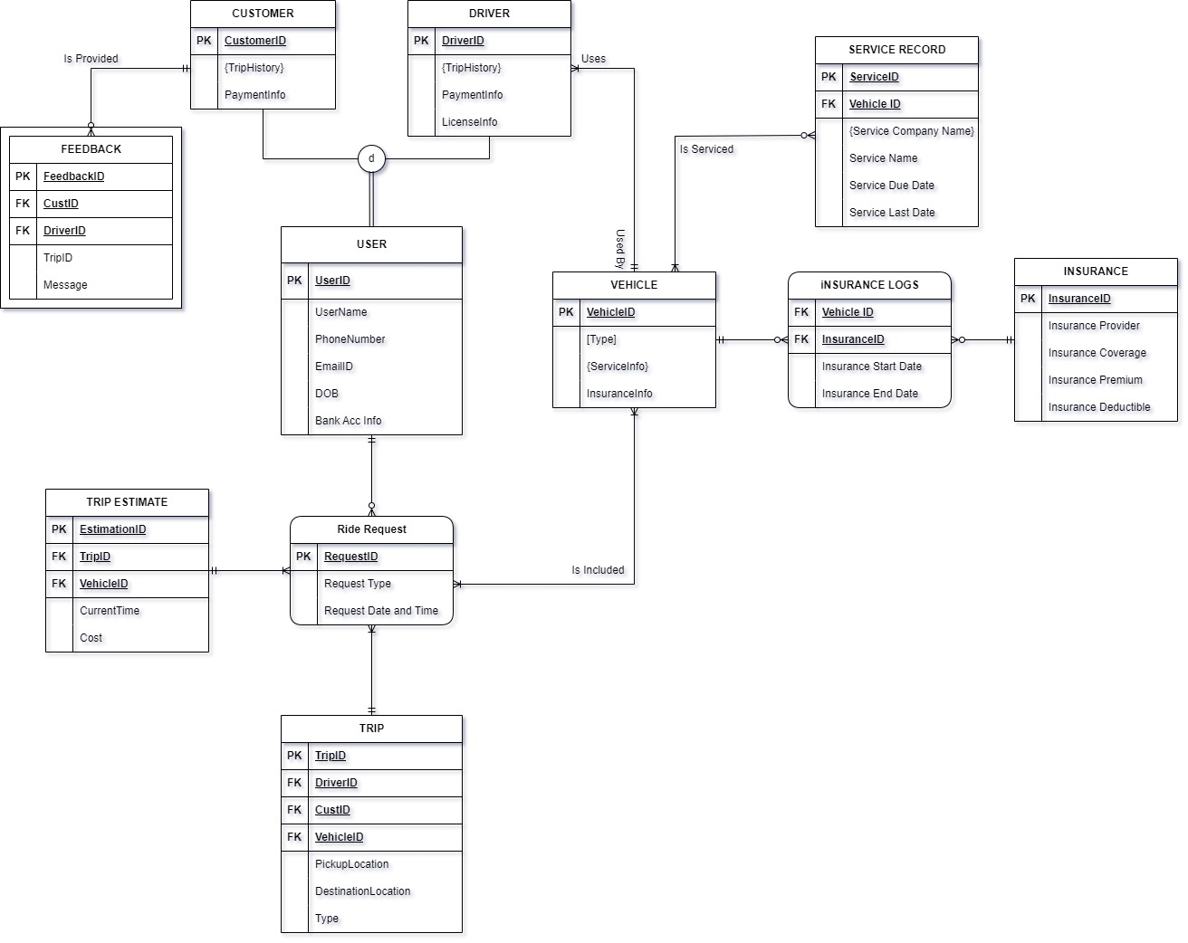
ERD

Slide 5
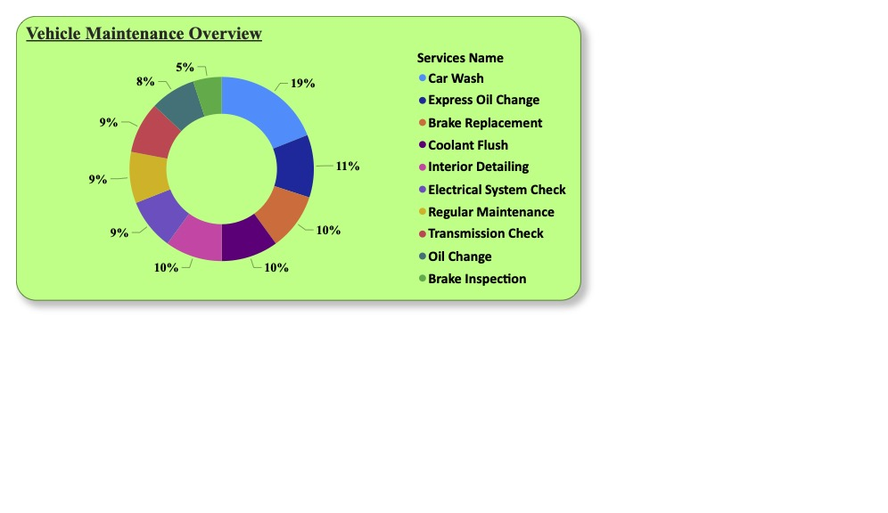
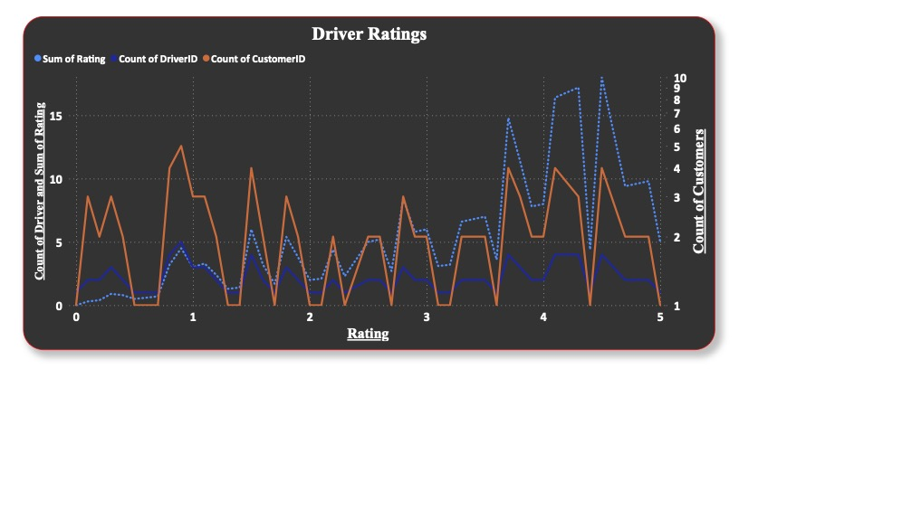
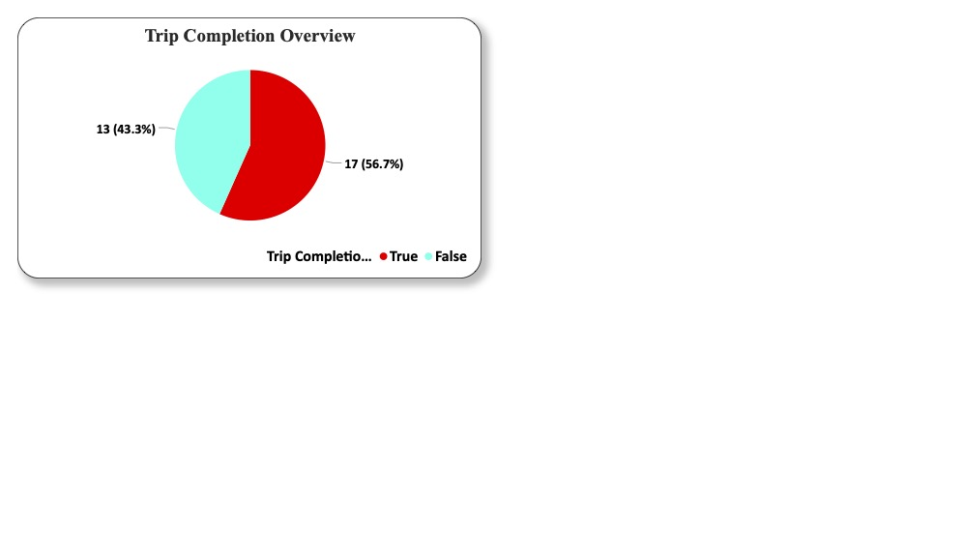
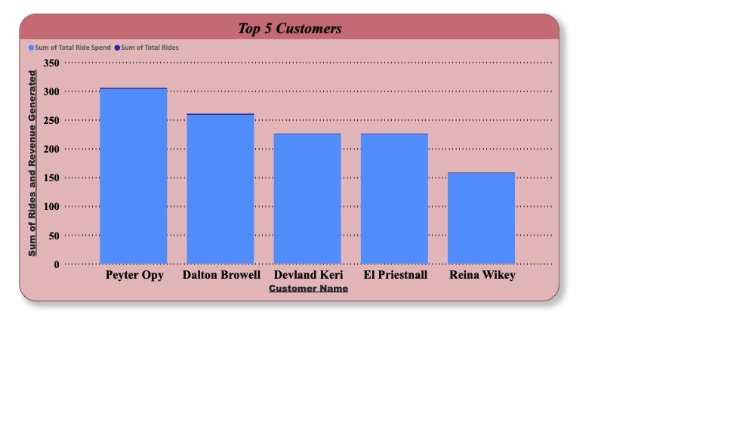
DASHBOARD

Slide 6
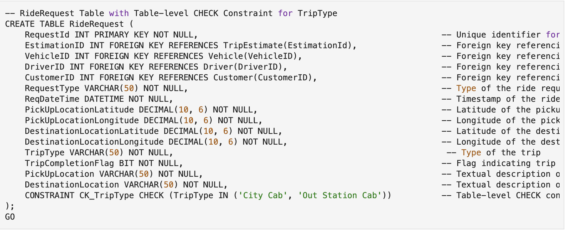
Sample Data Definition Scripts
To create the ride request table the following DDL script can be used.

Slide 7
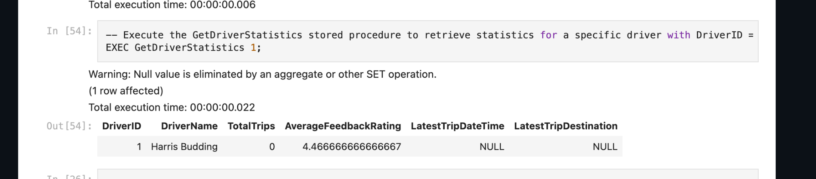
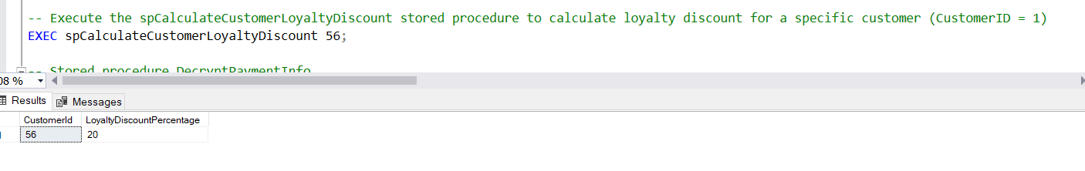
Stored Procedures
GetDriverStatistics
CalculateCustomerLoyaltyDiscount

Slide 8
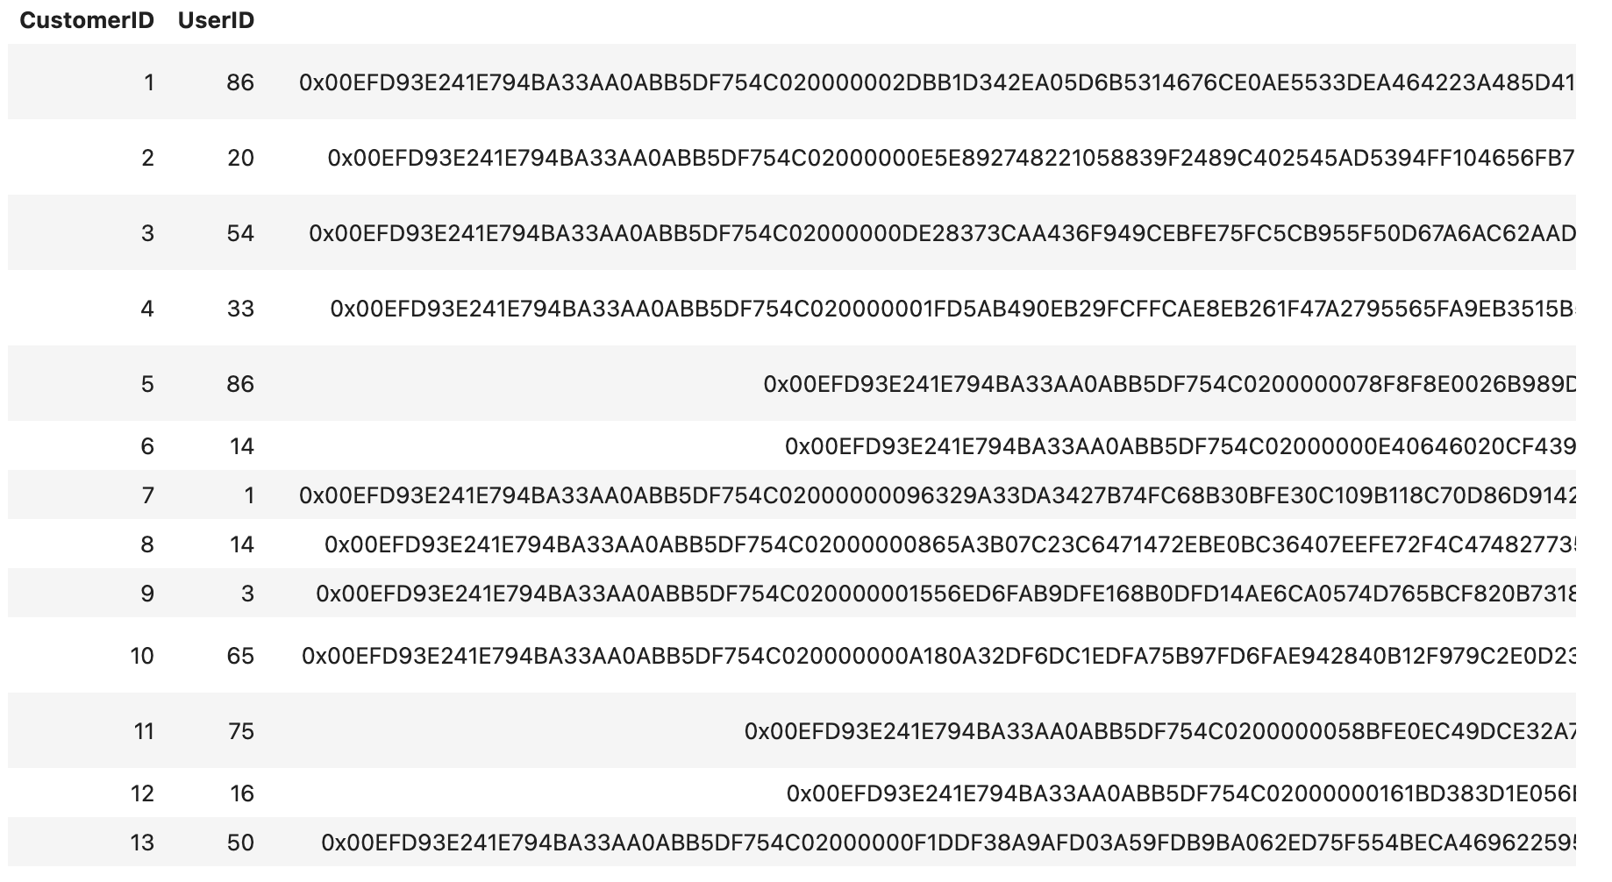
Trigger
Trigger is introduced to encrypt the payment info column of the Customer Table.

Slide 9
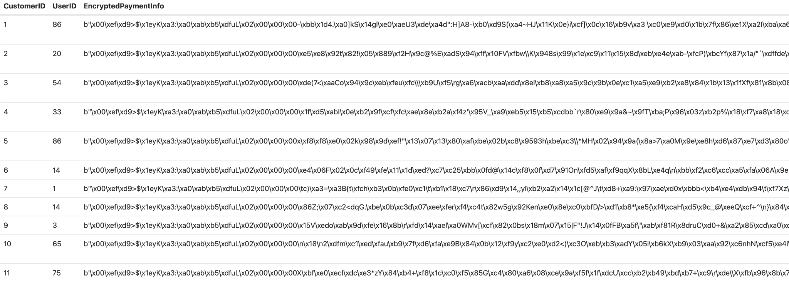
GUI
We have developed a functional GUI using flask and python that helps us read data from all the tables.

Slide 10

Give Tips to drivers after completing the ride.
Introduce surge pricing according to user categories.(UDF column)
FUTURE PROSPECTS
README.md

