Slide 1


From Capability to Competitive Advantage
Why IT Still Falls Short
Team C | ISYS 814 | Dr. Niel Shahrasbi
San Francisco State University
May 2026

Slide 2
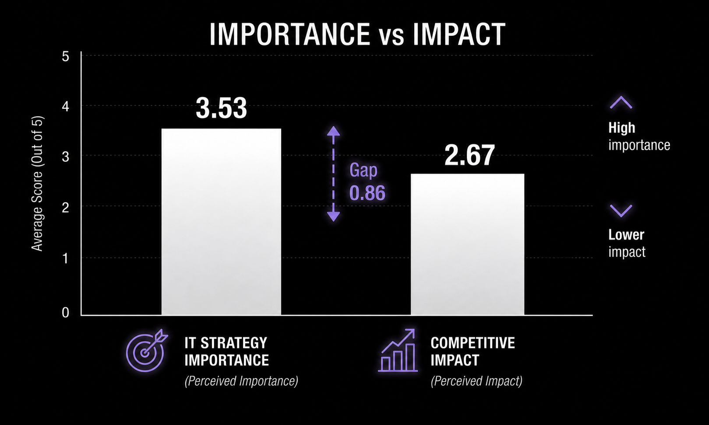

Slide 3
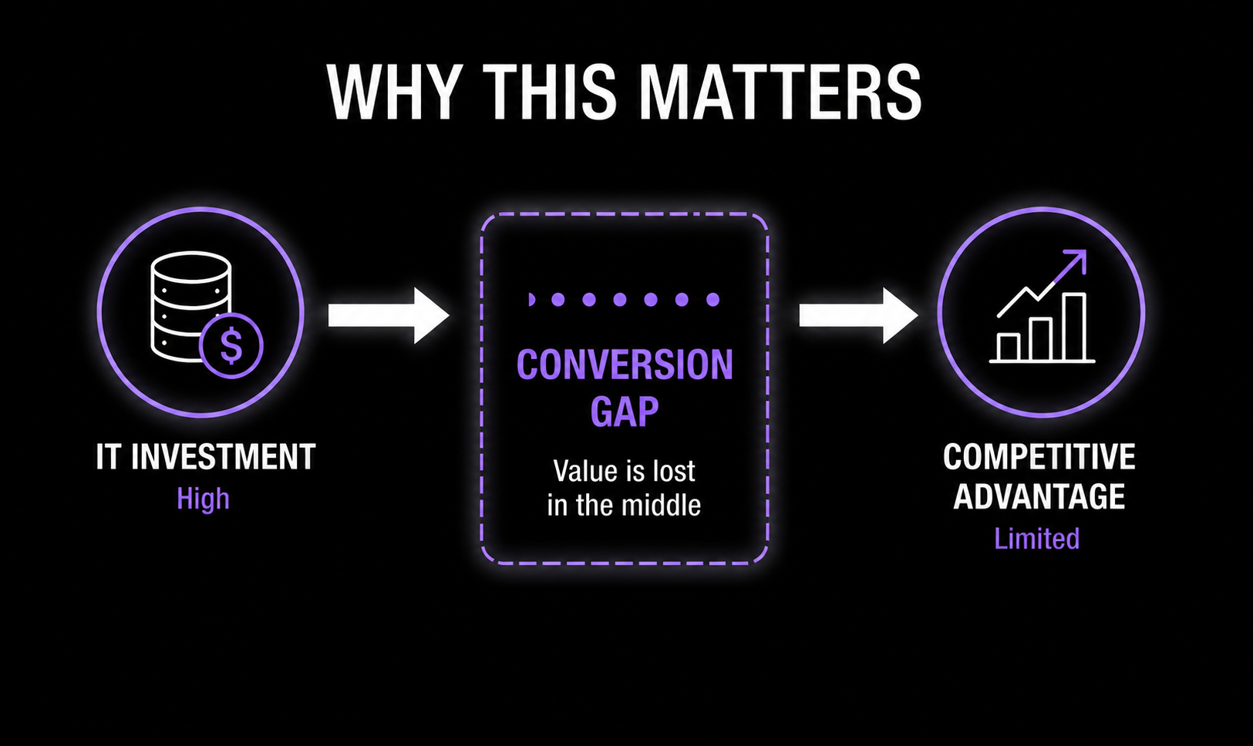

Slide 4
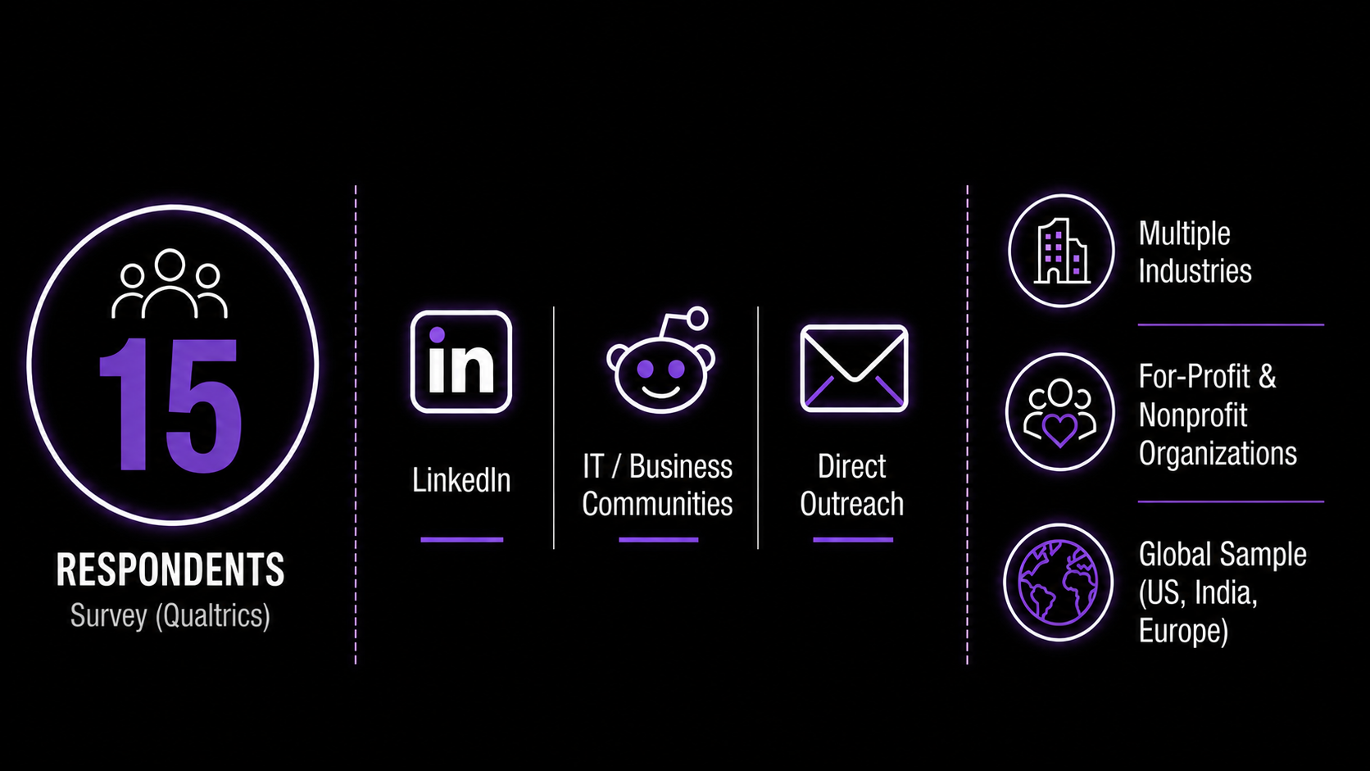
Data Collection

Slide 5
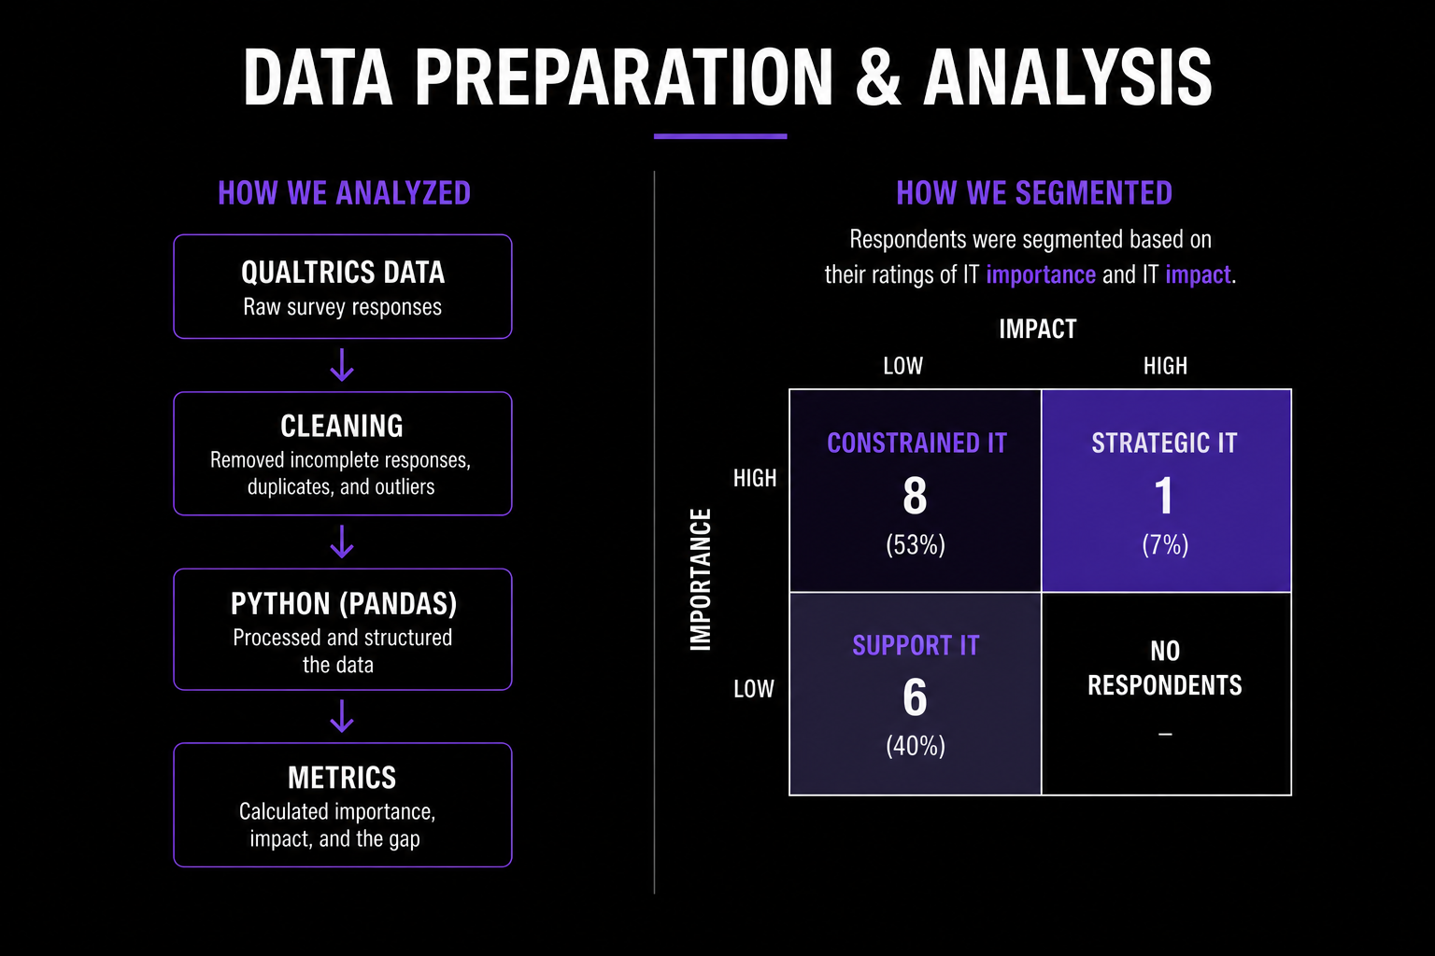

Slide 6
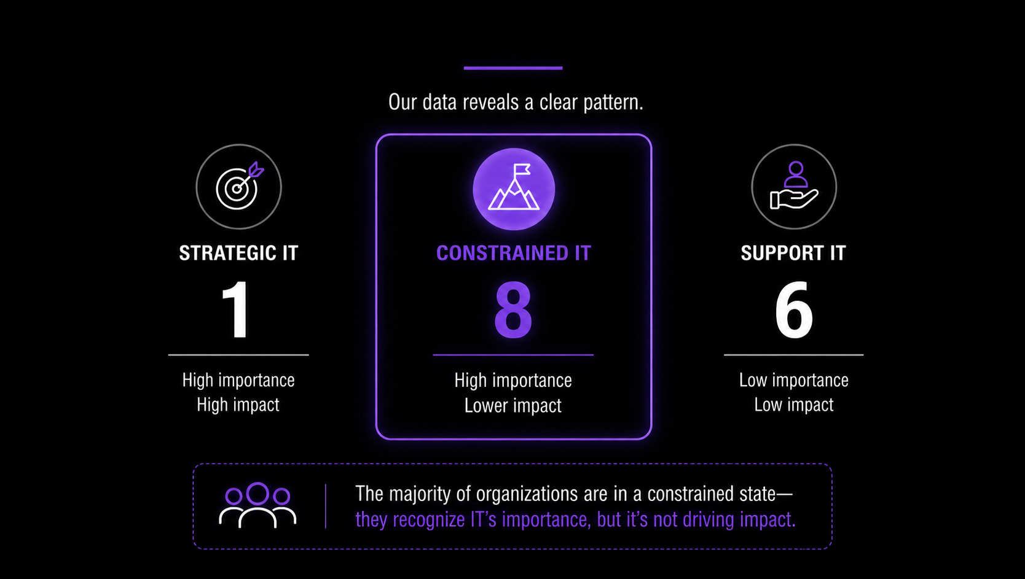
Most organizations are constrained

Slide 7
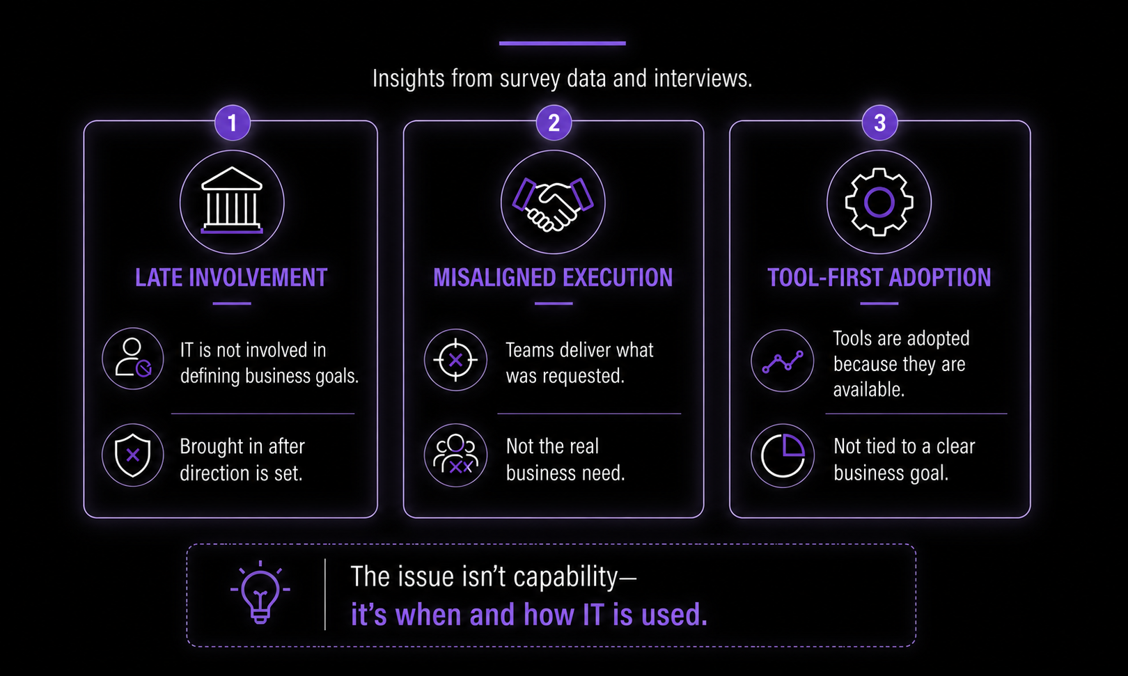
What’s holding it back

Slide 8
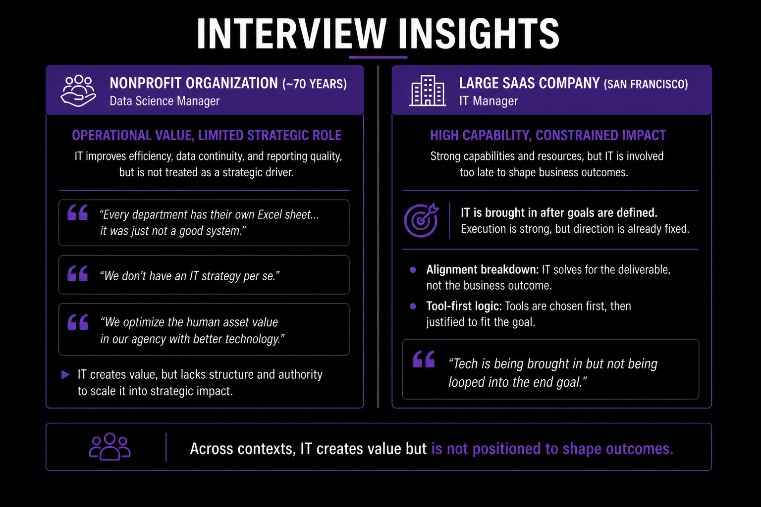

Slide 9
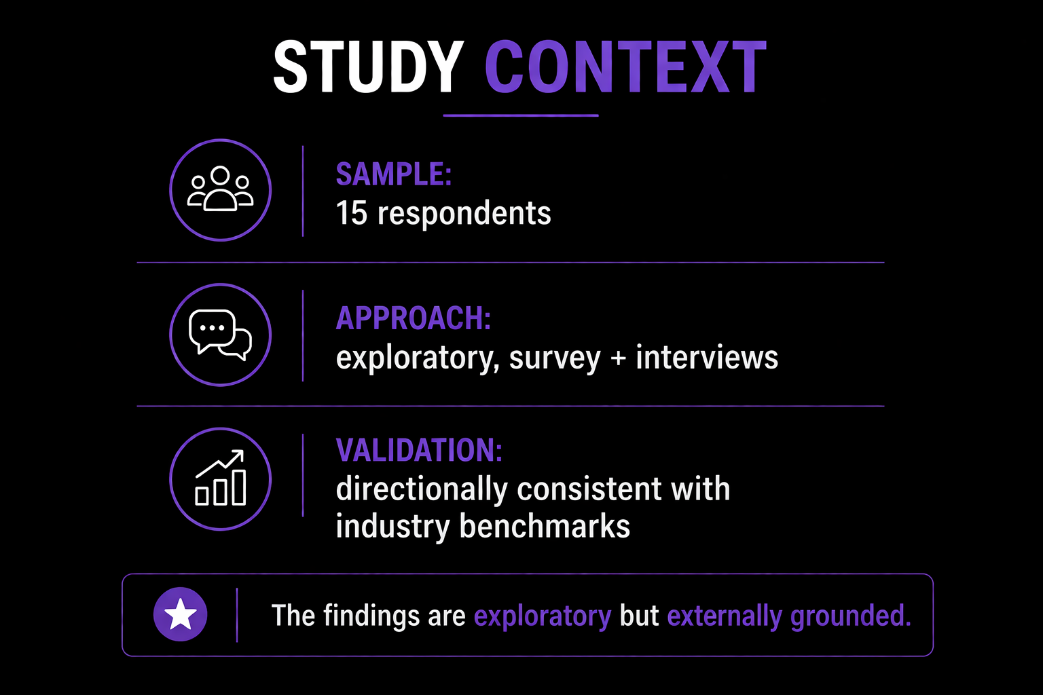

Slide 10
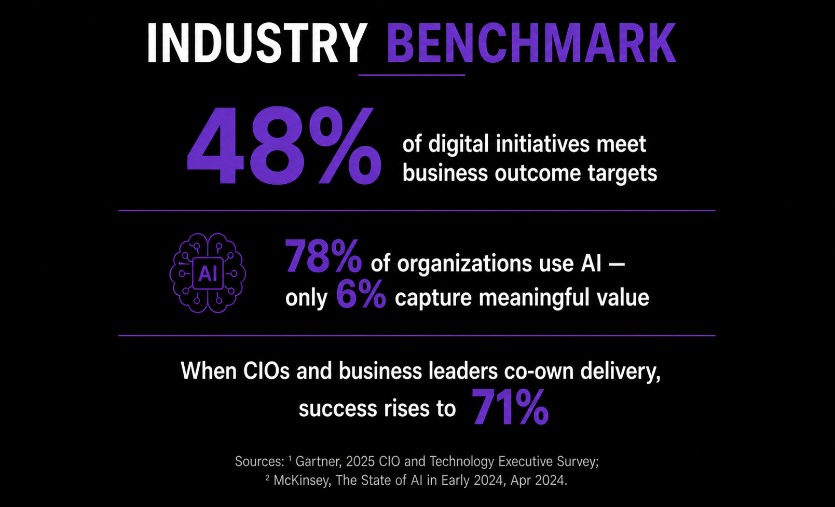

Slide 11
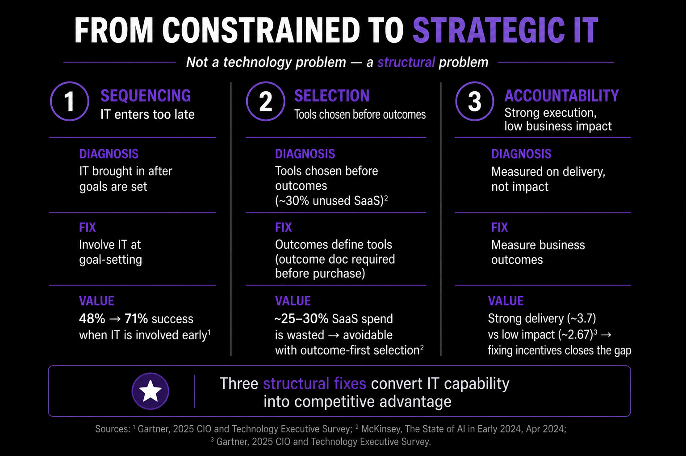

Slide 12


