Slide 1
bfinal-project
Network diagram..

Slide 2
MY NAME IS ABHISHEK SAVALIYA
hello good evening thank you for giving me this opportunity to represent the network diagram over here .

Slide 3

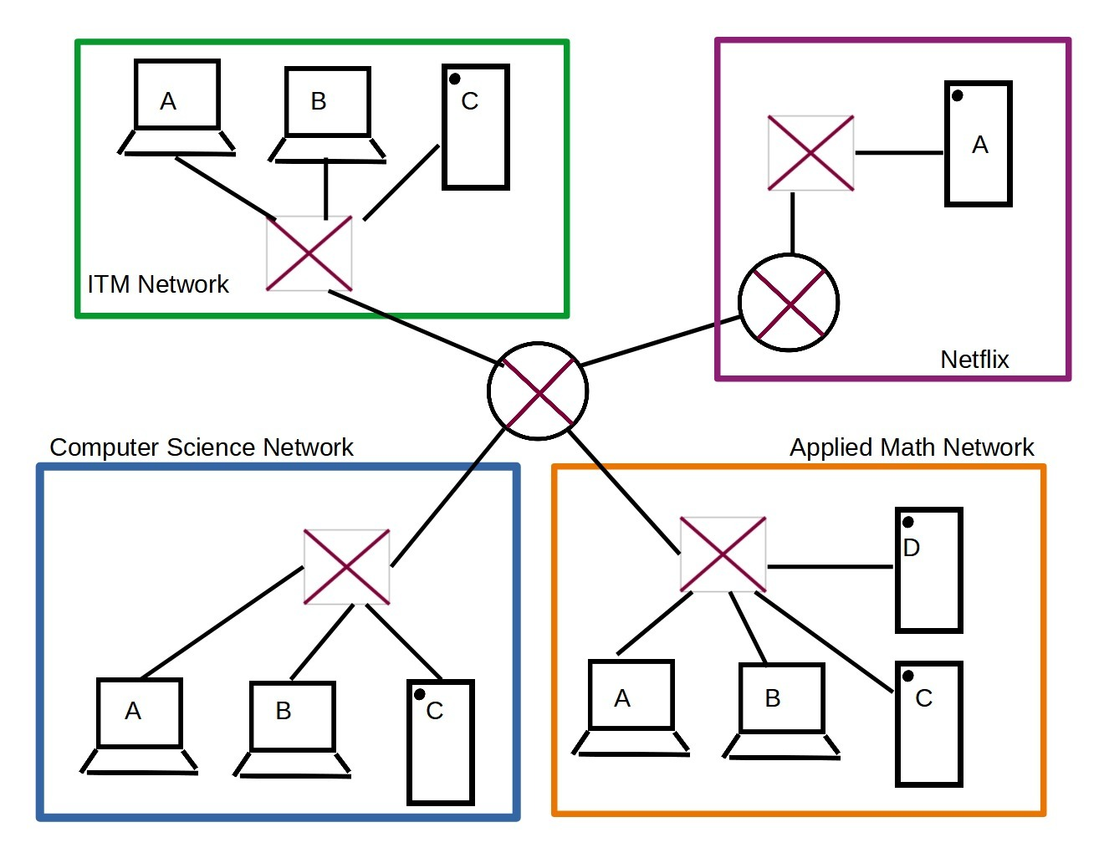
I will elaborate as per my knowledge here we can see that there is a three local area networks which is represent into the color of the blue green and the orange

Slide 4
All the equipment or the peripheral devices which is connected through the switches. and the all the different three LAN which is connected to the the router so router we can see into the middle one and from the top right of the corner,

Slide 5
It shows like it's the main router connected to the internet which is shows like the Netflix to access to the Netflix so all the three local area network users connected why the router and they connected to access the Netflix for the

Slide 6
Another Network so we can call like that is the local area and network connected to the internet this diagram is represent these Network.

Slide 7
Thank-You;

