Slide 1
extern "C" __declspec(dllexport)
LPXLOPER12 xSumForName(LPXLOPER12 tab, LPXLOPER12 xName)
extern "C" __declspec(dllexport)
double xSumForName(LPXLOPER12 tab, LPXLOPER12 xName)
Q
Q
Q
B
Q
Q
BK%B
Return type Number, hence B
Second argument type Number, hence B
First argument type Range, hence K%
extern "C" __declspec(dllexport)
double xRangeFunc(FP12* matrix, double scalar)
B
K%
B

Slide 2

Row 1
Row 2
Row 3

Slide 3
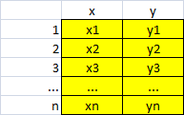

Slide 4
