Slide 1

Predictive sp500 LSTM model using walk-forward approach
Rafał Kraszek

Slide 2
Introduction
LSTM regression model on S&P 500 (SPX) returns:
Ranging from 1988-01-01 to 2023-10-30, split into:
2 year training subsets
1 year validation set
1 year out-of-sample test set
Frequency: daily
Used adjusted close prices to calculate daily returns
Data was min-max scaled

Slide 3
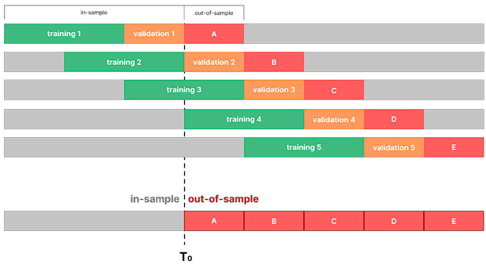
Walk-forward approach
Source: Baranochnikov I. and Ślepaczuk R., 2022

Slide 4
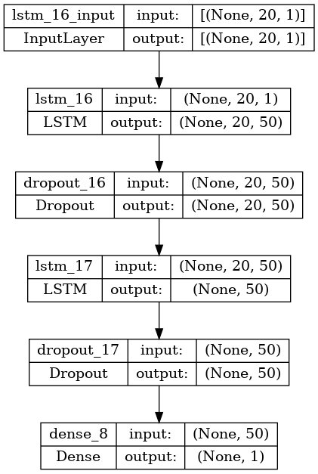
Model specification
Input: 20 previous daily returns (parametrized)
Output: today's forecasted return
Loss: MSE
Optimizer: ADAM
Learning rate: 0.001
Dropout: 0.2
Batch size: 32
10 epochs per timeframe

Slide 5
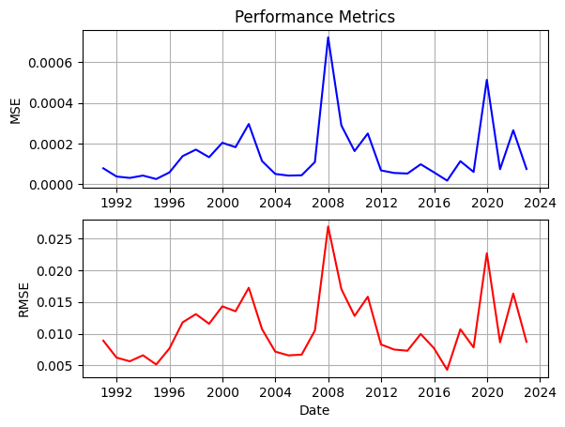
Training results

Slide 6
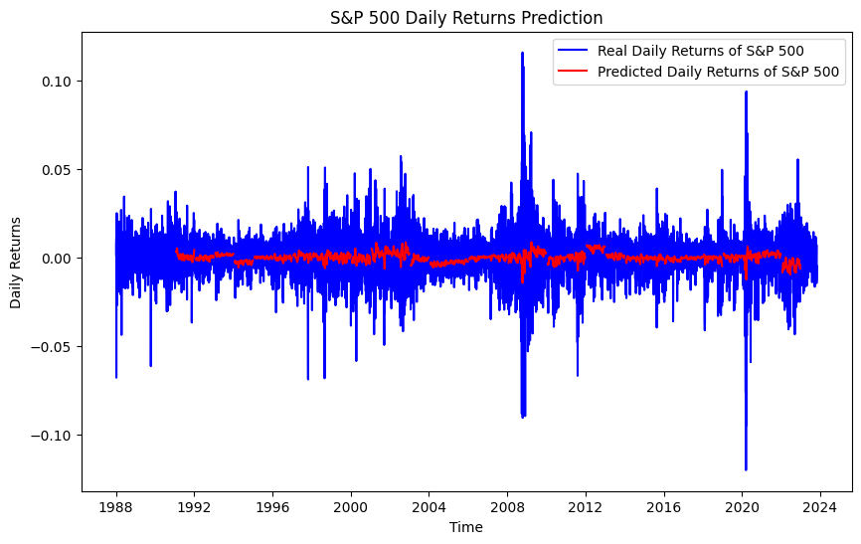
Training results

Slide 7
Simulation
Simulated the trading strategy based on the buy and sell signals with the following assumptions:
Buy & Sell at close prices
Transaction fees = 0.05%
Starting capital = 100k USD
Benchmark: Buy&Hold S&P500
Strategy signal: If the forecasted return is positive, go long, short otherwise. Hold position until the signal reverses

Slide 8
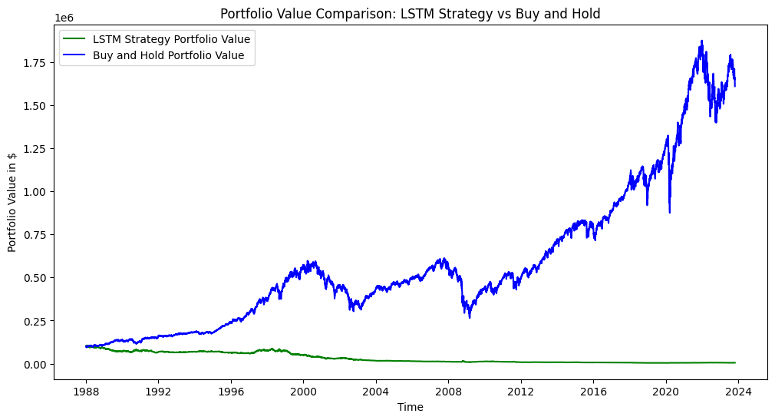
Simulation results

Slide 9
Simulation results
 | LSTM Strategy | Buy and Hold
Annualized Return Compounded | -0.077187 | 0.080342
Annualized Standard Dev. | 0.180380 | 0.180306
Sharpe Ratio | -0.678495 | 0.194900
Information Ratio | -0.033729 | N/A

Slide 10
Conclusions
The model cannot outperform the benchmark in its current form
Some improvements can be done:
Add more features to the model
Hyperparameter tuining
Different approach: Combine LSTM with a conventional highly performant strategy, train toward a different objective (classification, strategy evaluation)

Slide 11
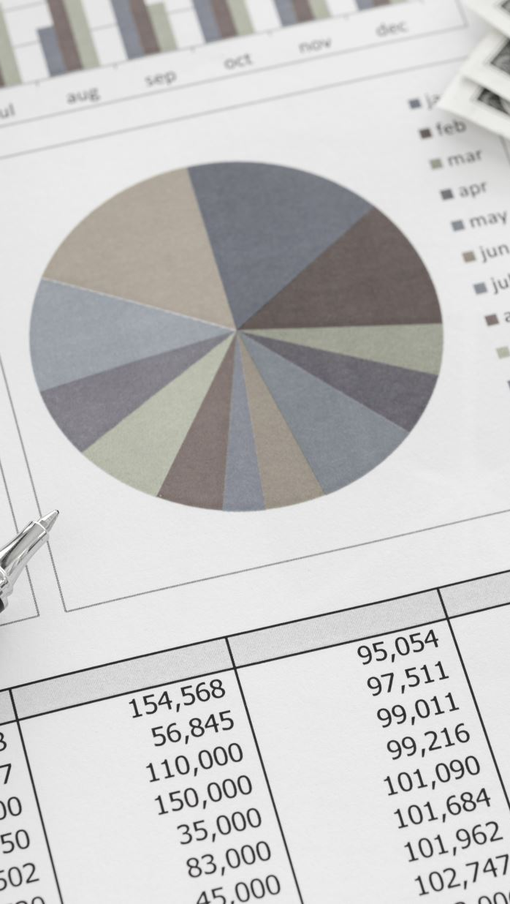
Sources
Kryńska K., Ślepaczuk R., 2022, Daily and intraday application of various architectures of the LSTM model in algorithmic investment strategies on Bitcoin and the S&P 500 Index, Working Papers of Faculty of Economic Sciences, University of Warsaw, WP 25/2022 (401), https://papers.ssrn.com/sol3/papers.cfm?abstract_id=4628806
Baranochnikov I. Ślepaczuk R., 2022, A comparison of LSTM and GRU architectures with novel walk-forward approach to algorithmic investment strategy, Working Papers of Faculty of Economic Sciences, University of Warsaw, WP 21/2022 (397), https://papers.ssrn.com/sol3/papers.cfm?abstract_id=4628576

