Slide 1
Understanding Servers
IT4GIS
Keith T. Weber, GISP
GIS Director
ISU-GIS Training and Research Center
Notes:
First, we need to make sure everyone knows this terminology:
Client
Host

Slide 2
What is a server?
Desktop
Workstation
Server
Notes:
An initial difference is the software or rather the operating system installed on it.
The next difference is the functional role of the computer

Slide 3
Functional Roles
Data Storage
Application Host
GeoProcessing
Spatial Data Management
Website Host
E-mail
Notes:
In GIS and in this class, we will focus on the first three. The last (e-mail) is not a role for a GIS server.
Data storage AKA File Server

Slide 4
Data Storage
The role of hardware
NAS (network attached storage)
SAN (storage area network)
DAS (direct attached storage)
[other]
Your role
Delete unnecessary data
Apply best data type to each attribute (tables) and raster file format/pixel depth)
Grid or GeoTIFF?
Notes:
Terminology: Network attached storage and storage area network
NAS: Network Attached Storage (NAS) generally refers to storage devices that can be attached to existing corporate networks. Sending storage data over the company network can seriously slow network speeds, which will affect applications such as e-mail and Internet access. SAN: Storage Area Network (SAN) A network built exclusively for storage devices, servers, backup systems and so forth. SANs can handle heavy bandwidth demands of storage data and segregate storage traffic to a network built specifically for storage needs.
A Storage Area Network (SAN) seeks to solve problems associated with sending storage data over regular networks by building a separate network just for storage devices, servers, backup systems and so forth. It can handle the heavy bandwidth demands of storage data and segregates storage traffic to a network built specifically for storage needs. However, SANs are both expensive and complicated to construct.

Slide 5
Data Storage: Fault Tolerance
RAID=Redundant Array of Inexpensive Disks
Hardware or software implementation
Level 0,1,5,10
Minimum four disks on server
Hard disk types
SCSI, IDE, etc.
Hot-swappable
Notes:
Goals: increased reliability and increased performance.
Hardware: greater performance gains, more expensive, increased reliability
Software: slower with little performance gain, less expensive, easier and more flexible.
RAID levels:
Parity: data redundancy
Striping: writing a data file across >1 disk
Mirroring: copying data in >1 location. Not the same as parity, since parity is one operation.
0=striping
1=mirroring or duplexing
5=striping with parity
10=raid 0 (striping w/o parity) using raid 1 disk set up (mirroring to a shadow drive).
Number of disks:
RAID 5 requires 3 drives at a minimum, plus one system drive.
Others require two disks plus one system
Do not fall into the logical drive trap. Config >1 logical drive on one physical drive then apply software RAID 0 or 1. There is no fault tolerance or performance gain here!
To truly take advantage of hardware RAID 5 –and maintain level of service (99.999%)-- you need hot-swappable drives. These must be SCSI.

Slide 6
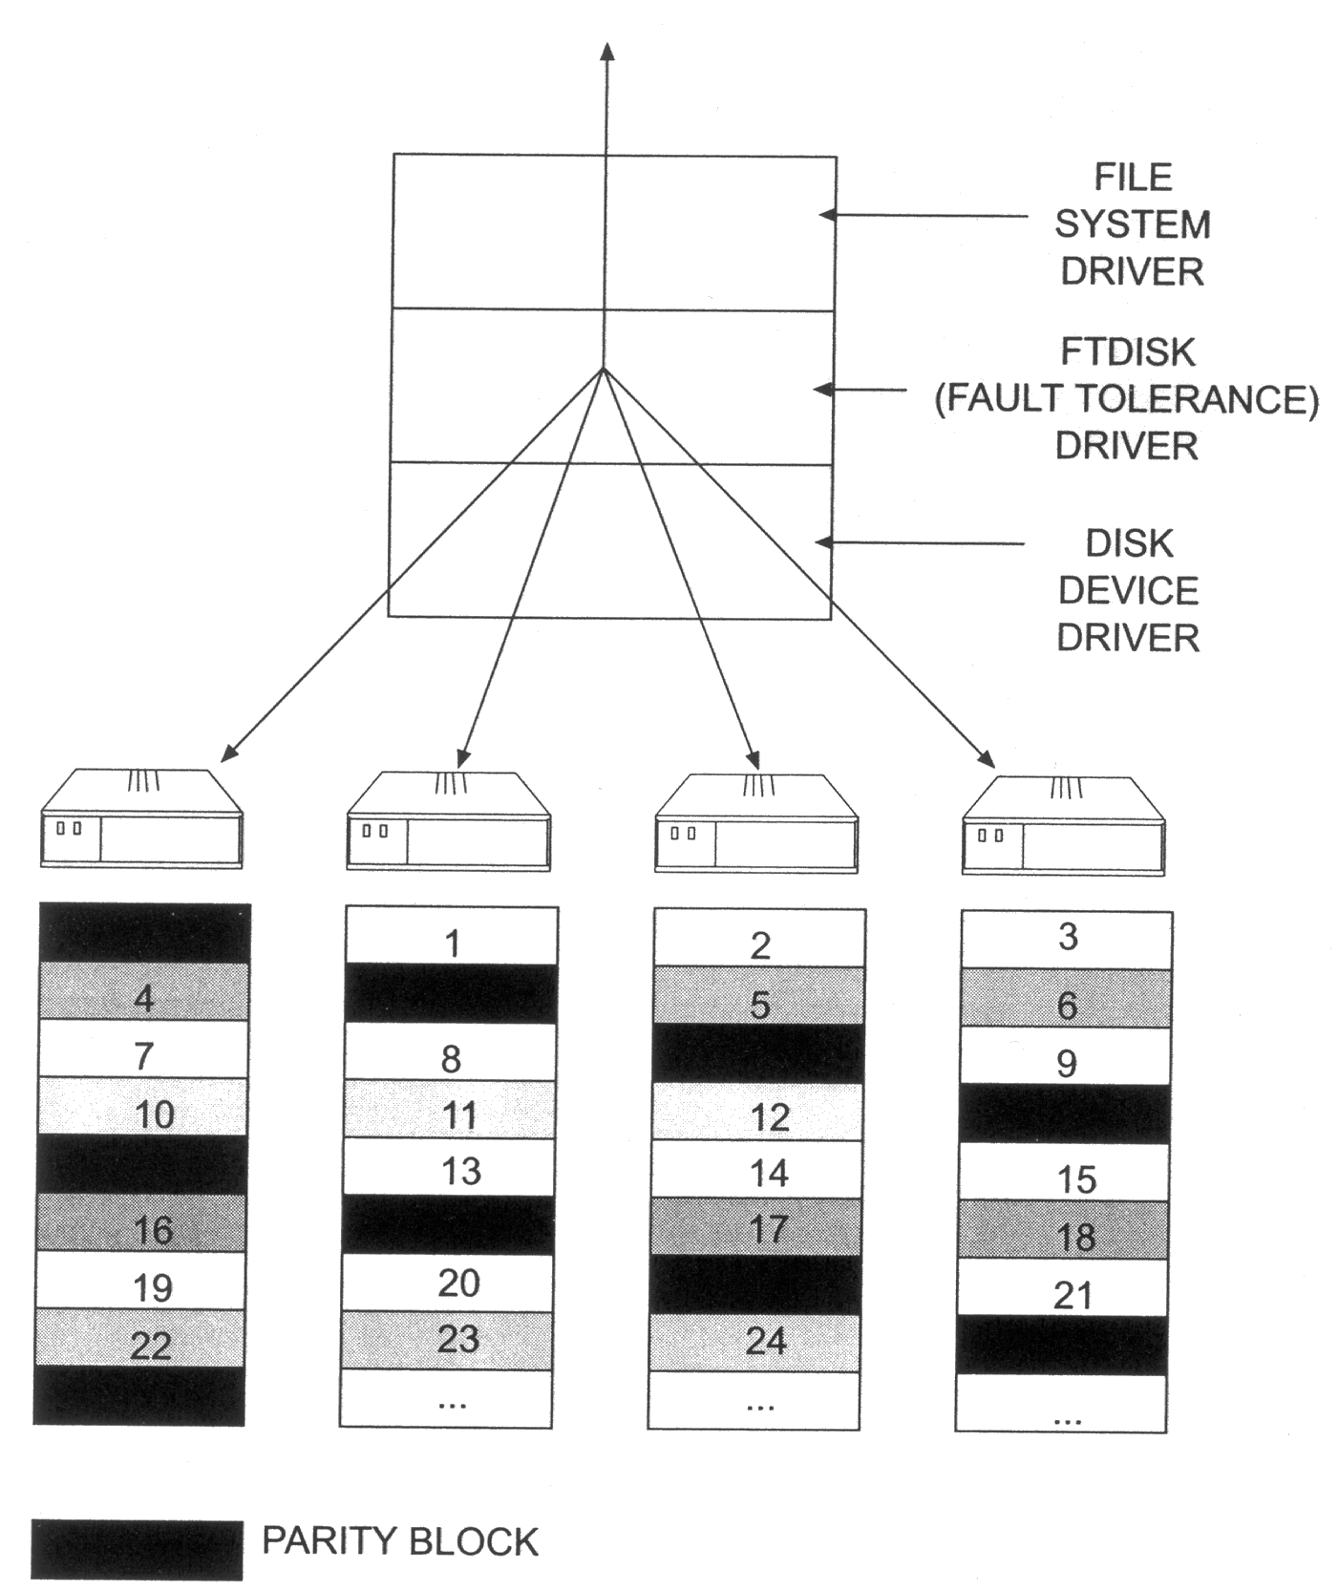
Data Storage: The Way Fault Tolerance Works!
6
6
Notes:
RAID 5 fault tol and how the parity functions.

Slide 7
Data Storage: RAID and RAIS
Redundant Array of Inexpensive Disks
Redundant Array of Inexpensive Servers

Slide 8
Hints and Tips: The 5-nines
99.999% of the time…
Servers are operational and functioning
How much down-time does this allow?
5 minutes!
No longer even a goal!
Why?

Slide 9
Application Host
GIS software-host server (application server)
GIS software license server
Notes:
Software host server:
advantage- one installation, reduced maintenance and re-installations
Disadvantage- high server hit (cost), more network congestion, can run slower
License server:
Advantage: one initial installation. Clients install from your install
Disadvantage: clients are responsible for actual software installation/maintenance

Slide 10
GeoProcessing
ArcGIS for Server software resides on server with GeoProcessing Services running
Clients have the desktop or workstation application installed
Large tasks are processed by the server via web interface
Can more fully utilize available processors and RAM

Slide 11
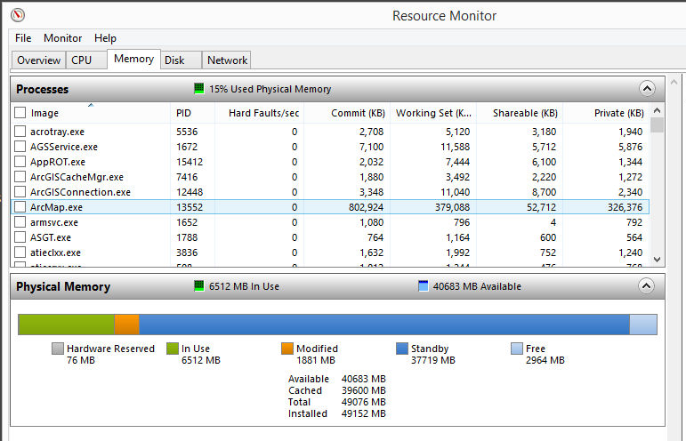
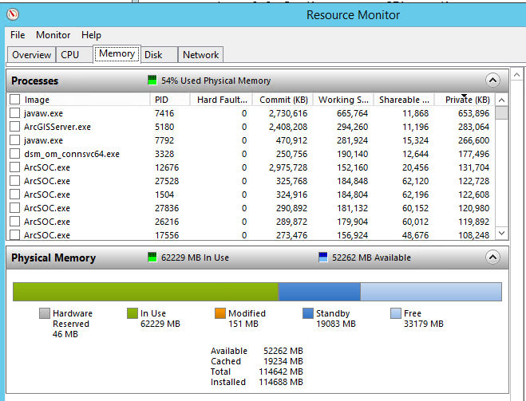
Why are Servers Faster?
More RAM and more CPU cores (yes)
But more importantly, a different architecture in RAM and CPU usage/allocation

Slide 12
GPU Processing
Graphical Processing Units
nVidia leads, but it all started with the demand for smooth video rendering by the gaming industry
Graphics cards and processing
Processing graphics is an intensive FLoating-point OPeration (FLOP) that must be done quickly
Geoprocessing can also be an intensive FLOP (but does not need to be done quite so fast)
In some cases, a server will not be faster if a good graphics card is not available

Slide 13
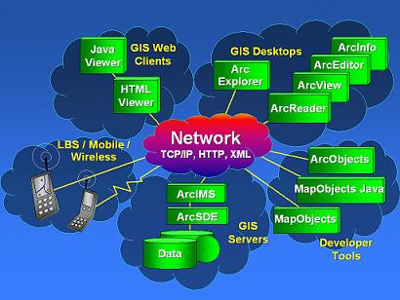
Spatial Data Management
SDE=Spatial Database Engine
Requires DBMS
ArcSDE
Spatial library organized with a RDBMS

Slide 14
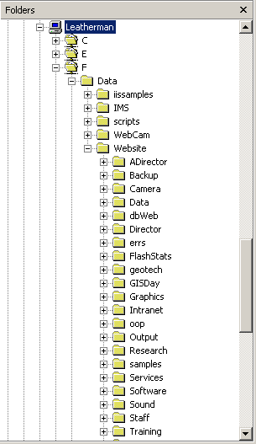
Web Server
IIS
Overview of structure on host server
Client access (https://giscenter.isu.edu)
ArcGIS for Server
Serving maps
Notes:
Internet Information Server:
Drive:\data\website\homepage.htm (default pages…index.htm)
Clients: http://www.yourwebsite.com/homepage.htm
Internet Map Server:
Project files should reside outside the website folder…pseudo firewall.

Slide 15
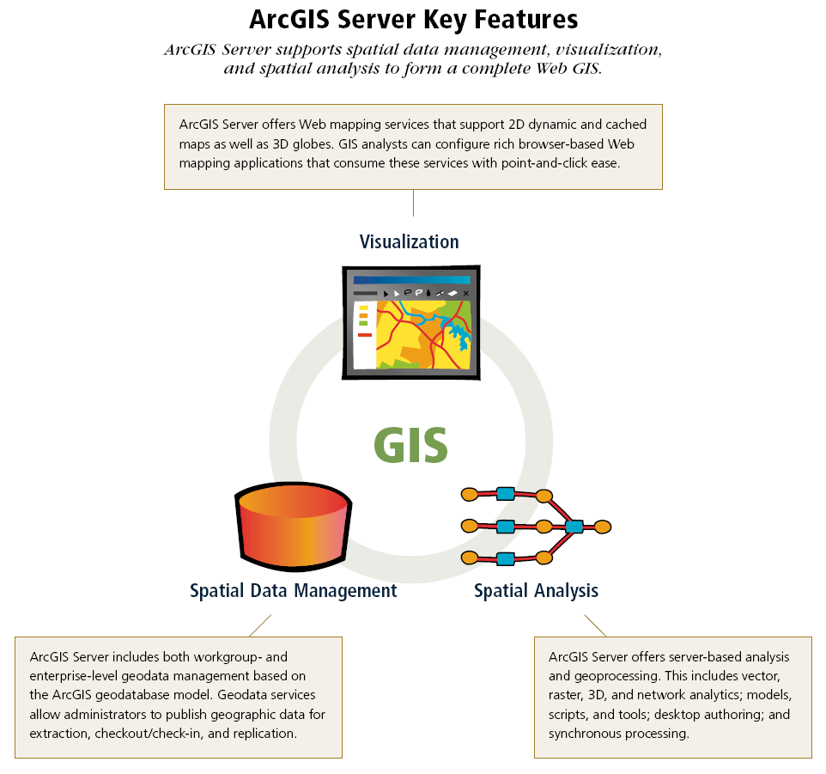
ArcGIS for Server
Compliments SDE by serving GeoData services
Includes Web Services as the next generation web map server
Provides Geo-Processing capabilities even through the Web!
Notes:
This combines and performs several of the tasks in an integrated fashion.

Slide 16
Types of Server Hardware
Glorified desktops
Standard Rack-based
Blade
Rack based, but not limited to 42 Units
Can contain more than CPUs
ISU’s Research Data Center (RDC)
Notes:
Contain A/C units as part of the blade, etc.

Slide 17
Professional Tips
Data folder for clients
Data liability policy
Use of Temp folders
System Administration:
Do not allow write access from remote clients anywhere on your system!
Security
Web access is principal security threat
FTP is a primary avenue for intrusion
Dynamic IP addressing
Notes:
Freedom vs. security
Graphics file location…admin purposes
What is FTP?
FTP refers to the File Transfer Protocol [1], one of the protocols within the TCP/IP protocol suite used on the Internet. The File Transfer Protocol makes it possible to transfer files from one computer (or host) on the Internet to another. There are many FTP implementations built on the specification of the FTP protocol. A user of an FTP program must log in to both hosts in order to transfer a file from one to the other.
It is common for a user with files on more than one host to use the FTP program to transfer files from one host to another. In this case, the user has an account on both hosts involved, so he has passwords for both hosts.
However, Internet users may also take advantage of a wealth of information available from archive sites by using a general purpose account called "anonymous FTP".
What is an Archive Site?
An archive site is a host that acts as a repository of information, much like a conventional library. Information stored on these Internet hosts is made available for users to transfer to their local sites. Users run software to identify this information and transfer it to their own hosts. Such a transfer is done with a program that implements the File Transfer Protocol (FTP).
What is Anonymous FTP?
Anonymous FTP is a means by which archive sites allow general access to their archives of information. These sites create a special account called "anonymous". User "anonymous" has limited access rights to the archive host, as well as some operating restrictions. In fact, the only operations allowed are logging in using FTP, listing the contents of a limited set of directories, and retrieving files. Some sites limit the contents of a directory listing an anonymous user can see as well. Note that "anonymous" users are not usually allowed to transfer files TO the archive site, but can only retrieve files from such a site.
Traditionally, this special anonymous user account accepts any string as a password, although it is common to use either the password "guest" or one's electronic mail (e-mail) address. Some archive sites now explicitly ask for the user's e-mail address and will not allow login with the "guest" password. Providing an e-mail address is a courtesy that allows archive site operators to get some idea of who is using their services.
Write access. Deleting is a write operation.

Slide 18
Applying Security to Your Server
Reactive:
TCP/IP exclusion
Proactive
Service packs
Updating anti-virus dictionaries
Disabling and uninstalling FTP
Firewalls
Notes:
Include/exclude by IP address
Discuss

Slide 19
Security (cont’d)
Backup your data
Mission critical
Critical
Non-critical data
Difference between Backup and Archive
Notes:
Differentiating criticality of data will be discussed later in class. For now, I just want to throw that idea or concept out to you.
Back up is very important. We will detail this later in class as well.

Slide 20

Key Concepts
A server is best defined by its Functional Role.
You should now know several roles for GIS servers.
Fault tolerance addresses data integrity (information assurance).
Proactive security measure address data security.

Slide 21
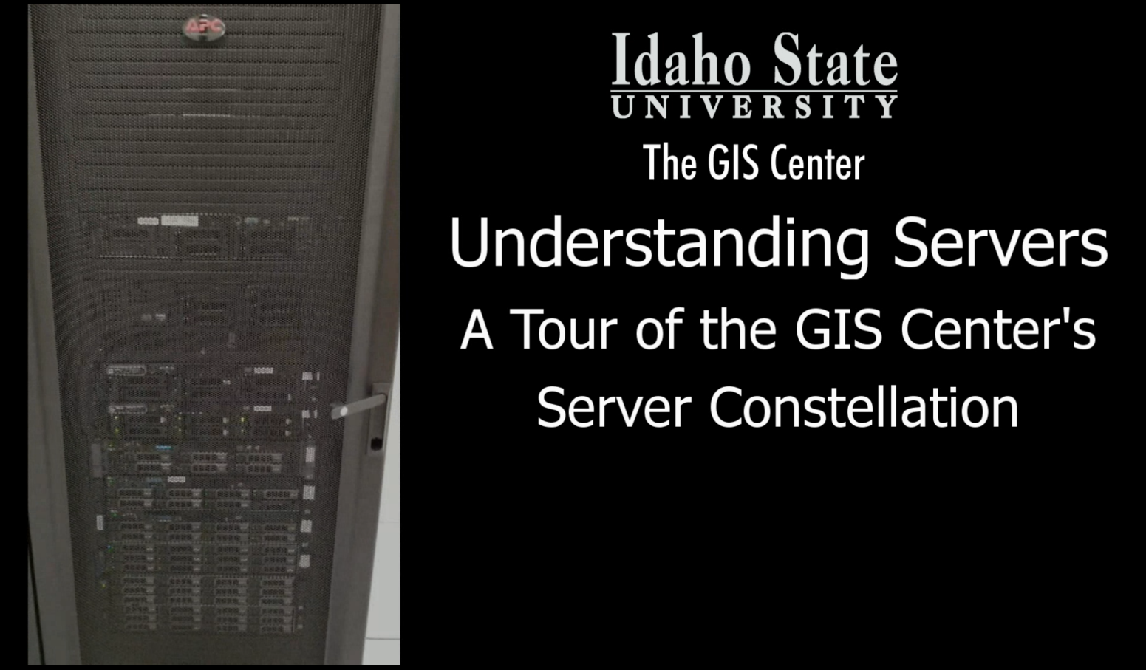
A Tour of the Server Room (in under 2 minutes)

Slide 22
Keep the Servers Cool
Cool aisle and hot aisle approach
Liquid cooling (e.g., INL C3)
Better approach but much more expensive
ROI good on larger data centers (INL C3)
ROI poor on smaller data centers (ISU RDC)

Slide 23
Professional Hints and Tips
Email is not a text SMS…

Slide 24
Questions…Assignment
Get ready for the 2-minute write
Notes:
Give tour

