Slide 1

Foodie App
Presented by
Asawari Wagh
Akhil Elagandula
Ajay Thiramdas

Slide 2
Foodie App
In This App User will be able to register. A registered user will be able to login.
User can Search for restaurant and cuisine based on the location.
User can be able to add his favourite restaurant or cuisine.
User can View all favourite restaurants and cuisines under favourite section.

Slide 3
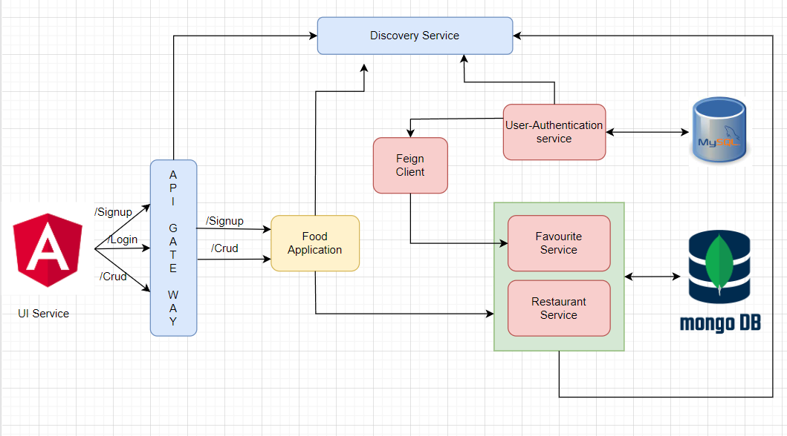
Architecture diagram

Slide 4
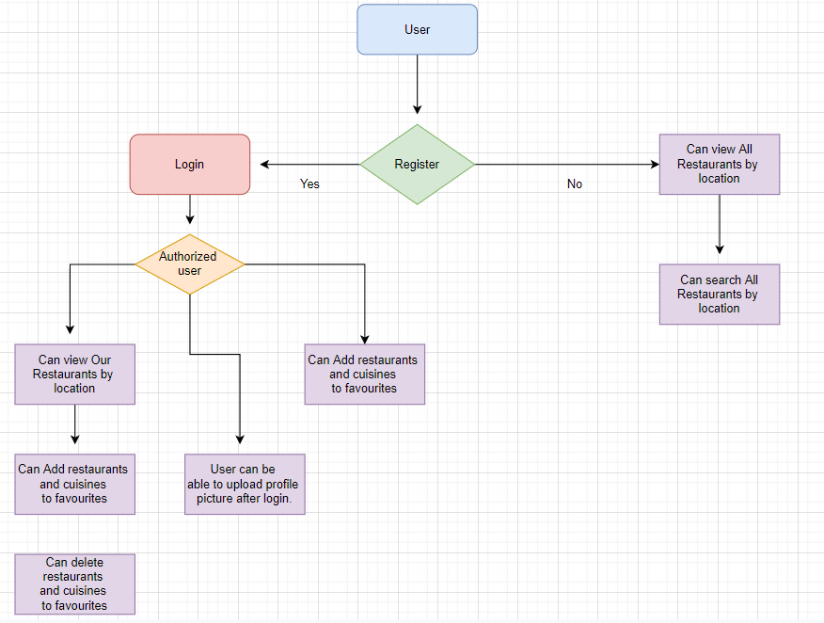
Workflow diagram

Slide 5

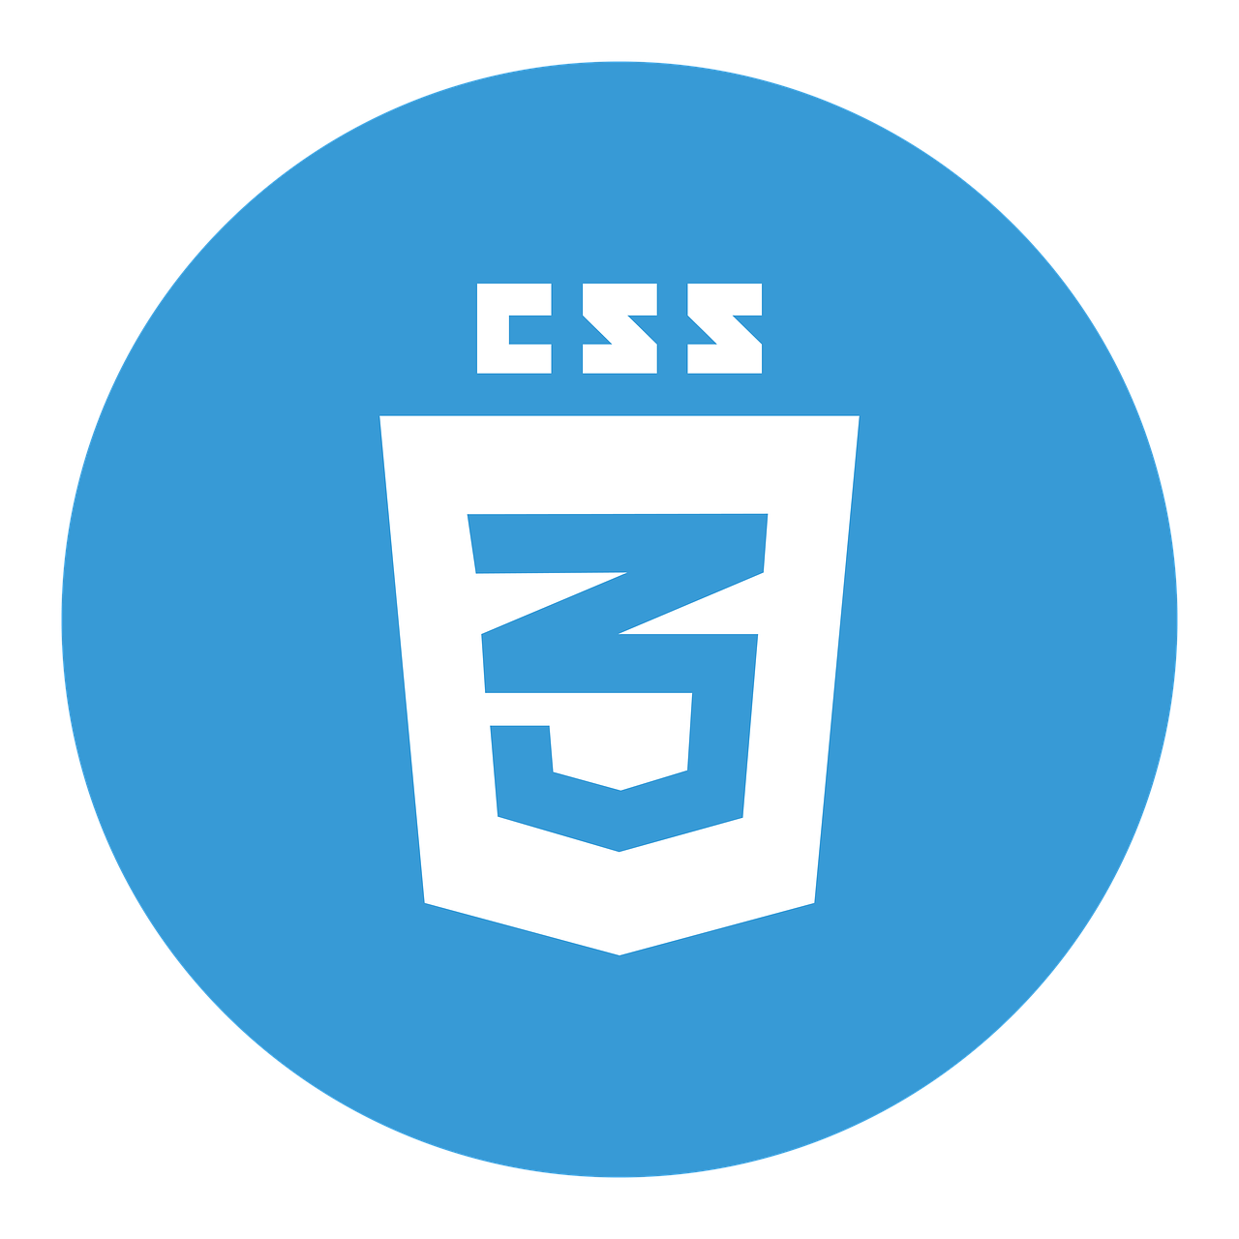









Technologies Used

Slide 6
Features we have implemented at Backend
API Gateway Service
Eureka Server
Rabbit MQ
Docker
Docker Compose

Slide 7

API Gateway Service
Service One
API Gateway Service
Service Two
Service Three

Slide 8
API Gateway
An API gateway is an API management tool that sits between a client and a collection of backend services.
An API gateway acts as a reverse proxy to accept all application programming interface (API) calls, aggregate the various services required to fulfill them and return the appropriate result.

Slide 9

Eureka Server
Eureka Server makes it easy for clients to be serviced depending on the availability of a service.
Multiple instances of the same microservice can be executed at any given point in time.

Slide 10
Rabbit MQ
Rabbit MQ is one of the most popular open source message brokers that gives all applications a common platform to send and receive messages. Here the messages get safe place to live until received.
In Asynchronous Communication, the user doesn't wait for a response from the server . The flow of communication is one way.

Slide 11
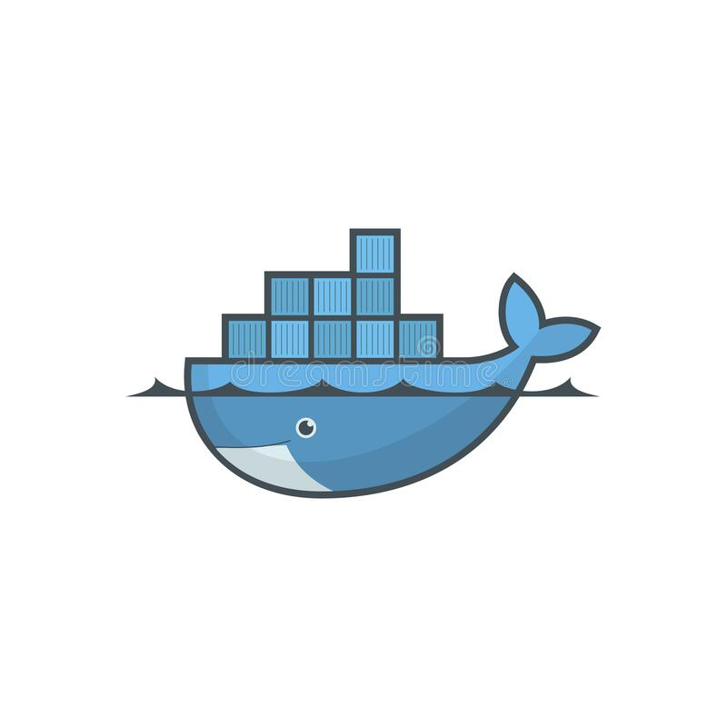
Docker
Docker is a container technology used to build, ship, and run any app, anywhere.
Docker helps separate applications from the infrastructure so that a software can be delivered quickly
Using Docker methodologies for shipping, testing, and deploying a code can significantly help reduce the delay caused during writing a code and running it in production.

Slide 12
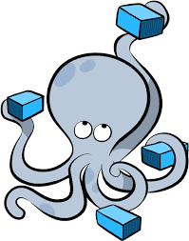
Docker Compose
Docker Compose is used for running multiple containers as a single service.
Docker Compose files are very easy to write in a scripting language called YAML.

Slide 13
Project walkthrough

Slide 14
Question & Answer / Feedback

Slide 15


