Slide 1
A new evaluation matrix when equal importance to all the classes is desired with robustness to data imbalance.
Swapnil Asawa
University of Pittsburgh

Slide 2
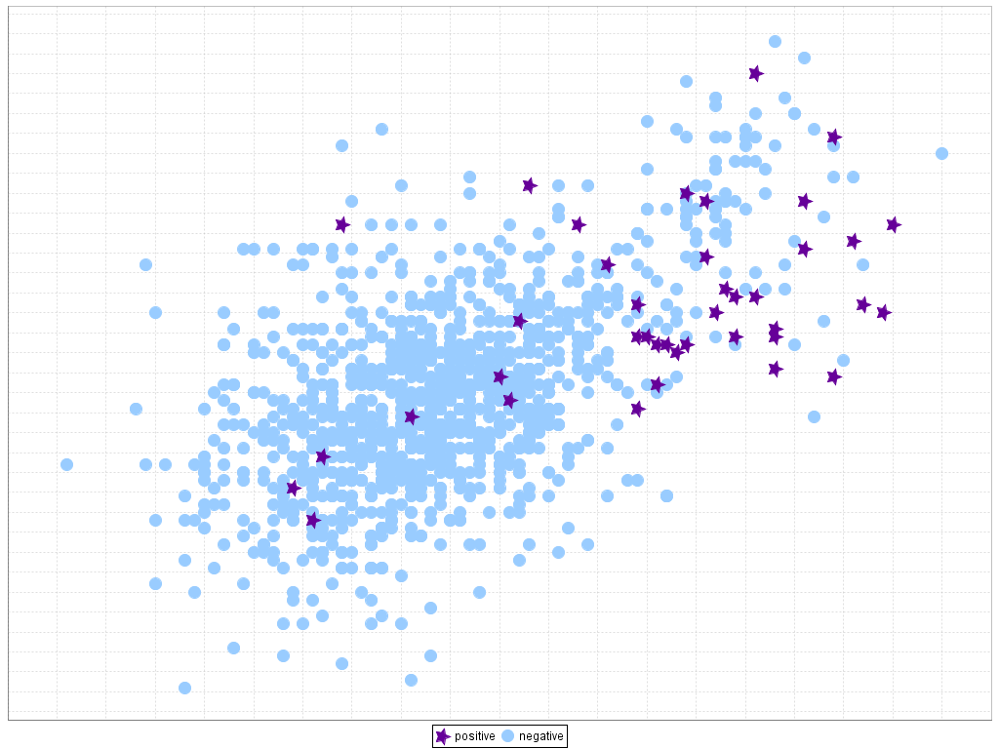
Motivation
The most popular reported metrics namely Accuracy, Precision, Recall, and F1-score are not good indicators when the data is imbalanced. Several papers report the matrixs which are favourable to thier results.
We should know which evaluations we should be skeptical about and when.
Also, some of these matrices are not symmetric
if we exchange just the labels of +ves and negatives, good measures will turn poor.
Ideally this is not a pleasant property as mostly we give equal importance to both the classes irrespective to the data unbalanced.
The data available is mostly unbalanced.
Hence, it is important to have matrices which are robust to it.

Slide 3
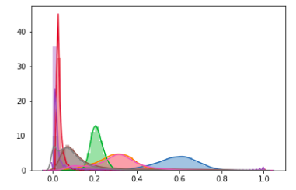

Dataset : Predicting pulsar star in the universe
Pulsars are a rare type of Neutron star that produce radio emission.
They are of considerable scientific interest as probes of space-time, the inter-stellar medium, and states of matter.
As pulsars rotate, their emission beam sweeps across the sky produces a detectable pattern of broadband radio emission
Highly unbalanced data with ration 10:1
Desired property: to give equal importance to each class irrespective of the data imbalance.
Attributes from the signal patterns:
Mean of the integrated profile Standard deviation of the integrated profile Excess kurtosis of the integrated profile Skewness of the integrated profile Mean of the DM-SNR curve Standard deviation of the DM-SNR curve Excess kurtosis of the DM-SNR curve Skewness of the DM-SNR curve

Slide 4
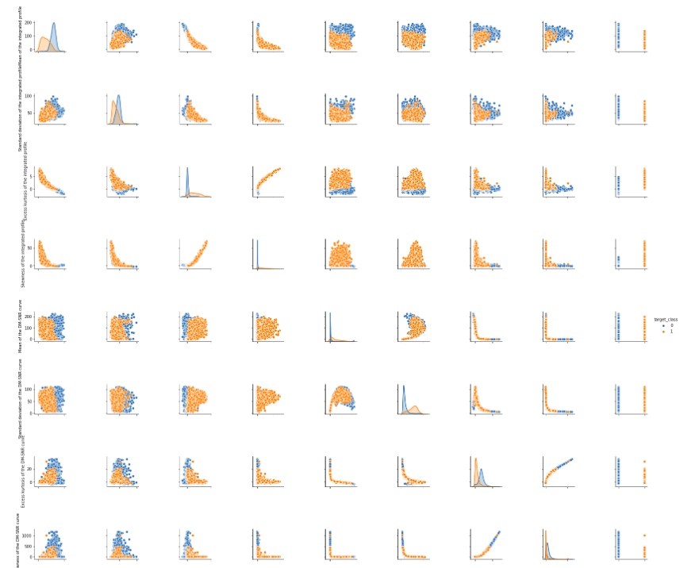

Slide 5
Methodology:
Literature review on unbalanced data
Preprocessing: Standardization
Visualization and Analysis of data.
PCA and chosen 2 most important PCs for visualization.
Train test set splits.
Running multiple configuration of DECISION TREEs and scoring on various different evaluation matrix namely
famous ones “Accuracy, precision, recall, F1-score,specificity, ROC, auc”,
not so famously reported “ matthew, cohans_kappa” and,
own invented “TPNR”
Conclusion

Slide 6
What I designed: TPNR
My designed matric: TPR* TNR
WHAT?
TPR= ratio of Positives detected
TNR= ratio of Negatives detected
WHY?
Makes positives and negatives equally important.
Give equal weight to both positive and negative classes.
Makes evaluation unbiased of data imbalance.
Aren’t there other matrics already available?
Matthew, cohans_kappa evaluation matrixes take care of symmetry but not ideally data imbalance.

Slide 7
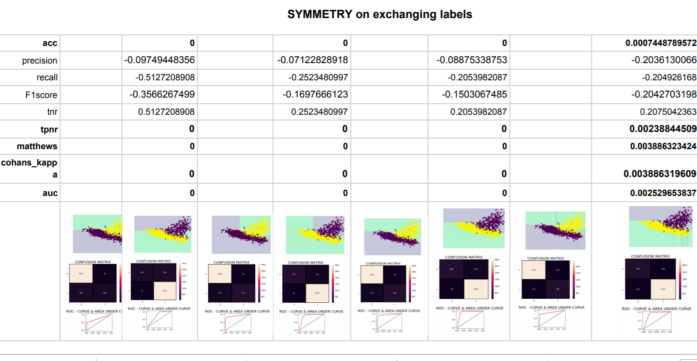

Slide 8
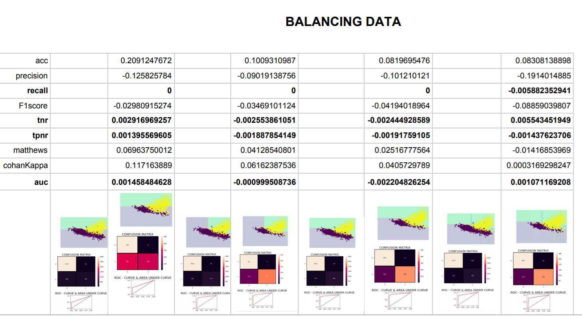

Slide 9

Conclusion
The matrix which were effective on symmetry as well as on data imbalancing were:
TPNR
AUC

Slide 10
Discussion
Why AUC is also doing a good job?
Because AUC is area under sensitivity* (1-specificity)
Area under is same as area under sensitivity* specificity
sensitivity=TPR, specificity=TNR
So it’s Area under TPR* TNR
Cons of AUC?
Not a very intuitive measure.
AUC becomes complicated to extend to multi classes.
Whereas TPNR can be easily extended as product of True class rate

Slide 11
Future work
How to give more weightage if we want to give difference importance to different classes but we still want to have immunity to data imbalance?

Slide 12

QUESTIONS?

