Slide 1

AI LAB TRAINING • DAY 1 • SESSION 1 • 09:00 – 10:30
The General AI Ecosystem
From computing infrastructure to model development, deployment, and inference — and why the numbers force us into the cloud and onto the edge.
Ethiopian Defense University — Day 1, Session 1 of 4 • 1.5 hours

Slide 2


SESSION 1 • OBJECTIVES
What This Session Covers — and What You Walk Away With
We will cover
You will be able to
The layered structure of the AI ecosystem, from GPU chips up to finished applications
The vocabulary you will hear all week: model, training, inference, token, LLM
How much compute AI training really needs — using PaLM 540B as the worked example
Why cloud computing exists, and what it lets a small team do
Why Edge AI exists, and when it is the only option
Name the five layers of the AI stack and give an example from each
Explain what training and inference are, and why one is far more expensive
Use the PaLM numbers to justify why AI needs specialized hardware
Give one reason cloud computing is necessary and one reason Edge AI is necessary
Identify which defense tasks belong on the edge and which belong in the cloud

Slide 3




SESSION 1 • CORE VOCABULARY
Six Words You Will Hear All Week
AI
Machine Learning
Model
Software doing tasks that normally need human intelligence — language, vision, decisions.
Instead of writing rules, we show the computer many examples and it learns the patterns.
The 'brain' produced by learning — a big file of numbers that makes predictions.
Training
Inference
Token
Teaching a model with huge data. Expensive: powerful GPUs, often for weeks.
Using an already-trained model to answer. Fast and cheap compared to training.
A chunk of text, roughly a word. Models read and write text token by token.

Slide 4





SESSION 1 • COMPUTE VOCABULARY
The Machines Behind the Magic
GPU
TPU
LLM
A chip doing thousands of calculations in parallel — the engine of all modern AI.
Google's custom AI chip, same job as a GPU. PaLM was trained on TPU pods.
Large Language Model — trained on trillions of tokens to understand and generate language (GPT, PaLM, Llama).
Cloud Computing
Edge AI
Why it matters
Renting computers and GPUs over the internet (AWS, GCP, Azure, IBM) instead of buying them.
Running AI directly on local devices — phones, drones, cameras — with no internet needed.
Days 2–3 are all cloud platforms. Later today you'll rent a free cloud GPU yourself in two clicks.

Slide 5
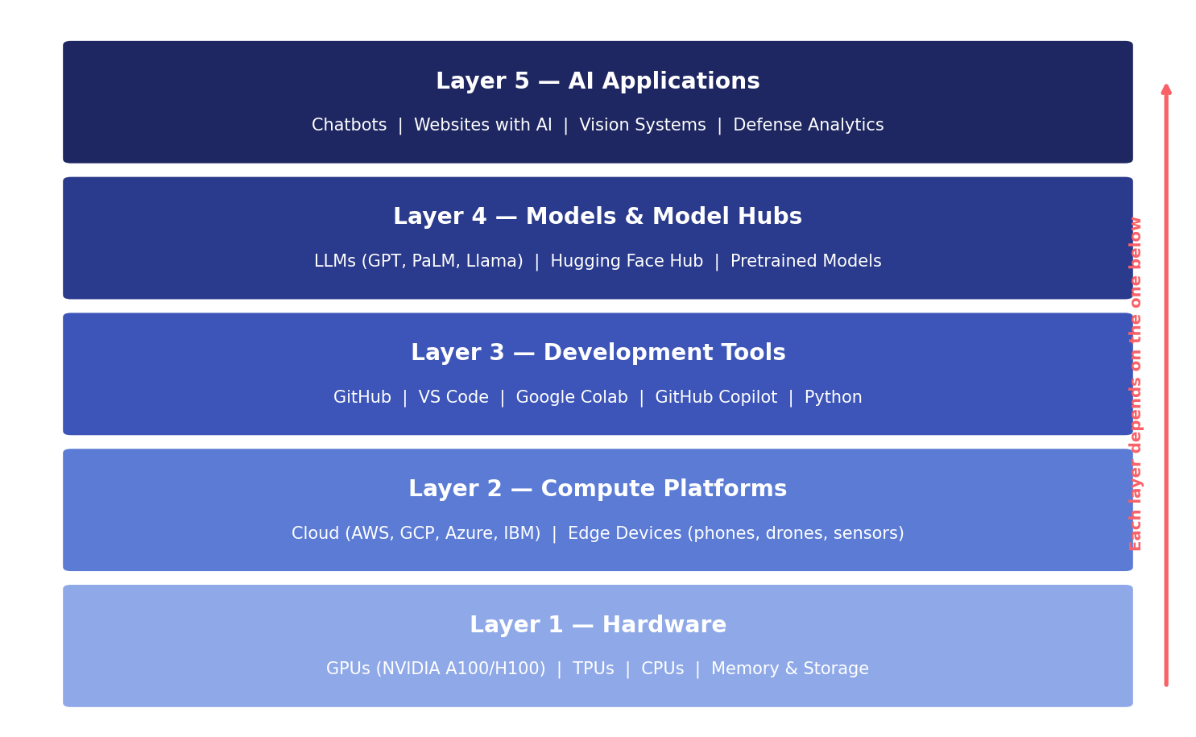
SESSION 1 • THE BIG PICTURE
The AI Ecosystem Is a Stack of Layers
Today = Layer 3
Days 2–3 = Layer 2
Read it bottom-up: every application depends on the layers beneath it.

Slide 6
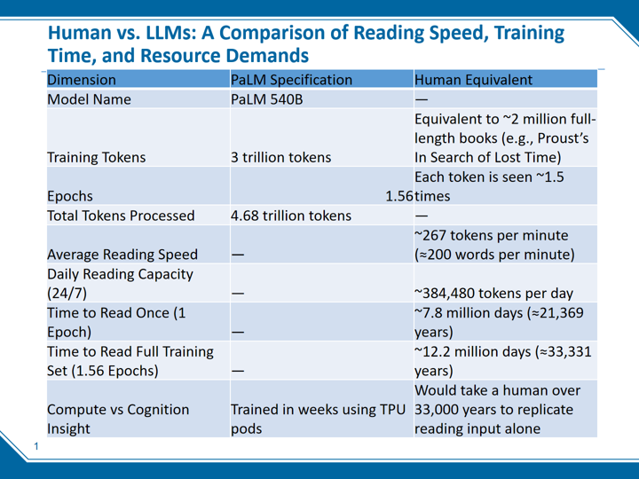
SESSION 1 • COURSE SLIDE
Human vs. LLM: The Scale of AI Training
PaLM 540B — reading speed, training time and resource demands, compared with a human reader.

Slide 7
SESSION 1 • THE TAKEAWAY
What Those Numbers Actually Mean
~2M
33,000
weeks
full-length books
years of human reading
on TPU pods
3 trillion training tokens is a library no human could ever read
to match the 4.68 trillion tokens PaLM processed (1.56 epochs)
the same workload, done by specialized AI hardware in the cloud
The takeaway: GPUs and TPUs compress tens of thousands of years of “reading” into weeks. This is why ordinary laptops cannot train modern AI — and why the next two ideas, cloud and edge, exist.

Slide 8



SESSION 1 • CLOUD
Why Cloud Computing Is Necessary
Nobody can afford the hardware
Thousands of GPUs may be needed for only a few weeks of training. Buying them makes no sense — renting does.
Rent by the hour, release when done
AWS, Google Cloud, Azure, and IBM (Days 2–3) let anyone use supercomputer-class hardware on demand.
Ready-made AI services
SageMaker, Azure ML, and Watson let teams train and deploy models without managing any hardware at all.
You will use it today
Google Colab gives you a free cloud machine — and a free GPU — right in the browser, in Session 2.

Slide 9




SESSION 1 • EDGE
Why Edge AI Is Necessary
No internet in the field
Drones, sensors, vehicles, and remote outposts often have no connection — cloud AI simply isn't reachable.
No time for a round trip
A drone avoiding an obstacle can't wait for data to travel to a data center and back. Edge AI responds instantly.
Sensitive data stays local
In defense contexts, data often must not leave the device. Edge AI keeps it on board.
The hybrid pattern
Train the big model in the cloud, then shrink it and deploy a small version onto the edge device. Real systems use both.

Slide 10
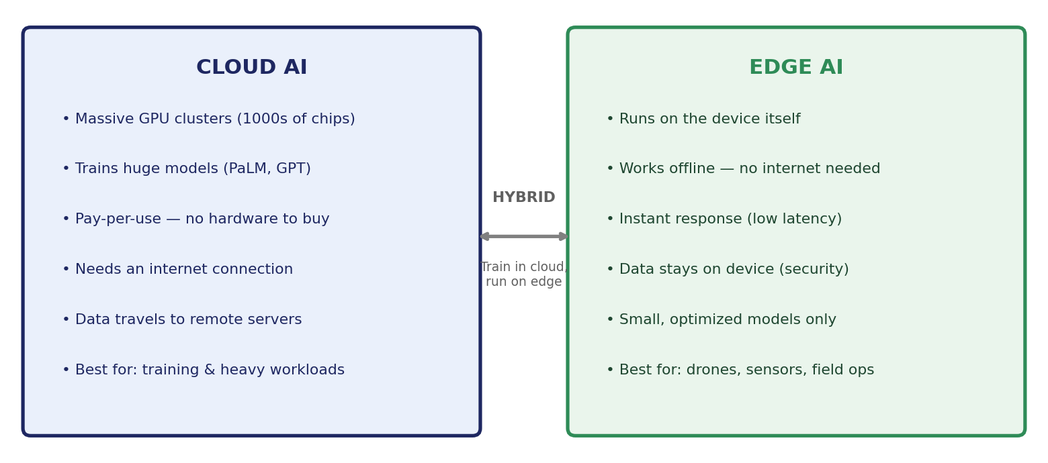
SESSION 1 • PUTTING IT TOGETHER
Cloud + Edge: Two Answers to One Problem
Discuss (10 min): Which defense-sector tasks must run on the edge, and which belong in the cloud?

Slide 11
SESSION 1 — THREE IDEAS TO CARRY FORWARD
1
The stack
Hardware → compute platforms → development tools → models → applications. Everything you build sits on layers below it.
2
The scale
Training a frontier model equals roughly 33,000 human-years of reading. That is why GPUs, TPUs and the cloud exist.
3
Two deployment homes
Cloud for training and heavy workloads; edge for offline, instant, and sensitive work. Serious systems use both.
Next — Session 2 (10:45): GitHub & Google Colab. You'll create your account, your first repository and your first dataset commit, then run code on Google's cloud.

