Slide 1
Xeno Affordance Design
Andrew Baca

Slide 2
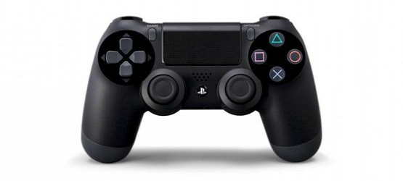
PS4 DualShock Remote Controller

Slide 3
Functions
Handles to grip palms around
Mappings
  Thumbs to joysticks, analogs, anything on the front face of the remote
  Bumpers/triggers on the back of the remote for pointer/middle finger(s)
  Swipe Pad, not used for much, can be ignored

Slide 4
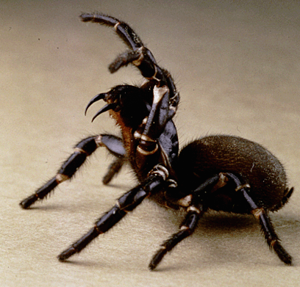
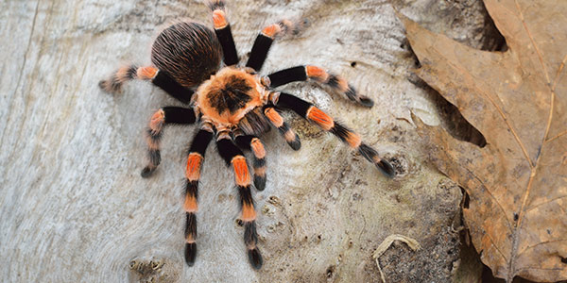
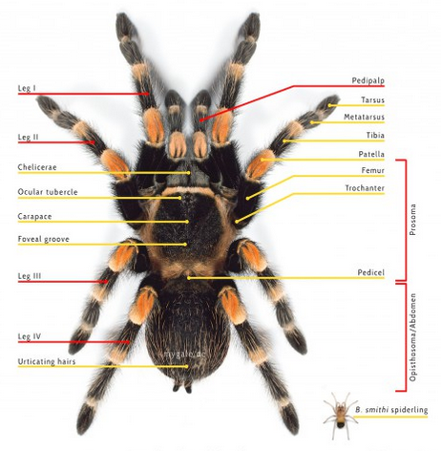
Animal
Turantula

Slide 5
Functions
Use all 8 legs to walk
Pedipalps for grips kind of like hands
Front four legs can be used in other functions

Slide 6
New remote
Sits flat on a surface like a keyboard/mouse
New button mappings/remote shape
  Triggers for pedipalps
  Joysticks for mid front legs
  Analogs for front legs

Slide 7
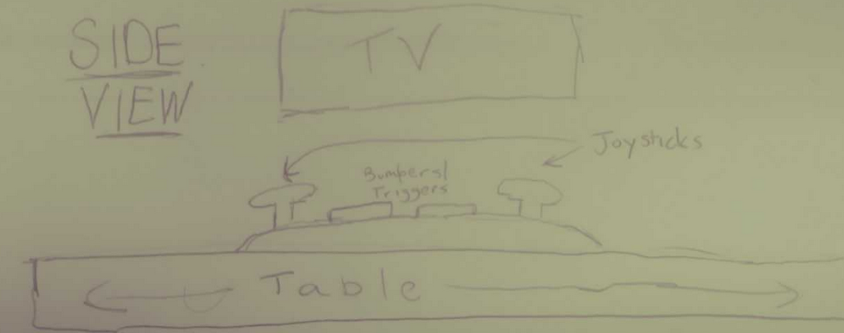

Slide 8
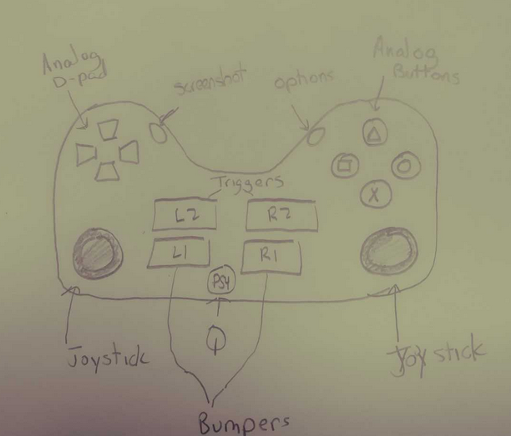

Slide 9
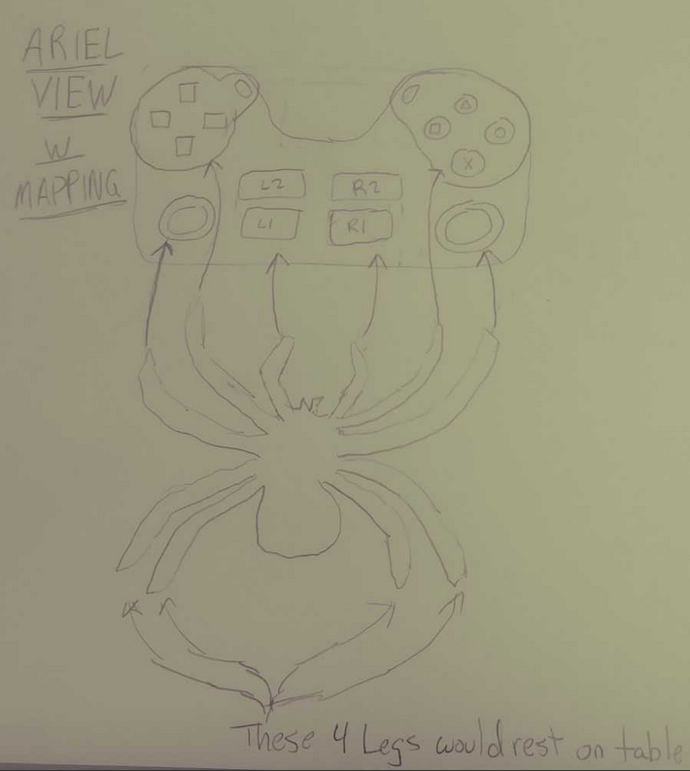

Slide 10
Discussion
Flattened remote
New mappings

