Slide 1
Assignment GIT Group – 9 (Topic – Rebase)
Team Members
Praanav Bhowmik
Ashish Chaudhary
Humera Ahmad
Vaibhav Bansal
Asbin Bhadra

Slide 2
Rebase
In git, there are mainly two ways to integrate changes from one branch to another. : merge and rebase.
Rebasing is process of moving or combining sequence of commits to a new base commit.
Rebasing is the most useful and easily visualized in the context of a feature branching workflow.
Rebasing takes a set of commits copies them, and stores them ouside your repository.

Slide 3
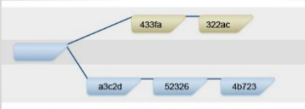
Let’s take an example.
In this we have two branches

Slide 4
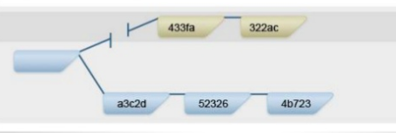
What rebase do : it cuts of these commits
The above commits(433fa and 322ac) don’t have any information about their parents anymore.

Slide 5
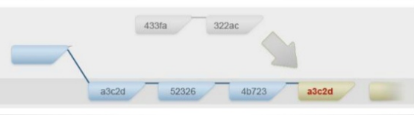
The system then applies them on the top the new branch.
We literally cut of these commits and then apply it on top of the new branch.

Slide 6
Rebase Commands
git rebase <branch name>
- It will your branch to master
git rebase -i <branch name>
- This is an interactive rebase
- Interactive rebasing gives you the opportunity to alter individual commits in the process instead of rebasing blindly.
git rebase –-continue
- It allows to bypass the commits that caused the failure

Slide 7
Pros and Cons
Pros:
Clean and flat history.
Reduction of merge commits.
Manipulating single commit is easy.
Cons:
More complex.
Rebasing can be dangerous.

Slide 8
Thank you

