Slide 1
x
1 2 3 4 5
1 2 3
4
5
y

Slide 2

end_angle: 240°
start_angle: 30°

Slide 3
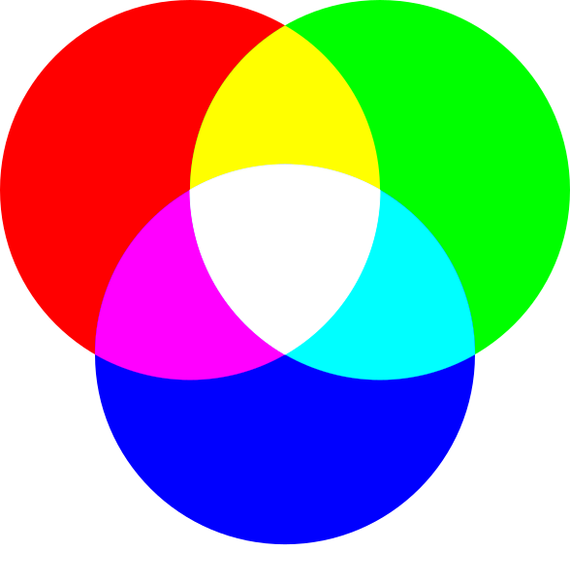
(red, green, blue)

