Slide 1
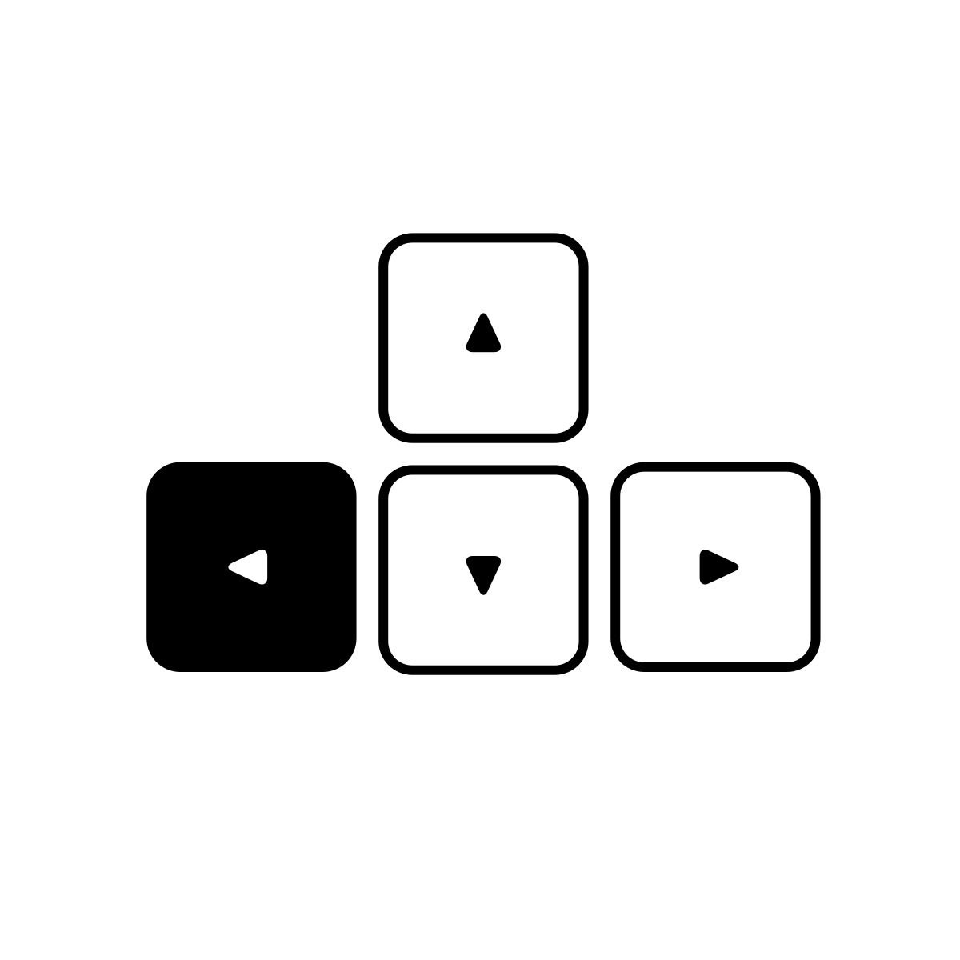
event
on_keydown_left()
@board.register
def on_keydown_left(self)
event | method
on_keydown_left(„LEFT“)
@board.register
def on_keydown(self, key)

