Slide 1
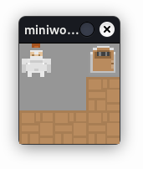
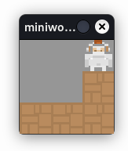
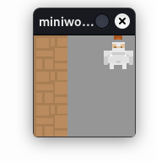

Slide 2
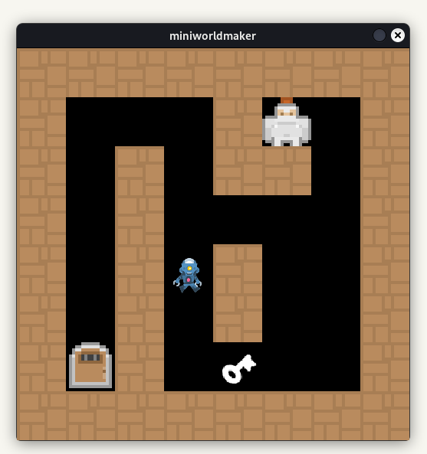
1 1 1 1 1 1 1 1
1 0 0 0 1 2 0 1
1 0 1 0 1 1 0 1
1 0 1 0 0 0 0 1
1 0 1 3 1 0 0 1
1 0 1 0 1 0 0 1
1 5 1 0 4 0 0 1
1 1 1 1 1 1 1 1

