Slide 1
arr[0]
arr[3]
arr[3][1]
arr[0][3]

Slide 2
arr[0]
arr[3]
x
arr[3][1]; x=3, y=1
y

Slide 3
x
1 2 3 4 5
1 2 3
4
5
y

Slide 4
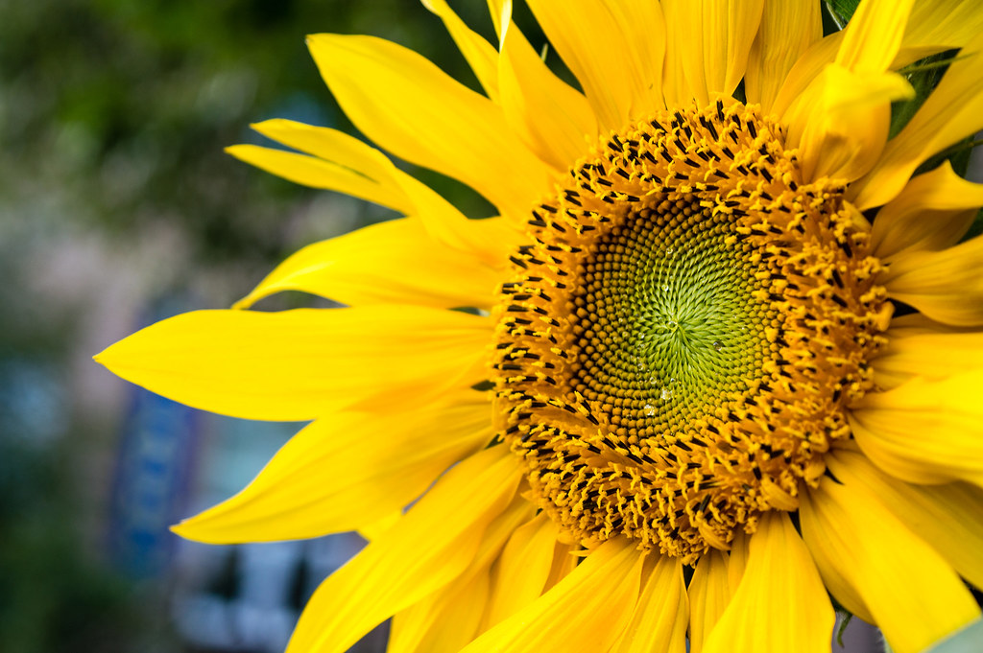
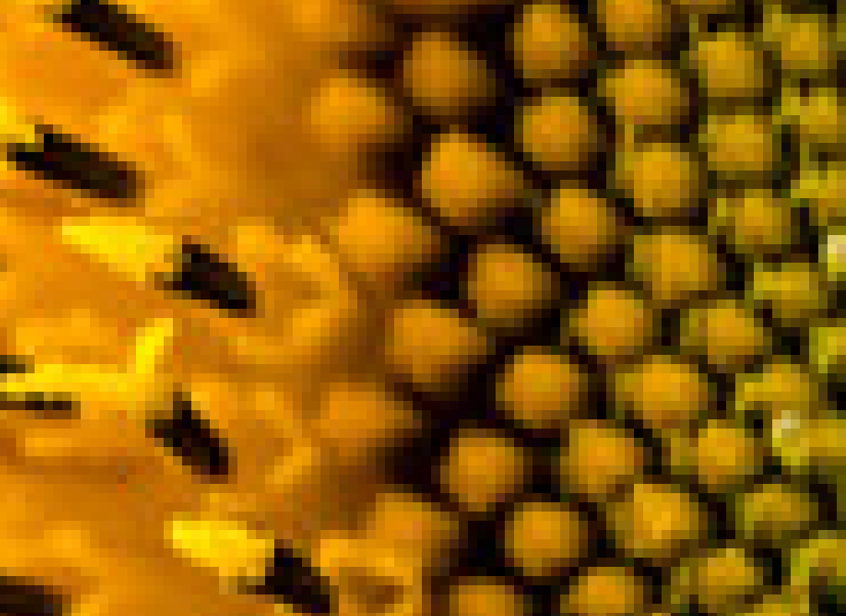

Slide 5

end_angle: 240°
start_angle: 30°

Slide 6
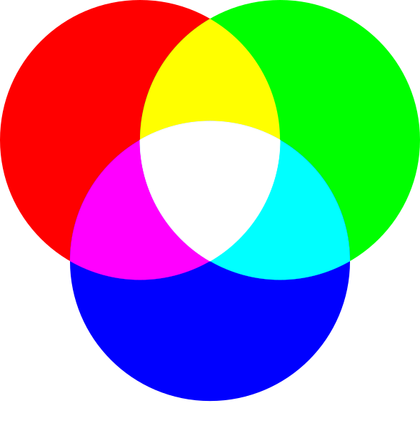
(red, green, blue)

