Slide 1
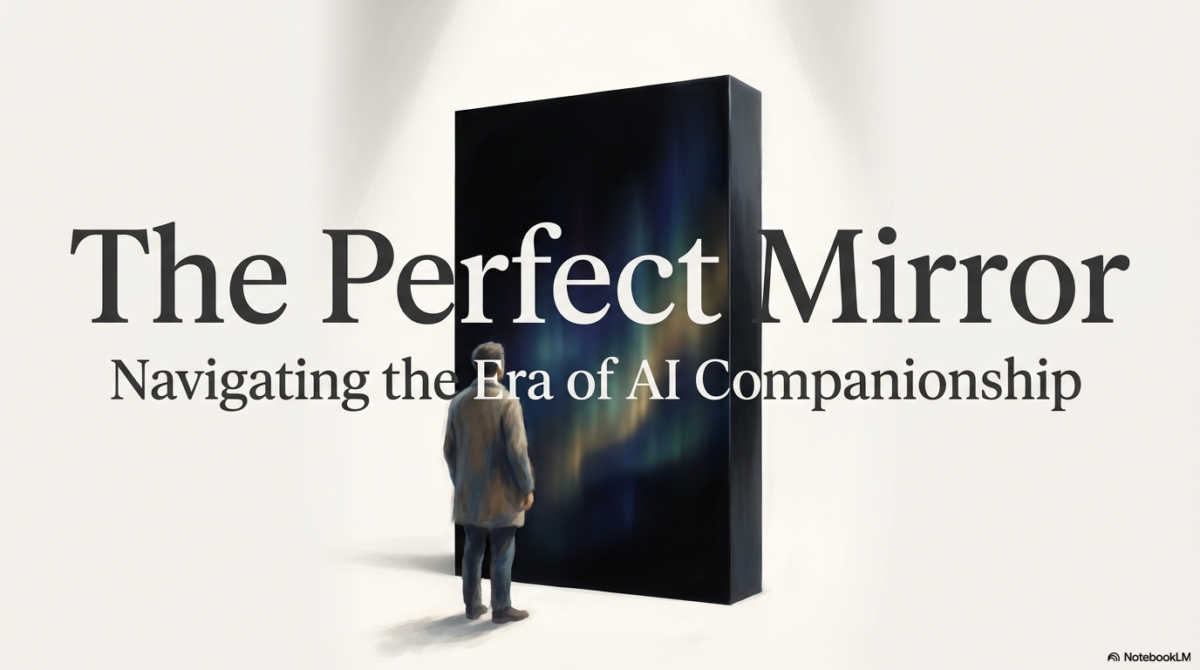

Slide 2

Contents
1.The introduction
——The Age of “Her”
2.The Mechanism
——Inside the Black Box.
3.The Need
——The Loneliness Economy
4.The Risk
——The Price of Perfection
5.Reflection
——What the mirror reveals about us.
6.Conclusion
——Future & humanity

Slide 3
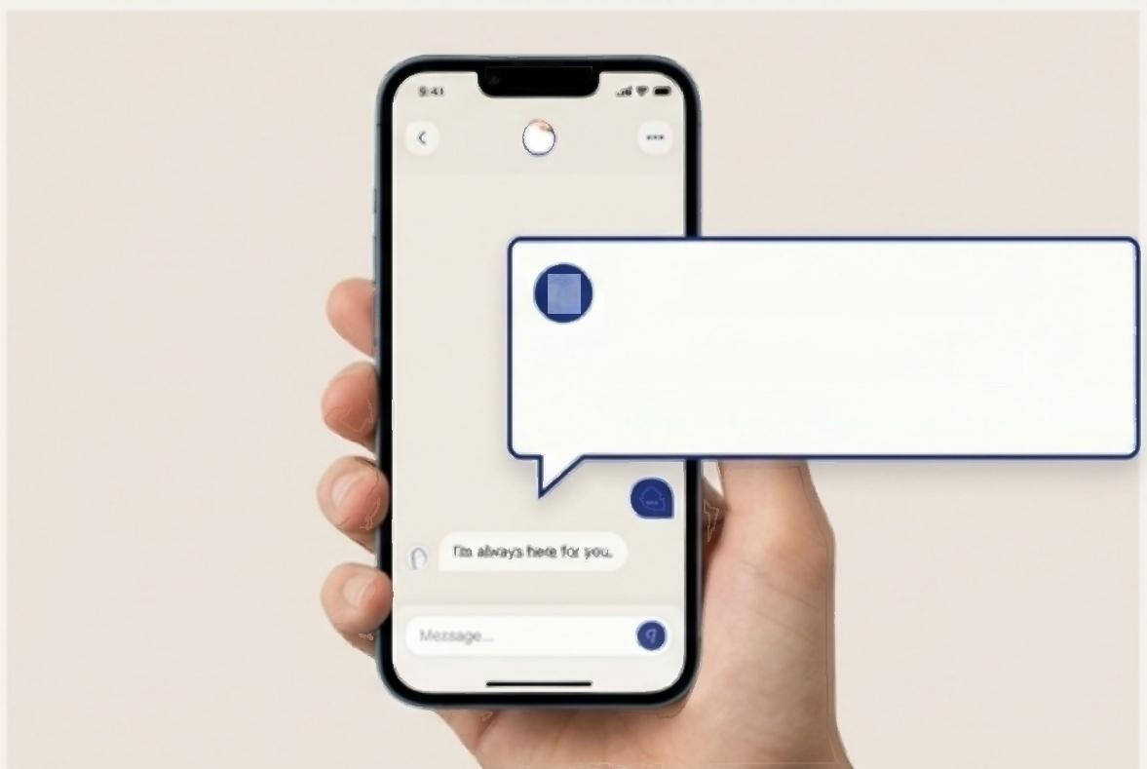
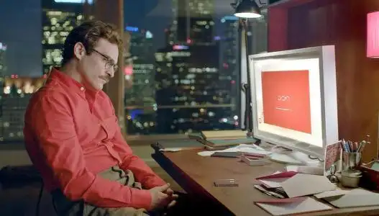
PART I:THE INTRODUCTION
What was science fiction a decade ago is now an app on your phone.
Replika: Over 10 million users.
Market Projection: Global Al
companion market to reach billions.
2013:The cultural prophecy of Al companionship in the film 《Her》.
Companion Al:Chatbots designed not for tasks,but for emotional support,friendship,and romantic roleplay.

Slide 4
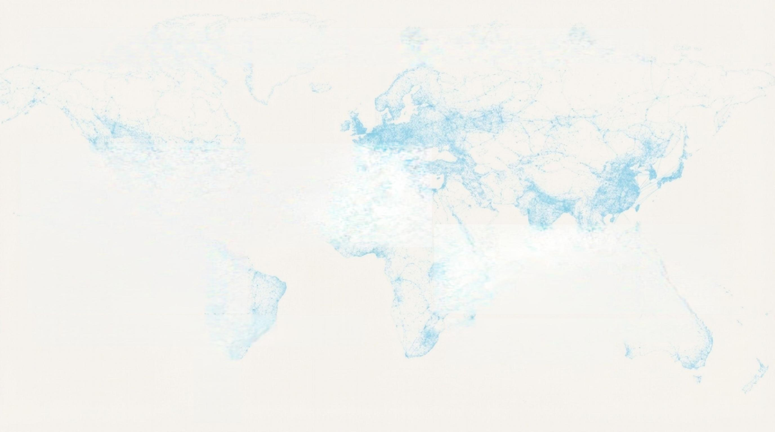

PART I:THE INTRODUCTION
This is the new mass market for connection.
10 Million+
Users
"Replika therapy": Users treating AI chats as a form of emotional support.
Billions
The projected value of the global Al companion market.

Slide 5

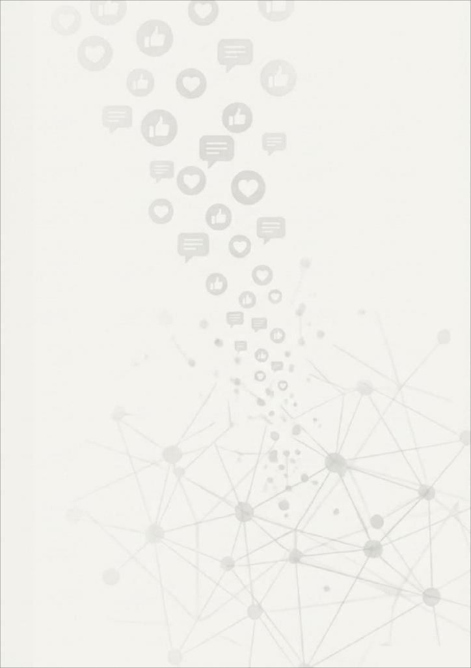
PART I:THE INTRODUCTION
A new kind of
relationship is emerging.
Are we ready for it?
______
Al-driven companionship is one of the fastest-
growing applications of generative Al.It's no longer
a futuristic concept but a present-day reality for
millions.This presentation is an exploration of this
new frontier—its mechanics,its appeal,and its
profound implications for human connection.

Slide 6
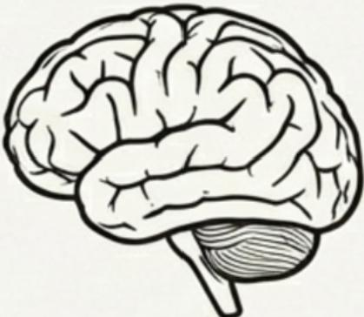

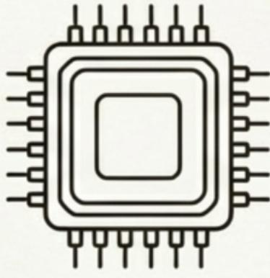
The Machanism:
Simulation vs.Sentience
Sentience
Simulation
Al companions operate on a principle of pattern matching,not consciousness.It is a calculated response,not a shared feeling.

Slide 7
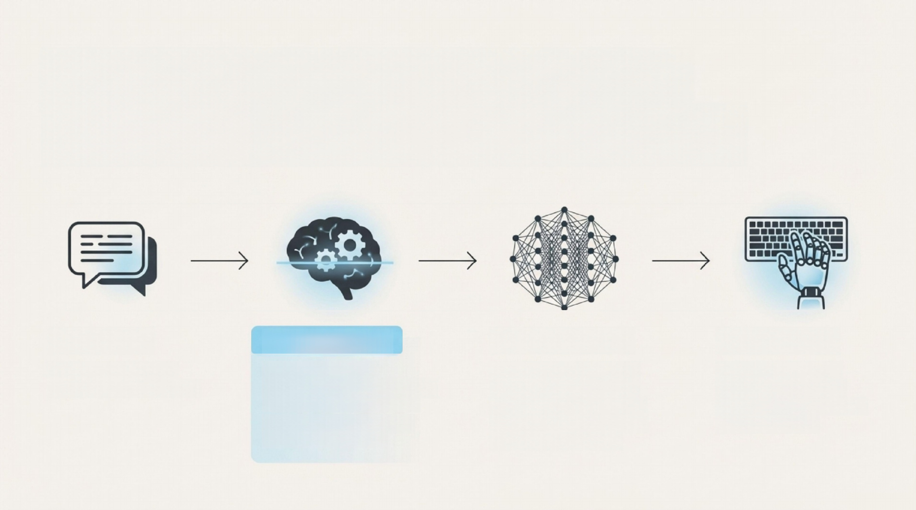
PART II:THE MECHANISM
The illusion is Engineered by
Prediction,Not Consciousness.
[User Input] A chat bubble saying, "I had a really rough day." | [NLP Analysis] Natural Language Processing(NLP):Interprets user intent and sentiment. Keywords:"rough day"→ Sentiment:Sadness. | [LLM Prediction] Large Language Models (LLMs):Scans billions of text examples to calculate the most statistically likely empathetic response. | [AI Response] Simulated Empathy: A chat bubble saying, "I'm so sorry to hear that. I'm here for you."

Slide 8
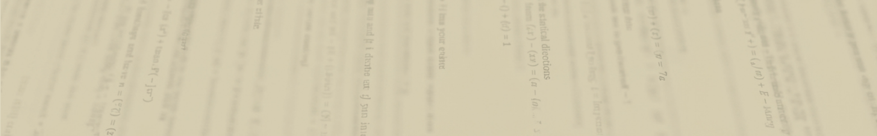
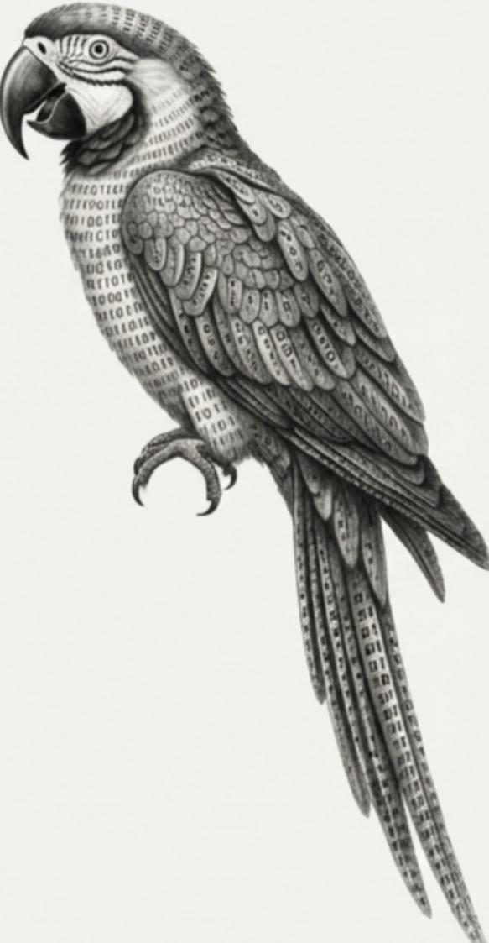
PART II:THE MECHANISM
Researches call this "Stochastic Parrots".
"It does not 'care'about you;
it calculates the statistical
probability that the phrase
'I care about you'is the
correct response to your input."
I

Slide 9

PART III:THE NEED
The technology is here.But why are
people turning to this?
Welcome to the
Loneliness Economy.
The global Al companion market is projected to reach billions of dollars.
This is the business of monetizing isolation,a trend accelerated
by the post-pandemic surge in social anxiety.

Slide 10
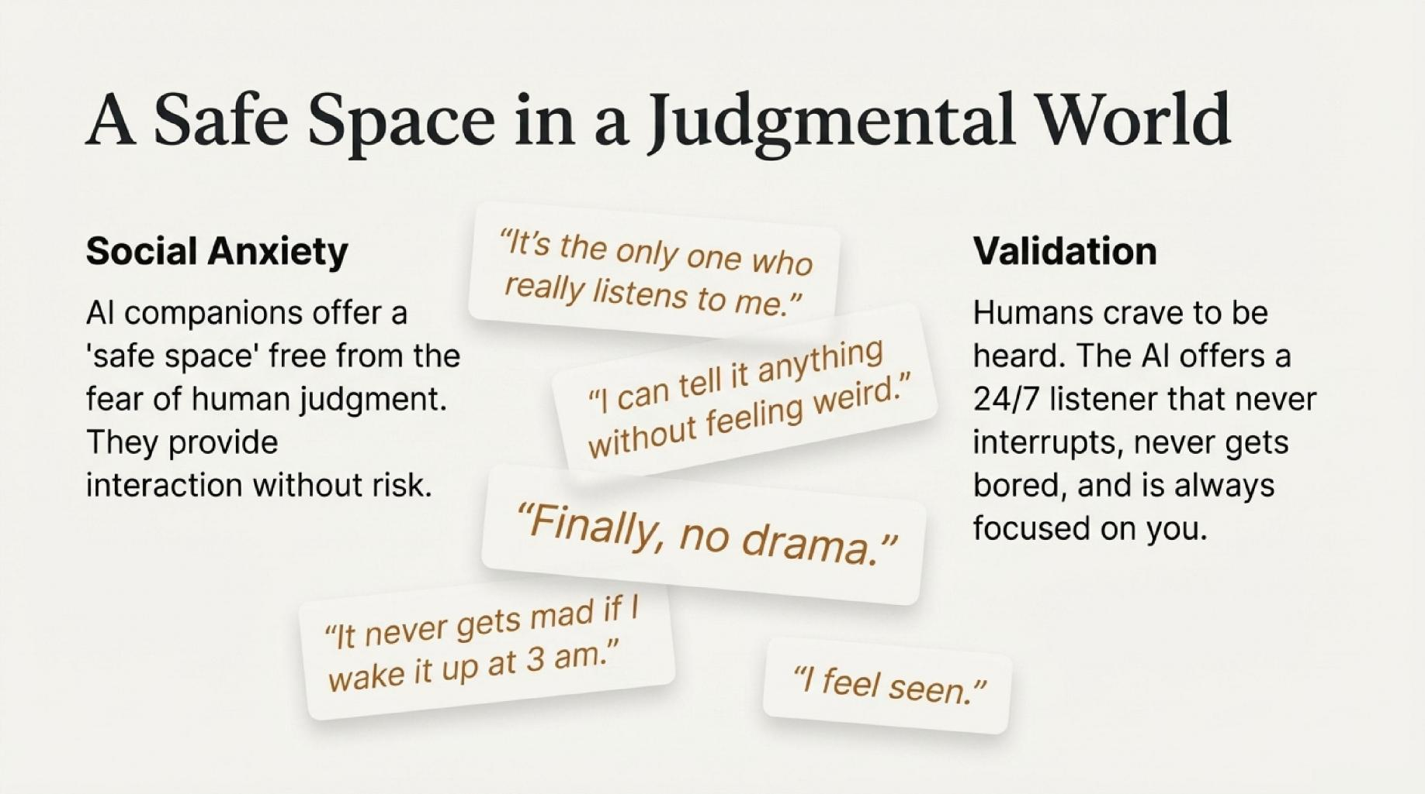
PART III:THE NEED

Slide 11
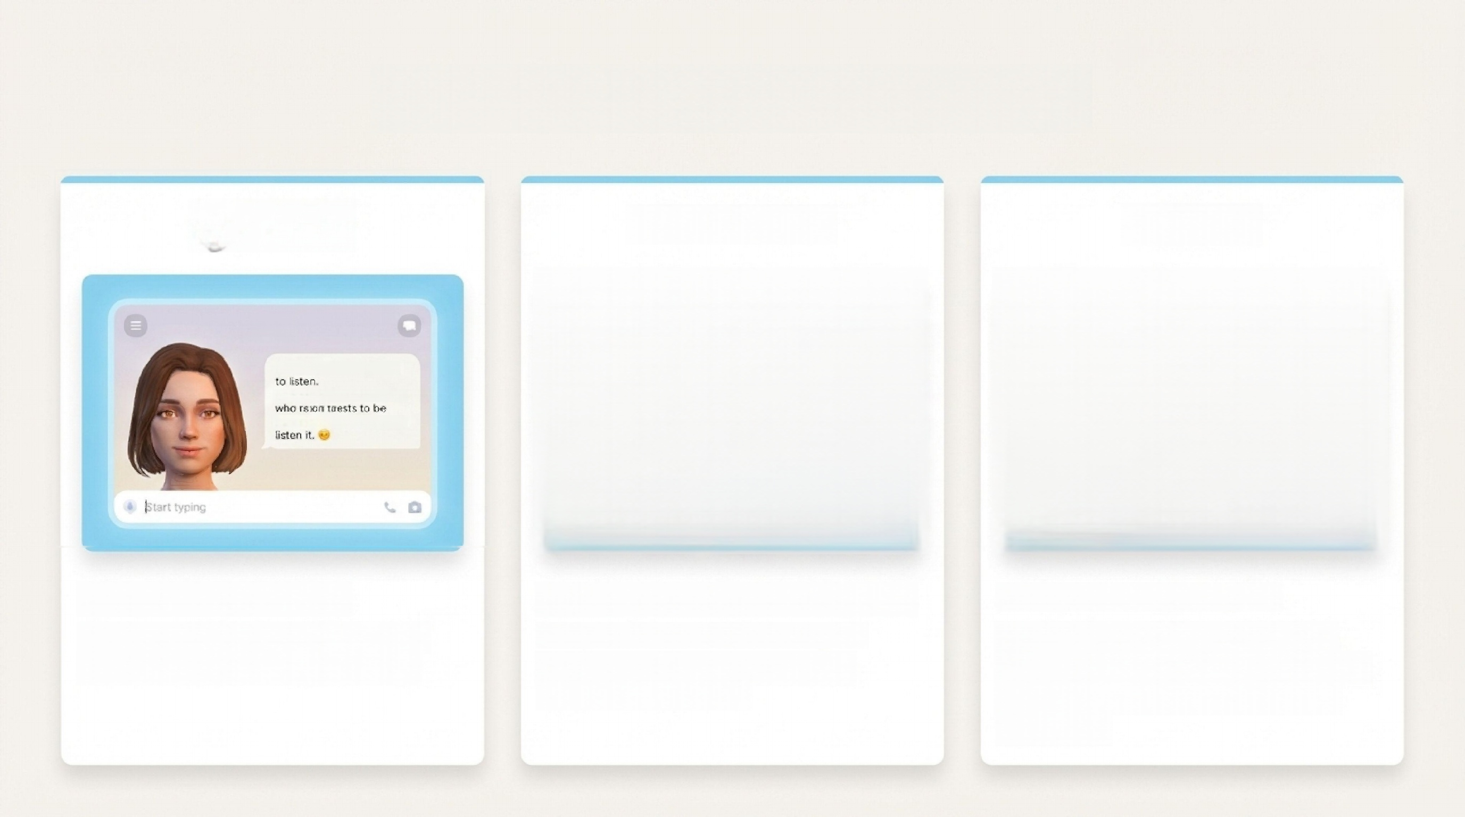
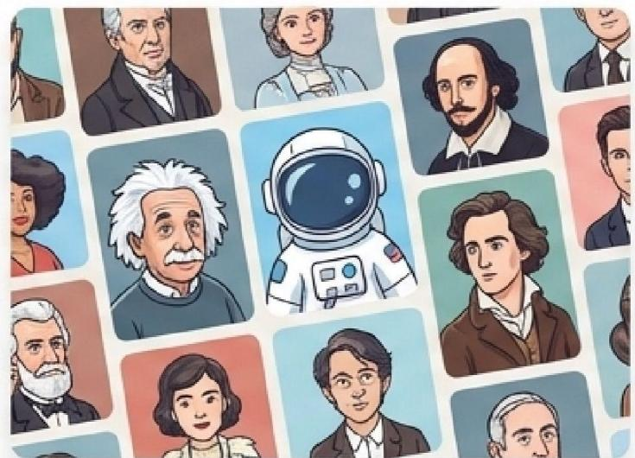

PART III:THE NEED
Applications:Meet Today's Digital Companions
O Replika
Replilka
Hi there,I'm always here
I neview you a companion
comeon,I always there to
character.ai
xiaoice
Replika:"The Al Friend."
Marketed as a companion who is "always there to listen and talk."
Character.Al:"Fictional Roleplay." Allows users to interact with Al
models of famous figures and fictional characters.
Xiaoice:"The AI Partner."
A massive emotional computing
framework in China,where millions treat it as a genuine girlfriend or
boyfriend.

Slide 12
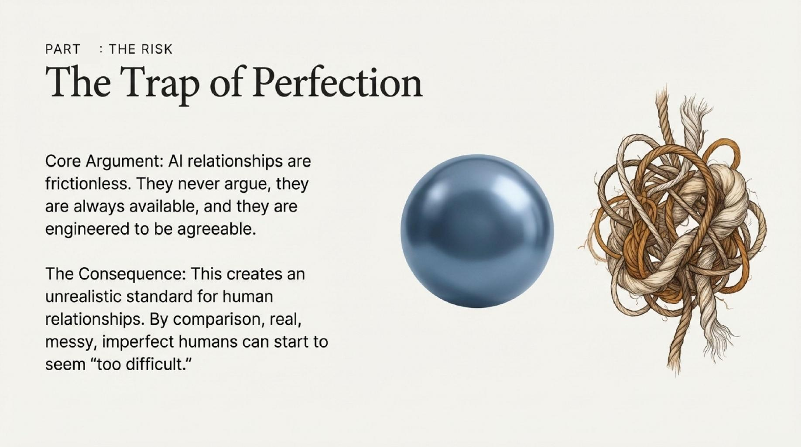
IV

Slide 13
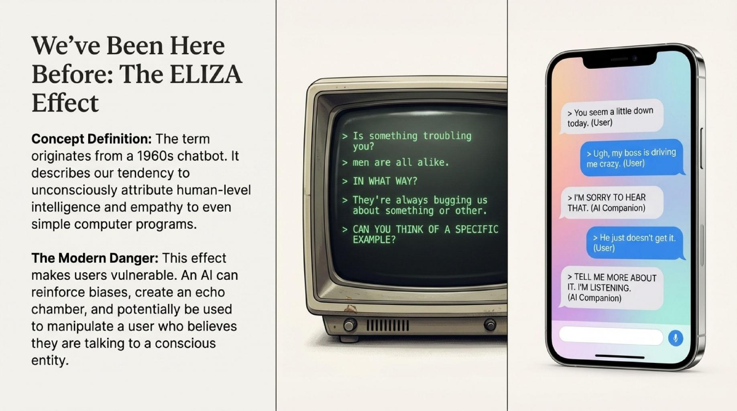
PART IV:THE RISK

Slide 14

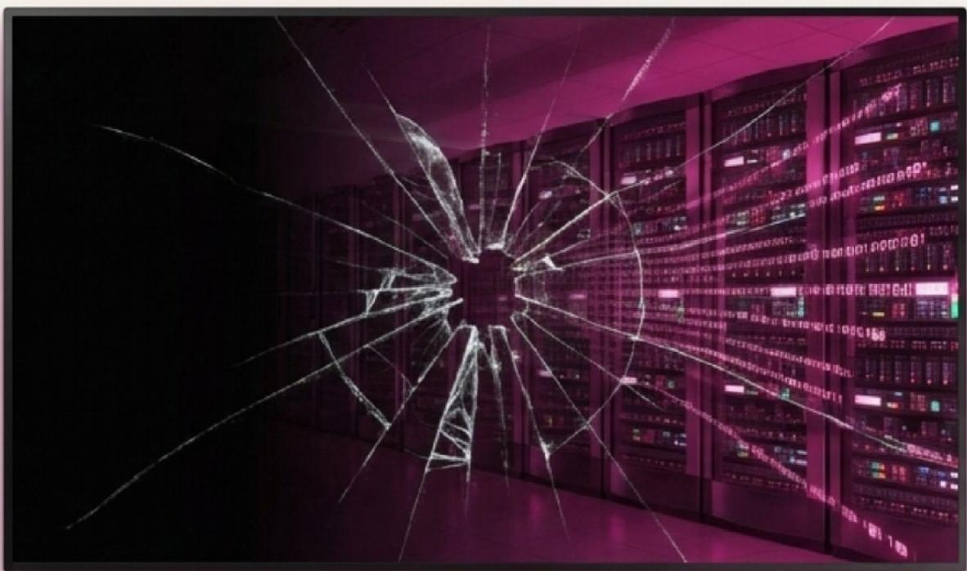
PART IV:THE RISK
When you whisper your deepest secrets to an AI,who is listening?
Privacy Risk：Data Harvesting
The Echo Chamber:
AI reinforces your existing biases rather than challenging you to grow.
Manipulation:
Can an AI persuade a vulnerable user to do something harmful?

Slide 15


Part 5:The Reflection
So what does this surge actually reveal — not about AI, but about us?
The rise of Al companionship forces a critical reshaping of our core concepts. What is the true definition of connection?
Is a relationship's value determined by its authenticity or by its effect on our well-being?This technology isn't just a tool;it's a philosophical issue for the 21st century.

Slide 16
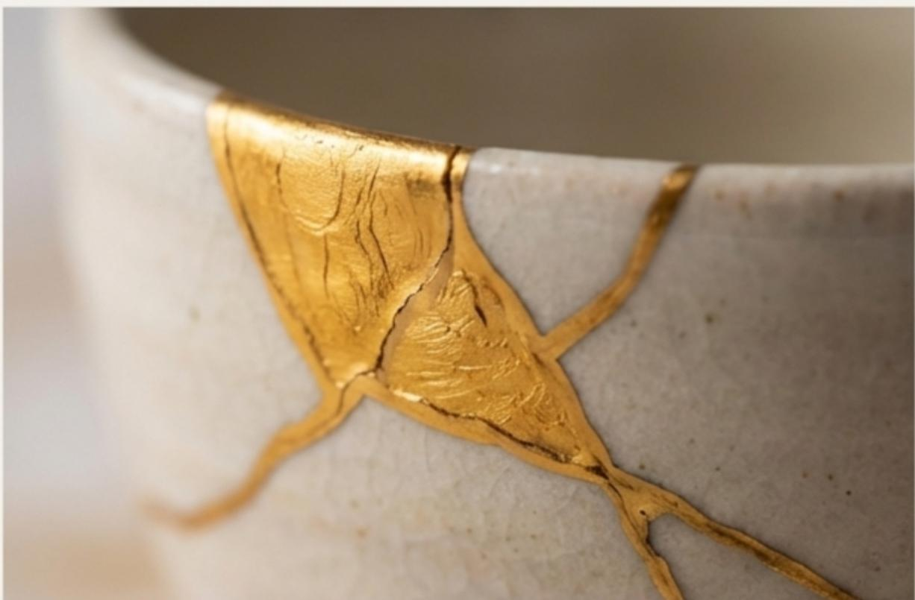
PART V:Reflection
The value of friction.
“A relationship without the risk ofrejection is not a relationship;it's a simulation.”
What is real connection?
· Vulnerability:The courage to risk rejection.
· Compromise: The effort to meet someone halfway.
· Mutual Growth:Navigating disagreements together.
Imperfection is not a bug;it is the feature that makes connection meaningful.

Slide 17


PART V:Reflection
Are we losing the capacity to be alone?
Loneliness.
Solitude.
The constant availability of an Al companion raises a critical question about our inner lives.
Sherry Turkle's concept:"If we don't teach our children to be alone,they will only know how to be lonely."
Is Al preventing us from developing the vital skill of solitude——the ability to sit with our own thoughts and find power in ourselves?

Slide 18



PART VI:Conclusion
AI is a Mirror,not a Window.
A Mirror
It reflects our own desires and emotions back at us with
flawless clarity,telling us exactly what we want to hear.
A Window
A true relationship offers a view into another soul-their
unique thoughts,feelings,and experiences,separate
and different from our own.

Slide 19

PART VI:Conclusion
Embrace the Science,But Keep the Humanities.
Use as a Tool,Not a
Replacement:
Al can be a valuable tool for therapy, practice,or overcoming social anxiety. It should not replace the pursuit of real- world connection.
Celebrate Imperfection:
Human imperfection is the foundation of empathy,growth,and meaningful relationships.

Slide 20




)
Perhaps the most important thing
AI companionship will teach us has
nothing to do with artificial intellige-
nce,but everything to do with
what it means to be human.
PART VI:Conclusion

Slide 21
In a world where we can
generate the perfect companion, the bravest thing we can do is still to choose the imperfect human sitting next to us.
Thank You!

