Slide 1
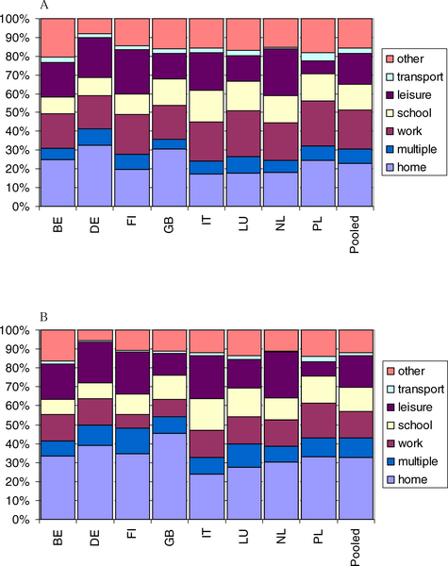
Figure 2. The Distribution by Location and by Country of (A) All Reported Contacts and (B) Physical Contacts Only
Mossong J, Hens N, Jit M, Beutels P, Auranen K, et al. (2008) Social Contacts and Mixing Patterns Relevant to the Spread of Infectious Diseases. PLOS Medicine 5(3): e74. https://doi.org/10.1371/journal.pmed.0050074
https://journals.plos.org/plosmedicine/article?id=10.1371/journal.pmed.0050074

