Slide 1
re:AGENT · TRACK C · BIO DESIGN
An agent that designs aptamer switches
Type a biomarker. Get 96 wells a wet lab can order — and the reasons to believe them, or not.
Continuous electrochemical (E-AB) biosensing · IL-6, IL-10, TNF-α
Claude Agent SDK · ViennaRNA · Paperclip · Modal/Proto · Primer3
Notes:
[12s · 0:12 of 4:36]
Continuous cytokine sensing. We design the aptamer switches, not the electronics. Three targets, IL-6 first because it is the hardest.

Slide 2
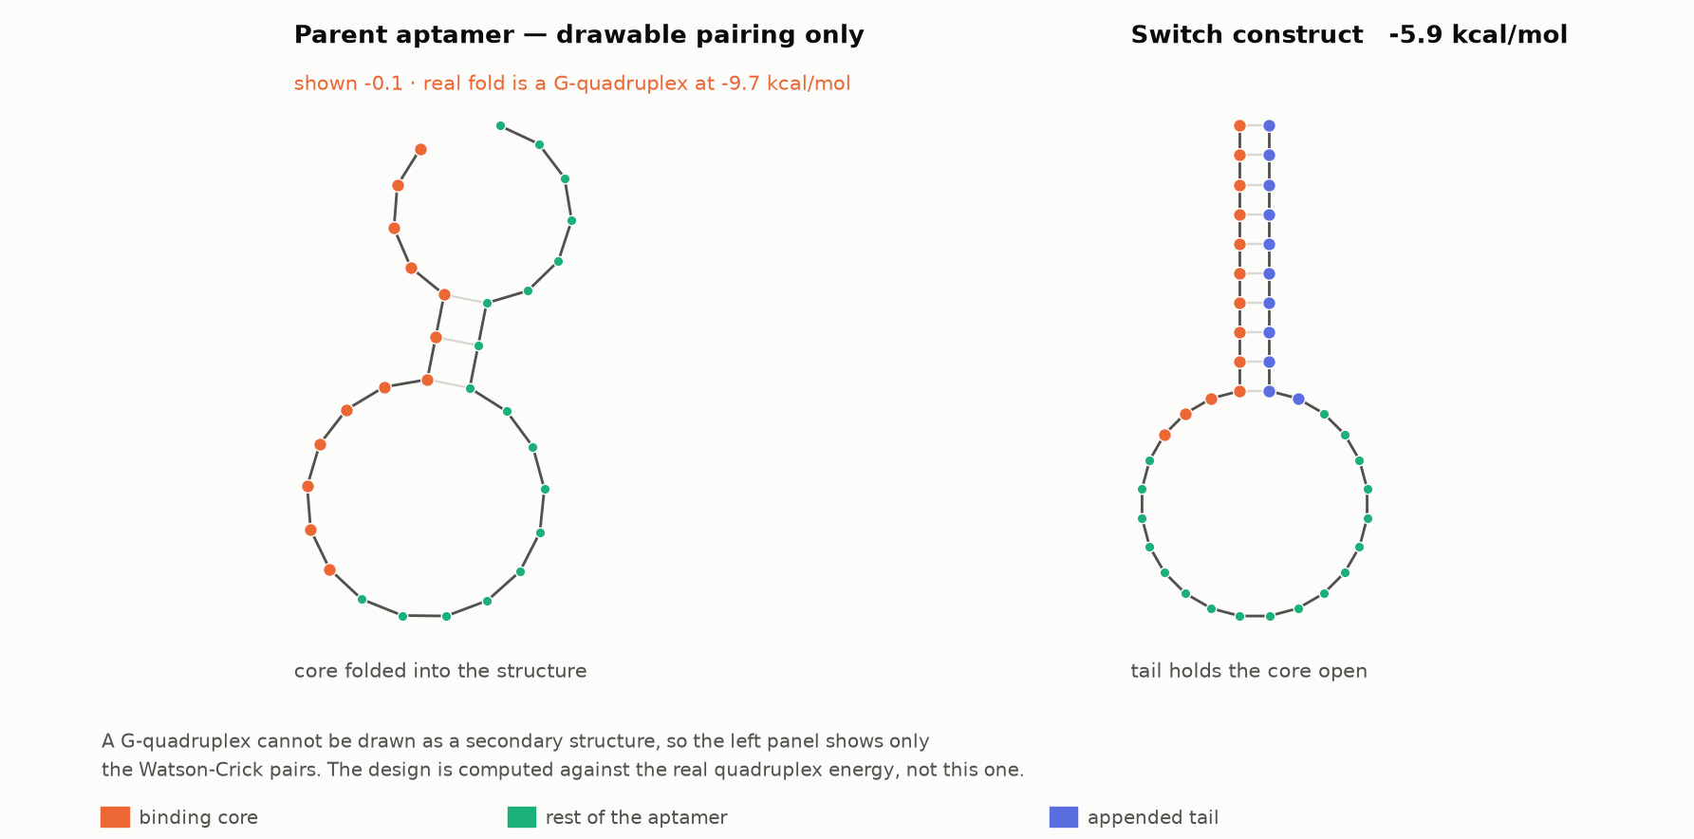
THE PROBLEM
A binder is not a sensor
An E-AB sensor reports a conformational change, not a binding event. The aptamer is tethered to gold at the 5′ end and carries a methylene-blue reporter at the 3′ end; current changes only if the molecule folds differently when the target arrives.
So the design problem is not "find a binder". It is: take a published binder and destabilise it by exactly the right amount.
Too stable and it never switches. Too loose and it never folds. The usable window is roughly 2 kcal/mol wide — and that is narrower than the folding model's own error bar.
Notes:
[28s · 0:40 of 4:36]
The key idea, and the one thing to land: an E-AB sensor reports a SHAPE CHANGE, not binding. A perfect binder that never moves gives no signal. So we take a published binder and destabilise it by a precise amount — and the usable window is narrower than the folding model's error bar. That tension drives every decision after this.

Slide 3
WHAT WE BUILT
One input, eight tools, an orderable plate
find_parents
greps the full text of the literature for sequences
The agent chooses the order and can refuse.
If no published parent binds the target, it says so and stops rather than inventing one — de novo aptamer design has no validated computational method.
Everything runs on the Claude Agent SDK with Claude Code's own tools switched off, so the agent has exactly these eight and nothing else.
assess_parent
folds it; decides which design lever even exists
design_plate
enumerates, scores, filters, tiles, exports
validate_plate
re-scores with an independent engine (Primer3)
test_core_sensitivity
does the plate survive its own assumption?
build_hedged_plate
spends 96 wells across the uncertainty
learn_from_results
reads the bench data and moves the window
read_ledger
what is measured, assumed, and rejected
Notes:
[20s · 1:00 of 4:36]
One input: a biomarker name. Eight tools, agent picks the order. Point at find_parents and build_hedged_plate — those are the two that matter. Say it can refuse: no published parent, no plate.

Slide 4
EVIDENCE
Search for sequences, not for topics
Ranking papers by relevance finds reviews. We grep the full text of the corpus for DNA/RNA strings, then read what is printed on either side of each hit.
Every candidate carries printed_as — the words the paper set immediately around the sequence — so the agent can see it is about to design against the receptor rather than the ligand.
Corroboration is counted, not assumed: how many independent papers print the identical sequence.
53
10
papers containing a candidate sequence
parents extracted with attribution
3
0
independent papers print the chosen parent
affinities borrowed from another aptamer
No paper reports a Kd for this exact sequence, so every affinity-derived number is omitted rather than estimated. An earlier version borrowed 8.5 nM from an anti-IL-6-receptor aptamer and produced a full column of wrong figures, none marked as such.
Notes:
[18s · 1:18 of 4:36]
We grep full text for SEQUENCES, not rank papers by topic. Each hit carries the words printed around it, so the agent can see it is about to design against the receptor instead of the ligand. It caught exactly that. Zero borrowed affinities — an earlier version borrowed a Kd from an anti-IL-6-RECEPTOR aptamer and produced a column of confident wrong numbers.

Slide 5
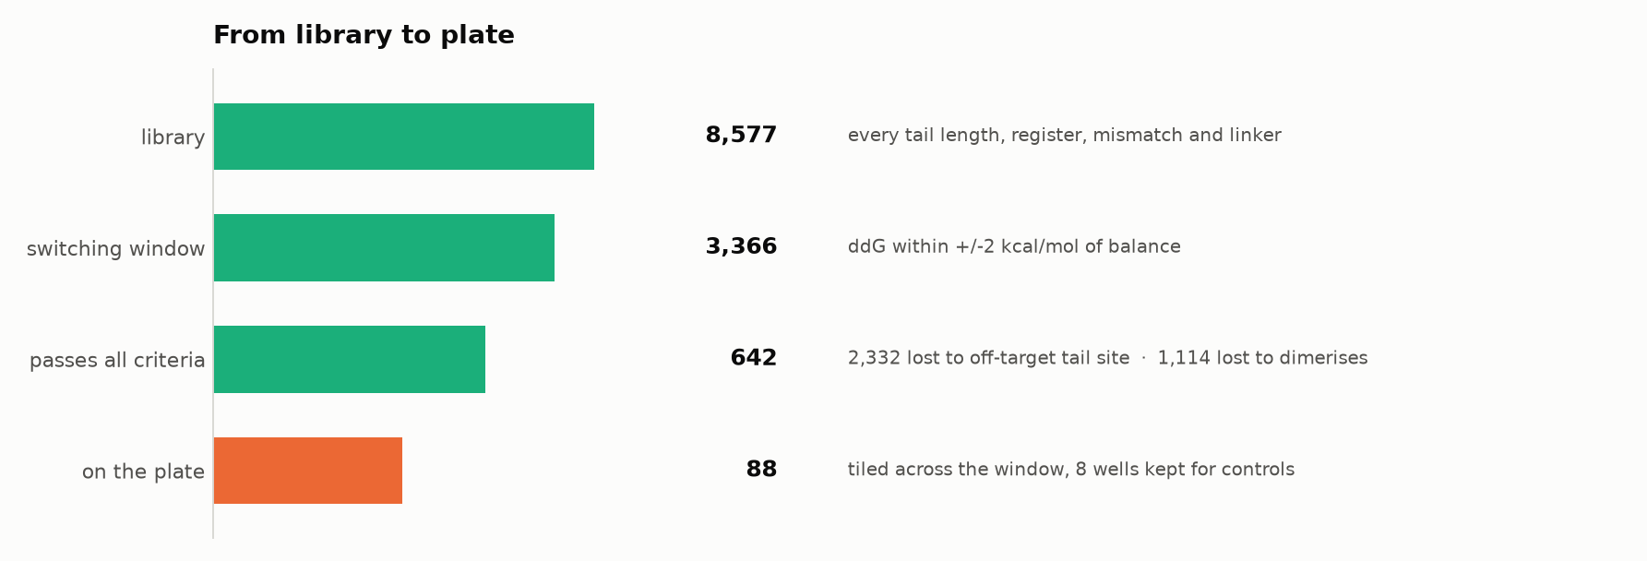
DESIGN
From 8,577 candidates to 96 wells
8,577 variants enumerated, not sampled — every tail length, register, mismatch count and linker.
3,366 land in the switching window; 642 also pass specificity, self-dimer, G-run, homopolymer and GC filters.
Filters run before tiling, not after. Tiling first leaves holes wherever a band happened to contain only dimerising designs, and the plate silently stops covering the range it claims to.
Notes:
[16s · 1:34 of 4:36]
8,577 enumerated, not sampled. Filters run BEFORE tiling — tiling first leaves holes wherever a band held only dimerising designs, and the plate stops covering the range it claims to.

Slide 6
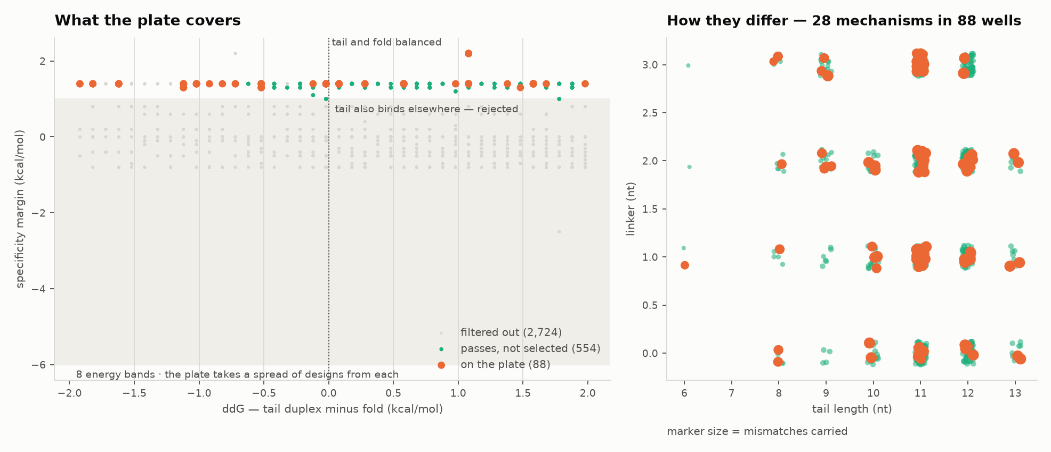
THE HONEST CORE
We tile the window instead of ranking it
Taking the top 96 by predicted energy gives 96 near-identical sequences and one bit of information.
If the model's centre is off by a kcal/mol — and near zero it can be — every well fails together and the round teaches nothing.
So the plate spans eight energy bands, 11 wells each, chosen to be mechanistically unalike within a band. The experiment returns the shape of the response and locates the optimum even when the prediction is wrong.
Plate position is randomised against ddG and checked against a 2,000-permutation null: row spread 0.555 vs 1.345 at the 95th percentile.
Notes:
[26s · 2:00 of 4:36]
Why we do not ship a top-96 list. Ranked, you get 96 near-identical sequences and one bit of information; if the model centre is off by one kcal/mol they all fail together. Tiling returns the SHAPE of the response even when the prediction is wrong. Position randomised against energy, checked against a permutation null.

Slide 7
WHAT MOST TOOLS SKIP
Then we tested our own assumption, and it failed
No paper maps where IL-6 contacts this aptamer. Every energy in the design is computed against an assumed binding core — so we swept the assumption and re-designed under each one.
2 of 4
0
176
core hypotheses yield any usable plate at all
designs survive every core hypothesis
designs total across the productive cores
The plate was an artefact of an assumption we could not check.
"Do not order" is not an answer a wet lab can act on — they have a budget, a synthesis slot and a question. Refusing to choose is not rigour; it passes the problem back.
Notes:
[40s · 2:40 of 4:36]
The slide to slow down on. No paper maps where IL-6 touches this aptamer, so every energy rests on an assumed binding core. We swept it. Two of four cores give a plate at all, and ZERO designs survive every core — our plate was an artefact of an assumption we cannot check. Then say the hard part: 'do not order' is not an answer. A lab has a budget and a synthesis slot.

Slide 8
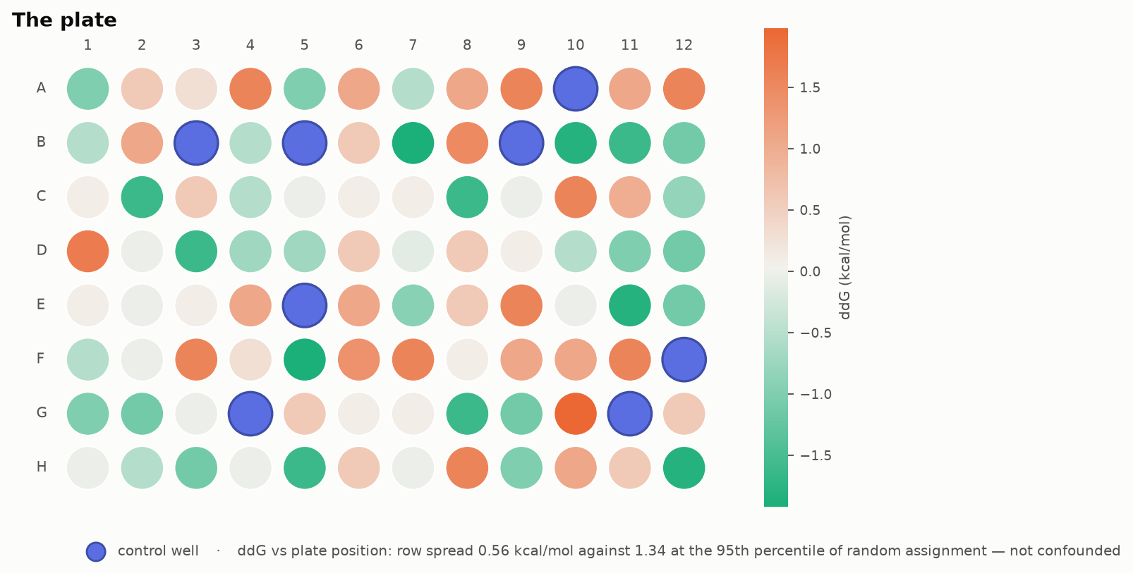
THE DELIVERABLE
So we spend the plate on the uncertainty
One 96-well plate, allocated across both surviving core hypotheses, every well labelled with the hypothesis it belongs to.
control: 8 wells · core 1-15: 44 wells · core 16-30: 44 wells
Read it twice: which switches work, and which core was right. A hypothesis with no responsive well is eliminated — the epitope question answered by a synthesis run that was happening anyway.
Wells are randomised against hypothesis as well as against energy. Split by hypothesis into rows A–D and E–H and any row gradient is perfectly confounded with the comparison. Controls are shared, not duplicated: they report on the assay, not the core.
Notes:
[34s · 3:14 of 4:36]
So spend the plate on the uncertainty. 44 wells per core hypothesis, 8 shared controls, every well labelled. Read it twice: which switches work, and which core was right. A hypothesis with no responsive well is eliminated — the epitope question answered by a synthesis run that was happening anyway. Randomised against hypothesis, not blocked by row, or a warm corner of the plate becomes your result.

Slide 9
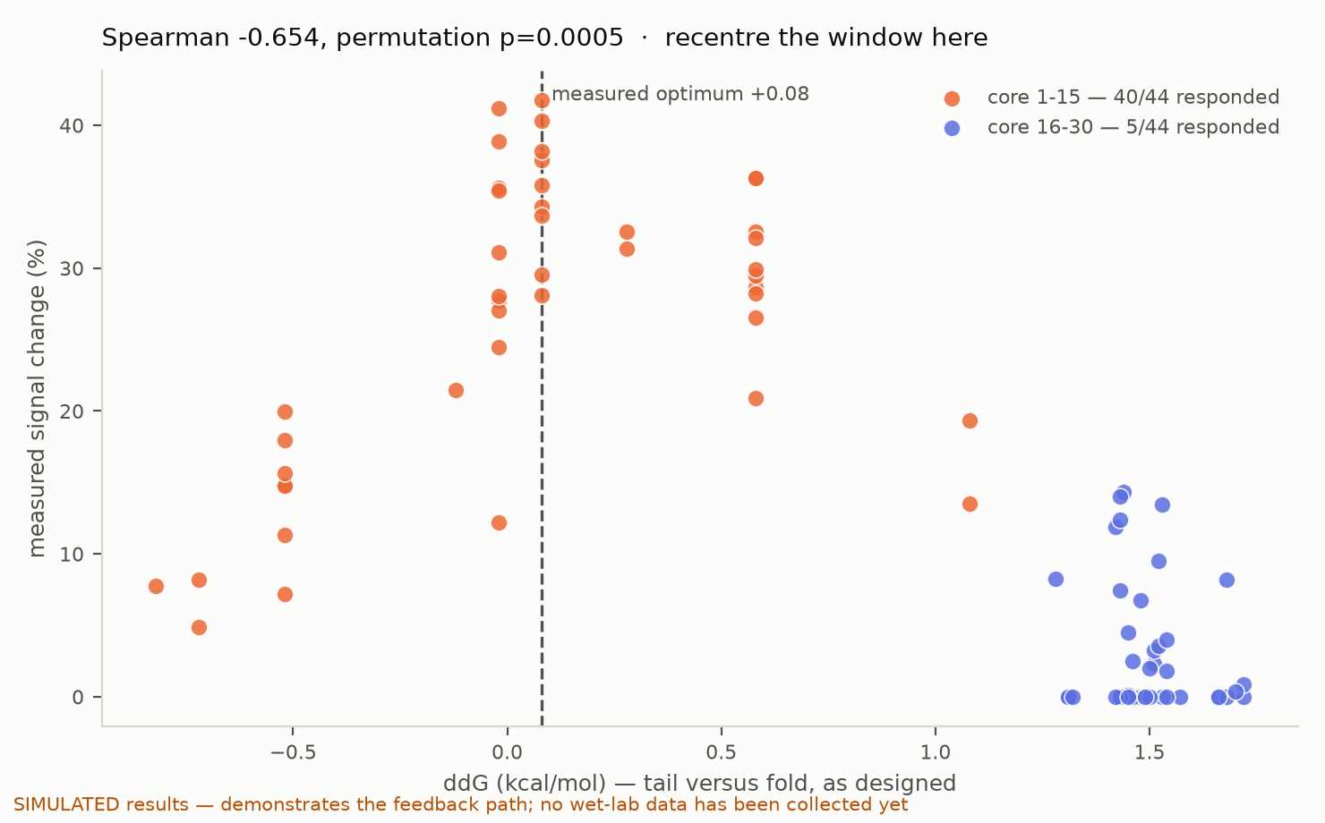
DESIGN → BUILD → TEST → LEARN
The bench answers, and the next round moves
Upload a results CSV and the agent reads it before it designs anything.
core 1-15: 40/44 wells responded, median 28.45%
core 16-30: 5/44 wells responded, median 0.0%
One plate settles the epitope question. The window recentres on the measured optimum (ddG +0.08), not the predicted one.
And on a pure-noise plate it reports ρ=-0.117, p=0.2599 and refuses to recentre. Every correlation is tested against a 2,000-permutation null before it is allowed to move a design.
Notes:
[40s · 3:54 of 4:36]
The loop closes. Upload the plate reader CSV, it is read before anything is designed. On this plate one core responded 40 of 44, the other 5 of 44 — epitope settled in one round. Window recentres on the MEASURED optimum. Then the important half: on a pure-noise plate it reports p=0.26 and refuses to move. A tool that finds signal in noise is worse than no tool. Say the data on screen is simulated — it is labelled on the figure.

Slide 10
WHAT DID NOT WORK
Three models we tried, controlled, and threw away
OpenDDE (AlphaFold3-class complex prediction)
Control: the same protein against a scrambled aptamer of identical length and base composition. Scrambled scored HIGHER: interface pTM 0.676 vs 0.580, and higher on pLDDT, pTM and ranking score too.
Evo2-7B (genome language model)
Control: six published aptamers, each against its own scramble. Real scored lower in 4 of 6, mean perplexity difference -0.22; the effect is carried almost entirely by AS1411, a GGTGGTGGT repeat, and both clear losses are the non-repetitive sequences.
surface electrostatics from an ESMFold2 structure
Control: proteins whose aptamers are textbook — nucleolin, thrombin, lysozyme. IL-6 (+1.78) outranked lysozyme (+1.39), and lysozyme — net charge +8, pI about 11 — reports zero exposed basic residues.
A tool that only reports what it used looks more certain than it is.
The dimer and fold energies the plate is filtered on were checked against Primer3's independent implementation: homodimer rank correlation 0.49–0.67 across plates, 0.81 on random DNA. Absolute values differ by ~6 kcal/mol because the parameter sets differ; the ordering, which is what the filter acts on, holds.
Notes:
[20s · 4:14 of 4:36]
Three external models we tried and threw away, each against a control. OpenDDE: the SCRAMBLED aptamer scored higher, so the contacts cannot define a core. Evo2: it prefers repetitive DNA, not aptamers. We report these because a tool that only lists what it used looks more certain than it is.

Slide 11
LIMITS, STATED UP FRONT
What this does not do
It cannot invent an aptamer. Without a published parent there is nothing honest to build on, and the agent says so.
It cannot predict affinity. Apparent Kd is computed only when a paper reports one for that exact sequence — usually none does, and the affinity figures are then omitted.
It cannot reach healthy baseline. IL-6 circulates at pg/mL and aptamer Kd values are nanomolar; switching costs affinity on top of that. This sensor class reaches sepsis and cytokine-release range, not routine monitoring — and the memo says so every time.
The binding core remains an assumption. That is precisely why the deliverable is a hedged plate rather than a confident one.
Notes:
[14s · 4:28 of 4:36]
Limits, said before anyone asks. Cannot invent an aptamer. Cannot predict affinity. Cannot reach healthy baseline — IL-6 circulates at pg/mL, aptamer Kd is nanomolar, and switching costs more affinity on top. This class reaches sepsis and CRS, and the memo says so every time.

Slide 12
96 wells, and an honest account of what they rest on
Every run archives a manifest: the parent and its citation, the thresholds chosen, the assumption made, the commit that produced it. A reader deciding whether to spend a synthesis slot can see all of it.
Reproduced from commit 1f95840 · github.com/ascendbio/aptamer-switch
Notes:
[8s · 4:36 of 4:36]
Every run archives a manifest: parent, citation, thresholds, the assumption, the commit. Close on the hedged plate as the deliverable.

