Slide 1
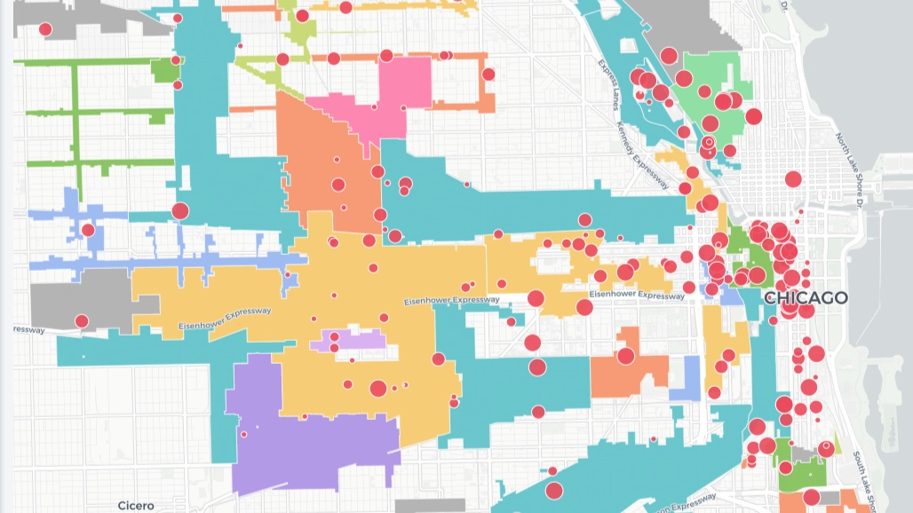
TIF, Construction, and Population Migrations in Chicago
Emmanuel Darko
Alex Schackmuth
Michael Stewart

Slide 2
Project Purpose
Geographically show the relationships between Tax Increment Financing (TIF), construction (new, renovations, and demolitions), and population migrations in the city of Chicago.
Does new construction displace racial enclaves and low-income communities?
These maps aim to show whether these shifts are present and if so what they look like.

Slide 3
Data Sources
The project utilizes data from the City of Chicago Data Portal and the American Community Survey (ACS).
We are using data on TIF projects and building permits from the Chicago Data Portal
Additionally we are using four years of ACS demographic data

Slide 4
App Structure
Flask Server
3 JS files, 1 for each map
One HTML file that ties everything together

Slide 5
Interactive Elements
Without intervention building permit and demographic maps cycle at similar periods over a similar (but note exact timeframe) unless stopped.
The TIF project map contains circles scaled in size to the approved cost of the project that provide popups when clicked on.
All maps allow user to zoom in and out in order to see patterns at different scales.

Slide 6
Map Construction
Maps where all built utilizing leaflet.js library
The cycling maps utilized a library called leaflet.liveupdate
These maps utilized other plugins we used in class such as heatmap and choropleth

Slide 7
Limitations
Census data does not count the Latino(a) population in the same way as other races (they are included in the white population)
This made tracking possible Latino displacement by gentrification impossible
Gentrification has been regarded as a “chaotic and complicated process”(Beauregard 1986)
As such there are several other factors overlooked in this app such as calculating the rent gap, and examining income, etc
Not enough time but we are pleased with our results

