Slide 1
DADS 5250 Hackathon
Group 1:
Colin Moller
Fabio Rollin
Nathan Tsung
Simar Singh
Anson Chan

Slide 2
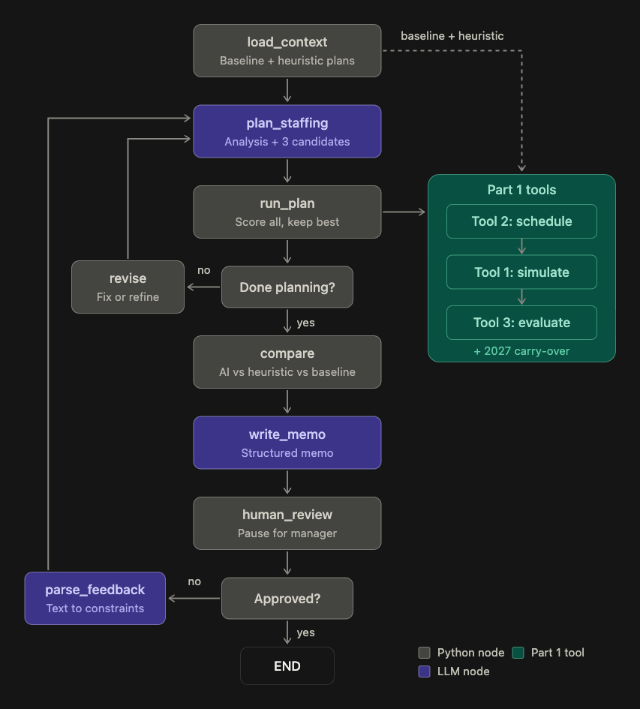
Dynamic Agent Staffing Optimization with GenAI
For this project, we will use a forecasting function to forecast advertiser demand for 2026 and use LLM to assist us to build a dynamic month-to-month staffing plan, taking into considerations of agent tasks (60-day support), staffing rules and costs, and revenue uplifts.

Slide 3
Overall Flow
Staffing Decisions
Build Staffing Schedule based on decisions
Simulate Scenario based on Schedule
Evaluate Simulated Scenarios
LLM decides how to hire and terminate in 2026 (3 candidates each round)
Use tool build_staffing_
schedule
Use tool evaluate
_plan
Use tool simulate_
country
Forecast 2026 Eligible Advertisers Demand
Heuristic Plan to Hire and Terminate (three rules to follow, refer to notebook)
Use tool build_staffing_
schedule
Use tool simulate_
country
Use tool evaluate
_plan
Compare plans
Build a baseline scenario:
0 hires and 0 terminations throughout the year
Use tool build_staffing_
schedule
Use tool simulate_
country
Use tool evaluate
_plan
Write memo for human approval

Slide 4
Tools
1. Simulate_Country
This simulates advertiser assignment and agent capacity for a country on a day-by-day bases over a specified simulation period. At the end, it will produce a table of how advertisers are supported based on the input staffing scenario.
*Due to performance, a faster_simulate_country is implemeted, but the logic is the same
2. Build_Staffing_Schedule
This converts monthly hiring and termination decisions into the actual productive agent headcount available each month, which calculating total staffing and termination costs
3. Evaluate_Plan
This evaluates the performance of a complete staffing simulation, combining advertiser service outcomes, agent utilization, staffing costs, and expected revenue uplift.

Slide 5






How the LLM Is Used in the Graph
plan_staffing
write_memo
parse_feedback
Chooses the headcount
Explains the plan
Takes manager input
3 strategies every round
Writes the approval memo for the manager
Headline, why this plan, AI vs. heuristic, risks and assumptions
Turns plain-English feedback into hard constraints
Enforced by validation on the next round
Aggressive
Moderate
Conservative
Writes an analysis first, then target agents for Feb–Dec with a reason per month
Tools validate and simulate every candidate and keeps the best
Iterates up to 5 rounds: fix failures, then refine the best plan
Uses only numbers computed by the simulator
“Don’t give anyone notice before June, and never go below 110 agents”
TECHNIQUES USED
LangGraph
Revise and refine loops, plus a human-approval pause
Prompt engineering
Rules, costs and feedback built into the prompt
Structured outputs
Pydantic schemas for plans, memos and constraints
Notes:
The LLM is used in three nodes of the LangGraph workflow; everything numeric comes from the simulator.
plan_staffing: the LLM first writes an analysis (busy months, idle capacity, which notice months pay off), then proposes three candidate plans with different strategies: aggressive, moderate and conservative. Each candidate gives target productive agents for February to December with a reason per month. Python converts targets into hires and terminations, validates them, and simulates every candidate with the Part 1 tools. If nothing passes, revise sends month-by-month feedback and the LLM tries again; after a pass it gets refine rounds to improve the best plan, up to 5 attempts in total. If no AI plan passes, the heuristic is the fallback.
write_memo: the LLM turns the final numbers into a structured approval memo: headline, why this plan, AI vs. heuristic, risks and assumptions. It is told to use only the numbers supplied.
parse_feedback: after the human review pause, the manager can reply in plain English. The LLM converts that into hard constraints (minimum agents, no notices before a month, cap on notices per month) that the validator enforces on the next round. Example from our Brazil run: no notice before June, never below 110 agents.
Techniques: LangGraph for the stateful graph, loops and human-in-the-loop pause; prompt engineering for the rules, costs, forecast and feedback given to the model; structured outputs (Pydantic schemas) so plans, memos and constraints are machine-checkable.

Slide 6
Final Report

Slide 7
Key Decisions and Assumptions
Each productive agent supports a maximum of 10 advertisers simultaneously.
Advertiser support lasts exactly 60 days.
Advertisers may wait up to 60 days.
Waiting advertisers are assigned FIFO.
All existing agents begin 2026 without existing advertiser assignments.
New agents require one month of ramp-up.
Ramping agents receive salary but provide zero capacity.
Termination requires one month's notice.
Agents remain productive during their notice month.
Termination costs 40% of annual salary.
The expected advertiser spend uplift used by the evaluation model is 13.75%.
Forecast growth is derived from 2024-2025 historical demand.

Slide 8
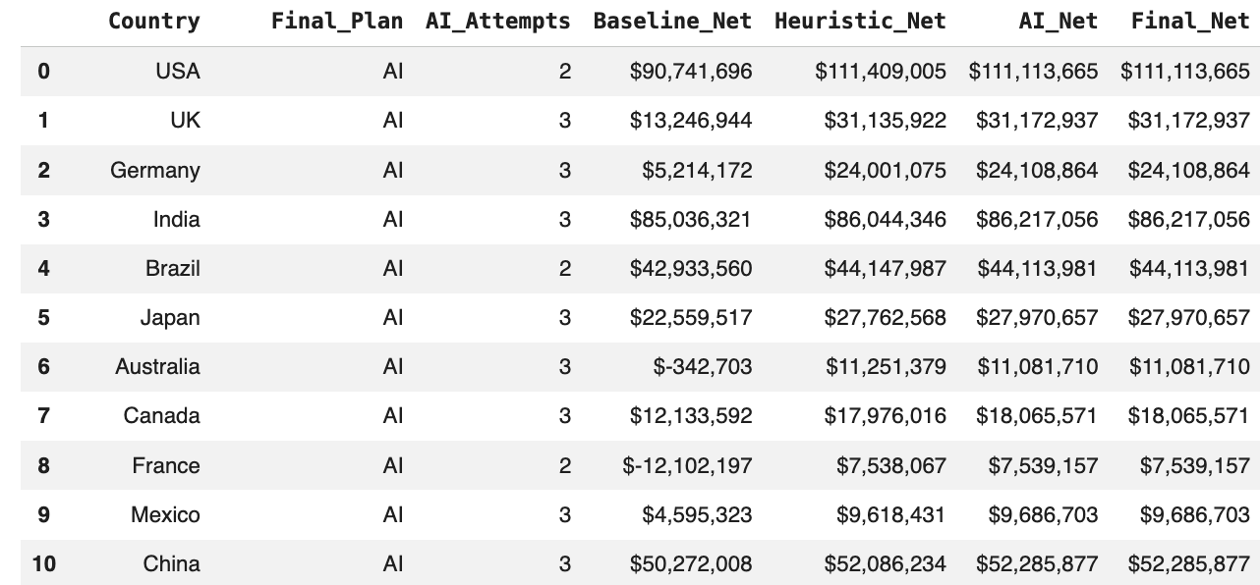

Overall:
Final Recommendations

Slide 9
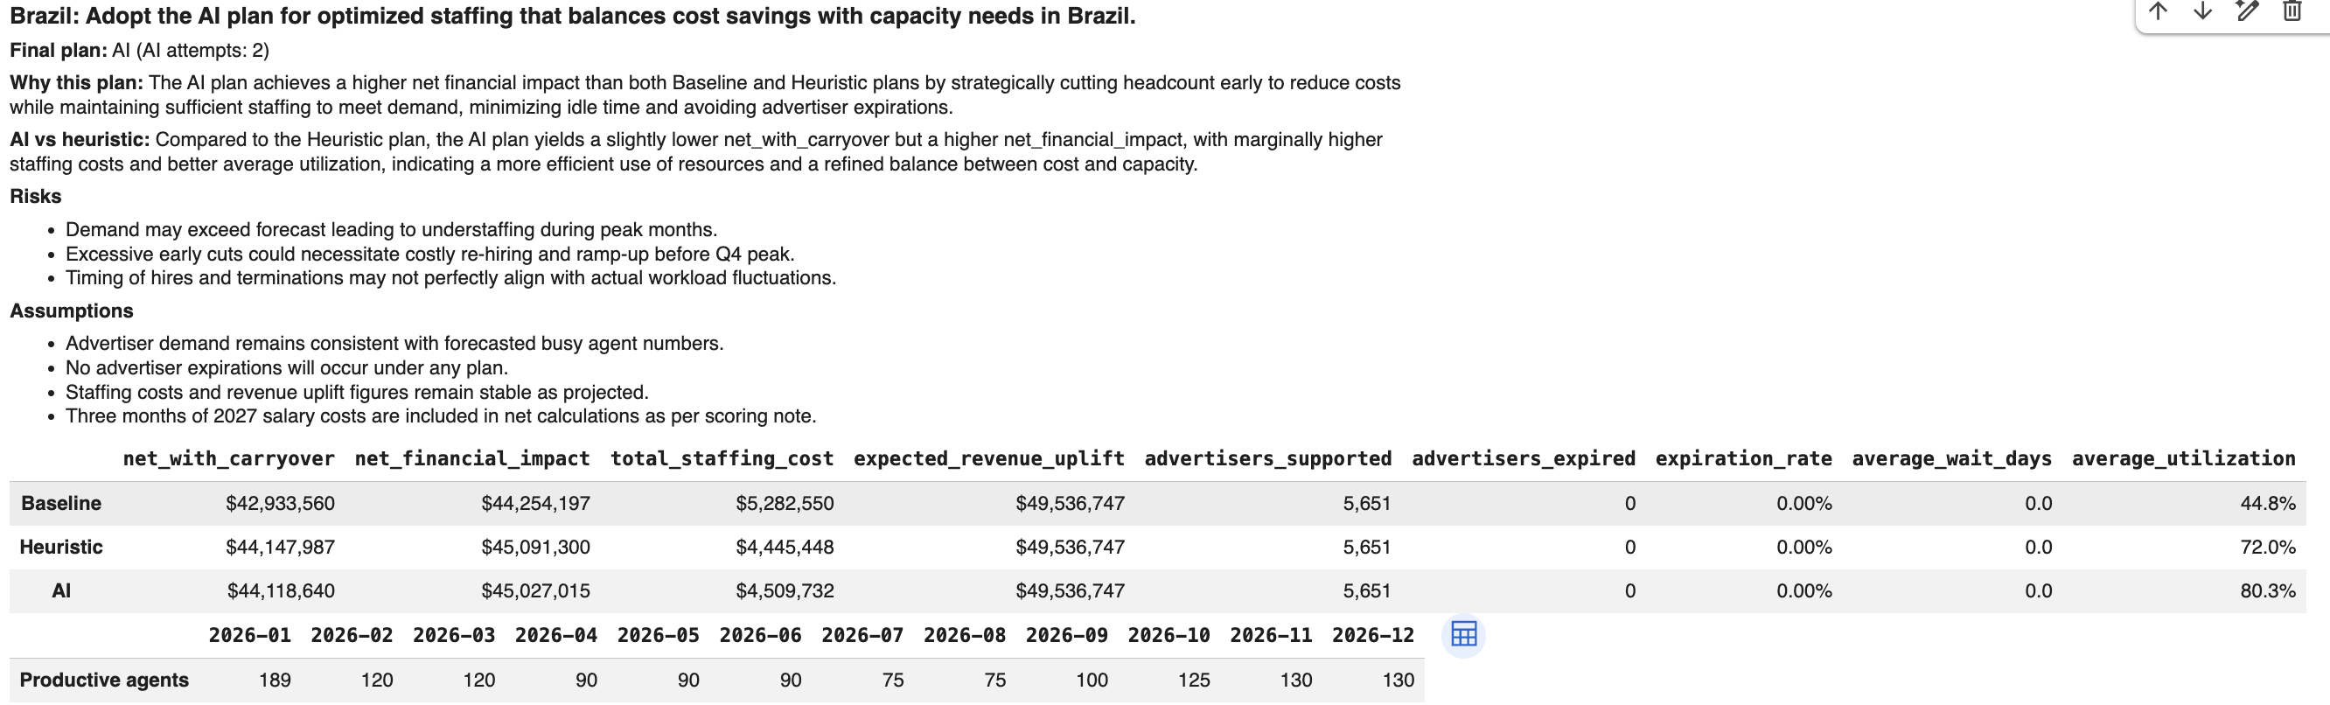
Detailed Analysis (Single Country Run)

Slide 10
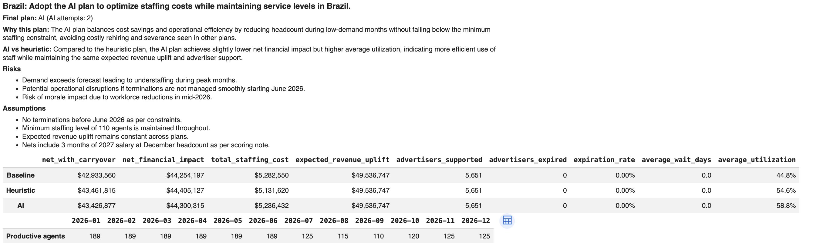
Detailed Analysis (Single Country Run with Human in the Loop)
Told: "Don't give anyone notice before June, and never go below 110 agents"

Slide 11
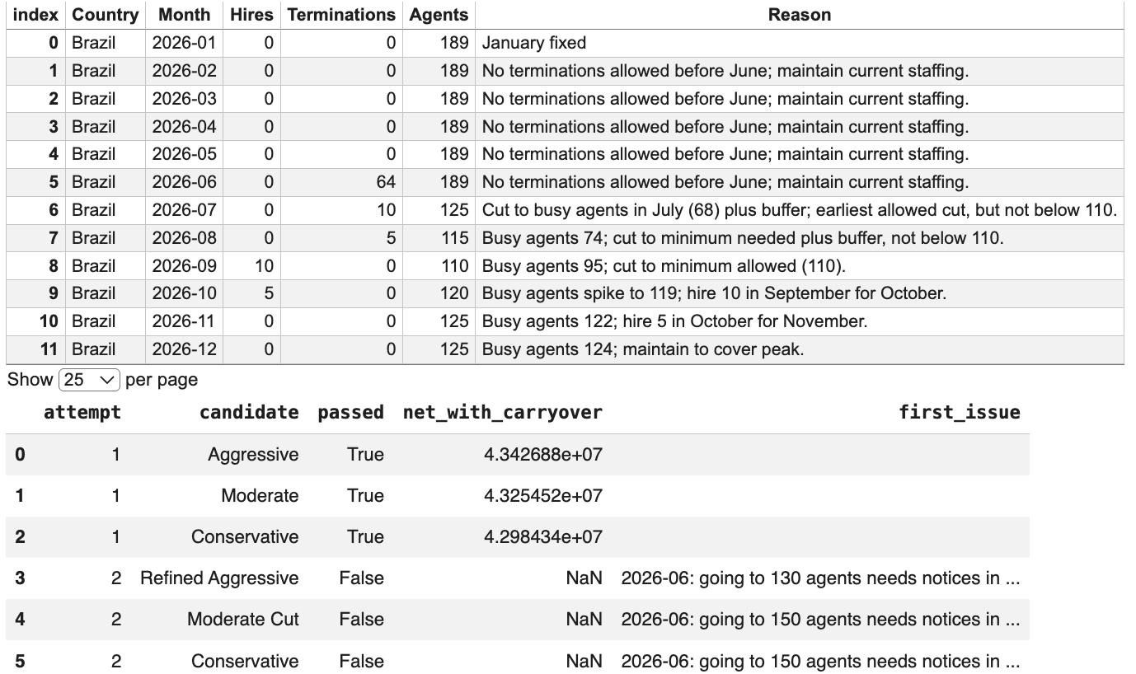
Detailed Analysis (Single Country Run with Human in the Loop)

Slide 12
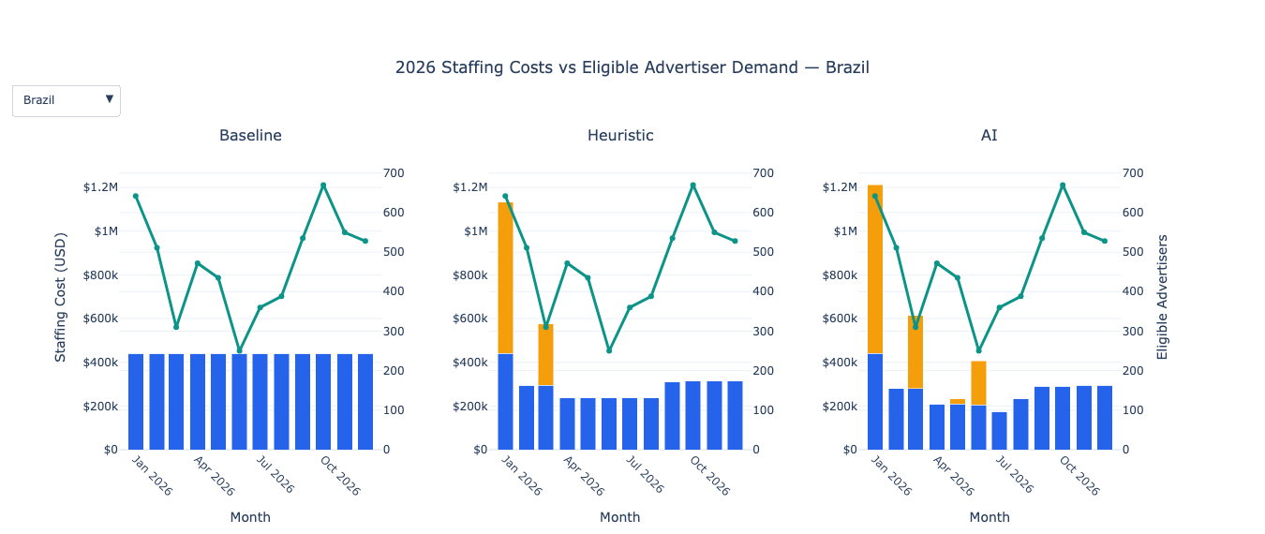
Detailed Analysis (Comparison Plots)

Slide 13
Thank You!

