Slide 1
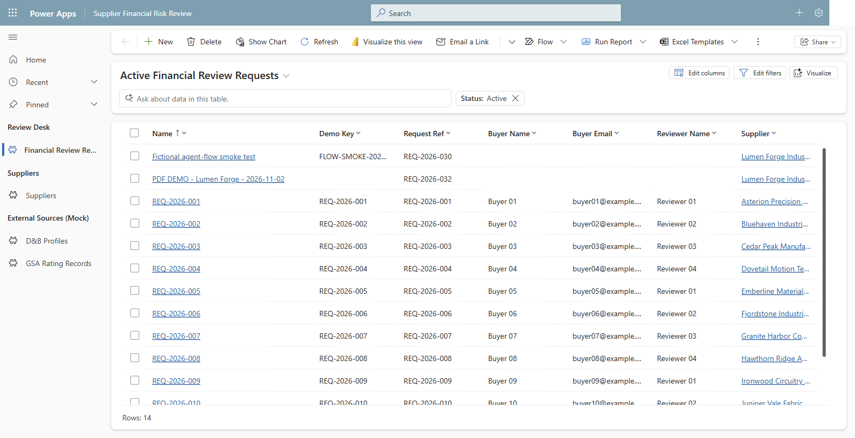
01 Open the request worklist - one starting point for supplier reviews.
Notes:
Capture date: 2026-11-02. Environment: DemoPRE. Browser: isolated Microsoft Edge Guest profile; the user completed sign-in.
Capture mode: read-only, explicitly selected by the user. No new request was saved and no existing records were edited.
Source: docs/09-demo-script.md, Step 2 (02:00-06:00); docs/requirements/source/fy27-magna-srm-use-case-extracted.txt, slides 1-3 and 6. External systems and supplier identities are fictional Dataverse mocks.
Step 2.1: Financial Review Requests, using the user-provided Active Financial Review Requests URL. The New command is visible. Personal buyer contact cells and the signed-in account avatar are masked for privacy.

Slide 2
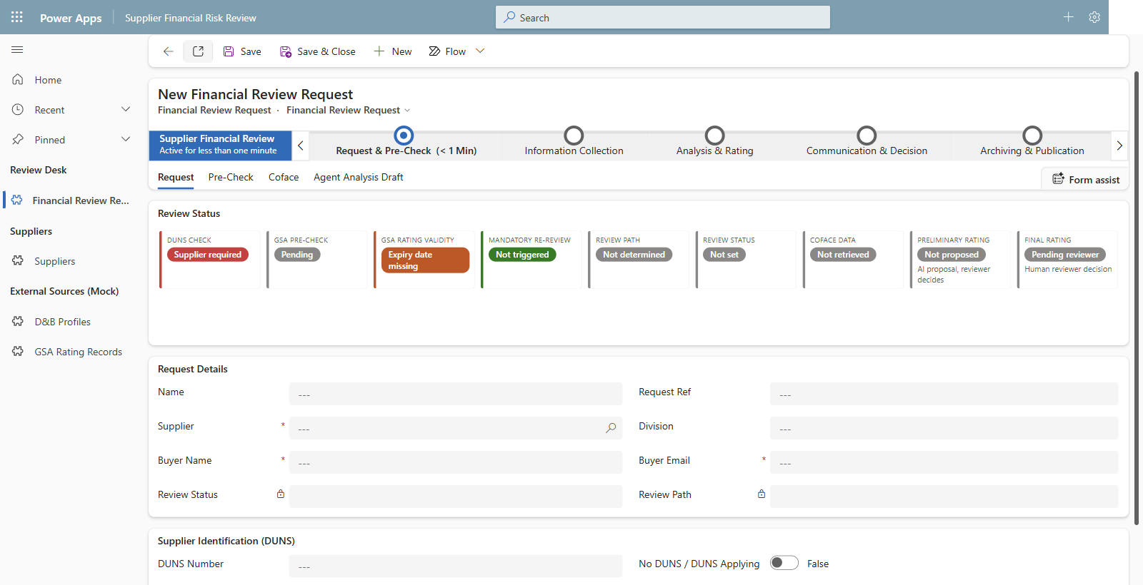
02 Start a new request - required supplier and buyer details, shown unsaved.
Notes:
Capture date: 2026-11-02. Environment: DemoPRE. Browser: isolated Microsoft Edge Guest profile; the user completed sign-in.
Capture mode: read-only, explicitly selected by the user. No new request was saved and no existing records were edited.
Source: docs/09-demo-script.md, Step 2 (02:00-06:00); docs/requirements/source/fy27-magna-srm-use-case-extracted.txt, slides 1-3 and 6. External systems and supplier identities are fictional Dataverse mocks.
Step 2.1-2: A genuine New Financial Review Request form. This form was left blank and was not saved. Required Supplier, Buyer Name, and Buyer Email fields are visible. No request was created, no generated reference is claimed, and no notification routing was changed.

Slide 3
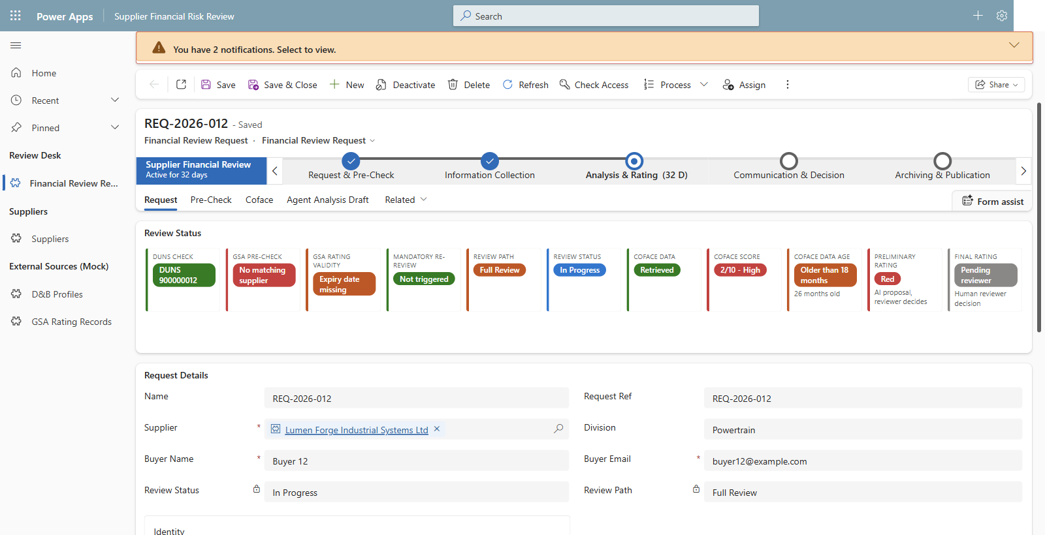
03 Seeded Lumen Forge - no GSA match and stale Coface data require Full Review.
Notes:
Capture date: 2026-11-02. Environment: DemoPRE. Browser: isolated Microsoft Edge Guest profile; the user completed sign-in.
Capture mode: read-only, explicitly selected by the user. No new request was saved and no existing records were edited.
Source: docs/09-demo-script.md, Step 2 (02:00-06:00); docs/requirements/source/fy27-magna-srm-use-case-extracted.txt, slides 1-3 and 6. External systems and supplier identities are fictional Dataverse mocks.
Step 2.3-4: Read-only fallback REQ-2026-012, supplier SUP-012 Lumen Forge Industrial Systems Ltd. This is an existing seeded record, not a new submission. The stored request is In Progress on the Full Review path, at Analysis & Rating. The red preliminary rating is pre-existing seed data, not a fresh PDF analysis.

Slide 4
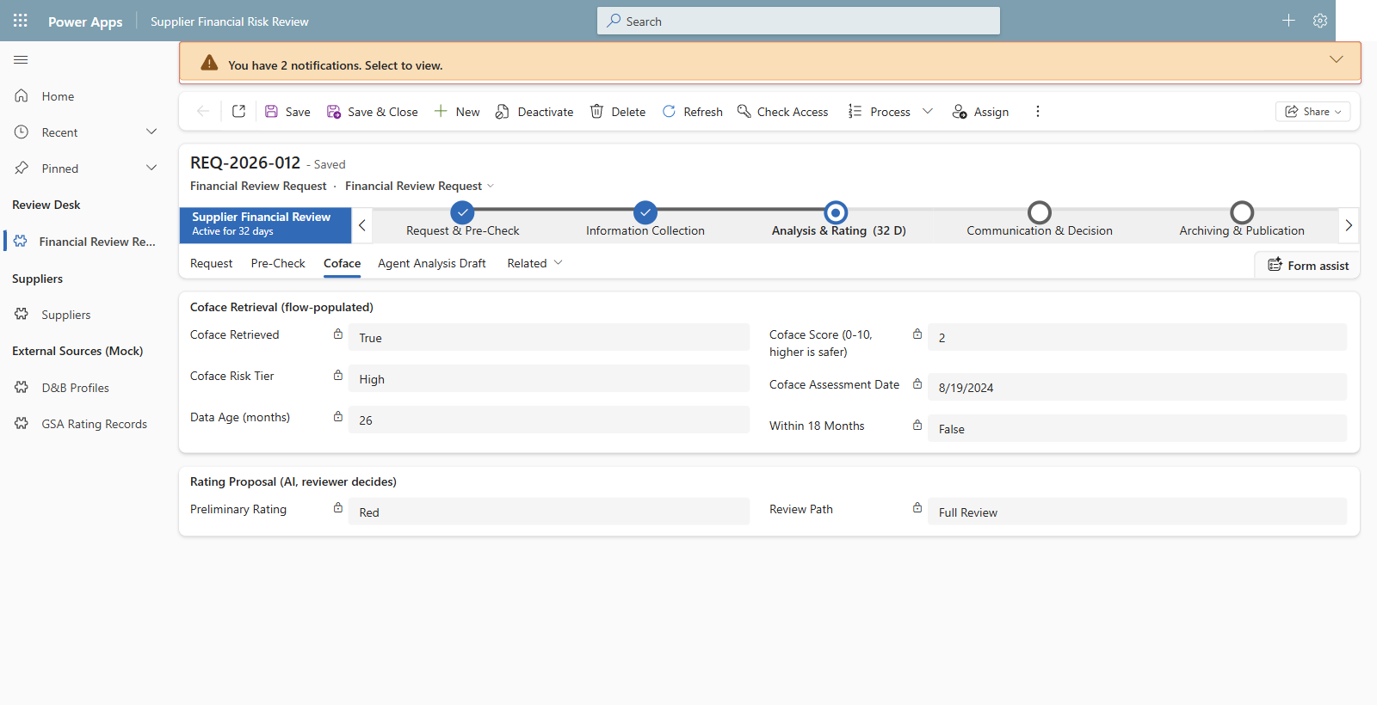
04 Seeded Coface evidence is over 18 months old - no fast-track shortcut.
Notes:
Capture date: 2026-11-02. Environment: DemoPRE. Browser: isolated Microsoft Edge Guest profile; the user completed sign-in.
Capture mode: read-only, explicitly selected by the user. No new request was saved and no existing records were edited.
Source: docs/09-demo-script.md, Step 2 (02:00-06:00); docs/requirements/source/fy27-magna-srm-use-case-extracted.txt, slides 1-3 and 6. External systems and supplier identities are fictional Dataverse mocks.
Step 2.3: Existing mocked Coface evidence on REQ-2026-012: score 2, High risk tier, assessment date 2024-08-19, stored data age 26 months, Within 18 Months = False, Full Review. The displayed preliminary Red rating is seeded and is not a human final rating or a result generated during this capture.

Slide 5
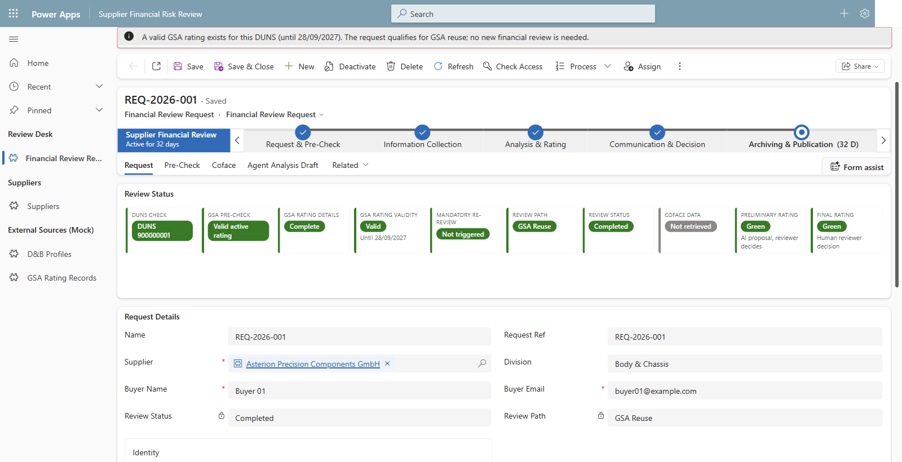
05 Fictional reuse contrast - a valid GSA rating avoids a redundant review.
Notes:
Capture date: 2026-11-02. Environment: DemoPRE. Browser: isolated Microsoft Edge Guest profile; the user completed sign-in.
Capture mode: read-only, explicitly selected by the user. No new request was saved and no existing records were edited.
Source: docs/09-demo-script.md, Step 2 (02:00-06:00); docs/requirements/source/fy27-magna-srm-use-case-extracted.txt, slides 1-3 and 6. External systems and supplier identities are fictional Dataverse mocks.
Step 2.5: Existing seeded REQ-2026-001 for Asterion Precision Components GmbH, SUP-001. Valid active GSA rating, no mandatory re-review, Review Path = GSA Reuse, Review Status = Completed. This screenshot is evidence of the seeded reuse example, not a newly executed workflow.

Slide 6
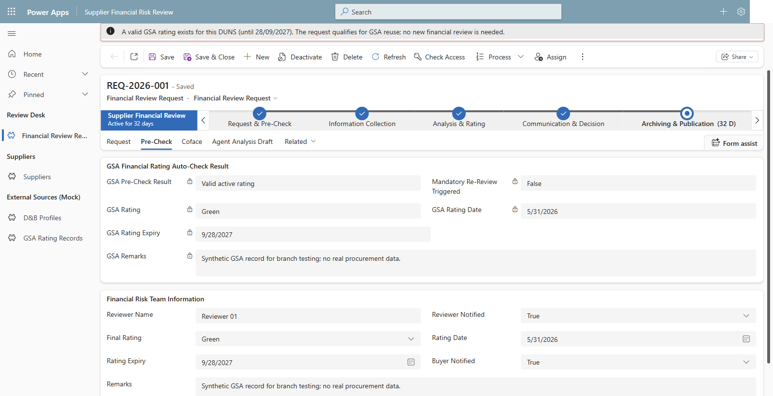
06 Reuse the existing Green rating - this is not a new AI rating.
Notes:
Capture date: 2026-11-02. Environment: DemoPRE. Browser: isolated Microsoft Edge Guest profile; the user completed sign-in.
Capture mode: read-only, explicitly selected by the user. No new request was saved and no existing records were edited.
Source: docs/09-demo-script.md, Step 2 (02:00-06:00); docs/requirements/source/fy27-magna-srm-use-case-extracted.txt, slides 1-3 and 6. External systems and supplier identities are fictional Dataverse mocks.
Step 2.5: REQ-2026-001 Pre-Check tab. Existing GSA and final ratings are Green, rating date 2026-05-31, expiry 2027-09-28. Synthetic GSA remarks explicitly state that no real procurement data is used. Values were read only and were not changed.

Slide 7
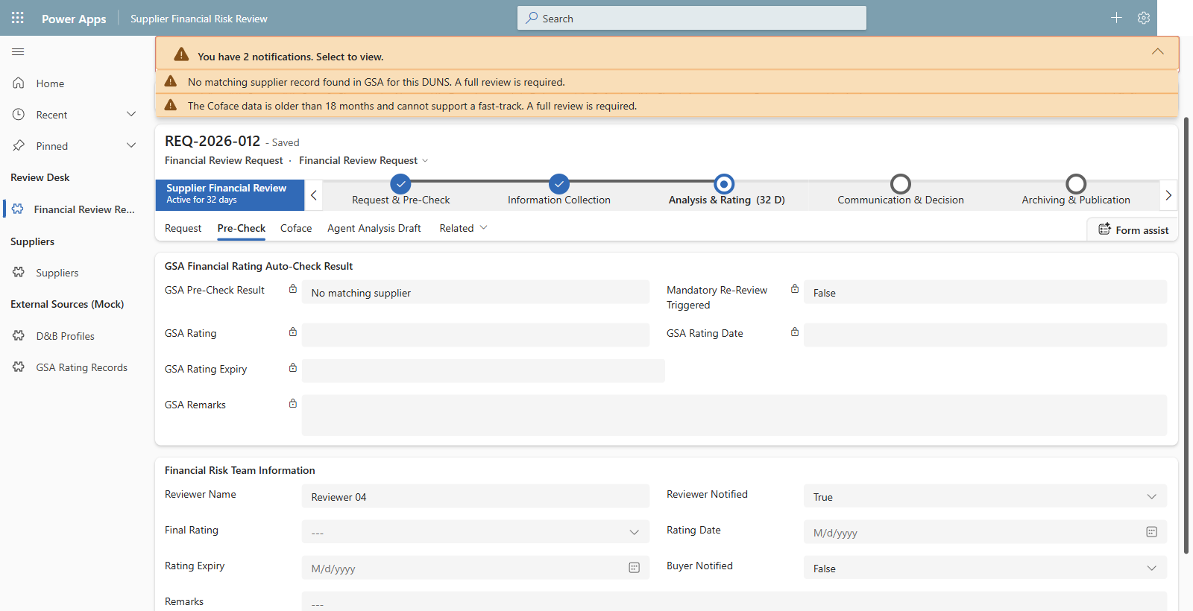
07 Back to seeded Lumen Forge - review evidence; the human owns the final rating.
Notes:
Capture date: 2026-11-02. Environment: DemoPRE. Browser: isolated Microsoft Edge Guest profile; the user completed sign-in.
Capture mode: read-only, explicitly selected by the user. No new request was saved and no existing records were edited.
Source: docs/09-demo-script.md, Step 2 (02:00-06:00); docs/requirements/source/fy27-magna-srm-use-case-extracted.txt, slides 1-3 and 6. External systems and supplier identities are fictional Dataverse mocks.
Step 2.6: Return to REQ-2026-012. No matching GSA supplier and stale Coface data require a full review. The Final Rating is blank. Interpret the two visible notifications together: a missing GSA match alone does not exclude a later fast-track based on eligible fresh Coface evidence. The first app notification is broader than that rule; the genuine screenshot has not been retouched. No final rating, reviewer confirmation, status, stage, or other record value was modified. Preview attachment handling is not a wired app-to-chat integration; extracted facts reach a request only through the explicit draft save described in Step 7, which was not performed.

