Slide 1
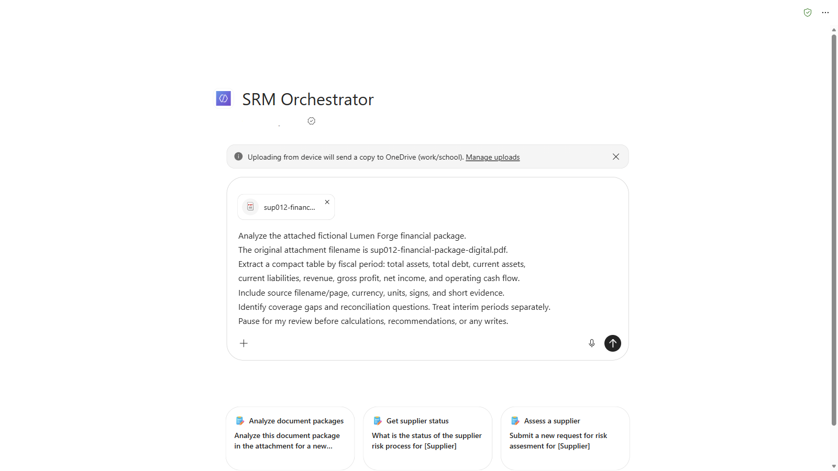
3.1 Attach the digital package - extraction comes before analysis or writes.
Notes:
Capture date: 2026-11-02. Browser: isolated Microsoft Edge Guest profile; the user completed the correct sign-in. These are genuine screenshots or focused crops of visible Microsoft Copilot / SRM Orchestrator responses, not fabricated chat content.
Channel: the existing Microsoft Copilot SRM Orchestrator, not Copilot Studio Draft Preview. No publication, agent edits, deployment, or environment configuration changes were performed. These observations do not prove Draft/published parity or the full connected-agent journey.
Traceability: docs\09-demo-script.md, Steps 3 and 4; source slide8, SRM-FIN-001; human-accountability boundaries in the source and main guide. The main demo script and PDF fixtures were not modified.
Privacy: unrelated chat navigation/account information and the initial creator byline are masked. Visible financial content was not retouched. Focused crops intentionally show only the relevant extraction, disclosure, or review gate.
Storage boundary: Microsoft Copilot copied the uploaded fictional PDFs to the signed-in work account's OneDrive. The agent's visible statements about nothing being persisted concern the business-record/save boundary, not the existence of OneDrive uploads or chat history. No Dataverse write or authenticated approval was requested; the visible conversations show no business-record save tool call. No separate live Dataverse audit verification was performed.
Scope of verification: all 32 requested digital values/signs/pages matched the original PDF; all six scan values/signs matched the FY2025 reference and scan pages 1-3. The scan has three raster-only pages with no embedded text layer. No expected-results file, manifest, seed CSV, or presenter guide was uploaded to the agent. Recognition is not guaranteed infallible.
Presenter caveat: original narrative reconciliation questions remain unapproved. In particular, FY2023 net income and operating cash flow are both positive, so the original 'diverge in direction' wording needs review; the original scan debt-comparison wording is also not endorsed. This deck demonstrates extraction and human review, not a validated risk conclusion.
The exact Step 3 prompt was composed with only sup012-financial-package-digital.pdf attached. The screenshot precedes submission. The visible Microsoft Copilot upload banner explicitly states that a copy is sent to OneDrive.
This run's conversation (requires the correct work account): https://copilot.cloud.microsoft/agents/copilotstudio/T_5bd9e801-f51d-90b8-6a37-879bf5a08731.5db18ed7-e817-44b4-a338-5f7d91078fcf/conversation/c71eec99-a0e8-471d-b697-32253c845675

Slide 2
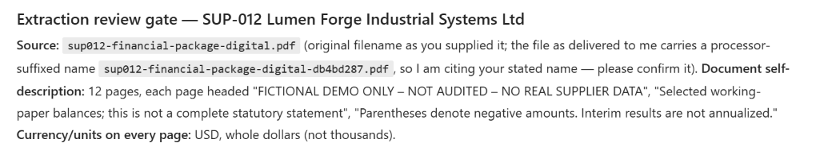
3.2 Source identity, whole-dollar units, and the filename caveat stay explicit.
Notes:
Capture date: 2026-11-02. Browser: isolated Microsoft Edge Guest profile; the user completed the correct sign-in. These are genuine screenshots or focused crops of visible Microsoft Copilot / SRM Orchestrator responses, not fabricated chat content.
Channel: the existing Microsoft Copilot SRM Orchestrator, not Copilot Studio Draft Preview. No publication, agent edits, deployment, or environment configuration changes were performed. These observations do not prove Draft/published parity or the full connected-agent journey.
Traceability: docs\09-demo-script.md, Steps 3 and 4; source slide8, SRM-FIN-001; human-accountability boundaries in the source and main guide. The main demo script and PDF fixtures were not modified.
Privacy: unrelated chat navigation/account information and the initial creator byline are masked. Visible financial content was not retouched. Focused crops intentionally show only the relevant extraction, disclosure, or review gate.
Storage boundary: Microsoft Copilot copied the uploaded fictional PDFs to the signed-in work account's OneDrive. The agent's visible statements about nothing being persisted concern the business-record/save boundary, not the existence of OneDrive uploads or chat history. No Dataverse write or authenticated approval was requested; the visible conversations show no business-record save tool call. No separate live Dataverse audit verification was performed.
Scope of verification: all 32 requested digital values/signs/pages matched the original PDF; all six scan values/signs matched the FY2025 reference and scan pages 1-3. The scan has three raster-only pages with no embedded text layer. No expected-results file, manifest, seed CSV, or presenter guide was uploaded to the agent. Recognition is not guaranteed infallible.
Presenter caveat: original narrative reconciliation questions remain unapproved. In particular, FY2023 net income and operating cash flow are both positive, so the original 'diverge in direction' wording needs review; the original scan debt-comparison wording is also not endorsed. This deck demonstrates extraction and human review, not a validated risk conclusion.
Genuine UI crop of the initial answer: 12 source pages, USD whole dollars, fictional/unaudited working-paper excerpts. The agent reports processor alias sup012-financial-package-digital-db4bd287.pdf and attributes the canonical original filename to the user. Original-name confirmation is still pending.
This run's conversation (requires the correct work account): https://copilot.cloud.microsoft/agents/copilotstudio/T_5bd9e801-f51d-90b8-6a37-879bf5a08731.5db18ed7-e817-44b4-a338-5f7d91078fcf/conversation/c71eec99-a0e8-471d-b697-32253c845675

Slide 3
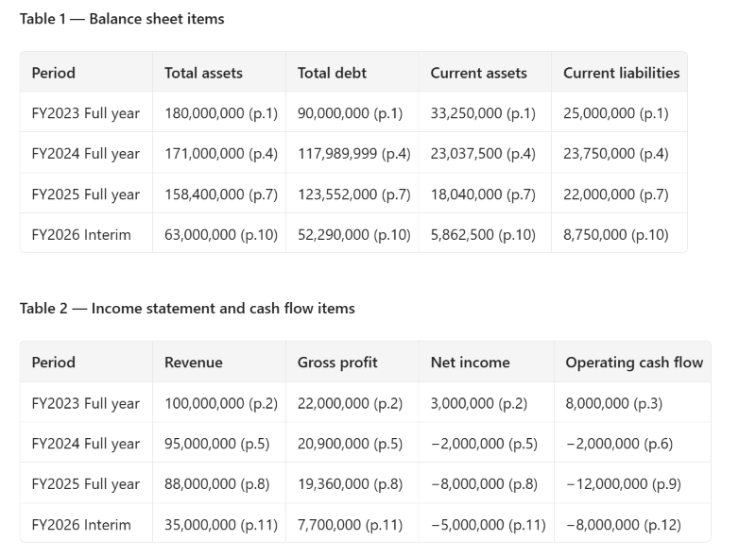
3.3 Four fiscal periods retain page-cited values; interim stays separate.
Notes:
Capture date: 2026-11-02. Browser: isolated Microsoft Edge Guest profile; the user completed the correct sign-in. These are genuine screenshots or focused crops of visible Microsoft Copilot / SRM Orchestrator responses, not fabricated chat content.
Channel: the existing Microsoft Copilot SRM Orchestrator, not Copilot Studio Draft Preview. No publication, agent edits, deployment, or environment configuration changes were performed. These observations do not prove Draft/published parity or the full connected-agent journey.
Traceability: docs\09-demo-script.md, Steps 3 and 4; source slide8, SRM-FIN-001; human-accountability boundaries in the source and main guide. The main demo script and PDF fixtures were not modified.
Privacy: unrelated chat navigation/account information and the initial creator byline are masked. Visible financial content was not retouched. Focused crops intentionally show only the relevant extraction, disclosure, or review gate.
Storage boundary: Microsoft Copilot copied the uploaded fictional PDFs to the signed-in work account's OneDrive. The agent's visible statements about nothing being persisted concern the business-record/save boundary, not the existence of OneDrive uploads or chat history. No Dataverse write or authenticated approval was requested; the visible conversations show no business-record save tool call. No separate live Dataverse audit verification was performed.
Scope of verification: all 32 requested digital values/signs/pages matched the original PDF; all six scan values/signs matched the FY2025 reference and scan pages 1-3. The scan has three raster-only pages with no embedded text layer. No expected-results file, manifest, seed CSV, or presenter guide was uploaded to the agent. Recognition is not guaranteed infallible.
Presenter caveat: original narrative reconciliation questions remain unapproved. In particular, FY2023 net income and operating cash flow are both positive, so the original 'diverge in direction' wording needs review; the original scan debt-comparison wording is also not endorsed. This deck demonstrates extraction and human review, not a validated risk conclusion.
The original wide answer was reformatted by the same live SRM Orchestrator conversation into two narrower tables using a layout-only follow-up. This did not approve extraction. All 32 requested numbers, signs, and physical page citations were compared with the original 12-page PDF; the reformatted values and citations were then verified unchanged. FY2024 debt remains 117,989,999. FY2026 interim is not annualized.
This run's conversation (requires the correct work account): https://copilot.cloud.microsoft/agents/copilotstudio/T_5bd9e801-f51d-90b8-6a37-879bf5a08731.5db18ed7-e817-44b4-a338-5f7d91078fcf/conversation/c71eec99-a0e8-471d-b697-32253c845675

Slide 4
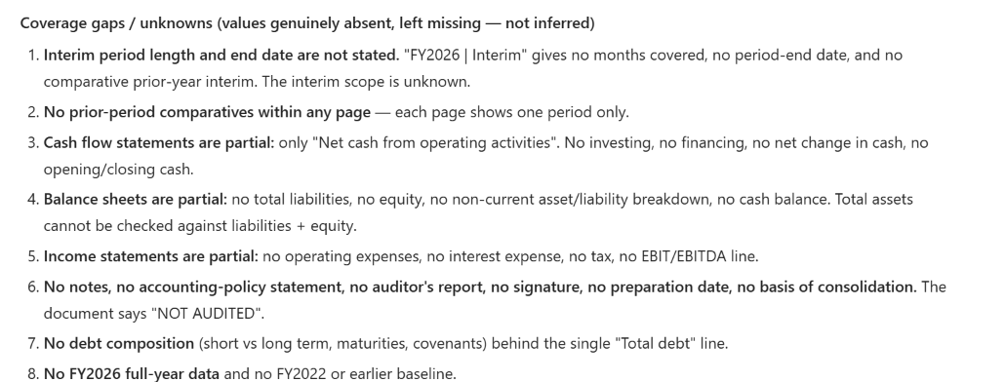
3.4 Missing disclosures stay missing - partial statements need reviewer follow-up.
Notes:
Capture date: 2026-11-02. Browser: isolated Microsoft Edge Guest profile; the user completed the correct sign-in. These are genuine screenshots or focused crops of visible Microsoft Copilot / SRM Orchestrator responses, not fabricated chat content.
Channel: the existing Microsoft Copilot SRM Orchestrator, not Copilot Studio Draft Preview. No publication, agent edits, deployment, or environment configuration changes were performed. These observations do not prove Draft/published parity or the full connected-agent journey.
Traceability: docs\09-demo-script.md, Steps 3 and 4; source slide8, SRM-FIN-001; human-accountability boundaries in the source and main guide. The main demo script and PDF fixtures were not modified.
Privacy: unrelated chat navigation/account information and the initial creator byline are masked. Visible financial content was not retouched. Focused crops intentionally show only the relevant extraction, disclosure, or review gate.
Storage boundary: Microsoft Copilot copied the uploaded fictional PDFs to the signed-in work account's OneDrive. The agent's visible statements about nothing being persisted concern the business-record/save boundary, not the existence of OneDrive uploads or chat history. No Dataverse write or authenticated approval was requested; the visible conversations show no business-record save tool call. No separate live Dataverse audit verification was performed.
Scope of verification: all 32 requested digital values/signs/pages matched the original PDF; all six scan values/signs matched the FY2025 reference and scan pages 1-3. The scan has three raster-only pages with no embedded text layer. No expected-results file, manifest, seed CSV, or presenter guide was uploaded to the agent. Recognition is not guaranteed infallible.
Presenter caveat: original narrative reconciliation questions remain unapproved. In particular, FY2023 net income and operating cash flow are both positive, so the original 'diverge in direction' wording needs review; the original scan debt-comparison wording is also not endorsed. This deck demonstrates extraction and human review, not a validated risk conclusion.
Genuine UI crop focused on the eight coverage gaps, without the following reconciliation-question section. Missing interim scope and absent statement components are left explicit. Only the requested financial figures and page citations were independently checked; the agent's wider narrative is not an approved financial assessment.
This run's conversation (requires the correct work account): https://copilot.cloud.microsoft/agents/copilotstudio/T_5bd9e801-f51d-90b8-6a37-879bf5a08731.5db18ed7-e817-44b4-a338-5f7d91078fcf/conversation/c71eec99-a0e8-471d-b697-32253c845675

Slide 5
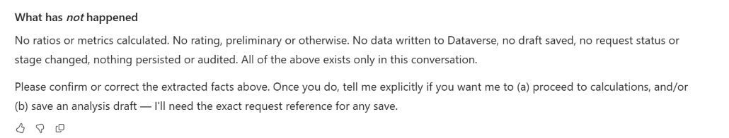
3.5 The agent pauses for extraction review; no rating or draft save is approved.
Notes:
Capture date: 2026-11-02. Browser: isolated Microsoft Edge Guest profile; the user completed the correct sign-in. These are genuine screenshots or focused crops of visible Microsoft Copilot / SRM Orchestrator responses, not fabricated chat content.
Channel: the existing Microsoft Copilot SRM Orchestrator, not Copilot Studio Draft Preview. No publication, agent edits, deployment, or environment configuration changes were performed. These observations do not prove Draft/published parity or the full connected-agent journey.
Traceability: docs\09-demo-script.md, Steps 3 and 4; source slide8, SRM-FIN-001; human-accountability boundaries in the source and main guide. The main demo script and PDF fixtures were not modified.
Privacy: unrelated chat navigation/account information and the initial creator byline are masked. Visible financial content was not retouched. Focused crops intentionally show only the relevant extraction, disclosure, or review gate.
Storage boundary: Microsoft Copilot copied the uploaded fictional PDFs to the signed-in work account's OneDrive. The agent's visible statements about nothing being persisted concern the business-record/save boundary, not the existence of OneDrive uploads or chat history. No Dataverse write or authenticated approval was requested; the visible conversations show no business-record save tool call. No separate live Dataverse audit verification was performed.
Scope of verification: all 32 requested digital values/signs/pages matched the original PDF; all six scan values/signs matched the FY2025 reference and scan pages 1-3. The scan has three raster-only pages with no embedded text layer. No expected-results file, manifest, seed CSV, or presenter guide was uploaded to the agent. Recognition is not guaranteed infallible.
Presenter caveat: original narrative reconciliation questions remain unapproved. In particular, FY2023 net income and operating cash flow are both positive, so the original 'diverge in direction' wording needs review; the original scan debt-comparison wording is also not endorsed. This deck demonstrates extraction and human review, not a validated risk conclusion.
The initial answer explicitly asks for confirmation or correction before calculations or a save. No approval was supplied. The later reformatting request also explicitly withheld approval and prohibited new analysis, ratings, Dataverse calls, and saves.
This run's conversation (requires the correct work account): https://copilot.cloud.microsoft/agents/copilotstudio/T_5bd9e801-f51d-90b8-6a37-879bf5a08731.5db18ed7-e817-44b4-a338-5f7d91078fcf/conversation/c71eec99-a0e8-471d-b697-32253c845675

Slide 6
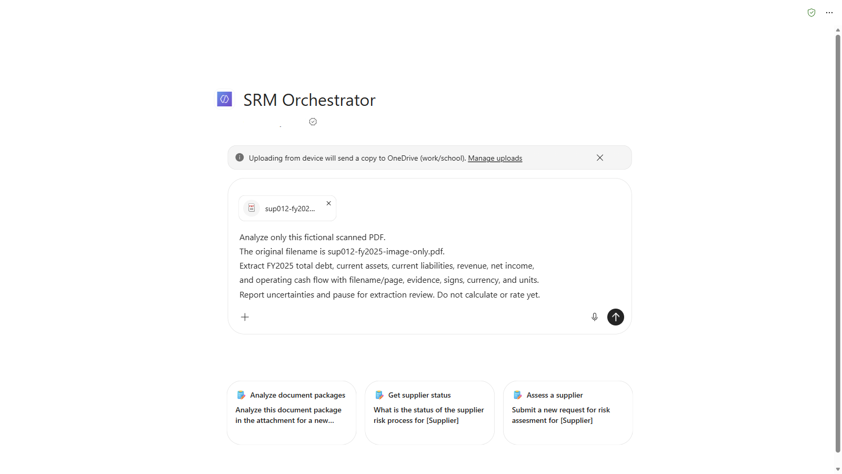
4.1 Start a fresh scan-only chat - keep the digital package out of this run.
Notes:
Capture date: 2026-11-02. Browser: isolated Microsoft Edge Guest profile; the user completed the correct sign-in. These are genuine screenshots or focused crops of visible Microsoft Copilot / SRM Orchestrator responses, not fabricated chat content.
Channel: the existing Microsoft Copilot SRM Orchestrator, not Copilot Studio Draft Preview. No publication, agent edits, deployment, or environment configuration changes were performed. These observations do not prove Draft/published parity or the full connected-agent journey.
Traceability: docs\09-demo-script.md, Steps 3 and 4; source slide8, SRM-FIN-001; human-accountability boundaries in the source and main guide. The main demo script and PDF fixtures were not modified.
Privacy: unrelated chat navigation/account information and the initial creator byline are masked. Visible financial content was not retouched. Focused crops intentionally show only the relevant extraction, disclosure, or review gate.
Storage boundary: Microsoft Copilot copied the uploaded fictional PDFs to the signed-in work account's OneDrive. The agent's visible statements about nothing being persisted concern the business-record/save boundary, not the existence of OneDrive uploads or chat history. No Dataverse write or authenticated approval was requested; the visible conversations show no business-record save tool call. No separate live Dataverse audit verification was performed.
Scope of verification: all 32 requested digital values/signs/pages matched the original PDF; all six scan values/signs matched the FY2025 reference and scan pages 1-3. The scan has three raster-only pages with no embedded text layer. No expected-results file, manifest, seed CSV, or presenter guide was uploaded to the agent. Recognition is not guaranteed infallible.
Presenter caveat: original narrative reconciliation questions remain unapproved. In particular, FY2023 net income and operating cash flow are both positive, so the original 'diverge in direction' wording needs review; the original scan debt-comparison wording is also not endorsed. This deck demonstrates extraction and human review, not a validated risk conclusion.
A new conversation was started through SRM Orchestrator's New chat control; the digital conversation was preserved by its URL. Only sup012-fy2025-image-only.pdf was uploaded. The original, clean image-only fixture was used, not the separate poor-quality derivative. The exact Step 4 prompt was composed before submission.
This run's conversation (requires the correct work account): https://copilot.cloud.microsoft/agents/copilotstudio/T_5bd9e801-f51d-90b8-6a37-879bf5a08731.5db18ed7-e817-44b4-a338-5f7d91078fcf/conversation/09010501-1253-451f-96ed-c39471376d46

Slide 7
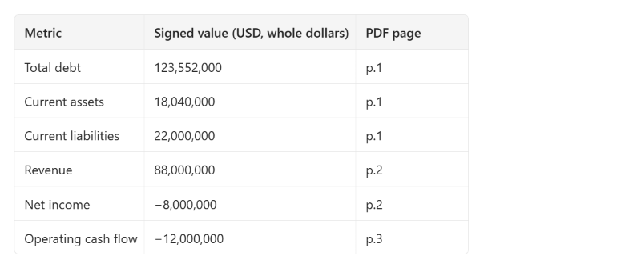
4.2 Six scan-derived figures retain their signs and physical PDF page references.
Notes:
Capture date: 2026-11-02. Browser: isolated Microsoft Edge Guest profile; the user completed the correct sign-in. These are genuine screenshots or focused crops of visible Microsoft Copilot / SRM Orchestrator responses, not fabricated chat content.
Channel: the existing Microsoft Copilot SRM Orchestrator, not Copilot Studio Draft Preview. No publication, agent edits, deployment, or environment configuration changes were performed. These observations do not prove Draft/published parity or the full connected-agent journey.
Traceability: docs\09-demo-script.md, Steps 3 and 4; source slide8, SRM-FIN-001; human-accountability boundaries in the source and main guide. The main demo script and PDF fixtures were not modified.
Privacy: unrelated chat navigation/account information and the initial creator byline are masked. Visible financial content was not retouched. Focused crops intentionally show only the relevant extraction, disclosure, or review gate.
Storage boundary: Microsoft Copilot copied the uploaded fictional PDFs to the signed-in work account's OneDrive. The agent's visible statements about nothing being persisted concern the business-record/save boundary, not the existence of OneDrive uploads or chat history. No Dataverse write or authenticated approval was requested; the visible conversations show no business-record save tool call. No separate live Dataverse audit verification was performed.
Scope of verification: all 32 requested digital values/signs/pages matched the original PDF; all six scan values/signs matched the FY2025 reference and scan pages 1-3. The scan has three raster-only pages with no embedded text layer. No expected-results file, manifest, seed CSV, or presenter guide was uploaded to the agent. Recognition is not guaranteed infallible.
Presenter caveat: original narrative reconciliation questions remain unapproved. In particular, FY2023 net income and operating cash flow are both positive, so the original 'diverge in direction' wording needs review; the original scan debt-comparison wording is also not endorsed. This deck demonstrates extraction and human review, not a validated risk conclusion.
Genuine UI crop of the live answer after a readability-only follow-up. The six values agree with the source-checked FY2025 reference: debt 123,552,000; current assets 18,040,000; current liabilities 22,000,000; revenue 88,000,000; net income -8,000,000; operating cash flow -12,000,000. Physical scan citations are pages 1, 2, and 3, not digital pages 7, 8, and 9. The follow-up clarified an initially ambiguous page-label phrase without supplying expected values or approving the facts.
This run's conversation (requires the correct work account): https://copilot.cloud.microsoft/agents/copilotstudio/T_5bd9e801-f51d-90b8-6a37-879bf5a08731.5db18ed7-e817-44b4-a338-5f7d91078fcf/conversation/09010501-1253-451f-96ed-c39471376d46

Slide 8
4.3 Recognition is not approval - a reviewer must confirm the scan-derived figures.
Notes:
Capture date: 2026-11-02. Browser: isolated Microsoft Edge Guest profile; the user completed the correct sign-in. These are genuine screenshots or focused crops of visible Microsoft Copilot / SRM Orchestrator responses, not fabricated chat content.
Channel: the existing Microsoft Copilot SRM Orchestrator, not Copilot Studio Draft Preview. No publication, agent edits, deployment, or environment configuration changes were performed. These observations do not prove Draft/published parity or the full connected-agent journey.
Traceability: docs\09-demo-script.md, Steps 3 and 4; source slide8, SRM-FIN-001; human-accountability boundaries in the source and main guide. The main demo script and PDF fixtures were not modified.
Privacy: unrelated chat navigation/account information and the initial creator byline are masked. Visible financial content was not retouched. Focused crops intentionally show only the relevant extraction, disclosure, or review gate.
Storage boundary: Microsoft Copilot copied the uploaded fictional PDFs to the signed-in work account's OneDrive. The agent's visible statements about nothing being persisted concern the business-record/save boundary, not the existence of OneDrive uploads or chat history. No Dataverse write or authenticated approval was requested; the visible conversations show no business-record save tool call. No separate live Dataverse audit verification was performed.
Scope of verification: all 32 requested digital values/signs/pages matched the original PDF; all six scan values/signs matched the FY2025 reference and scan pages 1-3. The scan has three raster-only pages with no embedded text layer. No expected-results file, manifest, seed CSV, or presenter guide was uploaded to the agent. Recognition is not guaranteed infallible.
Presenter caveat: original narrative reconciliation questions remain unapproved. In particular, FY2023 net income and operating cash flow are both positive, so the original 'diverge in direction' wording needs review; the original scan debt-comparison wording is also not endorsed. This deck demonstrates extraction and human review, not a validated risk conclusion.
Genuine UI crop of the first uncertainty item. The agent requests confirmation of page 1 and page 3 digits. Its statements about internal OCR/rendering are its own account, not independent proof of a particular processing order. Local PDF inspection separately confirmed exactly three pages and zero embedded text characters on all pages. Filename alias sup012-fy2025-image-only-5de0dd44.pdf remains a provenance caveat.
This run's conversation (requires the correct work account): https://copilot.cloud.microsoft/agents/copilotstudio/T_5bd9e801-f51d-90b8-6a37-879bf5a08731.5db18ed7-e817-44b4-a338-5f7d91078fcf/conversation/09010501-1253-451f-96ed-c39471376d46

Slide 9
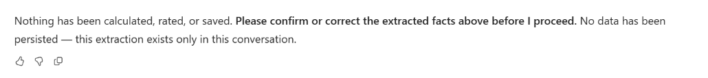
4.4 The reviewer must confirm or correct the facts before any next step.
Notes:
Capture date: 2026-11-02. Browser: isolated Microsoft Edge Guest profile; the user completed the correct sign-in. These are genuine screenshots or focused crops of visible Microsoft Copilot / SRM Orchestrator responses, not fabricated chat content.
Channel: the existing Microsoft Copilot SRM Orchestrator, not Copilot Studio Draft Preview. No publication, agent edits, deployment, or environment configuration changes were performed. These observations do not prove Draft/published parity or the full connected-agent journey.
Traceability: docs\09-demo-script.md, Steps 3 and 4; source slide8, SRM-FIN-001; human-accountability boundaries in the source and main guide. The main demo script and PDF fixtures were not modified.
Privacy: unrelated chat navigation/account information and the initial creator byline are masked. Visible financial content was not retouched. Focused crops intentionally show only the relevant extraction, disclosure, or review gate.
Storage boundary: Microsoft Copilot copied the uploaded fictional PDFs to the signed-in work account's OneDrive. The agent's visible statements about nothing being persisted concern the business-record/save boundary, not the existence of OneDrive uploads or chat history. No Dataverse write or authenticated approval was requested; the visible conversations show no business-record save tool call. No separate live Dataverse audit verification was performed.
Scope of verification: all 32 requested digital values/signs/pages matched the original PDF; all six scan values/signs matched the FY2025 reference and scan pages 1-3. The scan has three raster-only pages with no embedded text layer. No expected-results file, manifest, seed CSV, or presenter guide was uploaded to the agent. Recognition is not guaranteed infallible.
Presenter caveat: original narrative reconciliation questions remain unapproved. In particular, FY2023 net income and operating cash flow are both positive, so the original 'diverge in direction' wording needs review; the original scan debt-comparison wording is also not endorsed. This deck demonstrates extraction and human review, not a validated risk conclusion.
Genuine UI crop of the explicit extraction-review gate in the initial scan answer. No confirmation, calculations, rating decision, or Dataverse save was requested after extraction. Chat confirmation would not constitute authenticated approval even if provided.
This run's conversation (requires the correct work account): https://copilot.cloud.microsoft/agents/copilotstudio/T_5bd9e801-f51d-90b8-6a37-879bf5a08731.5db18ed7-e817-44b4-a338-5f7d91078fcf/conversation/09010501-1253-451f-96ed-c39471376d46

