Slide 1
Demo flow at a glance
From a review request to an evidence-backed draft. The reviewer owns the final rating.
Submit review
request
Agent reads
financial
PDFs
Surface gaps
and collateral
conflicts
Human reviews
the evidence
Agent prepares
preliminary
analysis
Agent saves
draft to the
review record
Human owns
the final
rating
REVIEW GATE
FINAL DECISION
Notes:
Reproduces all seven nodes and six edges of the Mermaid 'Demo flow at a glance' in docs/09-demo-script.md, in their original order. The final edge is dotted. Native PowerPoint shapes and text remain editable. This is the full-demo narrative, not proof that every capability ran in the following Step 2-4 screenshots. The human reviewer remains accountable for the final rating; the dotted handoff does not represent implemented authenticated approval. Source slide1 and slide8; SRM-FIN-001 and human-accountability requirements. Existing screenshot slides, notes, and captions are unchanged.

Slide 2
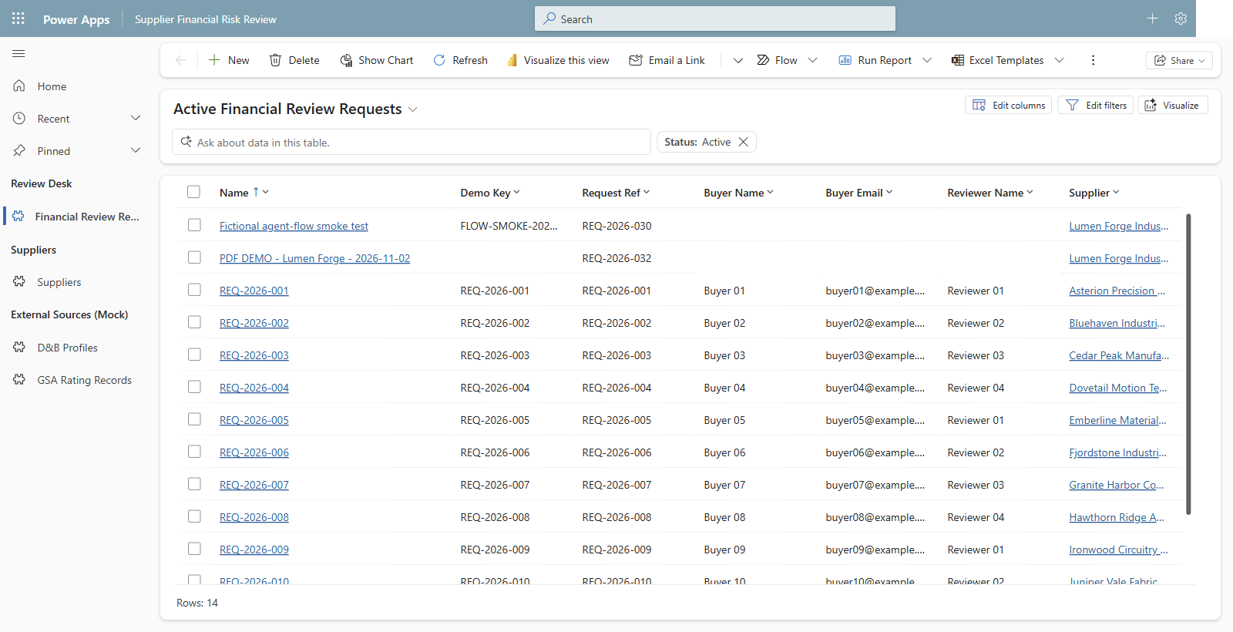
01 Open the request worklist - one starting point for supplier reviews.
Notes:
Capture date: 2026-11-02. Environment: DemoPRE. Browser: isolated Microsoft Edge Guest profile; the user completed sign-in.
Capture mode: read-only, explicitly selected by the user. No new request was saved and no existing records were edited.
Source: docs/09-demo-script.md, Step 2 (02:00-06:00); docs/requirements/source/fy27-magna-srm-use-case-extracted.txt, slides 1-3 and 6. External systems and supplier identities are fictional Dataverse mocks.
Step 2.1: Financial Review Requests, using the user-provided Active Financial Review Requests URL. The New command is visible. Personal buyer contact cells and the signed-in account avatar are masked for privacy.

Slide 3
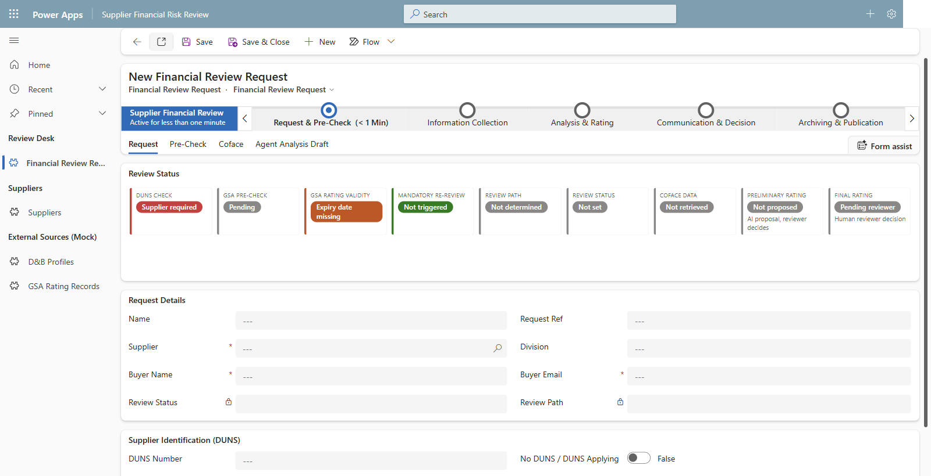
02 Start a new request - required supplier and buyer details, shown unsaved.
Notes:
Capture date: 2026-11-02. Environment: DemoPRE. Browser: isolated Microsoft Edge Guest profile; the user completed sign-in.
Capture mode: read-only, explicitly selected by the user. No new request was saved and no existing records were edited.
Source: docs/09-demo-script.md, Step 2 (02:00-06:00); docs/requirements/source/fy27-magna-srm-use-case-extracted.txt, slides 1-3 and 6. External systems and supplier identities are fictional Dataverse mocks.
Step 2.1-2: A genuine New Financial Review Request form. This form was left blank and was not saved. Required Supplier, Buyer Name, and Buyer Email fields are visible. No request was created, no generated reference is claimed, and no notification routing was changed.

Slide 4
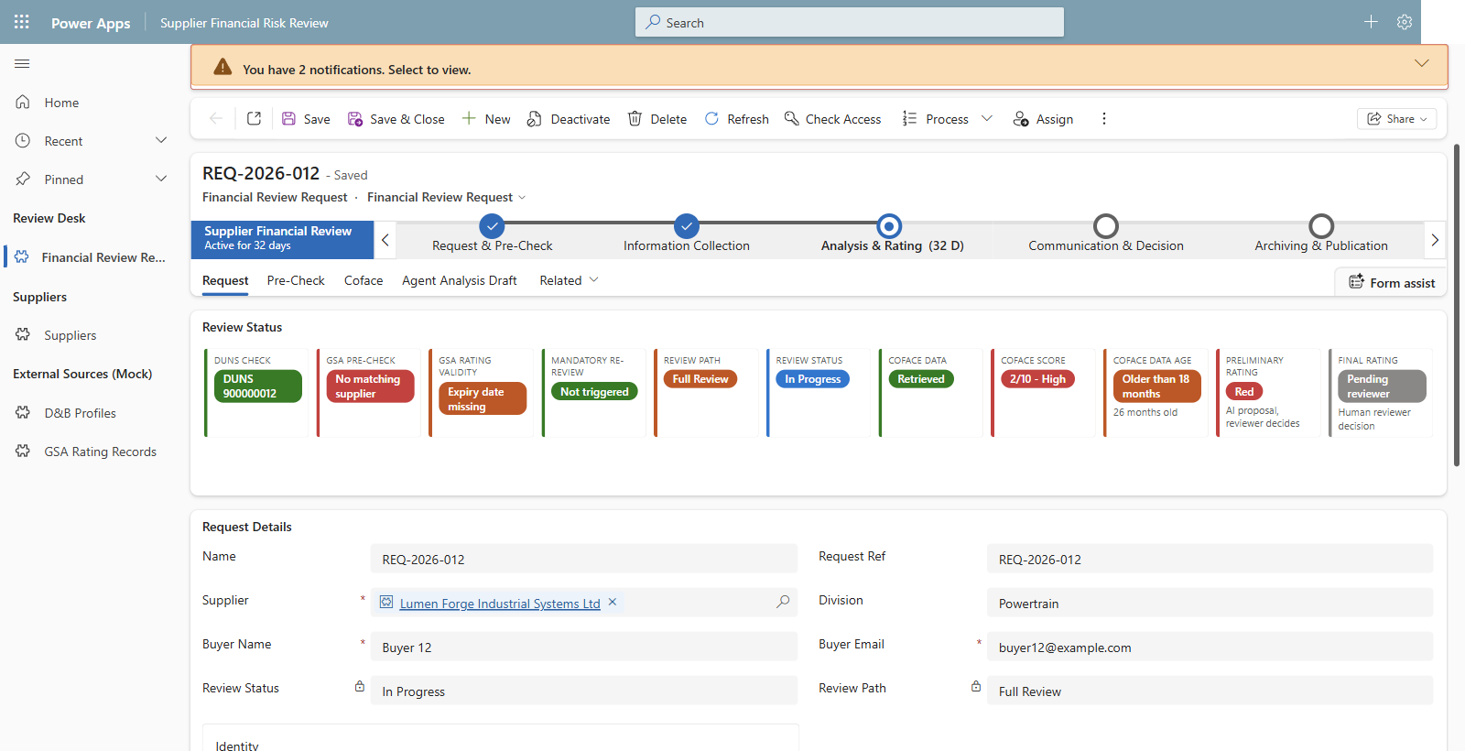
03 Seeded Lumen Forge - no GSA match and stale Coface data require Full Review.
Notes:
Capture date: 2026-11-02. Environment: DemoPRE. Browser: isolated Microsoft Edge Guest profile; the user completed sign-in.
Capture mode: read-only, explicitly selected by the user. No new request was saved and no existing records were edited.
Source: docs/09-demo-script.md, Step 2 (02:00-06:00); docs/requirements/source/fy27-magna-srm-use-case-extracted.txt, slides 1-3 and 6. External systems and supplier identities are fictional Dataverse mocks.
Step 2.3-4: Read-only fallback REQ-2026-012, supplier SUP-012 Lumen Forge Industrial Systems Ltd. This is an existing seeded record, not a new submission. The stored request is In Progress on the Full Review path, at Analysis & Rating. The red preliminary rating is pre-existing seed data, not a fresh PDF analysis.

Slide 5
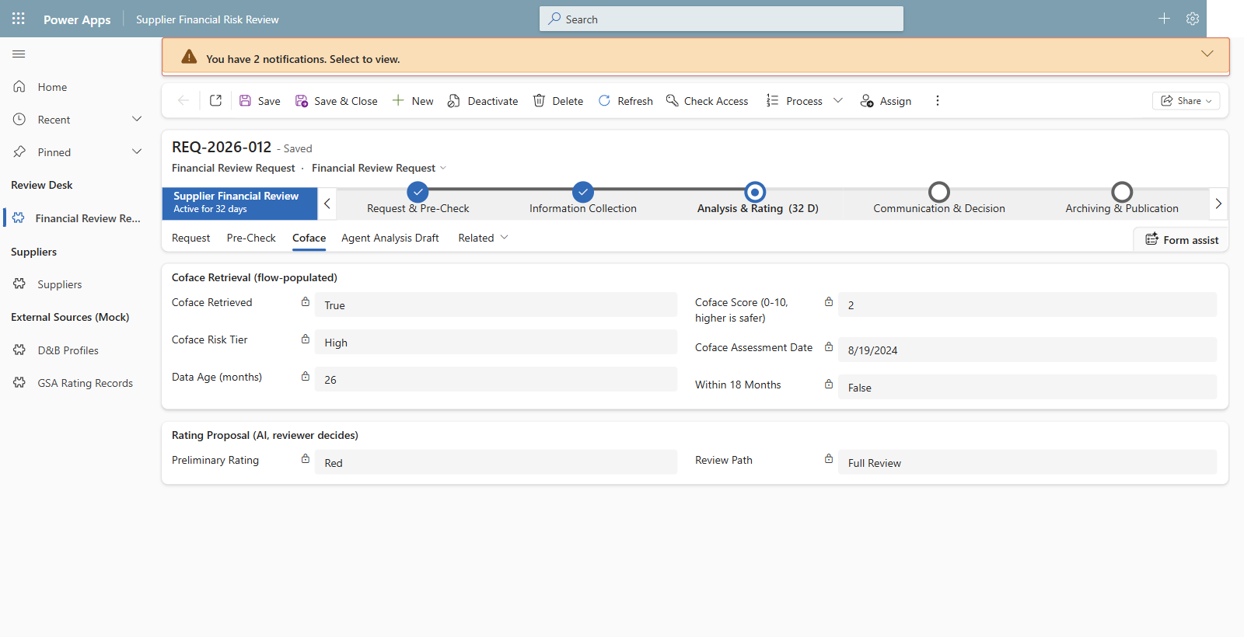
04 Seeded Coface evidence is over 18 months old - no fast-track shortcut.
Notes:
Capture date: 2026-11-02. Environment: DemoPRE. Browser: isolated Microsoft Edge Guest profile; the user completed sign-in.
Capture mode: read-only, explicitly selected by the user. No new request was saved and no existing records were edited.
Source: docs/09-demo-script.md, Step 2 (02:00-06:00); docs/requirements/source/fy27-magna-srm-use-case-extracted.txt, slides 1-3 and 6. External systems and supplier identities are fictional Dataverse mocks.
Step 2.3: Existing mocked Coface evidence on REQ-2026-012: score 2, High risk tier, assessment date 2024-08-19, stored data age 26 months, Within 18 Months = False, Full Review. The displayed preliminary Red rating is seeded and is not a human final rating or a result generated during this capture.

Slide 6
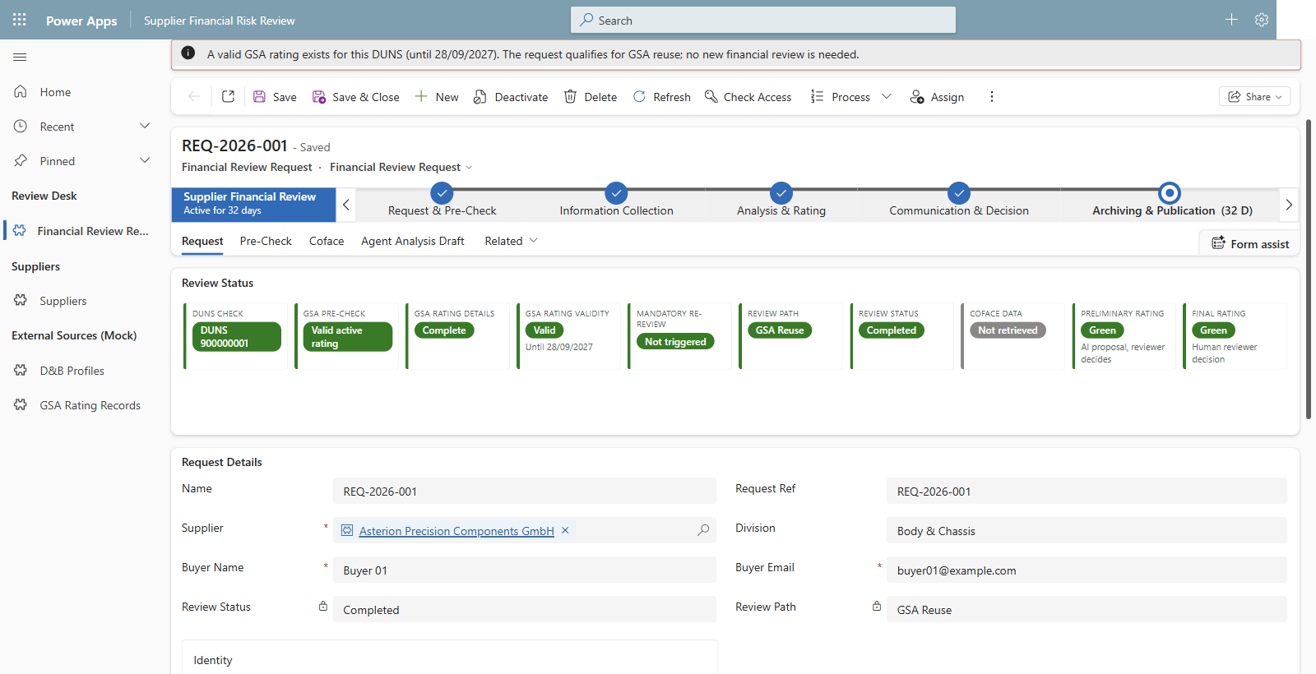
05 Fictional reuse contrast - a valid GSA rating avoids a redundant review.
Notes:
Capture date: 2026-11-02. Environment: DemoPRE. Browser: isolated Microsoft Edge Guest profile; the user completed sign-in.
Capture mode: read-only, explicitly selected by the user. No new request was saved and no existing records were edited.
Source: docs/09-demo-script.md, Step 2 (02:00-06:00); docs/requirements/source/fy27-magna-srm-use-case-extracted.txt, slides 1-3 and 6. External systems and supplier identities are fictional Dataverse mocks.
Step 2.5: Existing seeded REQ-2026-001 for Asterion Precision Components GmbH, SUP-001. Valid active GSA rating, no mandatory re-review, Review Path = GSA Reuse, Review Status = Completed. This screenshot is evidence of the seeded reuse example, not a newly executed workflow.

Slide 7
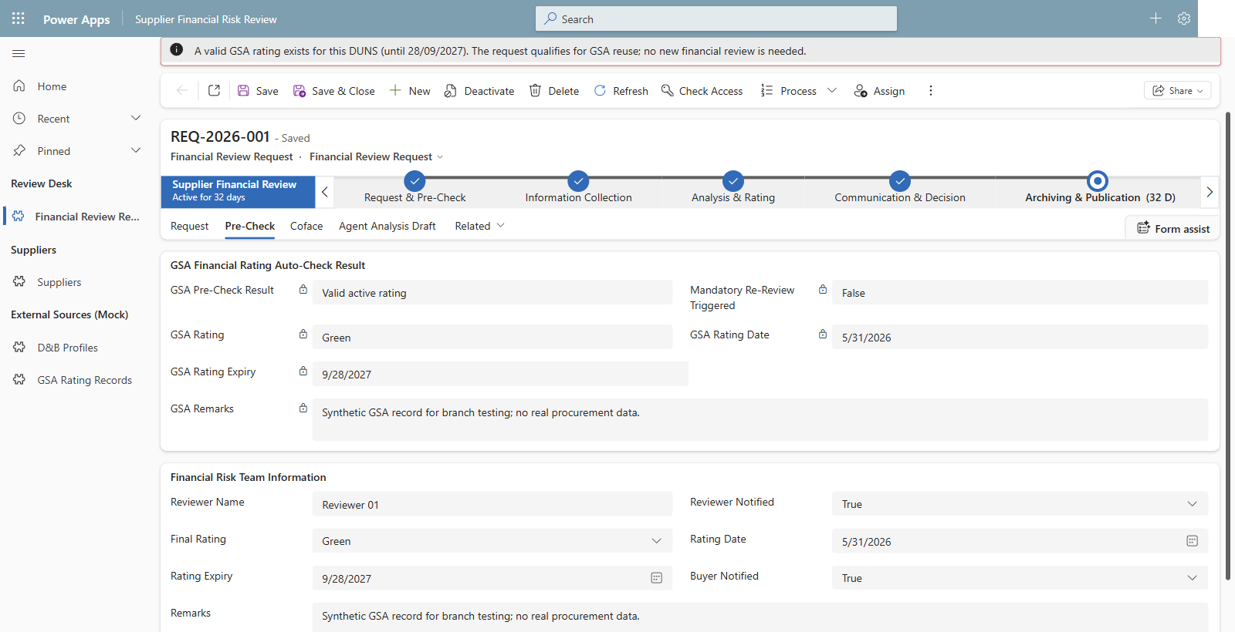
06 Reuse the existing Green rating - this is not a new AI rating.
Notes:
Capture date: 2026-11-02. Environment: DemoPRE. Browser: isolated Microsoft Edge Guest profile; the user completed sign-in.
Capture mode: read-only, explicitly selected by the user. No new request was saved and no existing records were edited.
Source: docs/09-demo-script.md, Step 2 (02:00-06:00); docs/requirements/source/fy27-magna-srm-use-case-extracted.txt, slides 1-3 and 6. External systems and supplier identities are fictional Dataverse mocks.
Step 2.5: REQ-2026-001 Pre-Check tab. Existing GSA and final ratings are Green, rating date 2026-05-31, expiry 2027-09-28. Synthetic GSA remarks explicitly state that no real procurement data is used. Values were read only and were not changed.

Slide 8
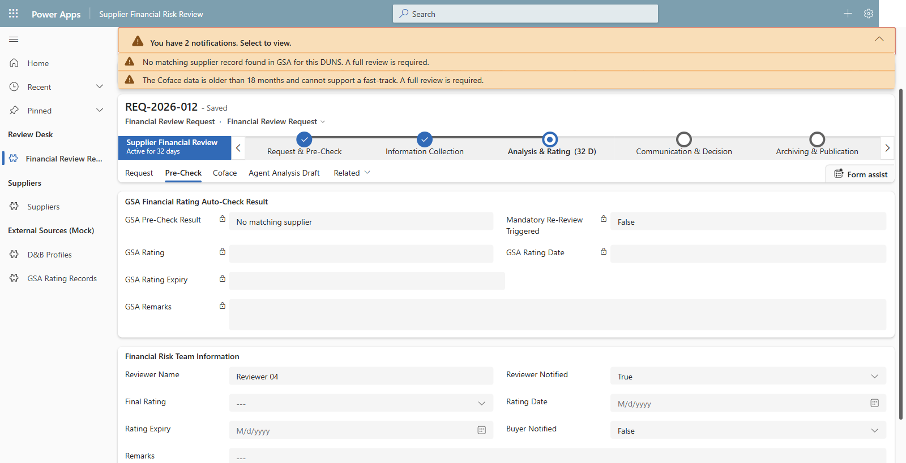
07 Back to seeded Lumen Forge - review evidence; the human owns the final rating.
Notes:
Capture date: 2026-11-02. Environment: DemoPRE. Browser: isolated Microsoft Edge Guest profile; the user completed sign-in.
Capture mode: read-only, explicitly selected by the user. No new request was saved and no existing records were edited.
Source: docs/09-demo-script.md, Step 2 (02:00-06:00); docs/requirements/source/fy27-magna-srm-use-case-extracted.txt, slides 1-3 and 6. External systems and supplier identities are fictional Dataverse mocks.
Step 2.6: Return to REQ-2026-012. No matching GSA supplier and stale Coface data require a full review. The Final Rating is blank. Interpret the two visible notifications together: a missing GSA match alone does not exclude a later fast-track based on eligible fresh Coface evidence. The first app notification is broader than that rule; the genuine screenshot has not been retouched. No final rating, reviewer confirmation, status, stage, or other record value was modified. Preview attachment handling is not a wired app-to-chat integration; extracted facts reach a request only through the explicit draft save described in Step 7, which was not performed.

Slide 9
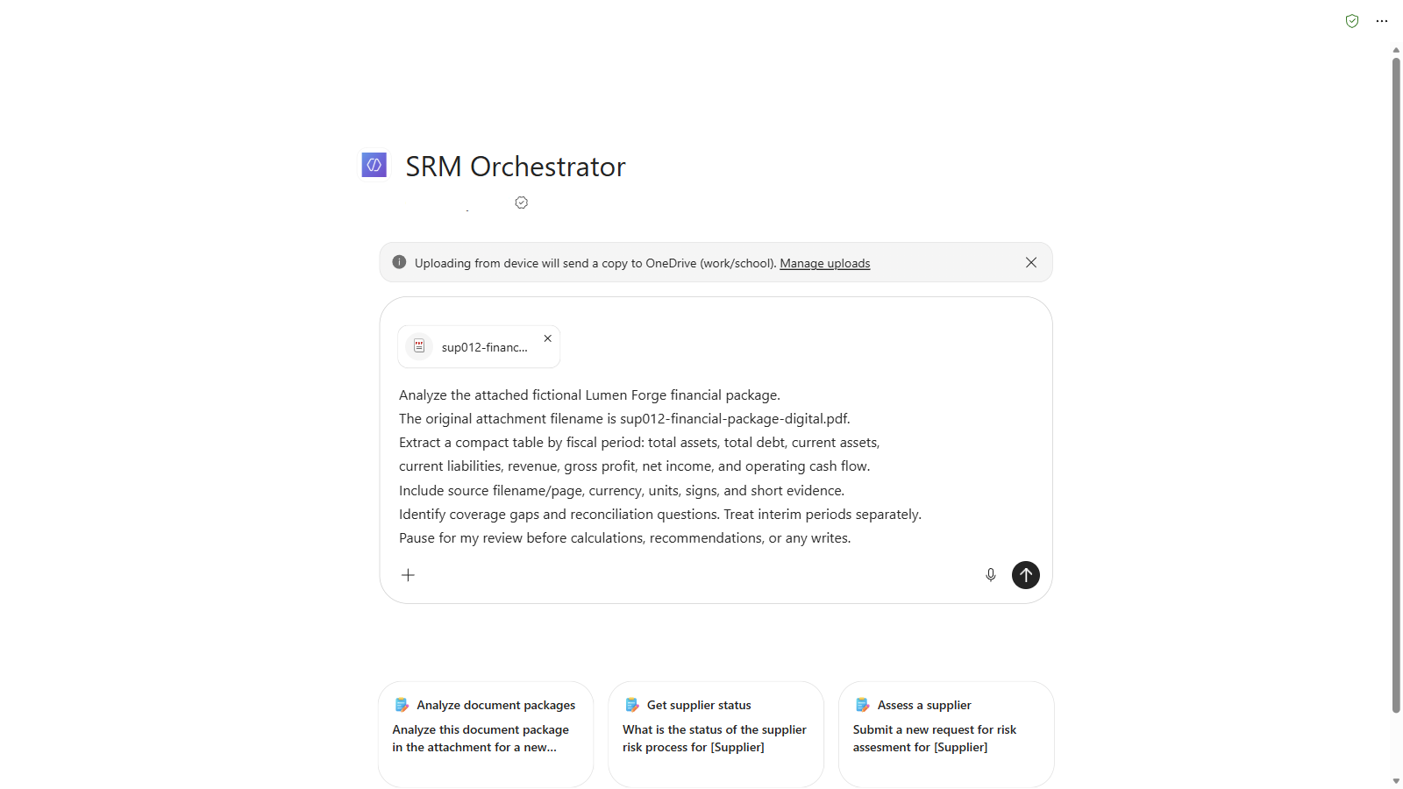
3.1 Attach the digital package - extraction comes before analysis or writes.
Notes:
Capture date: 2026-11-02. Browser: isolated Microsoft Edge Guest profile; the user completed the correct sign-in. These are genuine screenshots or focused crops of visible Microsoft Copilot / SRM Orchestrator responses, not fabricated chat content.
Channel: the existing Microsoft Copilot SRM Orchestrator, not Copilot Studio Draft Preview. No publication, agent edits, deployment, or environment configuration changes were performed. These observations do not prove Draft/published parity or the full connected-agent journey.
Traceability: docs\09-demo-script.md, Steps 3 and 4; source slide8, SRM-FIN-001; human-accountability boundaries in the source and main guide. The main demo script and PDF fixtures were not modified.
Privacy: unrelated chat navigation/account information and the initial creator byline are masked. Visible financial content was not retouched. Focused crops intentionally show only the relevant extraction, disclosure, or review gate.
Storage boundary: Microsoft Copilot copied the uploaded fictional PDFs to the signed-in work account's OneDrive. The agent's visible statements about nothing being persisted concern the business-record/save boundary, not the existence of OneDrive uploads or chat history. No Dataverse write or authenticated approval was requested; the visible conversations show no business-record save tool call. No separate live Dataverse audit verification was performed.
Scope of verification: all 32 requested digital values/signs/pages matched the original PDF; all six scan values/signs matched the FY2025 reference and scan pages 1-3. The scan has three raster-only pages with no embedded text layer. No expected-results file, manifest, seed CSV, or presenter guide was uploaded to the agent. Recognition is not guaranteed infallible.
Presenter caveat: original narrative reconciliation questions remain unapproved. In particular, FY2023 net income and operating cash flow are both positive, so the original 'diverge in direction' wording needs review; the original scan debt-comparison wording is also not endorsed. This deck demonstrates extraction and human review, not a validated risk conclusion.
The exact Step 3 prompt was composed with only sup012-financial-package-digital.pdf attached. The screenshot precedes submission. The visible Microsoft Copilot upload banner explicitly states that a copy is sent to OneDrive.
This run's conversation (requires the correct work account): https://copilot.cloud.microsoft/agents/copilotstudio/T_5bd9e801-f51d-90b8-6a37-879bf5a08731.5db18ed7-e817-44b4-a338-5f7d91078fcf/conversation/c71eec99-a0e8-471d-b697-32253c845675

Slide 10
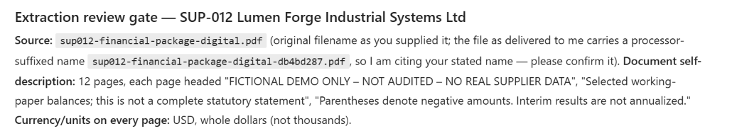
3.2 Source identity, whole-dollar units, and the filename caveat stay explicit.
Notes:
Capture date: 2026-11-02. Browser: isolated Microsoft Edge Guest profile; the user completed the correct sign-in. These are genuine screenshots or focused crops of visible Microsoft Copilot / SRM Orchestrator responses, not fabricated chat content.
Channel: the existing Microsoft Copilot SRM Orchestrator, not Copilot Studio Draft Preview. No publication, agent edits, deployment, or environment configuration changes were performed. These observations do not prove Draft/published parity or the full connected-agent journey.
Traceability: docs\09-demo-script.md, Steps 3 and 4; source slide8, SRM-FIN-001; human-accountability boundaries in the source and main guide. The main demo script and PDF fixtures were not modified.
Privacy: unrelated chat navigation/account information and the initial creator byline are masked. Visible financial content was not retouched. Focused crops intentionally show only the relevant extraction, disclosure, or review gate.
Storage boundary: Microsoft Copilot copied the uploaded fictional PDFs to the signed-in work account's OneDrive. The agent's visible statements about nothing being persisted concern the business-record/save boundary, not the existence of OneDrive uploads or chat history. No Dataverse write or authenticated approval was requested; the visible conversations show no business-record save tool call. No separate live Dataverse audit verification was performed.
Scope of verification: all 32 requested digital values/signs/pages matched the original PDF; all six scan values/signs matched the FY2025 reference and scan pages 1-3. The scan has three raster-only pages with no embedded text layer. No expected-results file, manifest, seed CSV, or presenter guide was uploaded to the agent. Recognition is not guaranteed infallible.
Presenter caveat: original narrative reconciliation questions remain unapproved. In particular, FY2023 net income and operating cash flow are both positive, so the original 'diverge in direction' wording needs review; the original scan debt-comparison wording is also not endorsed. This deck demonstrates extraction and human review, not a validated risk conclusion.
Genuine UI crop of the initial answer: 12 source pages, USD whole dollars, fictional/unaudited working-paper excerpts. The agent reports processor alias sup012-financial-package-digital-db4bd287.pdf and attributes the canonical original filename to the user. Original-name confirmation is still pending.
This run's conversation (requires the correct work account): https://copilot.cloud.microsoft/agents/copilotstudio/T_5bd9e801-f51d-90b8-6a37-879bf5a08731.5db18ed7-e817-44b4-a338-5f7d91078fcf/conversation/c71eec99-a0e8-471d-b697-32253c845675

Slide 11
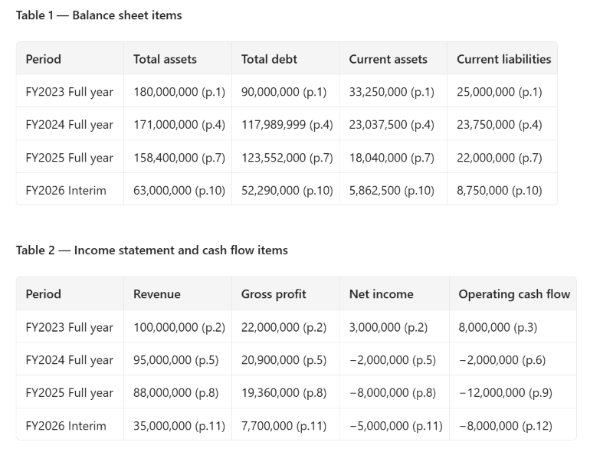
3.3 Four fiscal periods retain page-cited values; interim stays separate.
Notes:
Capture date: 2026-11-02. Browser: isolated Microsoft Edge Guest profile; the user completed the correct sign-in. These are genuine screenshots or focused crops of visible Microsoft Copilot / SRM Orchestrator responses, not fabricated chat content.
Channel: the existing Microsoft Copilot SRM Orchestrator, not Copilot Studio Draft Preview. No publication, agent edits, deployment, or environment configuration changes were performed. These observations do not prove Draft/published parity or the full connected-agent journey.
Traceability: docs\09-demo-script.md, Steps 3 and 4; source slide8, SRM-FIN-001; human-accountability boundaries in the source and main guide. The main demo script and PDF fixtures were not modified.
Privacy: unrelated chat navigation/account information and the initial creator byline are masked. Visible financial content was not retouched. Focused crops intentionally show only the relevant extraction, disclosure, or review gate.
Storage boundary: Microsoft Copilot copied the uploaded fictional PDFs to the signed-in work account's OneDrive. The agent's visible statements about nothing being persisted concern the business-record/save boundary, not the existence of OneDrive uploads or chat history. No Dataverse write or authenticated approval was requested; the visible conversations show no business-record save tool call. No separate live Dataverse audit verification was performed.
Scope of verification: all 32 requested digital values/signs/pages matched the original PDF; all six scan values/signs matched the FY2025 reference and scan pages 1-3. The scan has three raster-only pages with no embedded text layer. No expected-results file, manifest, seed CSV, or presenter guide was uploaded to the agent. Recognition is not guaranteed infallible.
Presenter caveat: original narrative reconciliation questions remain unapproved. In particular, FY2023 net income and operating cash flow are both positive, so the original 'diverge in direction' wording needs review; the original scan debt-comparison wording is also not endorsed. This deck demonstrates extraction and human review, not a validated risk conclusion.
The original wide answer was reformatted by the same live SRM Orchestrator conversation into two narrower tables using a layout-only follow-up. This did not approve extraction. All 32 requested numbers, signs, and physical page citations were compared with the original 12-page PDF; the reformatted values and citations were then verified unchanged. FY2024 debt remains 117,989,999. FY2026 interim is not annualized.
This run's conversation (requires the correct work account): https://copilot.cloud.microsoft/agents/copilotstudio/T_5bd9e801-f51d-90b8-6a37-879bf5a08731.5db18ed7-e817-44b4-a338-5f7d91078fcf/conversation/c71eec99-a0e8-471d-b697-32253c845675

Slide 12
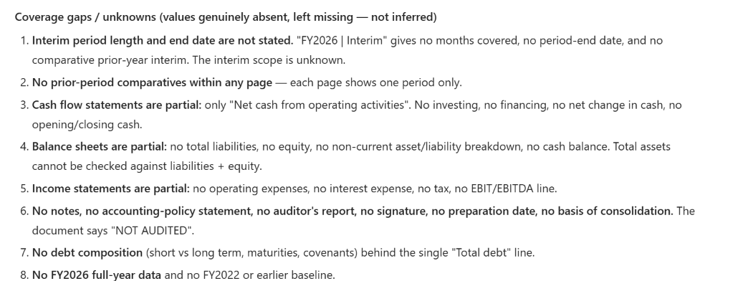
3.4 Missing disclosures stay missing - partial statements need reviewer follow-up.
Notes:
Capture date: 2026-11-02. Browser: isolated Microsoft Edge Guest profile; the user completed the correct sign-in. These are genuine screenshots or focused crops of visible Microsoft Copilot / SRM Orchestrator responses, not fabricated chat content.
Channel: the existing Microsoft Copilot SRM Orchestrator, not Copilot Studio Draft Preview. No publication, agent edits, deployment, or environment configuration changes were performed. These observations do not prove Draft/published parity or the full connected-agent journey.
Traceability: docs\09-demo-script.md, Steps 3 and 4; source slide8, SRM-FIN-001; human-accountability boundaries in the source and main guide. The main demo script and PDF fixtures were not modified.
Privacy: unrelated chat navigation/account information and the initial creator byline are masked. Visible financial content was not retouched. Focused crops intentionally show only the relevant extraction, disclosure, or review gate.
Storage boundary: Microsoft Copilot copied the uploaded fictional PDFs to the signed-in work account's OneDrive. The agent's visible statements about nothing being persisted concern the business-record/save boundary, not the existence of OneDrive uploads or chat history. No Dataverse write or authenticated approval was requested; the visible conversations show no business-record save tool call. No separate live Dataverse audit verification was performed.
Scope of verification: all 32 requested digital values/signs/pages matched the original PDF; all six scan values/signs matched the FY2025 reference and scan pages 1-3. The scan has three raster-only pages with no embedded text layer. No expected-results file, manifest, seed CSV, or presenter guide was uploaded to the agent. Recognition is not guaranteed infallible.
Presenter caveat: original narrative reconciliation questions remain unapproved. In particular, FY2023 net income and operating cash flow are both positive, so the original 'diverge in direction' wording needs review; the original scan debt-comparison wording is also not endorsed. This deck demonstrates extraction and human review, not a validated risk conclusion.
Genuine UI crop focused on the eight coverage gaps, without the following reconciliation-question section. Missing interim scope and absent statement components are left explicit. Only the requested financial figures and page citations were independently checked; the agent's wider narrative is not an approved financial assessment.
This run's conversation (requires the correct work account): https://copilot.cloud.microsoft/agents/copilotstudio/T_5bd9e801-f51d-90b8-6a37-879bf5a08731.5db18ed7-e817-44b4-a338-5f7d91078fcf/conversation/c71eec99-a0e8-471d-b697-32253c845675

Slide 13
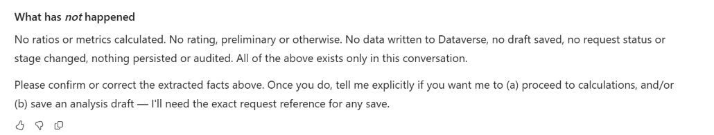
3.5 The agent pauses for extraction review; no rating or draft save is approved.
Notes:
Capture date: 2026-11-02. Browser: isolated Microsoft Edge Guest profile; the user completed the correct sign-in. These are genuine screenshots or focused crops of visible Microsoft Copilot / SRM Orchestrator responses, not fabricated chat content.
Channel: the existing Microsoft Copilot SRM Orchestrator, not Copilot Studio Draft Preview. No publication, agent edits, deployment, or environment configuration changes were performed. These observations do not prove Draft/published parity or the full connected-agent journey.
Traceability: docs\09-demo-script.md, Steps 3 and 4; source slide8, SRM-FIN-001; human-accountability boundaries in the source and main guide. The main demo script and PDF fixtures were not modified.
Privacy: unrelated chat navigation/account information and the initial creator byline are masked. Visible financial content was not retouched. Focused crops intentionally show only the relevant extraction, disclosure, or review gate.
Storage boundary: Microsoft Copilot copied the uploaded fictional PDFs to the signed-in work account's OneDrive. The agent's visible statements about nothing being persisted concern the business-record/save boundary, not the existence of OneDrive uploads or chat history. No Dataverse write or authenticated approval was requested; the visible conversations show no business-record save tool call. No separate live Dataverse audit verification was performed.
Scope of verification: all 32 requested digital values/signs/pages matched the original PDF; all six scan values/signs matched the FY2025 reference and scan pages 1-3. The scan has three raster-only pages with no embedded text layer. No expected-results file, manifest, seed CSV, or presenter guide was uploaded to the agent. Recognition is not guaranteed infallible.
Presenter caveat: original narrative reconciliation questions remain unapproved. In particular, FY2023 net income and operating cash flow are both positive, so the original 'diverge in direction' wording needs review; the original scan debt-comparison wording is also not endorsed. This deck demonstrates extraction and human review, not a validated risk conclusion.
The initial answer explicitly asks for confirmation or correction before calculations or a save. No approval was supplied. The later reformatting request also explicitly withheld approval and prohibited new analysis, ratings, Dataverse calls, and saves.
This run's conversation (requires the correct work account): https://copilot.cloud.microsoft/agents/copilotstudio/T_5bd9e801-f51d-90b8-6a37-879bf5a08731.5db18ed7-e817-44b4-a338-5f7d91078fcf/conversation/c71eec99-a0e8-471d-b697-32253c845675

Slide 14
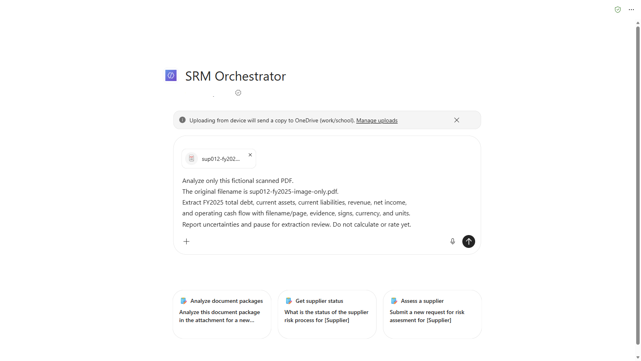
4.1 Start a fresh scan-only chat - keep the digital package out of this run.
Notes:
Capture date: 2026-11-02. Browser: isolated Microsoft Edge Guest profile; the user completed the correct sign-in. These are genuine screenshots or focused crops of visible Microsoft Copilot / SRM Orchestrator responses, not fabricated chat content.
Channel: the existing Microsoft Copilot SRM Orchestrator, not Copilot Studio Draft Preview. No publication, agent edits, deployment, or environment configuration changes were performed. These observations do not prove Draft/published parity or the full connected-agent journey.
Traceability: docs\09-demo-script.md, Steps 3 and 4; source slide8, SRM-FIN-001; human-accountability boundaries in the source and main guide. The main demo script and PDF fixtures were not modified.
Privacy: unrelated chat navigation/account information and the initial creator byline are masked. Visible financial content was not retouched. Focused crops intentionally show only the relevant extraction, disclosure, or review gate.
Storage boundary: Microsoft Copilot copied the uploaded fictional PDFs to the signed-in work account's OneDrive. The agent's visible statements about nothing being persisted concern the business-record/save boundary, not the existence of OneDrive uploads or chat history. No Dataverse write or authenticated approval was requested; the visible conversations show no business-record save tool call. No separate live Dataverse audit verification was performed.
Scope of verification: all 32 requested digital values/signs/pages matched the original PDF; all six scan values/signs matched the FY2025 reference and scan pages 1-3. The scan has three raster-only pages with no embedded text layer. No expected-results file, manifest, seed CSV, or presenter guide was uploaded to the agent. Recognition is not guaranteed infallible.
Presenter caveat: original narrative reconciliation questions remain unapproved. In particular, FY2023 net income and operating cash flow are both positive, so the original 'diverge in direction' wording needs review; the original scan debt-comparison wording is also not endorsed. This deck demonstrates extraction and human review, not a validated risk conclusion.
A new conversation was started through SRM Orchestrator's New chat control; the digital conversation was preserved by its URL. Only sup012-fy2025-image-only.pdf was uploaded. The original, clean image-only fixture was used, not the separate poor-quality derivative. The exact Step 4 prompt was composed before submission.
This run's conversation (requires the correct work account): https://copilot.cloud.microsoft/agents/copilotstudio/T_5bd9e801-f51d-90b8-6a37-879bf5a08731.5db18ed7-e817-44b4-a338-5f7d91078fcf/conversation/09010501-1253-451f-96ed-c39471376d46

Slide 15
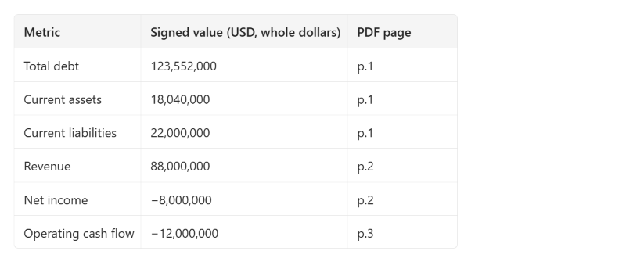
4.2 Six scan-derived figures retain their signs and physical PDF page references.
Notes:
Capture date: 2026-11-02. Browser: isolated Microsoft Edge Guest profile; the user completed the correct sign-in. These are genuine screenshots or focused crops of visible Microsoft Copilot / SRM Orchestrator responses, not fabricated chat content.
Channel: the existing Microsoft Copilot SRM Orchestrator, not Copilot Studio Draft Preview. No publication, agent edits, deployment, or environment configuration changes were performed. These observations do not prove Draft/published parity or the full connected-agent journey.
Traceability: docs\09-demo-script.md, Steps 3 and 4; source slide8, SRM-FIN-001; human-accountability boundaries in the source and main guide. The main demo script and PDF fixtures were not modified.
Privacy: unrelated chat navigation/account information and the initial creator byline are masked. Visible financial content was not retouched. Focused crops intentionally show only the relevant extraction, disclosure, or review gate.
Storage boundary: Microsoft Copilot copied the uploaded fictional PDFs to the signed-in work account's OneDrive. The agent's visible statements about nothing being persisted concern the business-record/save boundary, not the existence of OneDrive uploads or chat history. No Dataverse write or authenticated approval was requested; the visible conversations show no business-record save tool call. No separate live Dataverse audit verification was performed.
Scope of verification: all 32 requested digital values/signs/pages matched the original PDF; all six scan values/signs matched the FY2025 reference and scan pages 1-3. The scan has three raster-only pages with no embedded text layer. No expected-results file, manifest, seed CSV, or presenter guide was uploaded to the agent. Recognition is not guaranteed infallible.
Presenter caveat: original narrative reconciliation questions remain unapproved. In particular, FY2023 net income and operating cash flow are both positive, so the original 'diverge in direction' wording needs review; the original scan debt-comparison wording is also not endorsed. This deck demonstrates extraction and human review, not a validated risk conclusion.
Genuine UI crop of the live answer after a readability-only follow-up. The six values agree with the source-checked FY2025 reference: debt 123,552,000; current assets 18,040,000; current liabilities 22,000,000; revenue 88,000,000; net income -8,000,000; operating cash flow -12,000,000. Physical scan citations are pages 1, 2, and 3, not digital pages 7, 8, and 9. The follow-up clarified an initially ambiguous page-label phrase without supplying expected values or approving the facts.
This run's conversation (requires the correct work account): https://copilot.cloud.microsoft/agents/copilotstudio/T_5bd9e801-f51d-90b8-6a37-879bf5a08731.5db18ed7-e817-44b4-a338-5f7d91078fcf/conversation/09010501-1253-451f-96ed-c39471376d46

Slide 16
4.3 Recognition is not approval - a reviewer must confirm the scan-derived figures.
Notes:
Capture date: 2026-11-02. Browser: isolated Microsoft Edge Guest profile; the user completed the correct sign-in. These are genuine screenshots or focused crops of visible Microsoft Copilot / SRM Orchestrator responses, not fabricated chat content.
Channel: the existing Microsoft Copilot SRM Orchestrator, not Copilot Studio Draft Preview. No publication, agent edits, deployment, or environment configuration changes were performed. These observations do not prove Draft/published parity or the full connected-agent journey.
Traceability: docs\09-demo-script.md, Steps 3 and 4; source slide8, SRM-FIN-001; human-accountability boundaries in the source and main guide. The main demo script and PDF fixtures were not modified.
Privacy: unrelated chat navigation/account information and the initial creator byline are masked. Visible financial content was not retouched. Focused crops intentionally show only the relevant extraction, disclosure, or review gate.
Storage boundary: Microsoft Copilot copied the uploaded fictional PDFs to the signed-in work account's OneDrive. The agent's visible statements about nothing being persisted concern the business-record/save boundary, not the existence of OneDrive uploads or chat history. No Dataverse write or authenticated approval was requested; the visible conversations show no business-record save tool call. No separate live Dataverse audit verification was performed.
Scope of verification: all 32 requested digital values/signs/pages matched the original PDF; all six scan values/signs matched the FY2025 reference and scan pages 1-3. The scan has three raster-only pages with no embedded text layer. No expected-results file, manifest, seed CSV, or presenter guide was uploaded to the agent. Recognition is not guaranteed infallible.
Presenter caveat: original narrative reconciliation questions remain unapproved. In particular, FY2023 net income and operating cash flow are both positive, so the original 'diverge in direction' wording needs review; the original scan debt-comparison wording is also not endorsed. This deck demonstrates extraction and human review, not a validated risk conclusion.
Genuine UI crop of the first uncertainty item. The agent requests confirmation of page 1 and page 3 digits. Its statements about internal OCR/rendering are its own account, not independent proof of a particular processing order. Local PDF inspection separately confirmed exactly three pages and zero embedded text characters on all pages. Filename alias sup012-fy2025-image-only-5de0dd44.pdf remains a provenance caveat.
This run's conversation (requires the correct work account): https://copilot.cloud.microsoft/agents/copilotstudio/T_5bd9e801-f51d-90b8-6a37-879bf5a08731.5db18ed7-e817-44b4-a338-5f7d91078fcf/conversation/09010501-1253-451f-96ed-c39471376d46

Slide 17
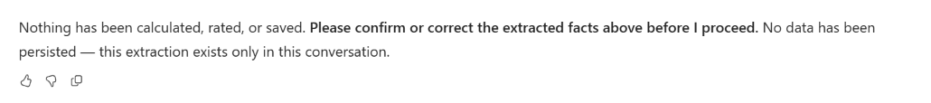
4.4 The reviewer must confirm or correct the facts before any next step.
Notes:
Capture date: 2026-11-02. Browser: isolated Microsoft Edge Guest profile; the user completed the correct sign-in. These are genuine screenshots or focused crops of visible Microsoft Copilot / SRM Orchestrator responses, not fabricated chat content.
Channel: the existing Microsoft Copilot SRM Orchestrator, not Copilot Studio Draft Preview. No publication, agent edits, deployment, or environment configuration changes were performed. These observations do not prove Draft/published parity or the full connected-agent journey.
Traceability: docs\09-demo-script.md, Steps 3 and 4; source slide8, SRM-FIN-001; human-accountability boundaries in the source and main guide. The main demo script and PDF fixtures were not modified.
Privacy: unrelated chat navigation/account information and the initial creator byline are masked. Visible financial content was not retouched. Focused crops intentionally show only the relevant extraction, disclosure, or review gate.
Storage boundary: Microsoft Copilot copied the uploaded fictional PDFs to the signed-in work account's OneDrive. The agent's visible statements about nothing being persisted concern the business-record/save boundary, not the existence of OneDrive uploads or chat history. No Dataverse write or authenticated approval was requested; the visible conversations show no business-record save tool call. No separate live Dataverse audit verification was performed.
Scope of verification: all 32 requested digital values/signs/pages matched the original PDF; all six scan values/signs matched the FY2025 reference and scan pages 1-3. The scan has three raster-only pages with no embedded text layer. No expected-results file, manifest, seed CSV, or presenter guide was uploaded to the agent. Recognition is not guaranteed infallible.
Presenter caveat: original narrative reconciliation questions remain unapproved. In particular, FY2023 net income and operating cash flow are both positive, so the original 'diverge in direction' wording needs review; the original scan debt-comparison wording is also not endorsed. This deck demonstrates extraction and human review, not a validated risk conclusion.
Genuine UI crop of the explicit extraction-review gate in the initial scan answer. No confirmation, calculations, rating decision, or Dataverse save was requested after extraction. Chat confirmation would not constitute authenticated approval even if provided.
This run's conversation (requires the correct work account): https://copilot.cloud.microsoft/agents/copilotstudio/T_5bd9e801-f51d-90b8-6a37-879bf5a08731.5db18ed7-e817-44b4-a338-5f7d91078fcf/conversation/09010501-1253-451f-96ed-c39471376d46

Slide 18
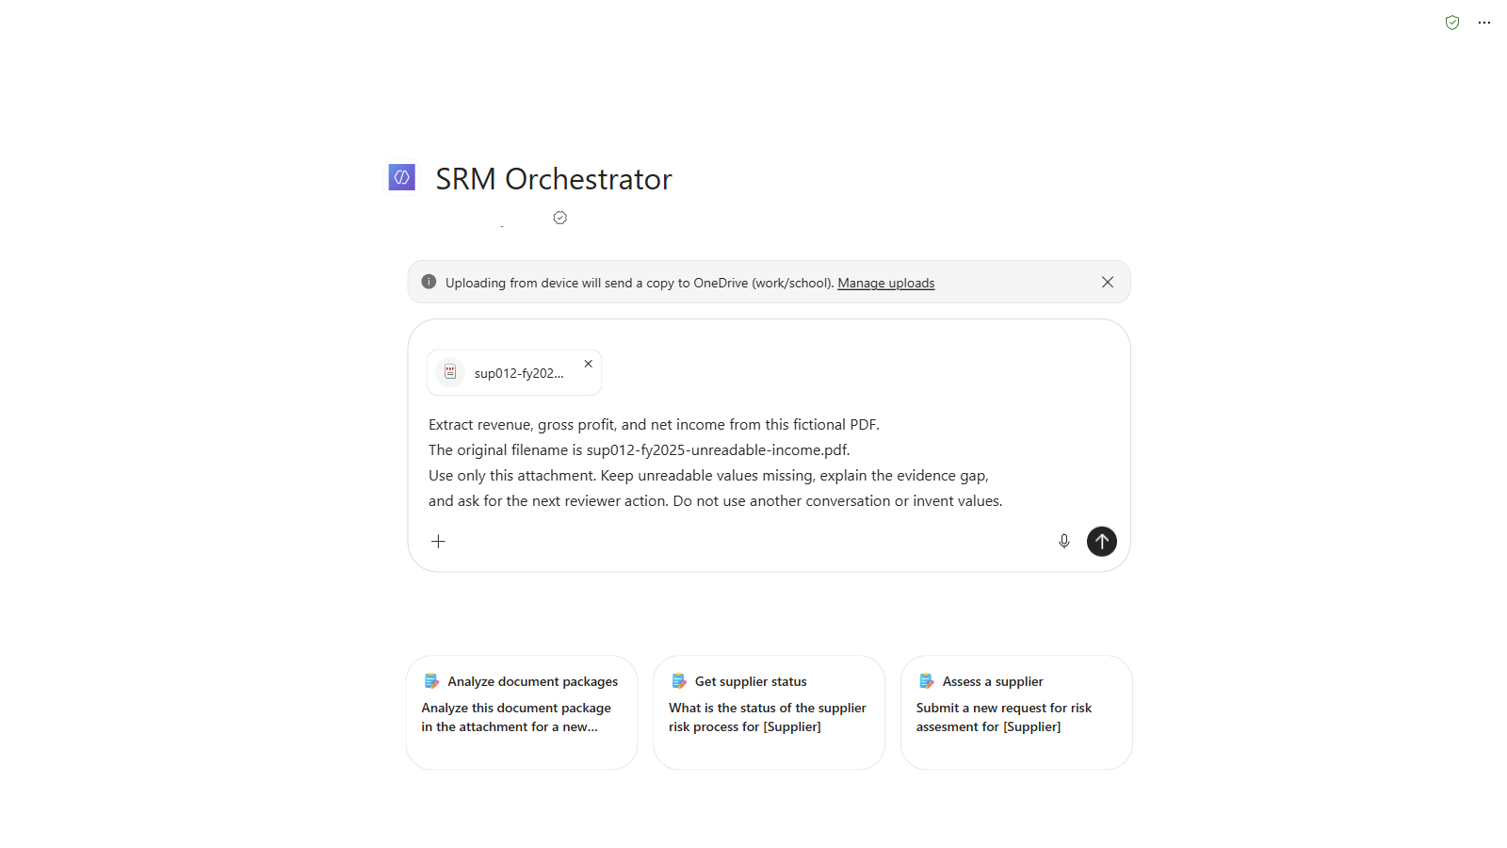
5.1 Use an isolated unreadable-only chat - no other file can fill the gap.
Notes:
Captured 2026-11-02 in Microsoft Copilot with the existing SRM Orchestrator, using an isolated Edge Guest profile and user-completed login. These are genuine visible UI screenshots or focused crops, not fabricated responses. Navigation/account data is masked. Uploaded fictional PDFs can be stored in the work account's OneDrive; absence of a Dataverse save does not mean absence of chat/OneDrive storage.
Traceability: docs/09-demo-script.md, sections 5,6,7; source slide8 (SRM-FIN-001), slide9 (SRM-NFR-001), and human-accountability/audit requirements. The script, source PDFs, agents, flows and environment metadata were not changed.
The authorized isolated DemoPRE request is REQ-2026-032, named PDF DEMO - Lumen Forge - 2026-11-02, record 1b2f2d05-81c8-4d16-b5c3-da237b5bdf54. The user explicitly authorized a new revision replacing its existing narrative while preserving evidence rows. Seeded REQ-2026-001 and REQ-2026-012 remain untouched. Baseline: Not Started, Full Review, no preliminary/final rating, finalratingconfirmed=false, Request & Pre-Check BPF stage. Any actual save result or blocker is described specifically below; permissions do not prove execution.
A fresh SRM Orchestrator conversation used only sup012-fy2025-unreadable-income.pdf and the exact Step 5 prompt. Neither the readable digital package nor scan was attached.

Slide 19
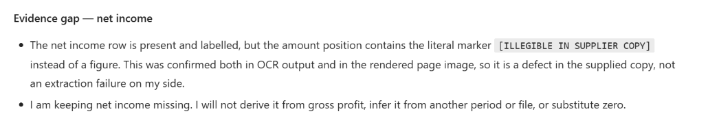
5.2 Unreadable net income stays missing - it is neither zero nor a guess.
Notes:
Captured 2026-11-02 in Microsoft Copilot with the existing SRM Orchestrator, using an isolated Edge Guest profile and user-completed login. These are genuine visible UI screenshots or focused crops, not fabricated responses. Navigation/account data is masked. Uploaded fictional PDFs can be stored in the work account's OneDrive; absence of a Dataverse save does not mean absence of chat/OneDrive storage.
Traceability: docs/09-demo-script.md, sections 5,6,7; source slide8 (SRM-FIN-001), slide9 (SRM-NFR-001), and human-accountability/audit requirements. The script, source PDFs, agents, flows and environment metadata were not changed.
The authorized isolated DemoPRE request is REQ-2026-032, named PDF DEMO - Lumen Forge - 2026-11-02, record 1b2f2d05-81c8-4d16-b5c3-da237b5bdf54. The user explicitly authorized a new revision replacing its existing narrative while preserving evidence rows. Seeded REQ-2026-001 and REQ-2026-012 remain untouched. Baseline: Not Started, Full Review, no preliminary/final rating, finalratingconfirmed=false, Request & Pre-Check BPF stage. Any actual save result or blocker is described specifically below; permissions do not prove execution.
The actual answer retained missing net income and explicitly refused derivation from gross profit or another file. The source is a fictional single-page image-only fixture containing [ILLEGIBLE IN SUPPLIER COPY]. Agent descriptions of internal OCR are not independent verification of processing order.

Slide 20
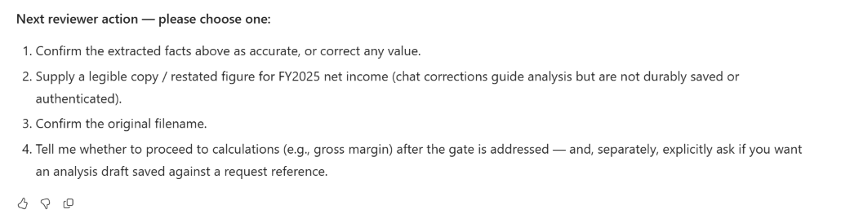
5.3 The reviewer must supply readable evidence or a clearly attributed correction.
Notes:
Captured 2026-11-02 in Microsoft Copilot with the existing SRM Orchestrator, using an isolated Edge Guest profile and user-completed login. These are genuine visible UI screenshots or focused crops, not fabricated responses. Navigation/account data is masked. Uploaded fictional PDFs can be stored in the work account's OneDrive; absence of a Dataverse save does not mean absence of chat/OneDrive storage.
Traceability: docs/09-demo-script.md, sections 5,6,7; source slide8 (SRM-FIN-001), slide9 (SRM-NFR-001), and human-accountability/audit requirements. The script, source PDFs, agents, flows and environment metadata were not changed.
The authorized isolated DemoPRE request is REQ-2026-032, named PDF DEMO - Lumen Forge - 2026-11-02, record 1b2f2d05-81c8-4d16-b5c3-da237b5bdf54. The user explicitly authorized a new revision replacing its existing narrative while preserving evidence rows. Seeded REQ-2026-001 and REQ-2026-012 remain untouched. Baseline: Not Started, Full Review, no preliminary/final rating, finalratingconfirmed=false, Request & Pre-Check BPF stage. Any actual save result or blocker is described specifically below; permissions do not prove execution.
The agent requests a legible copy or explicit correction. No figures were supplied from the earlier digital chat to this isolated conversation, and no correction or save was requested here.

Slide 21
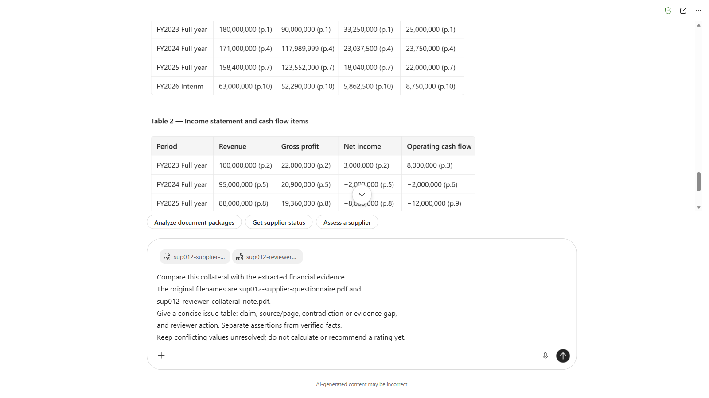
6.1 Compare collateral in the digital conversation - assertions are not verified facts.
Notes:
Captured 2026-11-02 in Microsoft Copilot with the existing SRM Orchestrator, using an isolated Edge Guest profile and user-completed login. These are genuine visible UI screenshots or focused crops, not fabricated responses. Navigation/account data is masked. Uploaded fictional PDFs can be stored in the work account's OneDrive; absence of a Dataverse save does not mean absence of chat/OneDrive storage.
Traceability: docs/09-demo-script.md, sections 5,6,7; source slide8 (SRM-FIN-001), slide9 (SRM-NFR-001), and human-accountability/audit requirements. The script, source PDFs, agents, flows and environment metadata were not changed.
The authorized isolated DemoPRE request is REQ-2026-032, named PDF DEMO - Lumen Forge - 2026-11-02, record 1b2f2d05-81c8-4d16-b5c3-da237b5bdf54. The user explicitly authorized a new revision replacing its existing narrative while preserving evidence rows. Seeded REQ-2026-001 and REQ-2026-012 remain untouched. Baseline: Not Started, Full Review, no preliminary/final rating, finalratingconfirmed=false, Request & Pre-Check BPF stage. Any actual save result or blocker is described specifically below; permissions do not prove execution.
Returned to this run's preserved digital conversation from Step 3. Uploaded only sup012-supplier-questionnaire.pdf and sup012-reviewer-collateral-note.pdf as new attachments and used the exact Step 6 prompt. Both original filenames were subsequently confirmed; processor suffixes are delivery aliases.

Slide 22
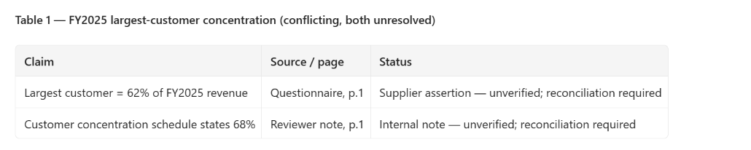
6.2 62% and 68% remain separate, unverified claims until reconciled.
Notes:
Captured 2026-11-02 in Microsoft Copilot with the existing SRM Orchestrator, using an isolated Edge Guest profile and user-completed login. These are genuine visible UI screenshots or focused crops, not fabricated responses. Navigation/account data is masked. Uploaded fictional PDFs can be stored in the work account's OneDrive; absence of a Dataverse save does not mean absence of chat/OneDrive storage.
Traceability: docs/09-demo-script.md, sections 5,6,7; source slide8 (SRM-FIN-001), slide9 (SRM-NFR-001), and human-accountability/audit requirements. The script, source PDFs, agents, flows and environment metadata were not changed.
The authorized isolated DemoPRE request is REQ-2026-032, named PDF DEMO - Lumen Forge - 2026-11-02, record 1b2f2d05-81c8-4d16-b5c3-da237b5bdf54. The user explicitly authorized a new revision replacing its existing narrative while preserving evidence rows. Seeded REQ-2026-001 and REQ-2026-012 remain untouched. Baseline: Not Started, Full Review, no preliminary/final rating, finalratingconfirmed=false, Request & Pre-Check BPF stage. Any actual save result or blocker is described specifically below; permissions do not prove execution.
The source questionnaire p.1 states 62%; reviewer collateral note p.1 states 68%. Both were checked locally against their actual PDF text. The agent produced a narrower table after a layout-only follow-up; no claim was approved or selected.

Slide 23
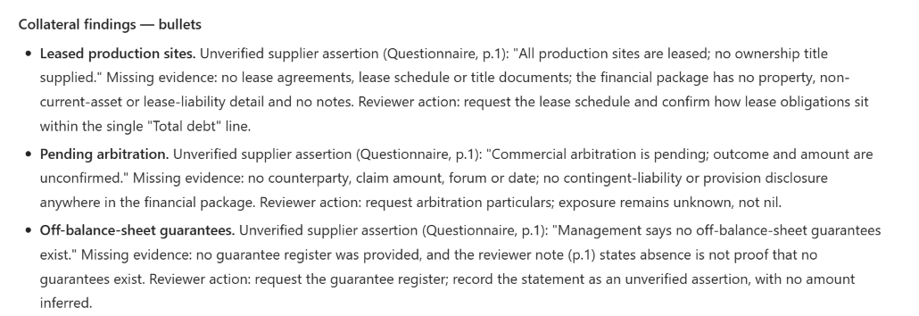
6.3 Leases, arbitration, and guarantees require evidence - unknown is not nil.
Notes:
Captured 2026-11-02 in Microsoft Copilot with the existing SRM Orchestrator, using an isolated Edge Guest profile and user-completed login. These are genuine visible UI screenshots or focused crops, not fabricated responses. Navigation/account data is masked. Uploaded fictional PDFs can be stored in the work account's OneDrive; absence of a Dataverse save does not mean absence of chat/OneDrive storage.
Traceability: docs/09-demo-script.md, sections 5,6,7; source slide8 (SRM-FIN-001), slide9 (SRM-NFR-001), and human-accountability/audit requirements. The script, source PDFs, agents, flows and environment metadata were not changed.
The authorized isolated DemoPRE request is REQ-2026-032, named PDF DEMO - Lumen Forge - 2026-11-02, record 1b2f2d05-81c8-4d16-b5c3-da237b5bdf54. The user explicitly authorized a new revision replacing its existing narrative while preserving evidence rows. Seeded REQ-2026-001 and REQ-2026-012 remain untouched. Baseline: Not Started, Full Review, no preliminary/final rating, finalratingconfirmed=false, Request & Pre-Check BPF stage. Any actual save result or blocker is described specifically below; permissions do not prove execution.
The original wide collateral table was restated by the agent as concise bullets for screenshot readability. Lease and arbitration assertions remain unverified. No guarantee register was provided; that absence is not evidence that no guarantees exist. No public-record or legal verification was performed.

Slide 24
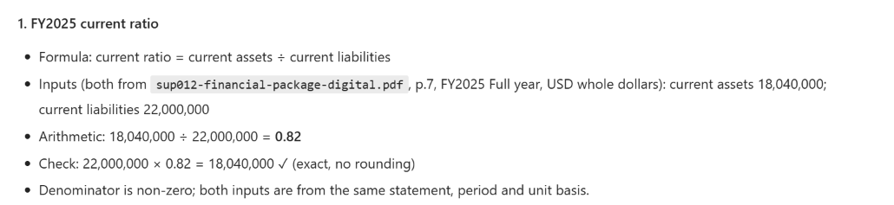
7.1 Reviewed source inputs produce FY2025 current ratio of 0.82.
Notes:
Captured 2026-11-02 in Microsoft Copilot with the existing SRM Orchestrator, using an isolated Edge Guest profile and user-completed login. These are genuine visible UI screenshots or focused crops, not fabricated responses. Navigation/account data is masked. Uploaded fictional PDFs can be stored in the work account's OneDrive; absence of a Dataverse save does not mean absence of chat/OneDrive storage.
Traceability: docs/09-demo-script.md, sections 5,6,7; source slide8 (SRM-FIN-001), slide9 (SRM-NFR-001), and human-accountability/audit requirements. The script, source PDFs, agents, flows and environment metadata were not changed.
The authorized isolated DemoPRE request is REQ-2026-032, named PDF DEMO - Lumen Forge - 2026-11-02, record 1b2f2d05-81c8-4d16-b5c3-da237b5bdf54. The user explicitly authorized a new revision replacing its existing narrative while preserving evidence rows. Seeded REQ-2026-001 and REQ-2026-012 remain untouched. Baseline: Not Started, Full Review, no preliminary/final rating, finalratingconfirmed=false, Request & Pre-Check BPF stage. Any actual save result or blocker is described specifically below; permissions do not prove execution.
Current assets 18,040,000 and current liabilities 22,000,000 were checked against digital PDF p.7. 18,040,000 / 22,000,000 = 0.82 exactly. Only the arithmetic inputs were initially confirmed; additional FY2024/25 facts were reviewed before the explicit save request. This is not authenticated approval.

Slide 25
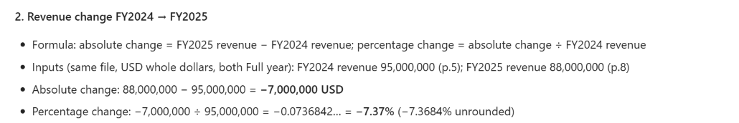
7.2 Full-year revenue falls from USD 95m to USD 88m - approximately 7.37%.
Notes:
Captured 2026-11-02 in Microsoft Copilot with the existing SRM Orchestrator, using an isolated Edge Guest profile and user-completed login. These are genuine visible UI screenshots or focused crops, not fabricated responses. Navigation/account data is masked. Uploaded fictional PDFs can be stored in the work account's OneDrive; absence of a Dataverse save does not mean absence of chat/OneDrive storage.
Traceability: docs/09-demo-script.md, sections 5,6,7; source slide8 (SRM-FIN-001), slide9 (SRM-NFR-001), and human-accountability/audit requirements. The script, source PDFs, agents, flows and environment metadata were not changed.
The authorized isolated DemoPRE request is REQ-2026-032, named PDF DEMO - Lumen Forge - 2026-11-02, record 1b2f2d05-81c8-4d16-b5c3-da237b5bdf54. The user explicitly authorized a new revision replacing its existing narrative while preserving evidence rows. Seeded REQ-2026-001 and REQ-2026-012 remain untouched. Baseline: Not Started, Full Review, no preliminary/final rating, finalratingconfirmed=false, Request & Pre-Check BPF stage. Any actual save result or blocker is described specifically below; permissions do not prove execution.
Digital PDF p.5 gives FY2024 revenue 95,000,000; p.8 gives FY2025 revenue 88,000,000. (88,000,000 - 95,000,000) / 95,000,000 = -7.368421...%. Interim is excluded. The screenshot crop omits the agent's reverse-check using rounded percentages, which is approximate, not an exact identity.

Slide 26
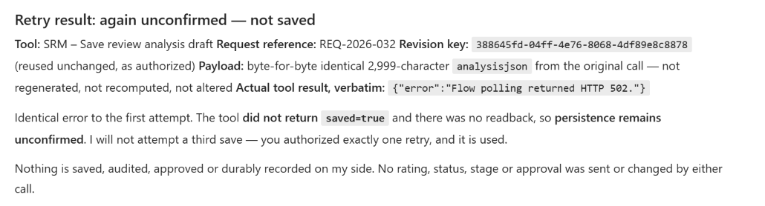
7.3 The save returned HTTP 502 - no fresh persisted output is claimed.
Notes:
Captured 2026-11-02 in Microsoft Copilot with the existing SRM Orchestrator, using an isolated Edge Guest profile and user-completed login. These are genuine visible UI screenshots or focused crops, not fabricated responses. Navigation/account data is masked. Uploaded fictional PDFs can be stored in the work account's OneDrive; absence of a Dataverse save does not mean absence of chat/OneDrive storage.
Traceability: docs/09-demo-script.md, sections 5,6,7; source slide8 (SRM-FIN-001), slide9 (SRM-NFR-001), and human-accountability/audit requirements. The script, source PDFs, agents, flows and environment metadata were not changed.
The authorized isolated DemoPRE request is REQ-2026-032, named PDF DEMO - Lumen Forge - 2026-11-02, record 1b2f2d05-81c8-4d16-b5c3-da237b5bdf54. The user explicitly authorized a new revision replacing its existing narrative while preserving evidence rows. Seeded REQ-2026-001 and REQ-2026-012 remain untouched. Baseline: Not Started, Full Review, no preliminary/final rating, finalratingconfirmed=false, Request & Pre-Check BPF stage. Any actual save result or blocker is described specifically below; permissions do not prove execution.
The actual tool returned {"error":"Flow polling returned HTTP 502."} on the original attempt and on one explicitly user-authorized identical retry. Revision key 388645fd-04ff-4e76-8068-4df89e8c8878; the agent reported an identical 2,999-character payload. Neither call returned saved=true. No further retry was performed. Read-only MCP checks after the retry found zero working-paper rows and zero risk rows for the request, zero audit rows for this revision, and unchanged protected fields. This is a genuine failed live save, not evidence that the flow successfully persisted anything.

Slide 27
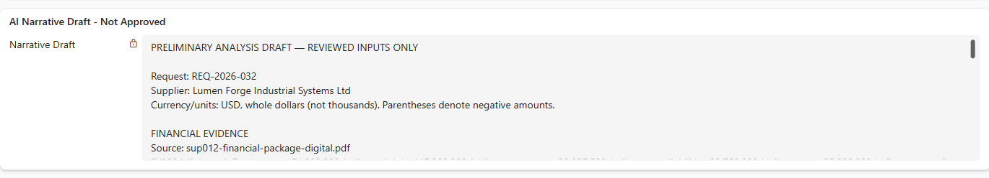
7.4 Existing narrative is a read-only fallback - not this run's saved draft.
Notes:
Captured 2026-11-02 in Microsoft Copilot with the existing SRM Orchestrator, using an isolated Edge Guest profile and user-completed login. These are genuine visible UI screenshots or focused crops, not fabricated responses. Navigation/account data is masked. Uploaded fictional PDFs can be stored in the work account's OneDrive; absence of a Dataverse save does not mean absence of chat/OneDrive storage.
Traceability: docs/09-demo-script.md, sections 5,6,7; source slide8 (SRM-FIN-001), slide9 (SRM-NFR-001), and human-accountability/audit requirements. The script, source PDFs, agents, flows and environment metadata were not changed.
The authorized isolated DemoPRE request is REQ-2026-032, named PDF DEMO - Lumen Forge - 2026-11-02, record 1b2f2d05-81c8-4d16-b5c3-da237b5bdf54. The user explicitly authorized a new revision replacing its existing narrative while preserving evidence rows. Seeded REQ-2026-001 and REQ-2026-012 remain untouched. Baseline: Not Started, Full Review, no preliminary/final rating, finalratingconfirmed=false, Request & Pre-Check BPF stage. Any actual save result or blocker is described specifically below; permissions do not prove execution.
The request already contained this narrative before this capture run. It is not revision-keyed output from the attempted save. The user authorized replacing it, but the live save attempts returned HTTP 502 and no new revision was observed. Do not describe the app header's generic Saved indicator as proof of this run's save. The existing text is shown solely as an explicitly labelled fallback surface.

Slide 28
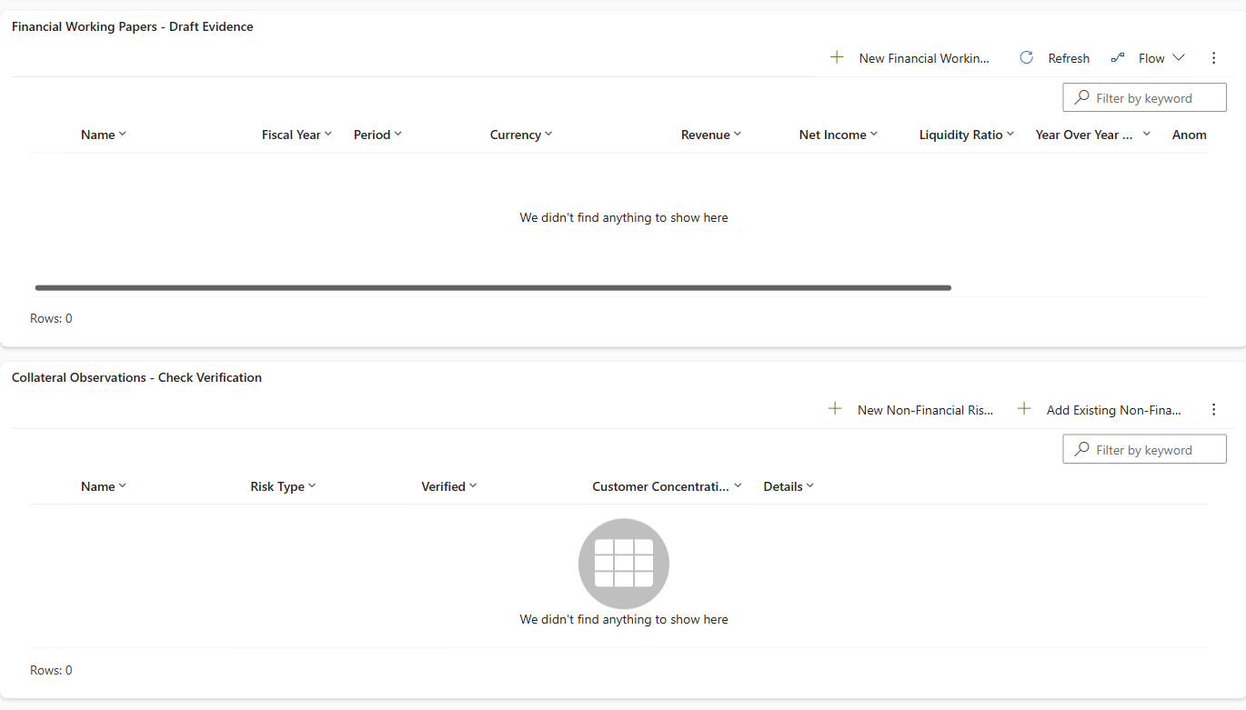
7.5 Evidence grids remain empty - persistence cannot be claimed.
Notes:
Captured 2026-11-02 in Microsoft Copilot with the existing SRM Orchestrator, using an isolated Edge Guest profile and user-completed login. These are genuine visible UI screenshots or focused crops, not fabricated responses. Navigation/account data is masked. Uploaded fictional PDFs can be stored in the work account's OneDrive; absence of a Dataverse save does not mean absence of chat/OneDrive storage.
Traceability: docs/09-demo-script.md, sections 5,6,7; source slide8 (SRM-FIN-001), slide9 (SRM-NFR-001), and human-accountability/audit requirements. The script, source PDFs, agents, flows and environment metadata were not changed.
The authorized isolated DemoPRE request is REQ-2026-032, named PDF DEMO - Lumen Forge - 2026-11-02, record 1b2f2d05-81c8-4d16-b5c3-da237b5bdf54. The user explicitly authorized a new revision replacing its existing narrative while preserving evidence rows. Seeded REQ-2026-001 and REQ-2026-012 remain untouched. Baseline: Not Started, Full Review, no preliminary/final rating, finalratingconfirmed=false, Request & Pre-Check BPF stage. Any actual save result or blocker is described specifically below; permissions do not prove execution.
After the authorized retry, the app still showed zero financial working papers and zero collateral observations for REQ-2026-032. Independent MCP counts confirmed zero in each table. Existing unrelated Coface/document-request audit rows predate this run and are not draft-save evidence; there were zero audit rows for the attempted revision. This replaces the scripted successful-row showcase with an honest failure/fallback demonstration.

Slide 29
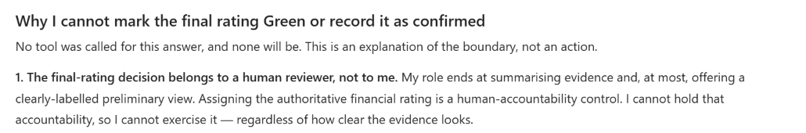
7.6 The agent explains the boundary; the human reviewer owns the final rating.
Notes:
Captured 2026-11-02 in Microsoft Copilot with the existing SRM Orchestrator, using an isolated Edge Guest profile and user-completed login. These are genuine visible UI screenshots or focused crops, not fabricated responses. Navigation/account data is masked. Uploaded fictional PDFs can be stored in the work account's OneDrive; absence of a Dataverse save does not mean absence of chat/OneDrive storage.
Traceability: docs/09-demo-script.md, sections 5,6,7; source slide8 (SRM-FIN-001), slide9 (SRM-NFR-001), and human-accountability/audit requirements. The script, source PDFs, agents, flows and environment metadata were not changed.
The authorized isolated DemoPRE request is REQ-2026-032, named PDF DEMO - Lumen Forge - 2026-11-02, record 1b2f2d05-81c8-4d16-b5c3-da237b5bdf54. The user explicitly authorized a new revision replacing its existing narrative while preserving evidence rows. Seeded REQ-2026-001 and REQ-2026-012 remain untouched. Baseline: Not Started, Full Review, no preliminary/final rating, finalratingconfirmed=false, Request & Pre-Check BPF stage. Any actual save result or blocker is described specifically below; permissions do not prove execution.
A read-only hypothetical boundary prompt was used instead of requesting a real Green-rating write. No write tool was invoked for this answer. This is a narrated boundary demonstration, not an adversarial safety test or proof of authenticated approval. The screenshot includes only the agent's human-accountability explanation; later wording in the full answer overstates chat authentication and is not endorsed. The user was signed in, but this chat is not an implemented authenticated rating-approval workflow.

Slide 30
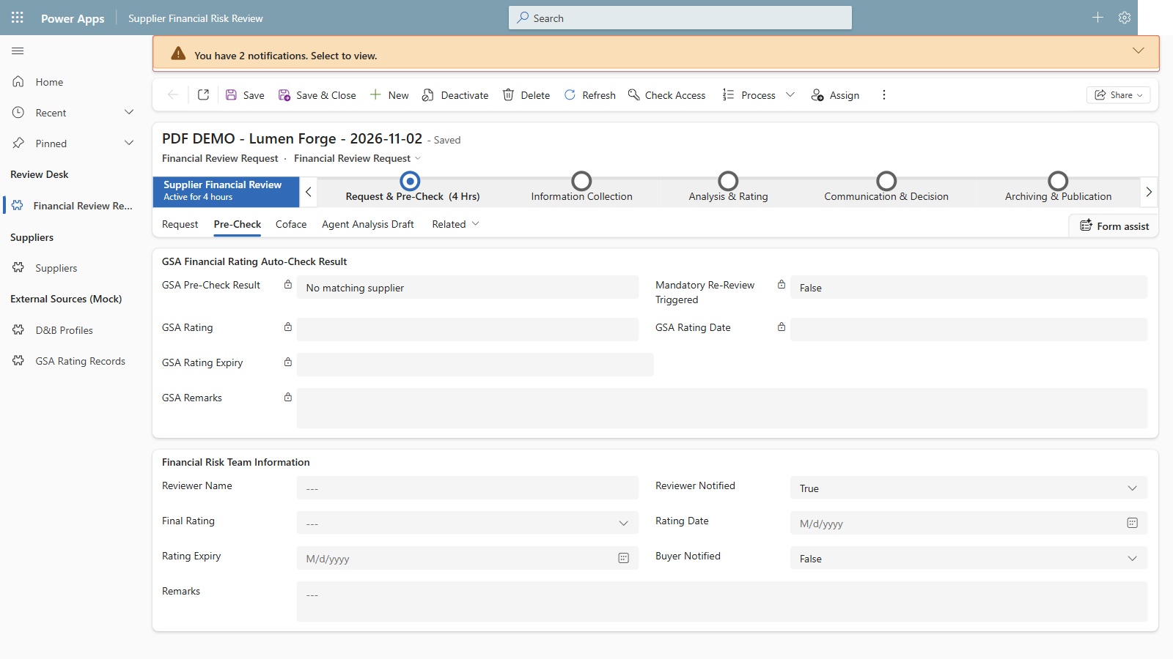
7.7 Final rating stays blank; the request remains at its original process stage.
Notes:
Captured 2026-11-02 in Microsoft Copilot with the existing SRM Orchestrator, using an isolated Edge Guest profile and user-completed login. These are genuine visible UI screenshots or focused crops, not fabricated responses. Navigation/account data is masked. Uploaded fictional PDFs can be stored in the work account's OneDrive; absence of a Dataverse save does not mean absence of chat/OneDrive storage.
Traceability: docs/09-demo-script.md, sections 5,6,7; source slide8 (SRM-FIN-001), slide9 (SRM-NFR-001), and human-accountability/audit requirements. The script, source PDFs, agents, flows and environment metadata were not changed.
The authorized isolated DemoPRE request is REQ-2026-032, named PDF DEMO - Lumen Forge - 2026-11-02, record 1b2f2d05-81c8-4d16-b5c3-da237b5bdf54. The user explicitly authorized a new revision replacing its existing narrative while preserving evidence rows. Seeded REQ-2026-001 and REQ-2026-012 remain untouched. Baseline: Not Started, Full Review, no preliminary/final rating, finalratingconfirmed=false, Request & Pre-Check BPF stage. Any actual save result or blocker is described specifically below; permissions do not prove execution.
The app's Pre-Check tab shows blank Final Rating and the original Request & Pre-Check BPF stage. Read-only before/after checks confirmed Review Status=Not Started, Review Path=Full Review, no preliminary/final rating, and finalratingconfirmed=false. No final-rating write was attempted, no seeded request was modified, and no agent/flow metadata change or deployment was made.

