Slide 1



Adaptive Segmentation and Automated Morphometric Analysis of Monogenetic Volcanic Cones in Distributed Fields
Aubrey Schrameck
Jean-Francois Smekens
Northern Arizona University
Arizona Space Grant - Student Symposium
April 18, 2026

Slide 2
Distributed Volcanic Fields: What & Why
What is a distributed volcanic field?
A region containing many small volcanoes spread across a broad area
Eruptions occur at multiple separate vents, rather than one central volcano
Often includes monogenetic cones (each formed by a single eruption)
Can remain preserved in the landscape for thousands to millions of years
Why do we care?
Preserves a record of past volcanic activity across time
Helps us understand how eruptions start and evolve
Enables comparison of volcanic features across large regions and even extraterrestrial planets

Slide 3
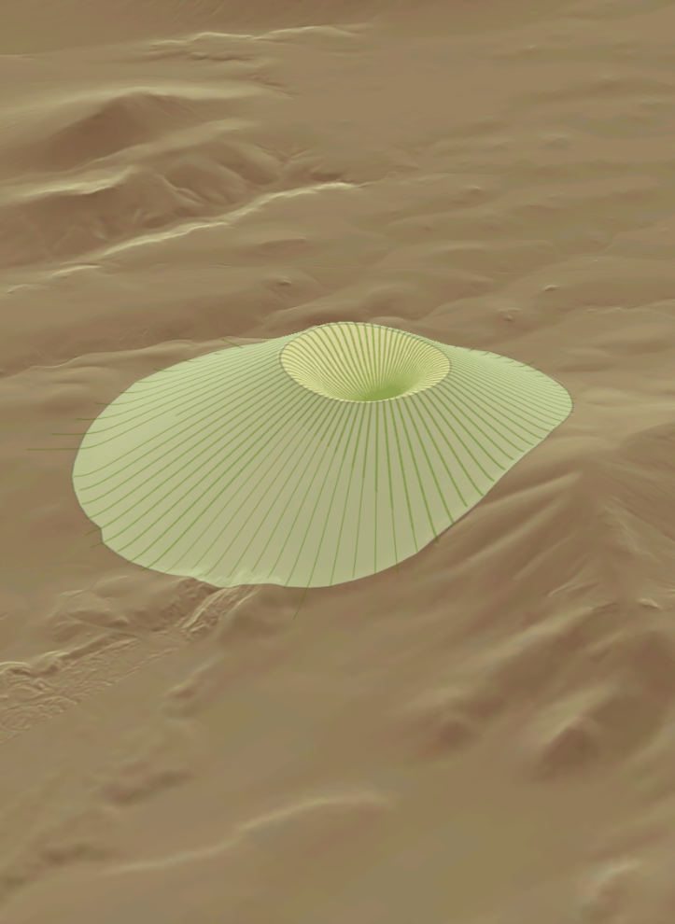
Limitations of Current Methods
Key Limitations
Inconsistent methods: Different studies use different mapping approaches, reducing reproducibility
Overlapping shapes: Different eruption types can produce very similar cone shapes
Erosion effects: Weathering and erosion gradually change geometry over time
Limited sample sizes: Many studies analyze only small datasets
Scalability challenges: Some regions contain tens of thousands of cones requiring automated approaches

Slide 4
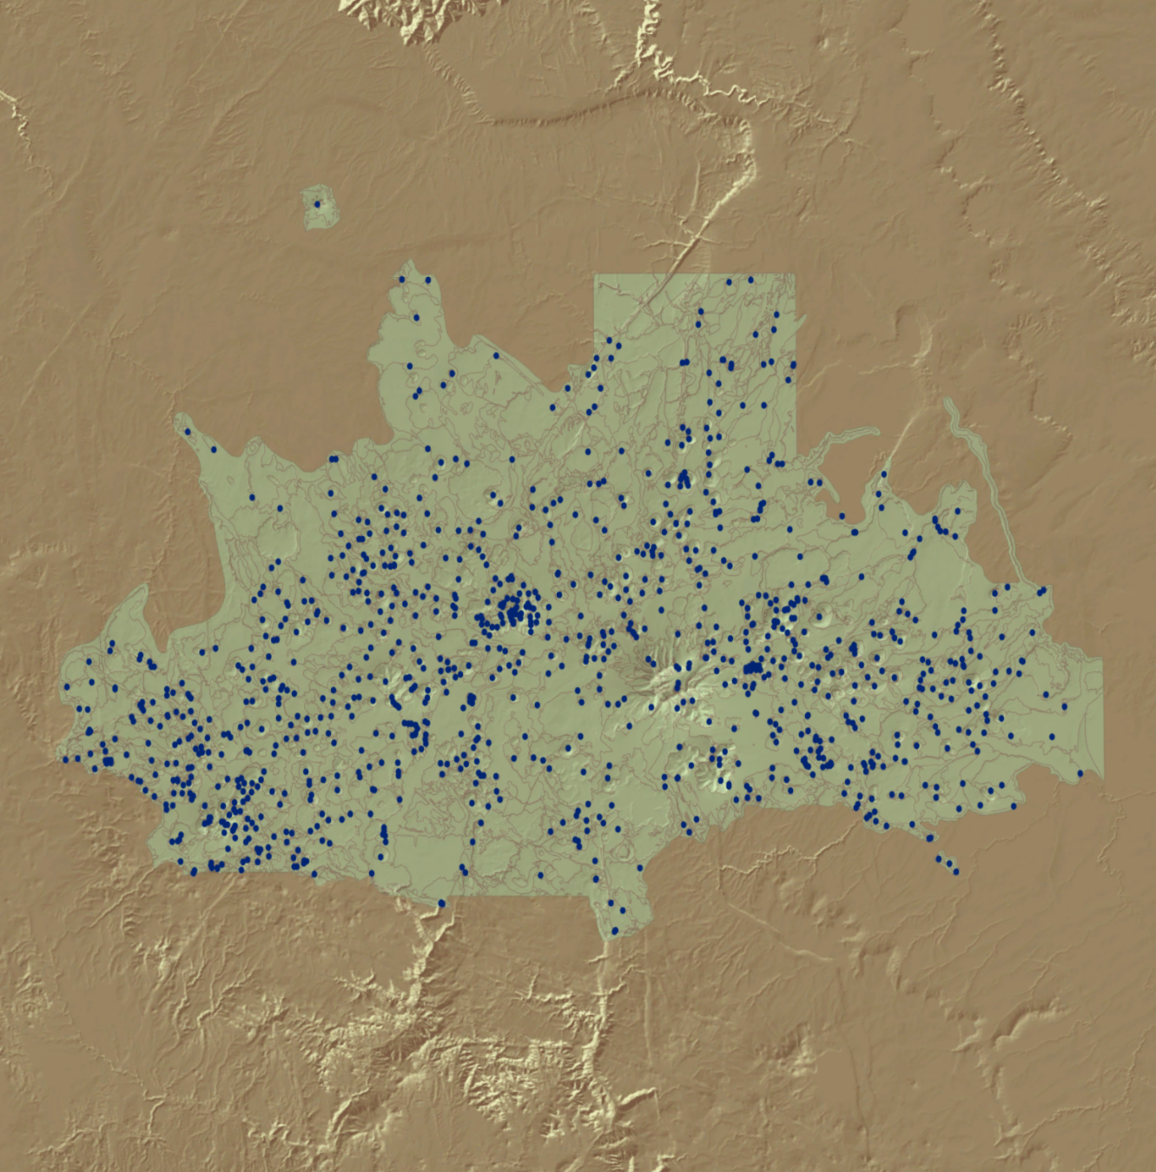
Core Goals
Our Goal: Develop a reproducible, scalable, and adaptive pipeline for analyzing cones
Automated pipeline:
Standardizes how cones are identified
Extracts key measurements
Scales efficiently from regional datasets to planetary-scale studies
Current Application:
445 volcanic cones analyzed
San Francisco Volcanic Field, Northern Arizona
High-resolution 1-meter elevation data from the United States Geological Survey (USGS)

Slide 5
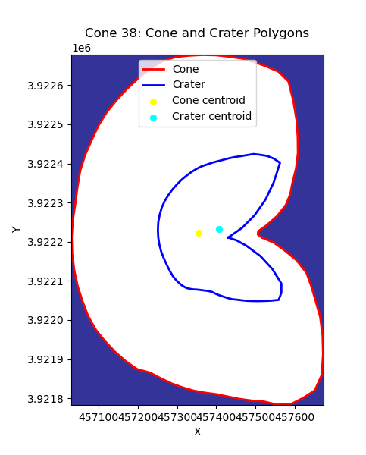
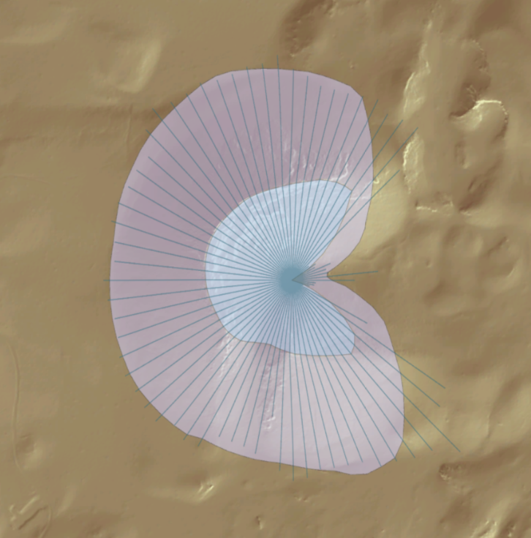
Stage 1: Adaptive DEM Segmentation
Objective: Automatically detect the cone boundary and crater rim from elevation data
How it works
Retrieve data: Download and combine elevation maps surrounding center point
Scan the shape: Calculate slopes along lines radiating from the center
Detect features:
Highest point → crater rim
Outer edge → cone base
Refine results: Smooth boundaries and create clean cone and crater outlines
Iteratively expand search until edges are found

Slide 6
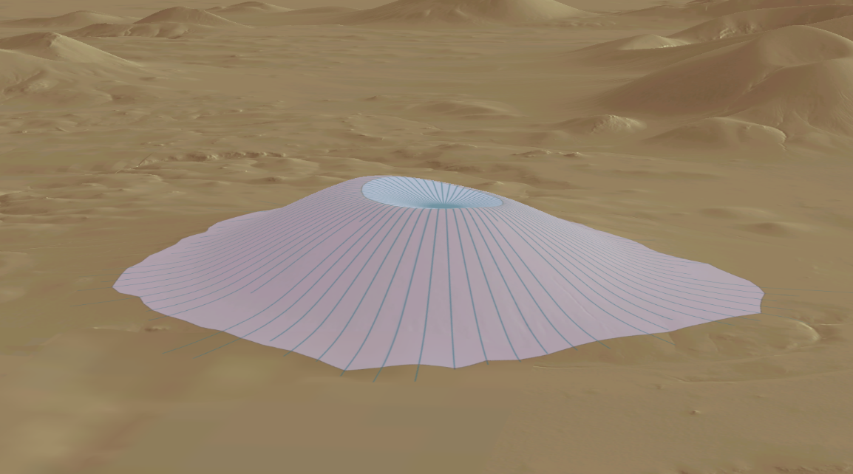
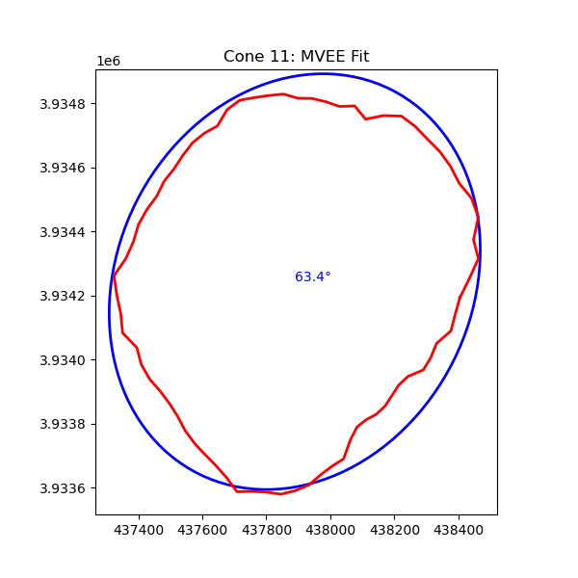
Stage 2: Morphometric Extraction
Objective: Consistently quantify the size, shape, and structure of each volcanic cone
How it works
Remove background terrain: Estimate the original ground surface and subtract it to isolate the volcano
Extract key metrics:
Cone and crater: height, depth, volume, perimeter, area, width, slope
Calculated: roundness (elongation, circularity, eccentricity), orientation and length of axes, ratios
Compute statistics: min, max, mean, median, standard deviation, skew, and kurtosis

Slide 7
Stage 3: Automated Pipeline
Objective: Execute Stage 1 (segmentation) and Stage 2 (morphometrics) at scale using a two-phase parallel pipeline with resume support and error handling
How it works
Phase 1 — Initial Processing:
Processes all new cones in parallel using ProcessPoolExecutor
Classifies errors as fatal or transient
Applies global cooldown to prevent API overload
Phase 2 — Targeted Retry:
Retries only transient failures using exponential backoff with a per-cone retry limit
Escalates cones to FAILED_FATAL status if retry limits are exceeded
Continues until all cones succeed or an external outage forces termination

Slide 8
Conclusions & Future Research
Conclusion: Developed an automated, scalable pipeline for DEM segmentation and morphometric extraction across large volcanic fields
Standardizes workflows to improve consistency, reproducibility, and scalability
Successfully applied to 445 cones in the San Francisco Volcanic Field, demonstrating regional-scale capability
Future Research — Expansion to Mars:
Extend the pipeline to planetary-scale datasets, targeting >65,000 cones on Mars
Enable large-scale comparative analysis between Earth and Martian volcanic morphologies
Support investigation of eruption processes, surface evolution, and planetary differences using consistent metrics

Slide 9
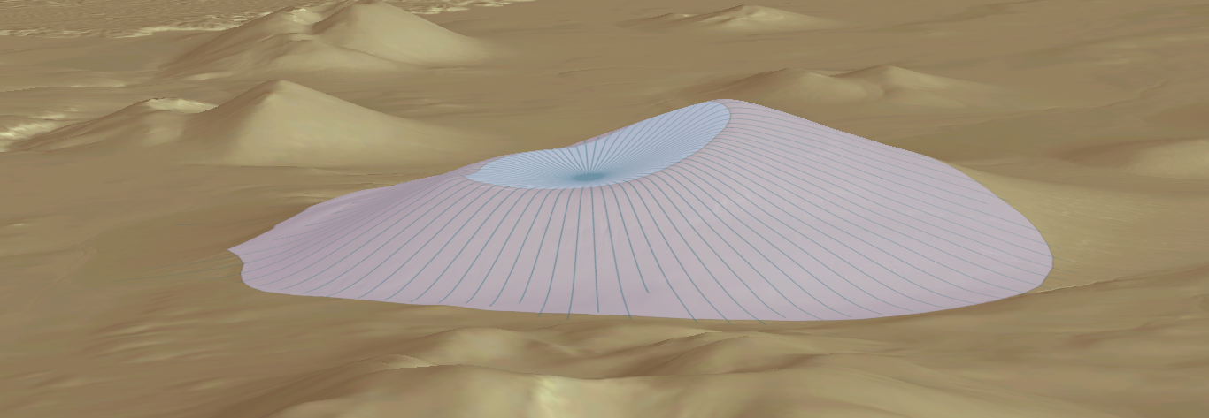
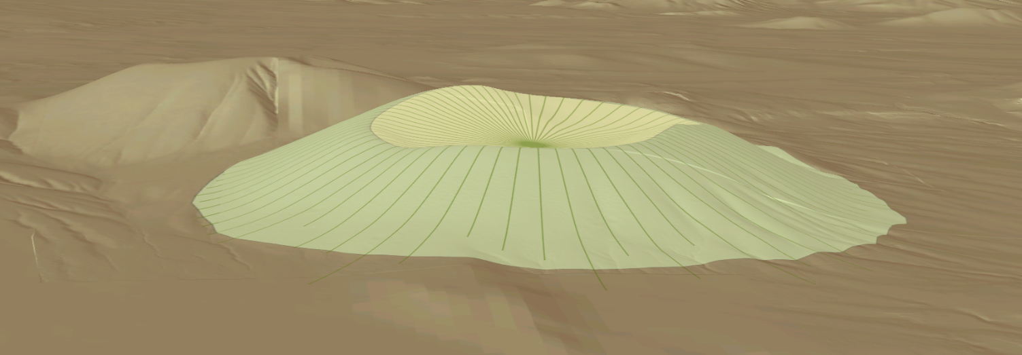
Thank you
References
[1] Pedrazzi D. et al. (2024), Geomorphology 109400, 10.1016/j.geomorph.2024.109400. [2] Poulos M. J. et al. (2012), Geophys. Res. Let. 39, 2012GL051283. [3] McGuire L. A., et al. (2014), JGR Earth Surface 119, 1725–1750. [4] Brož, P.et al. (2015), JGR Planets 120, 1512–1527. [5] Richardson, J. A. et al. (2021), JGR Planets 126, e2020JE006620. [6] Mills A. et al. (2024), Icarus 418, 116145.

