Slide 1
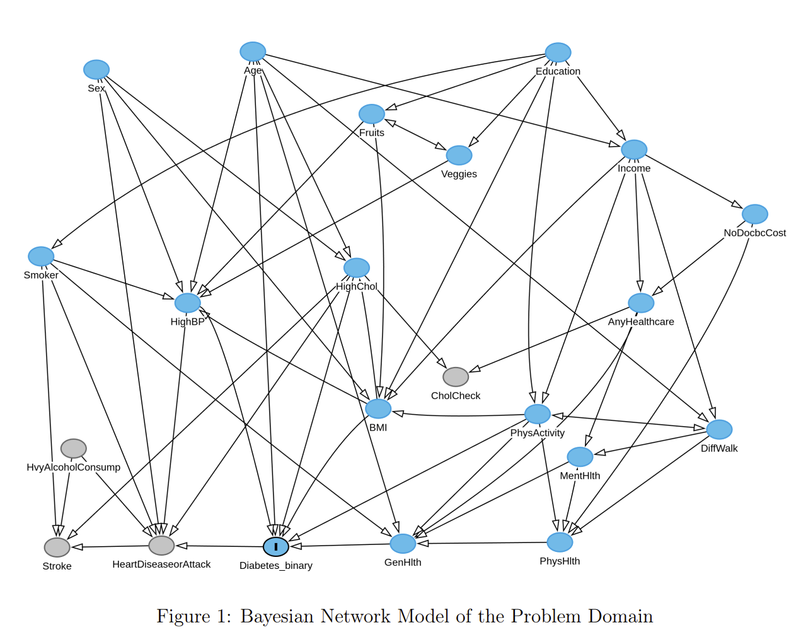
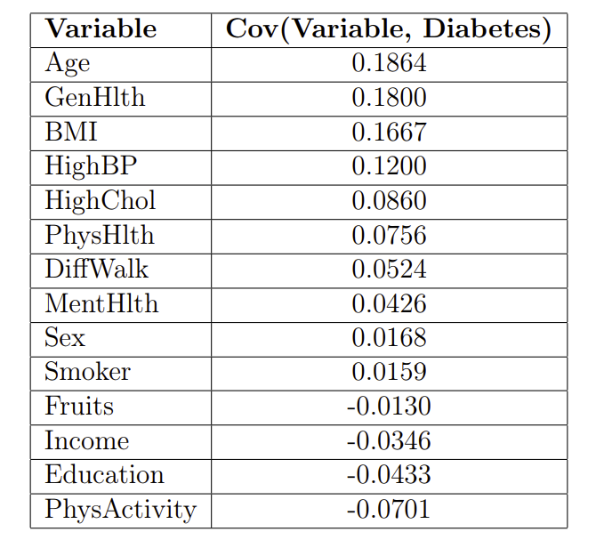

Diabetes Interventions
Daan Kersten, Andrew Schroeder, and Sven Meijboom

