Slide 1
OSGi
Anastasia Schwed

Slide 2
Outline
What is OSGi?
Why OSGi?
OSGi Architecture
Bundles and Services
Exercise

Slide 3

What is OSGi?
Open Service Gateway Initiative
First introduced by by OSGi Alliance in 2000
A set of specifications having several implementation frameworks (Equinox, Knoflerfish…)
https://www.osgi.org/

Slide 4
Key concepts
Bundles and Services
Modularity
Dynamic control
Reduced complexity
Interface model

Slide 5
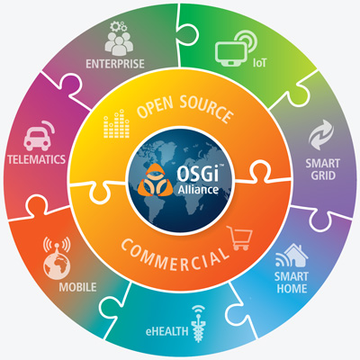
Why OSGi?

Slide 6
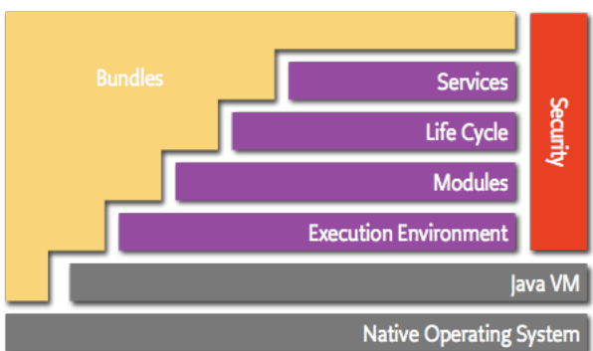
OSGi Architecture

Slide 7
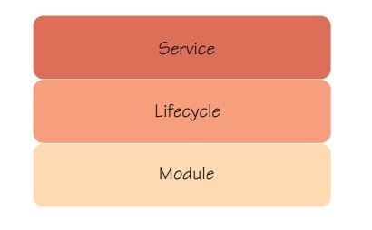
Layers
Module Layer
Bundles (Modules)
Package Level Encapsulation
Lifecycle Layer
Managing an OSGi application
Service Layer
Instances
How OSGi bundles communicate

Slide 8
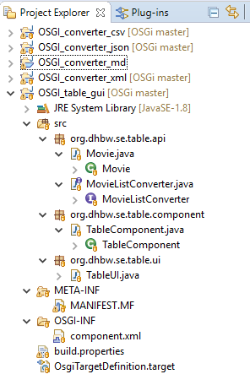
Module layer
Bundle
Code
MANIFEST.MF
Component definition(component.xml)
Unit of modularity and deployment
A class can be a part of several bundles
Dependencies are not transitive
No visibility for nested packages

Slide 9
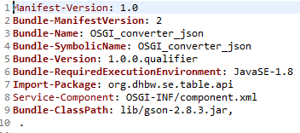
Module layer
MANIFEST.MF (located in the META-INF directory)
Imported or exported packages
Versions
Activator (optional)
Component definition

Slide 10
Lifecycle layer
Provides the ability to dynamically install and manage bundles in the OSGi framework.
The OSGi specification defines the following lifecycle operations: install, update, start, stop and uninstall.
Bundles can be controlled from the OSGi console

Slide 11
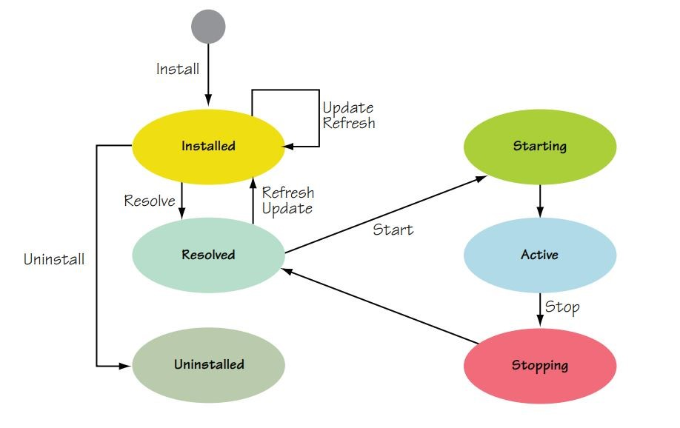
Lifecycle layer

Slide 12
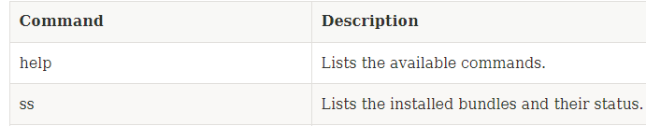

OSGi Console

Slide 13
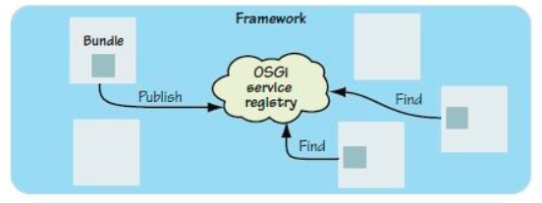
Service layer
Bundle communication
Hidden implementations
Publish, find and bind paradigm.
Services are published to the Service Registry
Service Tracker searches the registry for required services
and calls the set methods
Promotes interface driven development
A similar concept to Dependency Injection

Slide 14
Service registration and binding
1. Programmatically
2. Declarative Services (component.xml)

Slide 15
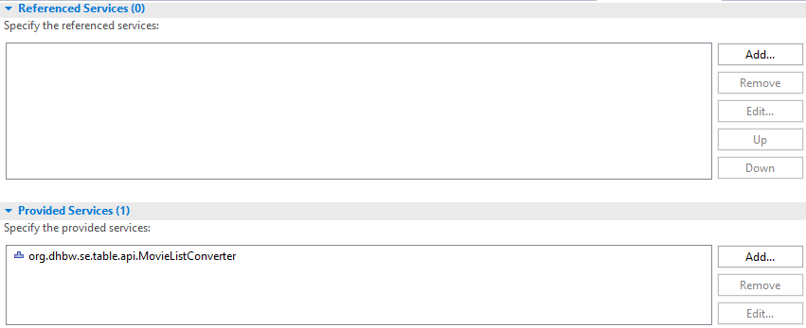
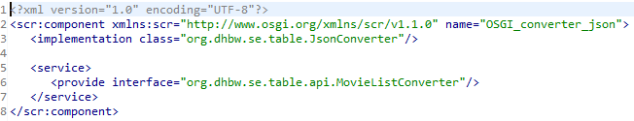
Service layer
Component definition:
Provided or referenced services (Interfaces)
Referenced services
Set methods (bind/unbind)
Activate()

Slide 16
Thank you for your attention!

Slide 17
The Cool Converter
Exercise

Slide 18
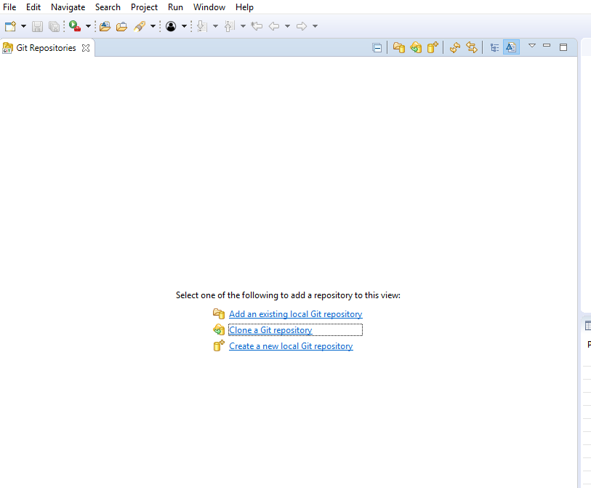
Clone project
https://github.com/aschwed/OSGi

Slide 19
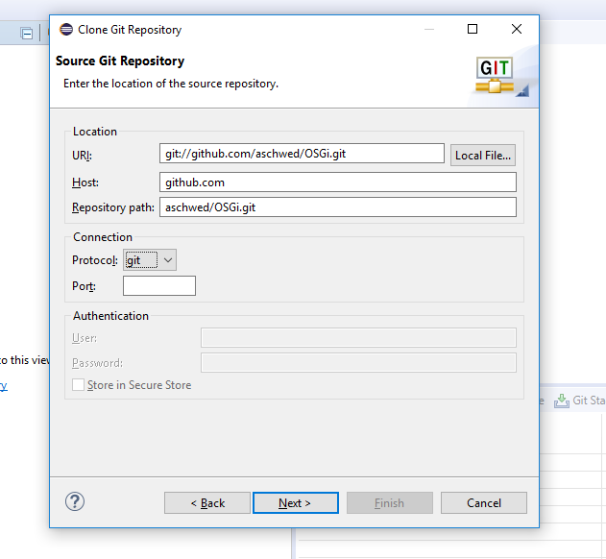

Slide 20
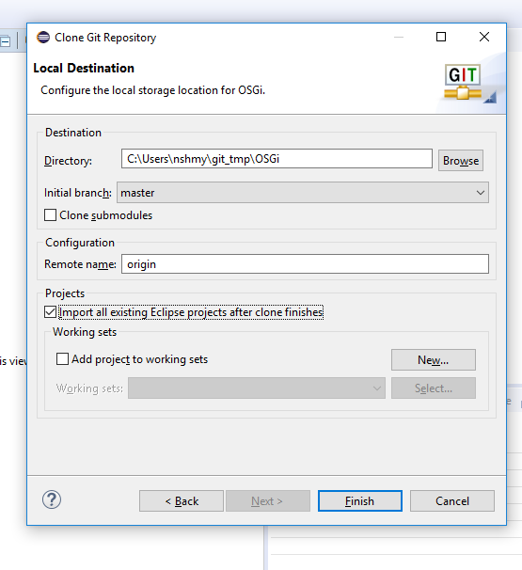

Slide 21
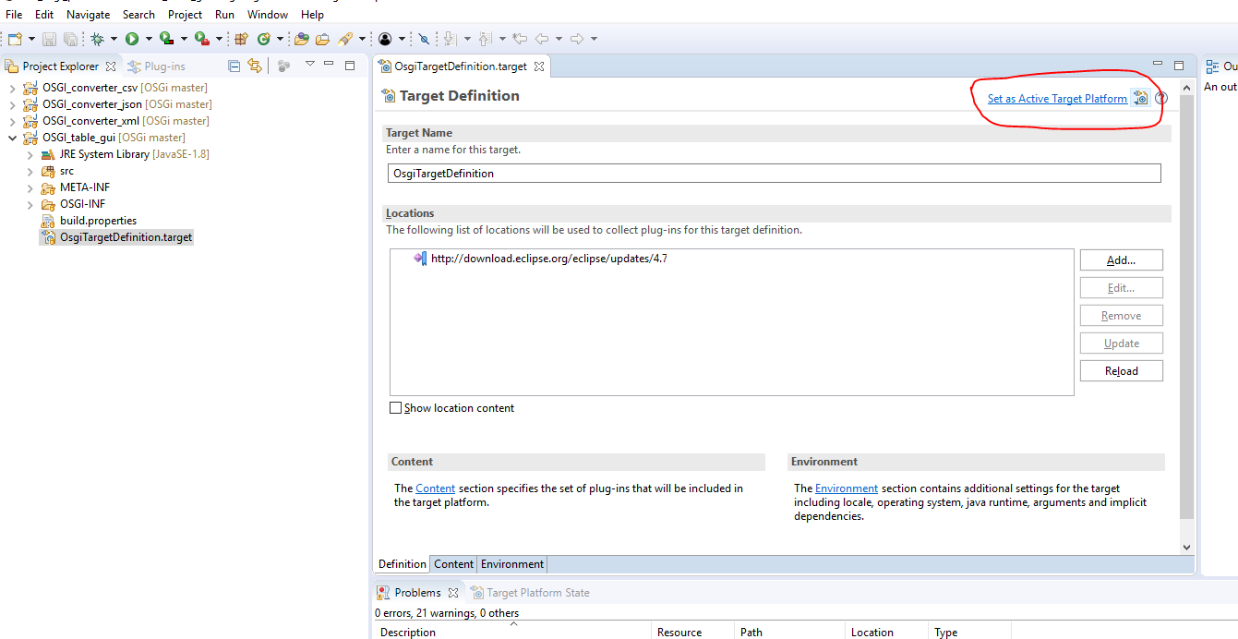
Set the Eclipse target platform

Slide 22
