Slide 1
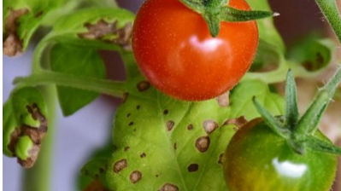
Smart Agriculture
Quantification of infection patterns on tomato leaves
Presented By –
Aahan Singh Charak
(189301024)
Sarthak Sharma
(189302091)

Slide 2
Why this Project ??
Agriculture plays a very important role in our daily lives. From providing food to everyone, livelihood to the farmers and reducing the pollution levels , agriculture plays an important role in the survival of human beings.
plants aren’t resistant to diseases. So, it becomes necessary for us to study the diseases occurring in plants, in order to develop measures to prevent and cure them.
Visual estimation is one of the ways to quantify and detect disease but it requires a lot of hard work and human resources.
So , this project aims at quantification of infection patterns on tomato leaves due to various pathogens using image processing techniques.

Slide 3
Methodology
Image Acquisition
Image Pre-processing
ROI Segmentation
Quantification
Ground Truth Validation

Slide 4
Image Acquisition : it is retrieving an image from some source , in this project plant village data set is used which consists of 54303 healthy and unhealthy leaf images divided into 38 categories by species and disease.
Image Pre-processing : It refers to the process of highlighting certain information of an image , as well as weakening or removing any unnecessary information according to specific needs.
ROI Segmentation : It is a segmentation technique, used for separating an object from its background , process of thresholding involves comparing each pixel value of the image ( pixel intensity) to a specified threshold. This divides all the pixels of the input image into 2 groups:
1) Pixels having an intensity value lower than threshold.
2)Pixels having an intensity value greater than threshold.
Quantification: As the name suggest , quantification tells about the magnitude of infection by percentage of bad pixels (infected) as compared to total pixels .
Ground Truth Validation: Analyzing how practical our results are in other words , in the real world how effective is our algorithm or process is a very crucial step in determining strength of applicability in real life , being compared to some “Gold Standards” helps in maintaining a level of practical usage.

Slide 5
Color Space
Color space means the use of a specific color model or system that turns colors into numbers. Each color model is a method of creating many colors from a small group of primary colors. Each model has a range of colors it can produce. That range is the color space.
In this Project we have used Lab and HSV color space.
Lab color space is a 3-axis color system with dimension L for lightness and a and b for the color dimensions
HSV has three components: hue, saturation, and value. This color space describes colors (hue or tint) in terms of their shade (saturation or amount of gray) and their brightness value.

Slide 6
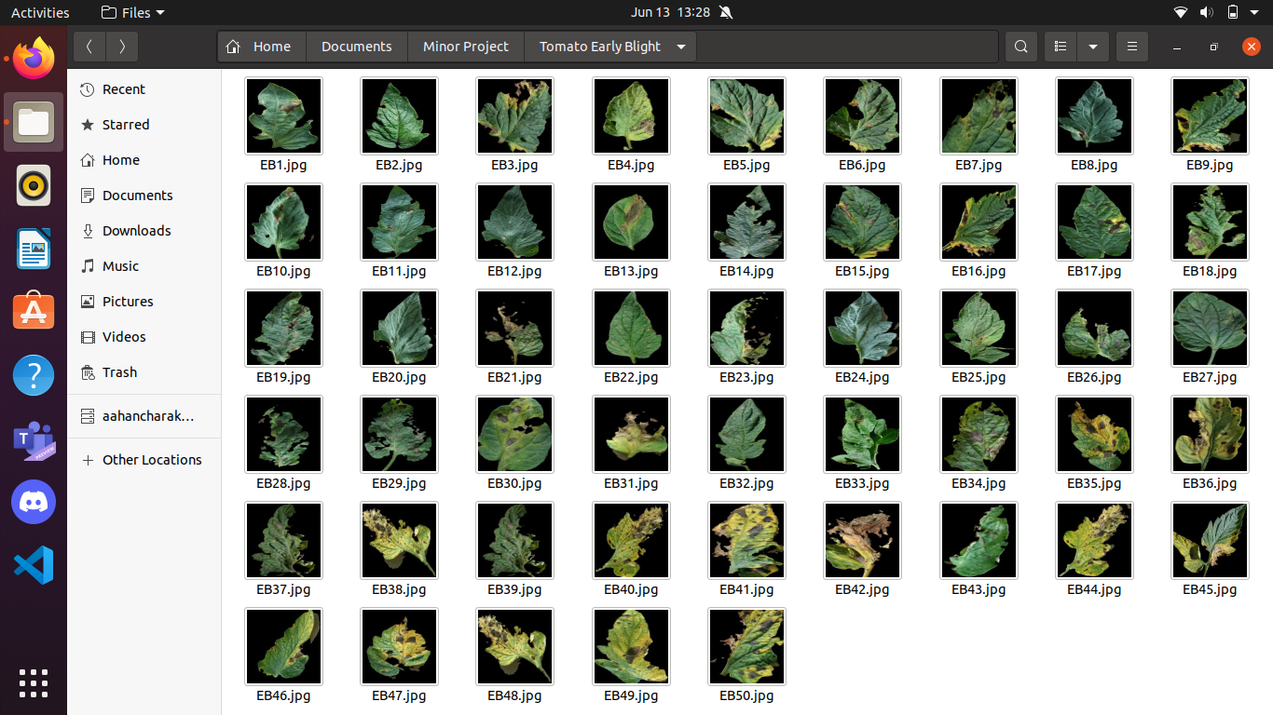
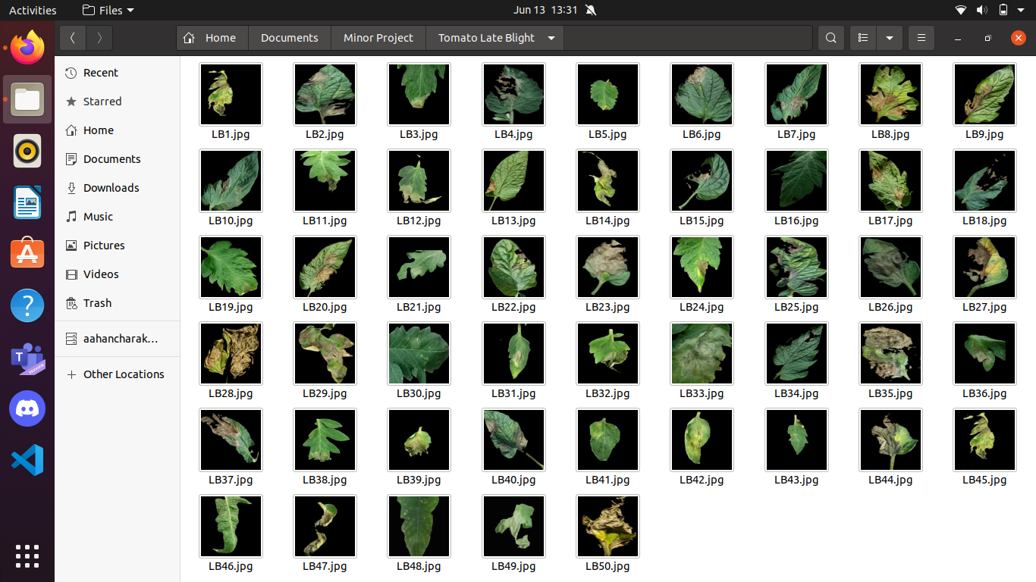
Data Set

Slide 7
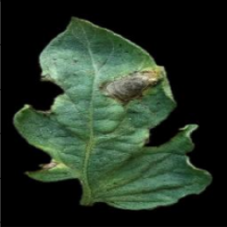

Lab Color Space
Original Image :
By default python reads in BRG format so , firstly we convert image from default BRG to RGB using :
Now, we have to covert RGB to Lab color space : this will be done by first obtaining mediatory values x,y,z then using them in obtaining ciel, ciea,cieb values …..

Slide 8
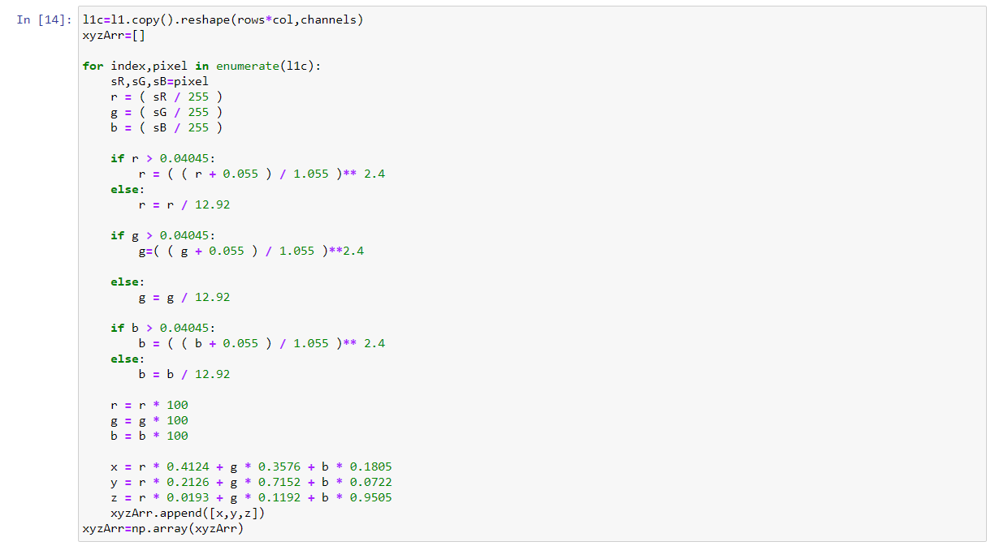
r,g,b x,y,z

Slide 9
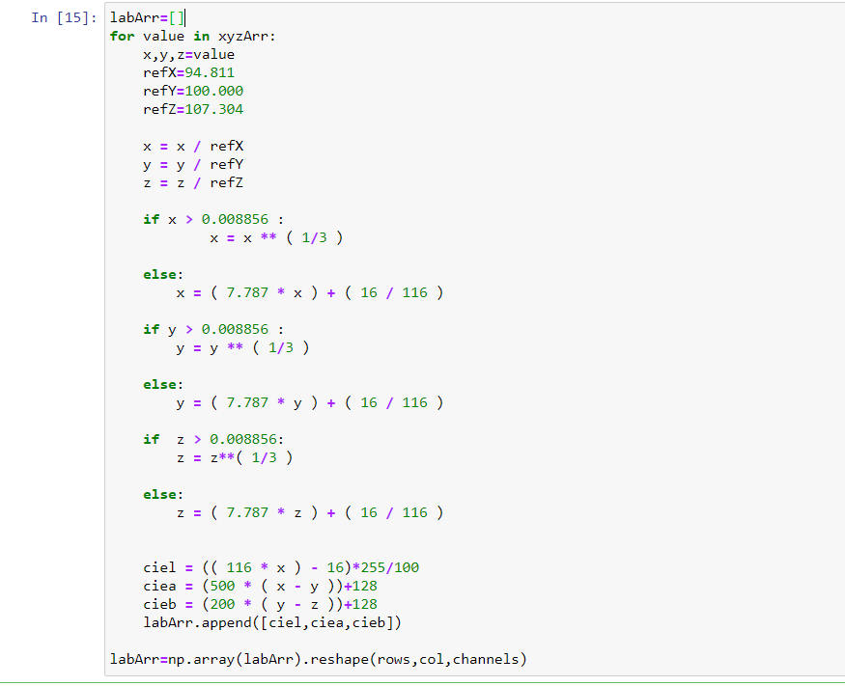
x,y,z ciel,ciea,cieb

Slide 10
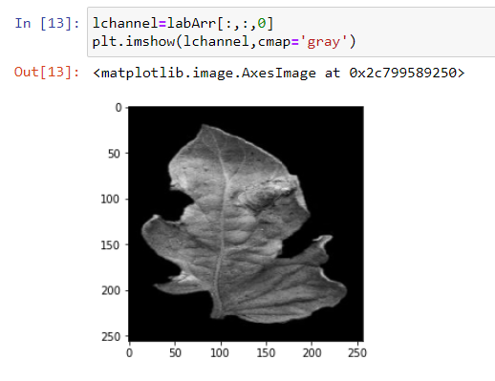
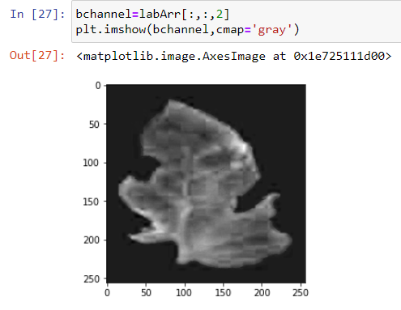
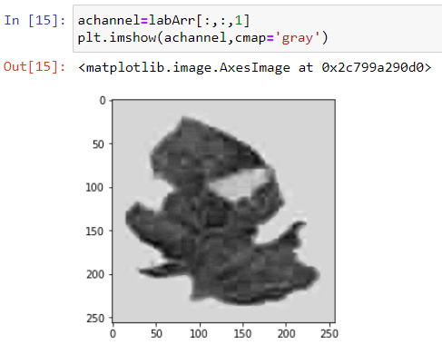
Results :
L channel :
b channel :
a channel :

Slide 11
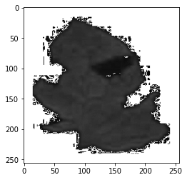
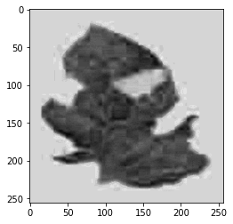
A Channel Pre-processing
}
A Channel Preprocessing
For a channel preprocessing needed
make the background white and invert the image. For open cv black color is 128 in a channel.
For each pixel in a-channel{
if(intensity(pixel)==128){
intensity(pixel)=255;
}
Else{
intensity(pixel)=255-pixel;
}}
Result
After
Before

Slide 12
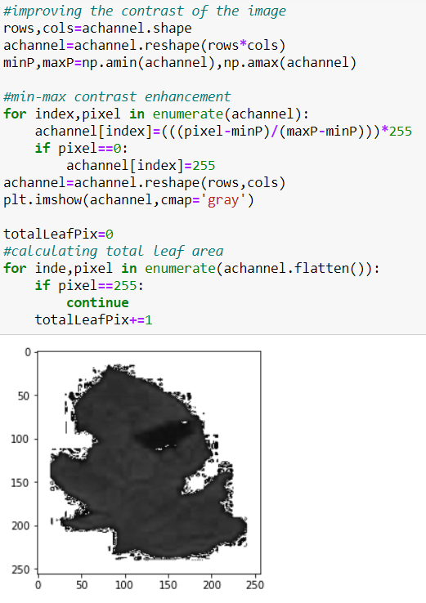
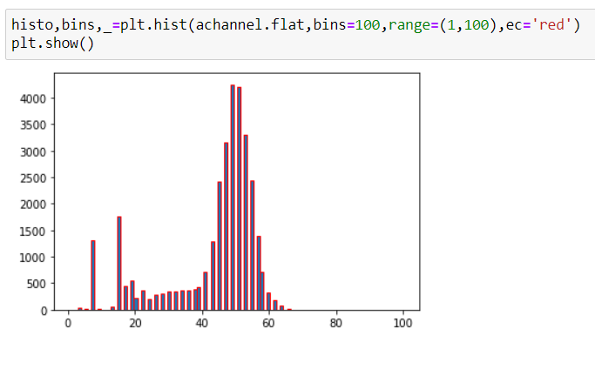
Thresholding
In this first we plot Histogram then we find out global Maxima , after using global maxima ,we obtain an image in which bad pixels can be segregated easily .
A channel gave best results in the end.

Slide 13
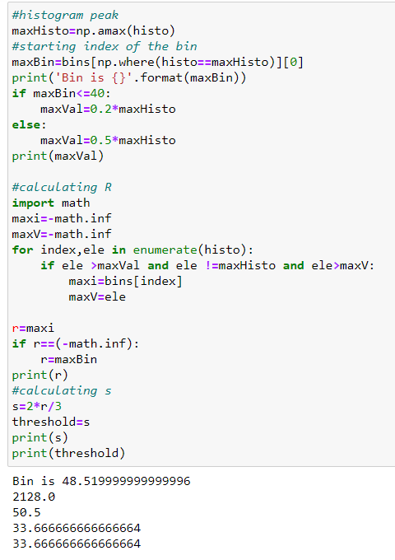
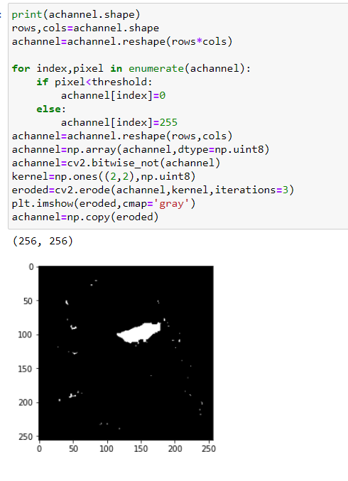
Global Maxima
Highest pixel value in an image is global maxima.
Pixel having value less then threshold are made black.
Pixel having value more than threshold are made white.
Thus we obtain an image in which infection can be segregated easily

Slide 14
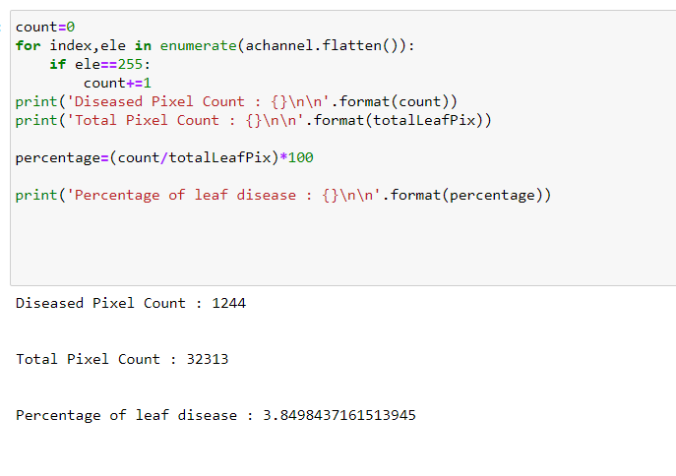
Quantifying
Quantification tells about the magnitude of infection.
This is calculated using formula :
percentage infection=(dead pixel /total leaf pixel)*100

Slide 15
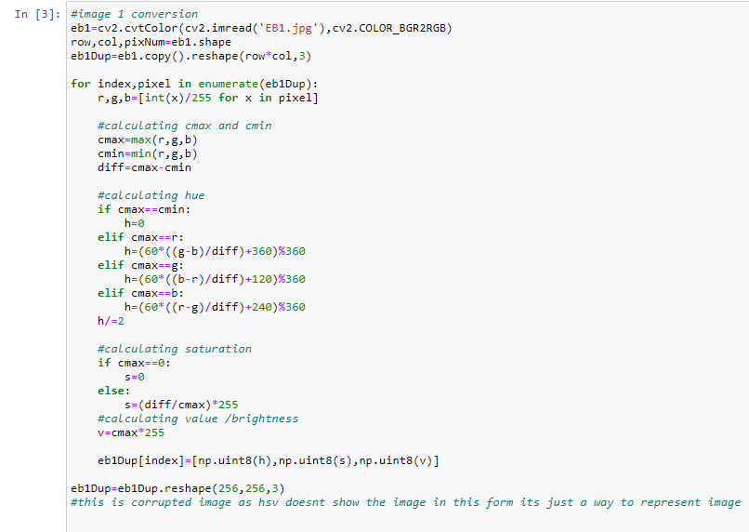
HSV Color Space
Firstly image conversion so that we can extract H,S,V channel :

Slide 16
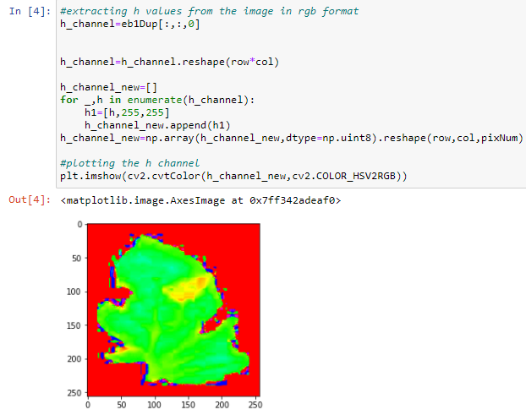
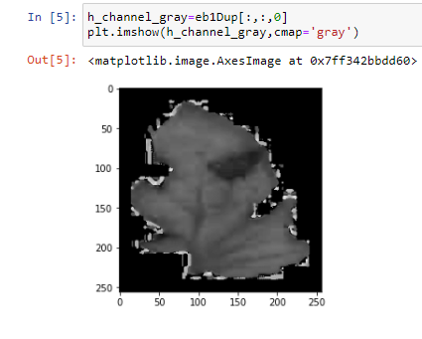
H Channel
Here, we are analyzing hue channel of the leaf with 100 percent saturation and 100 percent brightness so that the image can be analyzed based on the natural color of the leaf.
* RGB analysis * Gray Scale analysis

Slide 17
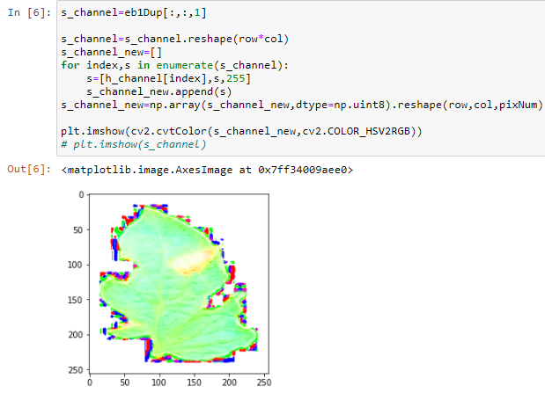
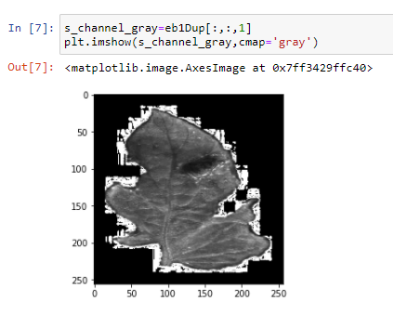
S Channel
Here we are analyzing the image based on the amount of white light mixed with it . Saturation is the same for each pixel, and hue too. Brightness is set to 100 so that black light has no effect on the analysis.
*RGB analysis * Gray Scale
analysis

Slide 18
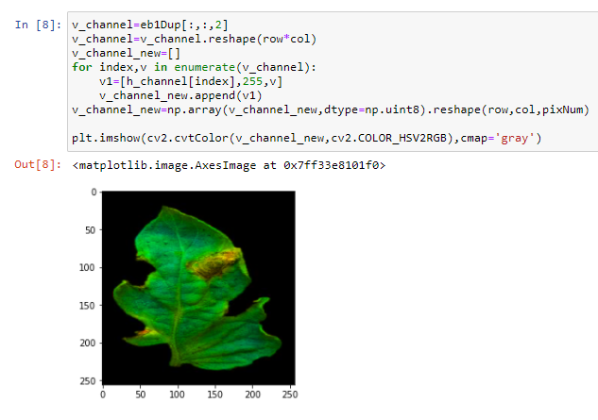
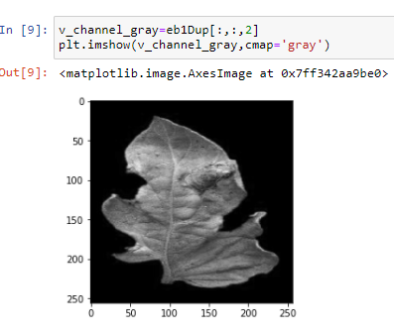
V Channel
Here we are analyzing the image based on the amount of black light mixed with it . Brightness is the same for each pixel, and hue too. Saturation is set to 100 so that white light has no effect on the analysis.
*RGB analysis * Gray Scale

Slide 19
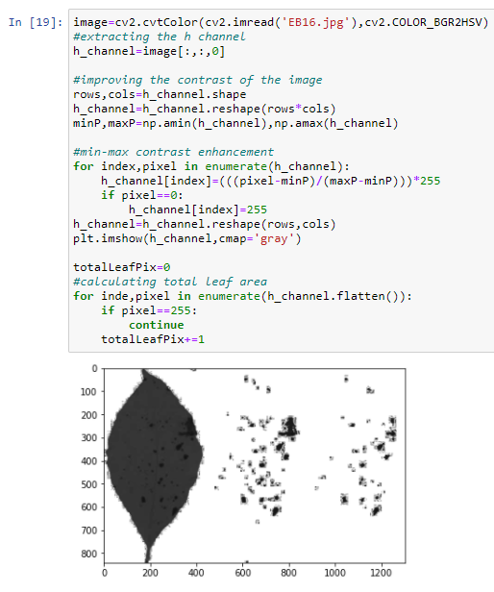
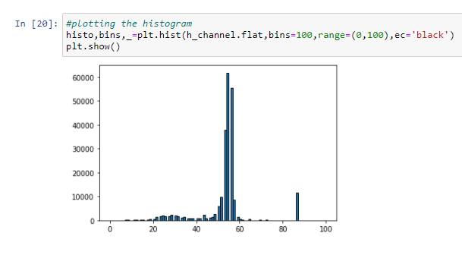
Thresholding
In this first we plot Histogram then we find out global Maxima , after using global maxima ,we obtain an image in which bad pixels can be segregated easily .
As Observed H channel gives best results

Slide 20
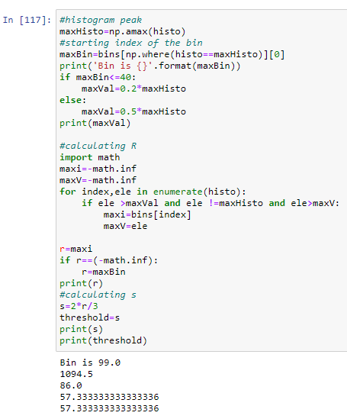
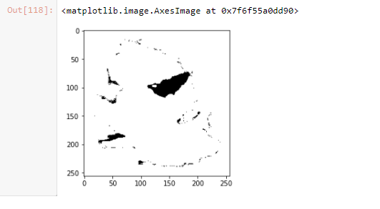
Global Maxima
Highest pixel value in an image is global maxima.
Pixel having value less then threshold are made black.
Pixel having value more than threshold are made white.
Thus we obtain an image in which infection can be segregated easily

Slide 21
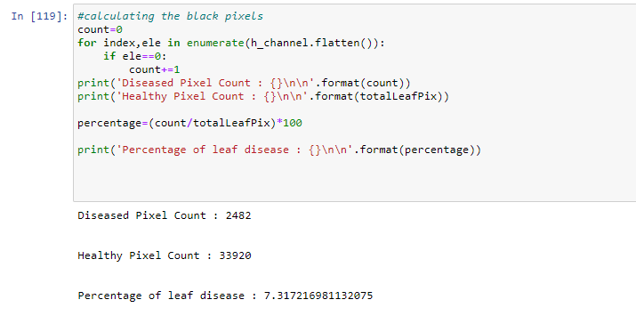
Quantifying
This is calculated using formula :
percentage infection=(dead pixel /total leaf pixel)*100

Slide 22
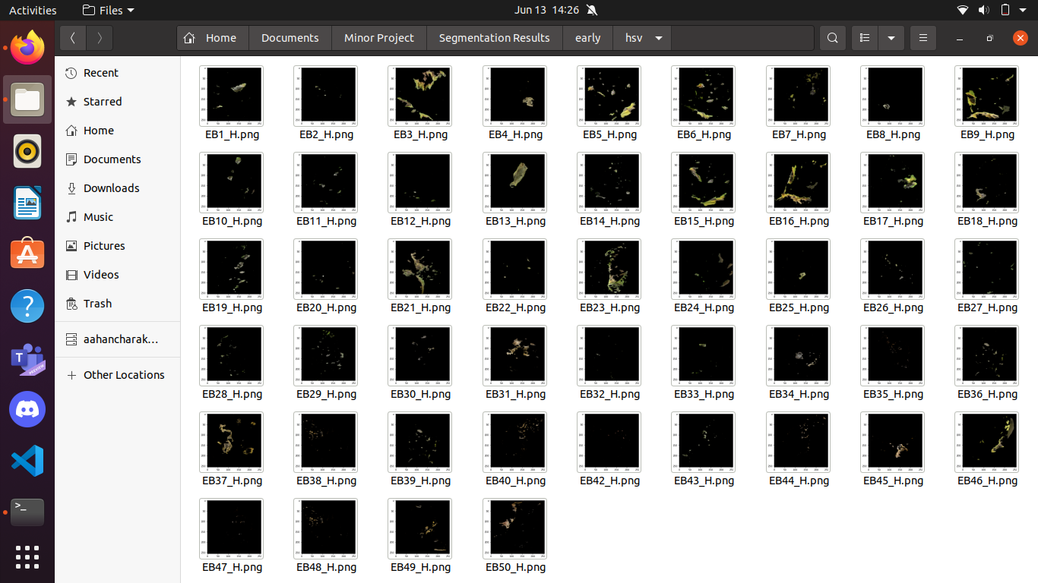
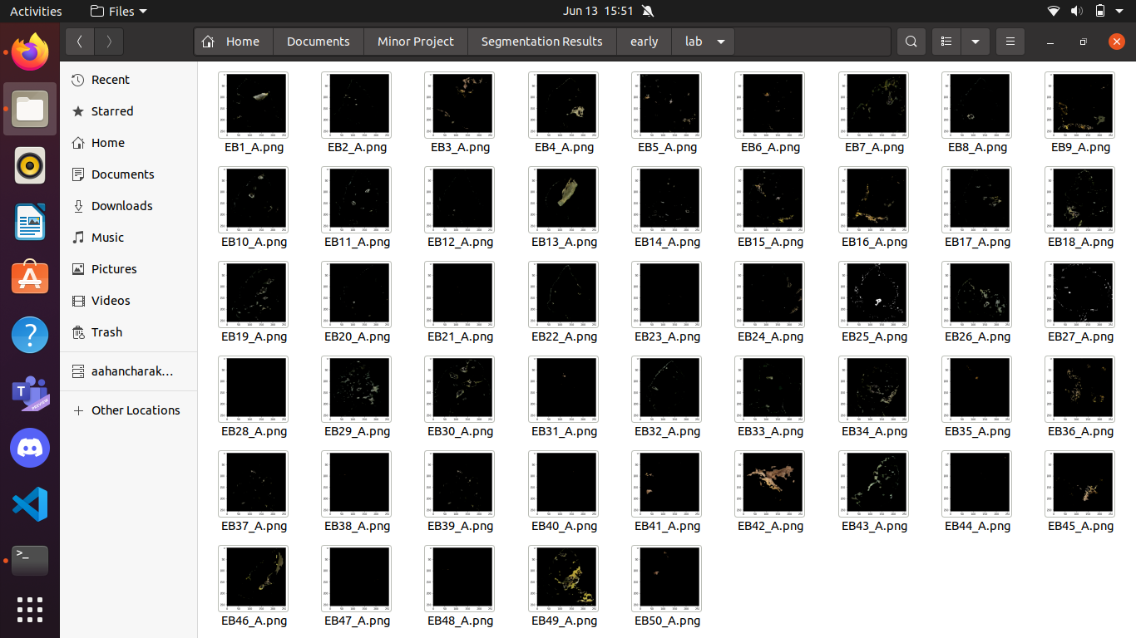
Segmented Results of Early Blight
h Channel
a Channel

Slide 23
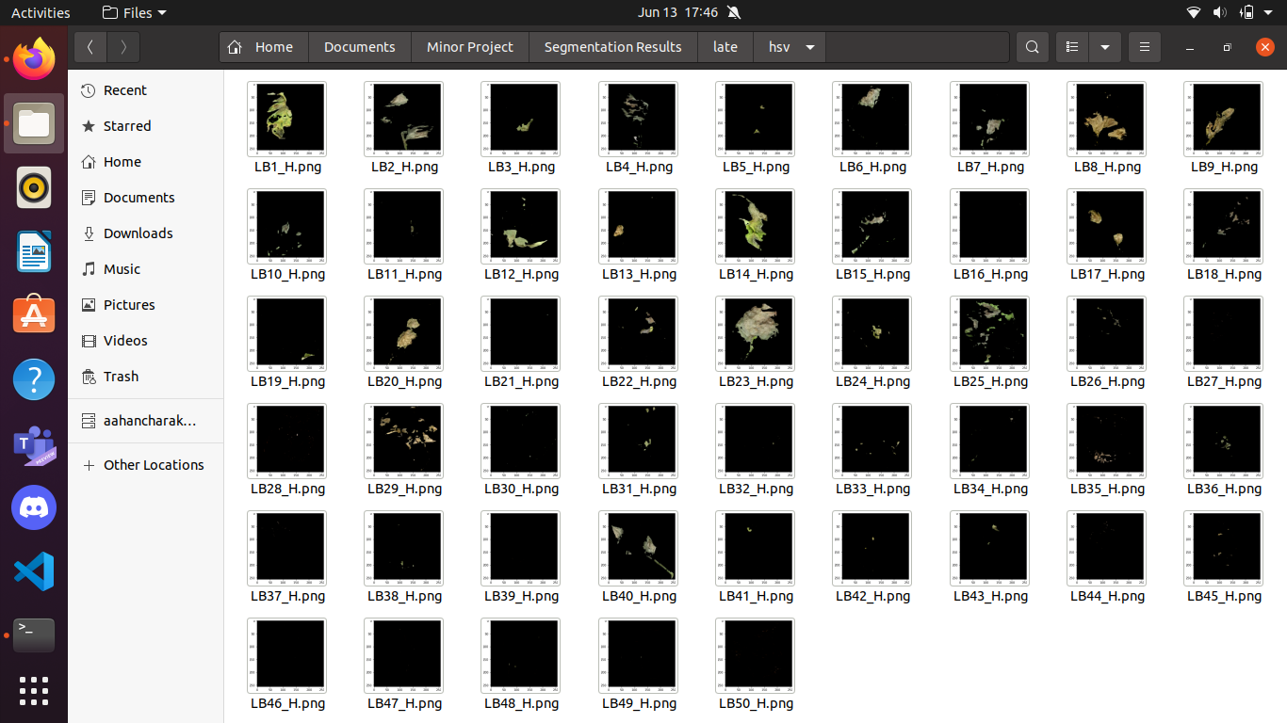

Segmented Results of Late Blight
h Channel
a Channel

Slide 24
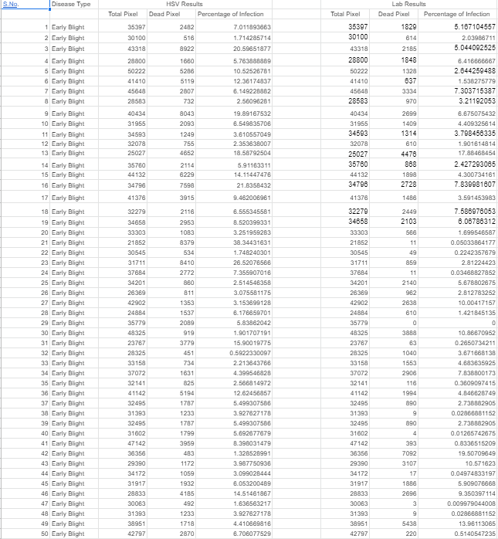
Quantification Results of Early Blight

Slide 25
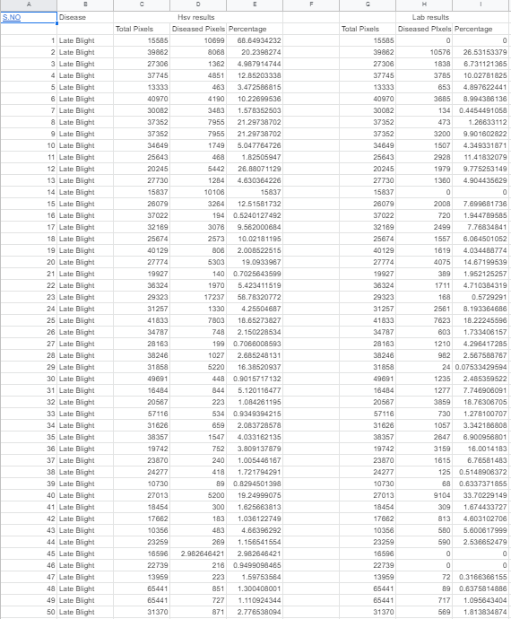
Quantification Results of Late Blight

Slide 26
Scope of Improvement
By experimental analysis, it was found out that for some images where h channel wasn’t able to yield satisfactory results, a channel was able to get the correct results and vice versa.
However, this was not true for all the images. In some of the sample images both of the channels were unable to yield correct results. The leaves which had a yellow colored diseased region and the leaves which had low contrast between the diseased and the healthy regions weren’t segmented properly by the algorithm.
Reason :
Since yellow hue lies closer to green hue , the yellow infected regions might’ve been taken into the healthy group by the algorithm. Same is the case with diseases showing light green color symptoms

Slide 27
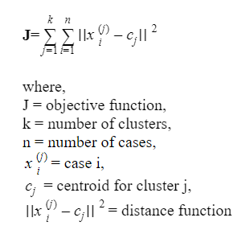
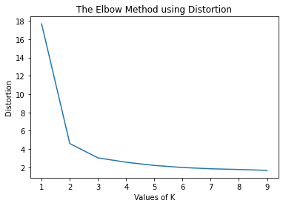
Solution = K-means Clustering
In image processing K-means clustering can be used to segment the region of interest from other objects in the image. Pixels which have similar color values are placed in a similar cluster and can be easily distinguished from the other pixels in the image.
The goal is to find groups having similar characteristics, and the number of groups is represented by “k” .The objective function for k-means clustering is
In our case, we will use a and b channels from lab color space to form
clusters of pixels. The appropriate number of clusters k can be identified by the
Elbow Method.

Slide 28
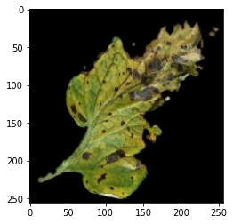
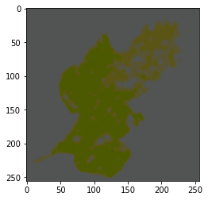
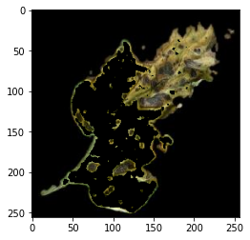
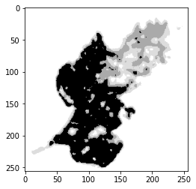
Clustering Result and Segmentation
To visualize the image in the rgb color channel, the luminance (L) value is kept around 90 and the resulting lab image was converted to rgb color image.
( After Clustering
Segmentation : Extracting the a-channel from the clustered image and then analyzing the image in grey-scale. After experimental analysis it was found that healthy leaf regions, which are dark green in color, have the lowest a values, hence in grey-scale they represent the darkest color.

Slide 29
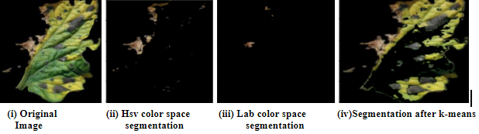
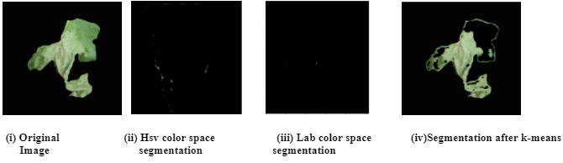
Final Result Comparison
A comparison between results given by the algorithm proposed by Barbedo(2016) and the k-means method is shown in Fig . Since most of the images produced a k value of 4, we chose 4 as our default k value.

Slide 30
Bibliography/References
1. Bock, C. H ., Barbedo, J. G., Del Ponte, E . M ., Bohnenkamp, D ., & Mahlein, A . K. ( 2020). From visual estimates to fully automated sensor-based measurements of plant disease severity: status and challenges for improving accuracy. Phytopathology Research, 2 , 1-30.
2. Barbedo, J . G . A. ( 2013). Digital image processing techniques for detecting, quantifying and classifying plant diseases. SpringerPlus , 2 (1), 1-12.
3. FAOSTAT. (2021). Retrieved 1 March 2 021, from http://www.fao.org/faostat/en/#data
4. Mohanty, S.( 2021). spMohanty/PlantVillage-Dataset. Retrieved 1 March 2021,from : https://github.com/spMohanty/PlantVillage-Dataset/blob/master/raw/color/Tomato___Bacterial_spot/00728f4d-83a0-49f1-87f8-374646fcda05___GCREC_Bact.Sp%206326.JPG

Slide 31
Thank You!

