Slide 1


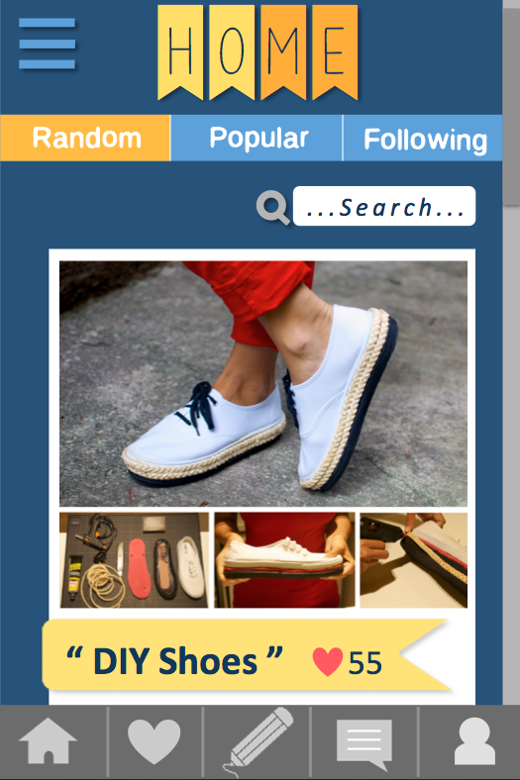




HanDIYcraft
Expenditure recently tends to keep getting higher than before, so people turns to find a way to reduce their unnecessary expenses. DIY (Do it yourself) is a method to recycle, renovate, and repair old things. Many people love to build creative DIY artworks and share their idea to others. However, another problem is they do not know where exactly they should buy certain materials to do their DIY artworks.
HanDIYcraft application provides several functions helping users to explore and share DIY ideas. Also, it allows users to communicate among each other by commenting, and with the shopkeeper by private messaging. It provides map function to solve the problem on finding shops to buy needed materials. On the other hand, shopkeepers are also able to provide information in order to advertise their shops to gain more customers. This application requires a smart phone on Android Operating System to serves portability to the users. In addition, it uses Google Maps API to identify the location of shops, and Facebook API to let people share their favorite DIY tutorials.
Ms. Nahathai Kaewtatib 542115018
Ms. Pimchanok Sripraphan 542115043

