Slide 1
Practice 2
Windows Programming Design

Slide 2
Practice 2- 1
Class Schedule Assistant

Slide 3
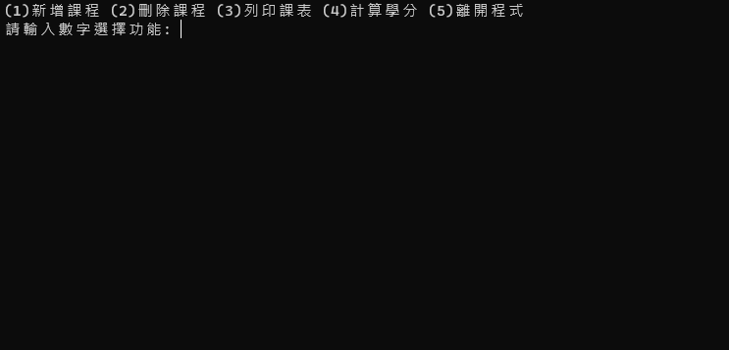
Class Schedule Assistant
Add course
Delete course
Print class schedule
Calculate credits
Leave program
Please enter a number to select a function

Slide 4
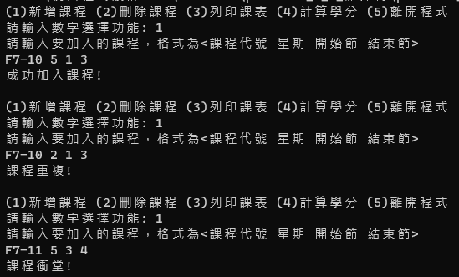
Add Course
Add the specific course into the schedule. When adding, it must be checked whether the course is repeated or has a conflict with another class.
The input format:
Course ID Day of the week Start End
Course ID format: OO-OO
Week: 1-7 (means Mon-Sun)
Section of start and end: 1-8 (start<=end)
Ex. F7-10 5 1 3
means adding F7-10 to section 1-3 on Friday
Please enter the course to add, the format is <course ID Day of the week Start End
Course added successfully!

Slide 5
Add Course
Output add the course successfully! after the course is added
Output repeated course! if the course is repeated
Output course conflict! if a conflict occurs
If repeated course! and course conflict! occur at the same time, just output one of them.
There is no other invalid input in the test case.
(ex. 123-456 8 10 1) will not in the test case。
Please enter the course to add, the format is <course ID Day of the week Start End
Course added successfully!

Slide 6
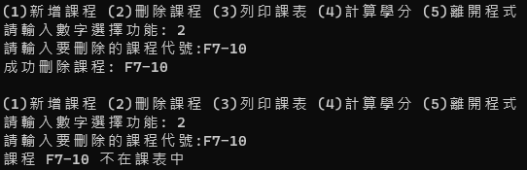
Delete Course
Enter the course ID to delete the course in the schedule. It must be checked whether the course already exists in the schedule.
Output: Delete <course id> after the course deleted successfully.
Output: <course id> is not in the schedule, if it is not in the schedule.
Please enter the course ID to delete
Course deleted successfully
Course F7-10 is not in the class schedule

Slide 7
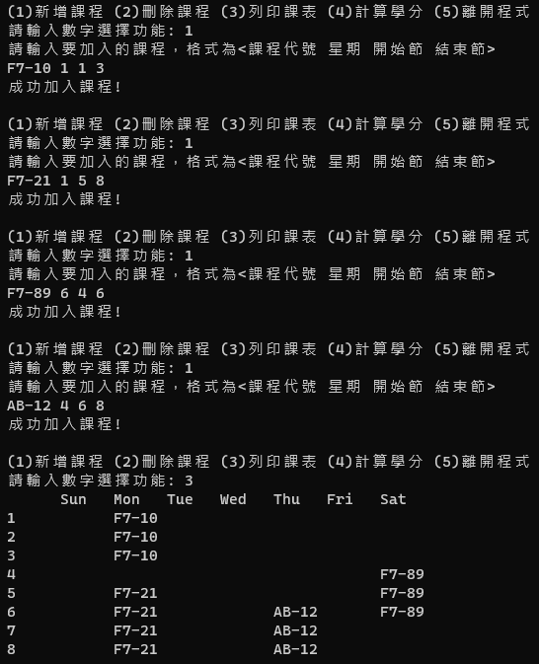
Print Class Schedule
Output the class schedule using an assigned format. The first row is the day of the week, the first column is the number of the section, and the rest is the course ID. If there is no class in the section, leave blank.

Slide 8
Print Class Schedule
There are 8 columns. Each column takes 6 blanks, and align left.
Hint: String.Format()can be used for formatting
Ex. String.Format({0, -10}, “hello”)
Will let the string “hello” takes 10 blanks and align left.
6 blanks

Slide 9
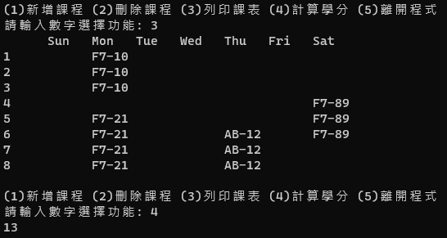
Calculate Credits
Print out current credits

Slide 10
Leave Program
The program must end normally when selected to leave the program.

Slide 11
Practice 2 - 2
Simple Reversi

Slide 12
Rules
2 players, who are O and X respectively, play Reversi on a 8*8 chessboard. 一There is nothing on the board in the beginning.
Player O goes first then Player X. On the chessboard, any empty space could a piece be placed.
Whenever a piece is settled, turn the piece to our flag if any opponent’s piece is caught by our piece (horizontal or vertical).
When there is no empty space, game is over, and the player with more pieces wins the game. A tie is not considered.

Slide 13
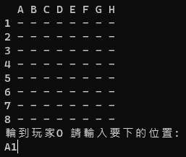
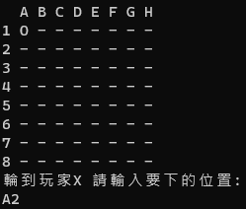
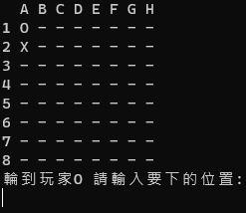
Output/Input Format
It’s Player O’s turn Please enter the spot to place the piece
Mark the coordinate of the chessboard, horizontal(A-H), vertical (1-8).
If it is one of Player O’s pieces, output O
If it is one of Player X’s pieces, output X
If it is an empty spot, output -
Use Console.Clear() to clear the previous game before a new piece is placed.

Slide 14
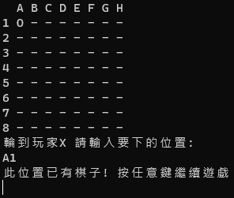
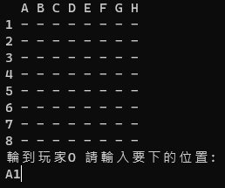
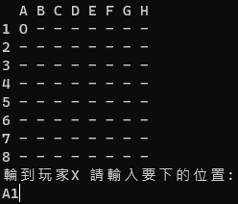
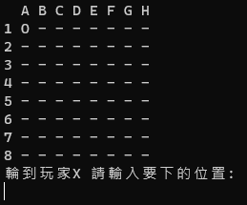
Output/Input Format
It must be checked whether the input spot already has a piece.
There will not be any out-of-scope online judges (ex. B9 or J5)。
This spot already exists a piece! Press any button to continue.

Slide 15
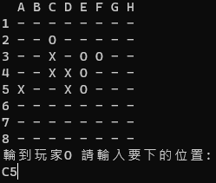
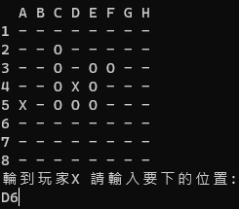
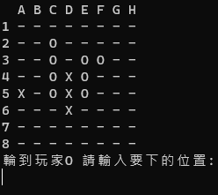
Rule Supplement
Whenever a piece is placed, turn the piece into our flag if any opponent’s piece is caught by our piece (horizontal or vertical) on the chessboard. Oblique direction is not considered

Slide 16
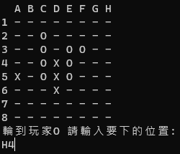
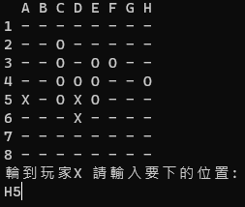
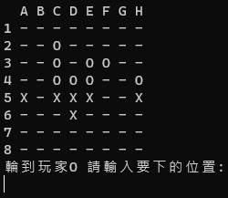
Rule Supplement
If the opponent’s piece is caught in the air, turn the piece that is caught in the middle into your own piece, and the empty spot caught has no change.

Slide 17
Hint
Whenever a piece is placed, only consider whether there is any other of your pieces vertically and horizontally. If yes, turn the opponent’s piece that is in the middle into yours.

Slide 18
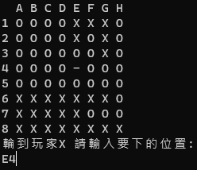
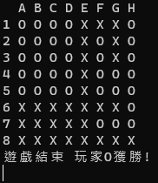
Game Over
If there is no other space on the chessboard, game is over, and the player with more pieces on the chessboard wins. A tie is not considered.
Game over Player O won!

