Slide 1
Practice 4
Window Program Design

Slide 2
Practice 4 - 1
Card Flipping Game

Slide 3
Card Flipping Game
Click Start Game to load the 9 pictures (TA will provide the materials, but it’s also fine to use your own)
Cards are all flipped to the back in the beginning
You can select 2 cards at once. If it’s a right guess, the 2 buttons will be disabled
Once every card has been flipped, game is over
Click Continue to flip the 2 cards back
Click Leave Game to quit the application

Slide 4
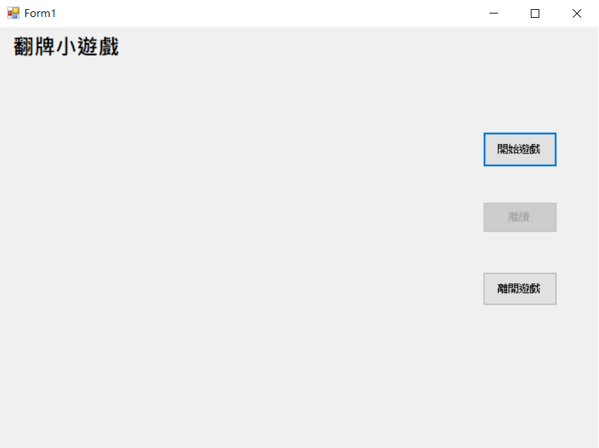
Card flipping game
Start game
continue
Leave game

Slide 5
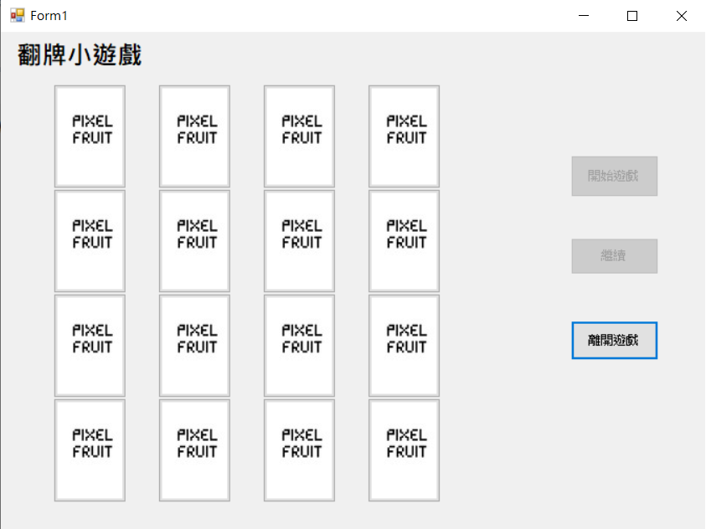
Start Game
The placement of each card is random
Every card is flipped to the back in the beginning

Slide 6
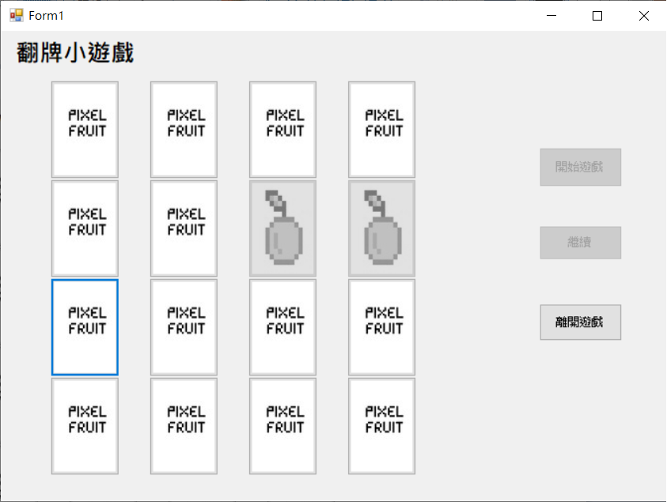
Start Game
If the 2 cards selected are the same, they are a pair
From there the user can continue without waiting for him/her clicking continue

Slide 7
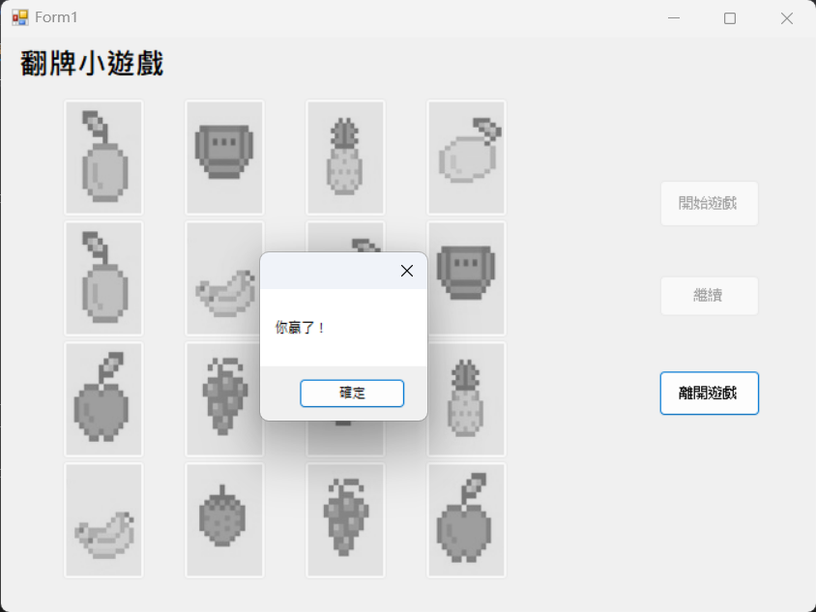
End Game
When all cards are revealed, the game ends.
MessageBox should pop out and show “You won ! ”
You won’t need to reset the game afterwards, leave all the cards at the gray state will be fine.
You won !

Slide 8
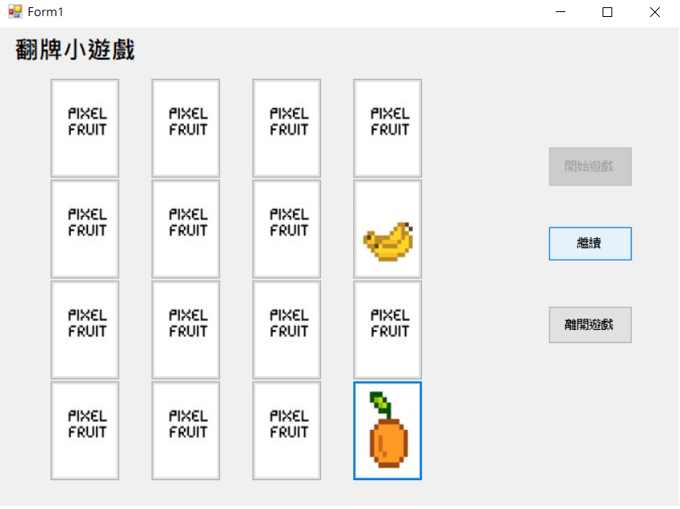
Continue
If the 2 cards selected are different, Continue can be clicked. Normally, it should be grayed out and is unclickable.

Slide 9
Leave Game
Clicking Leave Game should be able to end successfully.

Slide 10
Practice 4 - 2
The Complete Card Flipping Game

Slide 11
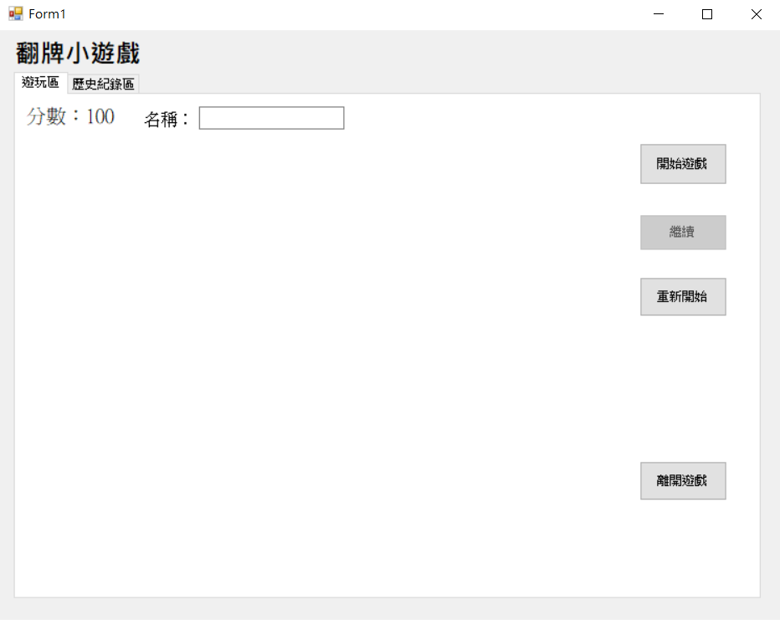
The Complete Card Flipping Game
4-1 functions must be included, and the following functions should be added
Score added
Username added to record the score
Clicking Restart should be able to play again
Use MessageBox to improve user experience
Use TabControl to distinguish the game area and the history
history
Game area
score
username

Slide 12
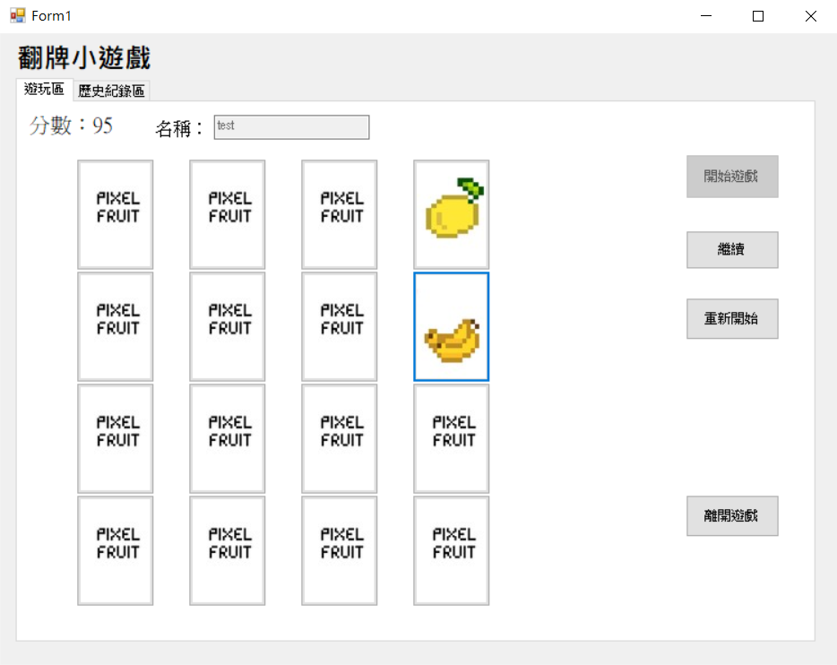
Score
All scores are 100 in the beginning
Right guess + 10
Wrong guess – 5
Because this was a wrong guess, -5, 100 -> 95

Slide 13
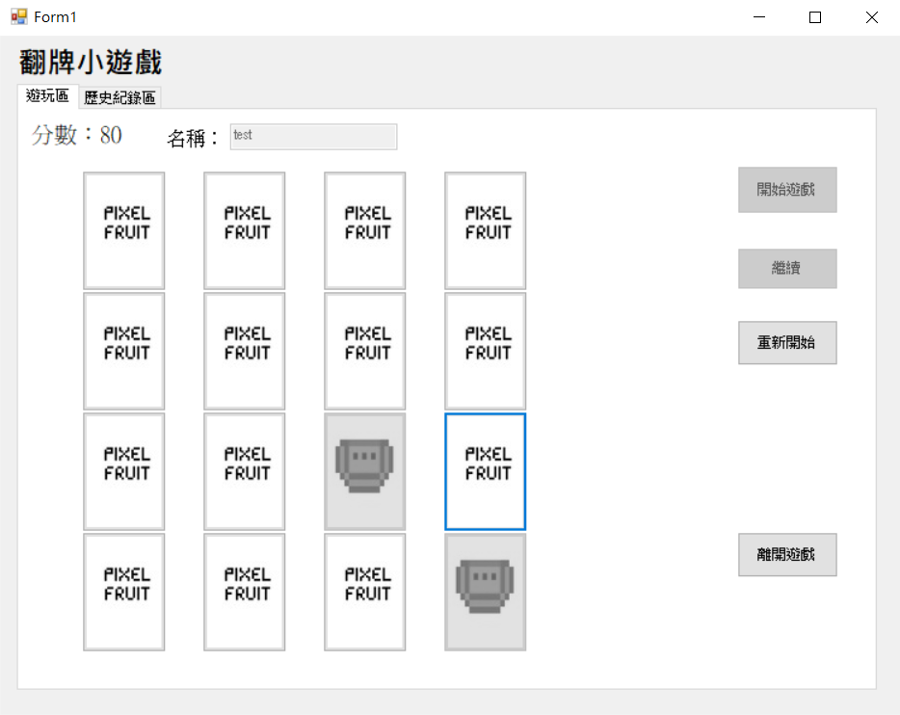
Score
All scores are 100 in the beginning
Right guess + 10
Wrong guess – 5
Because this was a right guess, +10, 70 -> 80

Slide 14
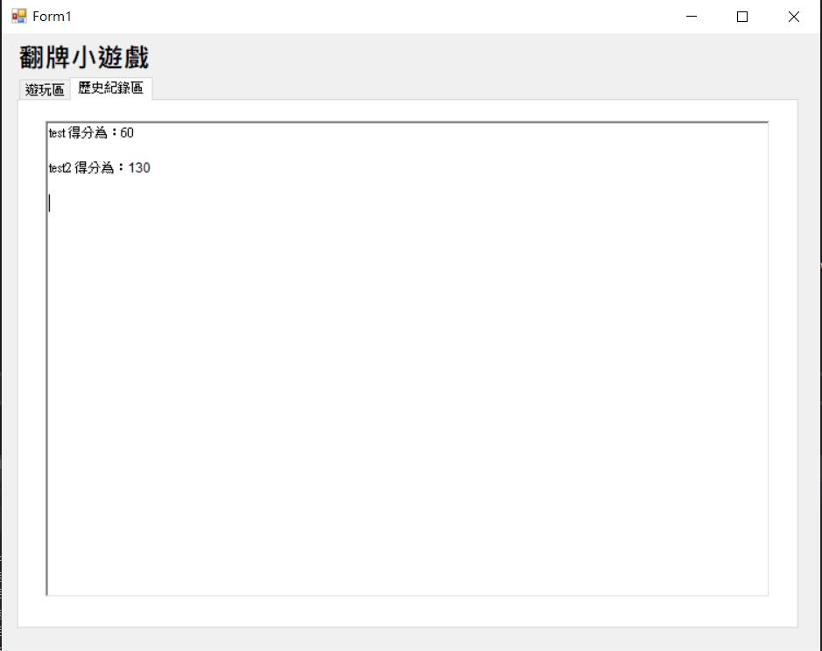
Record User Score
Use TabControl to separate the game area and the history
Show all players‘ score in the history.
The format is <name>scored:<score>
Just record the score every time you run the game. (Don’t consider saving the score after closing)
history
Game area

Slide 15
Restart
Click Restart should be able to return to the start of the game (clear all cards.)
Return to here ->

Slide 16
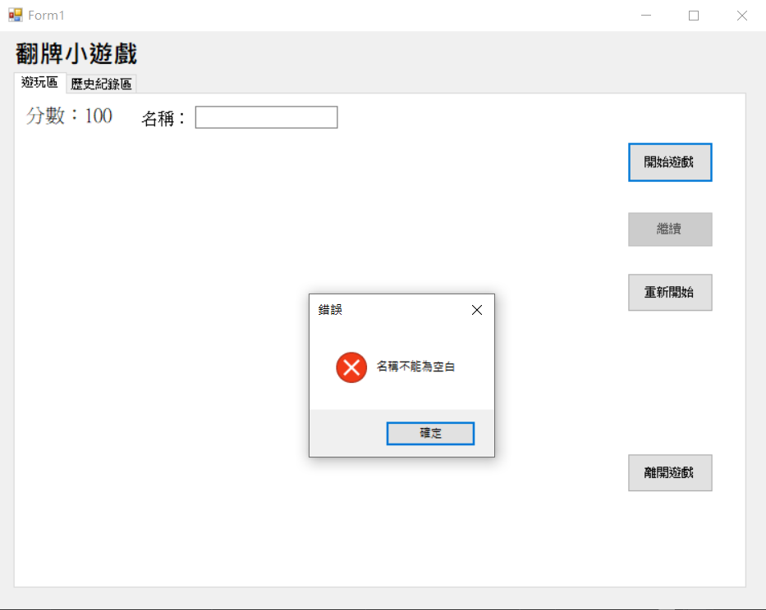
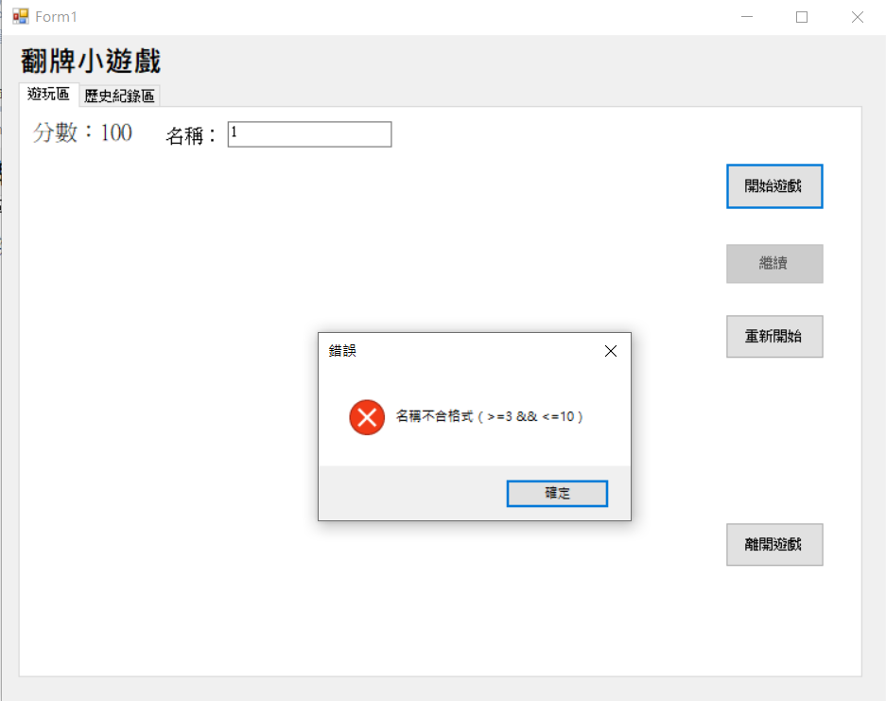
Use of MessageBox
Give a reminder if the format of the username is incorrect.
username should not be blank
Incorrect username format
Note that MessageBox should be the same as what the TA is showing, or else points will be deducted (MessageBox.Icon, MessageBox.Button)

Slide 17
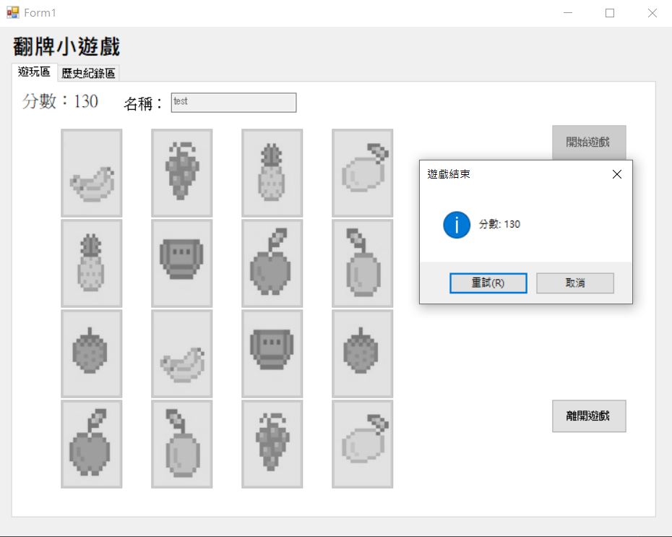
Use of MessageBox
MessageBox should pop up after completing the game
Show the score, and it must include Retry and Cancel
Retry is same as Restart, which returns to the start
Clicking Cancel will only close MessageBox
retry
cancel
Note that MessageBox should be the same as what the TA is showing, or else points will be deducted
(MessageBox.Icon, MessageBox.Button)

Slide 18
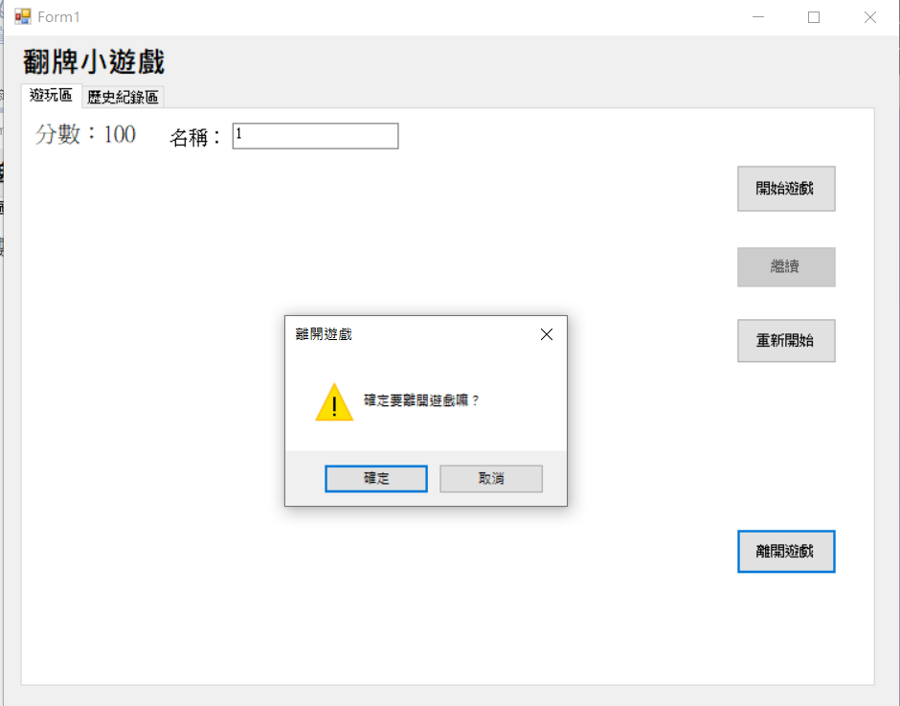
Use of MessageBox
Clicking Leave Game should have a reminder pop up
Are you sure you want to leave the game?
cancel
confirm
Note that MessageBox should be the same as what the TA is showing, or else points will be deducted (MessageBox.Icon, MessageBox.Button)

Slide 19
Hint
You can use Button Array to generate the 16 cards and set the corresponding information each time (SetBounds, Image, Enable, Click.) Lastly, add buttons using Controls.Add.
For the placement of the randomly generated cards, you can use Random to create a random array of size 16. Then, place the random[i] button from left to right top to bottom through the for loop.

