Slide 1
Practice 5
Windows Programming Languages

Slide 2
Practice 5- 1
Guess the Word

Slide 3
Guess the Word
The horizontal lines represent the letters the player needs to guess. Player can know how many letters are in the word (e.g.,_ _ _ _ _ ).
You need to guess all the letters right.
The keyboard having 26 letter keys is displayed at the top of the window. You should press the key to guess the letters.
If you choose a letter that is in the word, that letter will be revealed, (e.g., if you pick the letter "P" and it is in the word, the question will become "_PP_ _“ ).
However, if you pick a letter that is not in the word, the corresponding letter key at the top will disappear.
When you successfully guess the word right or pick the wrong letters 6 times, the game is over.

Slide 4
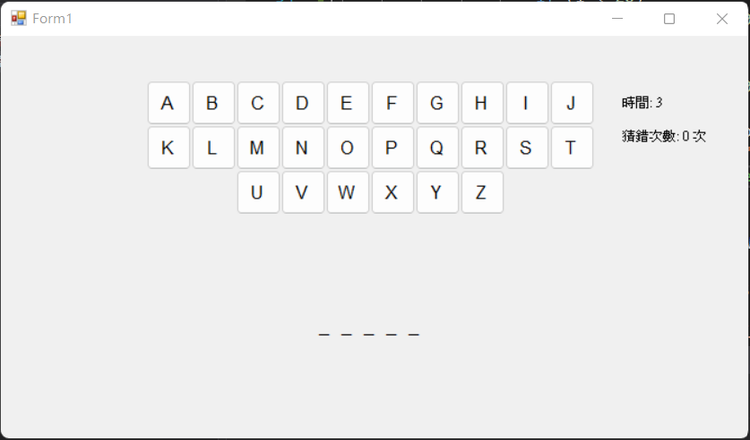

Slide 5
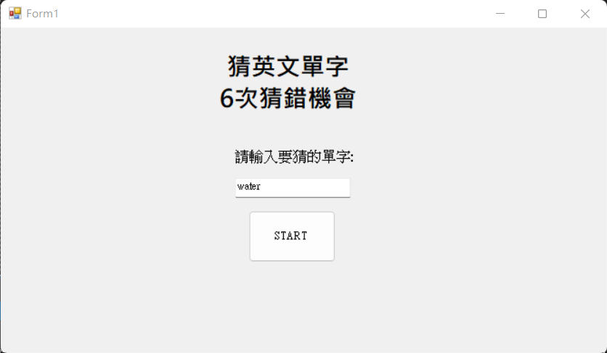
Game Start
The main menu is shown at the first, you can enter the word you want to be guessed.
Texbox Only English input
Press the "START" button.
Only English input

Slide 6
Game Start
After pressing the "START" button, the keyboard having 26 letter keys is displayed at the top of the window. The word you need to guess is shown as several horizontal lines, and the lines represent all the letters.
The total time you spend on the game and the times you guess the wrong letters are shown on the right.

Slide 7
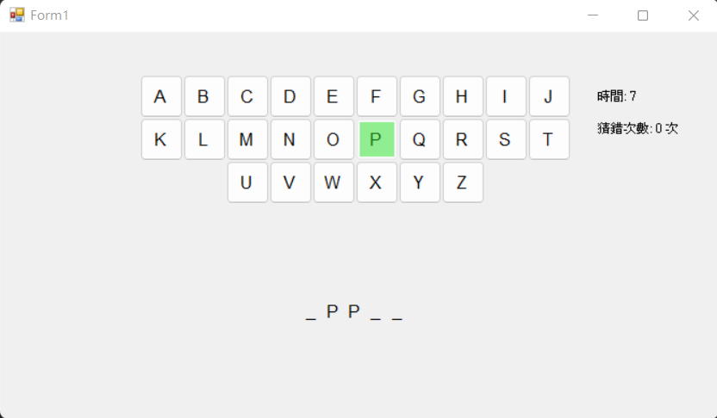
Game Start – Correct Letter
With each right letter guess, the letter is revealed from the horizontal lines.
The corresponding letter key will become green (Color.LightGreen).

Slide 8

Game Start – Wrong Letter
If you pick a letter that is not in the word, the corresponding letter key will disappear.
As shown on the right, since the letter “H” is not in the word, the “H” key disappears after pressing it.

Slide 9
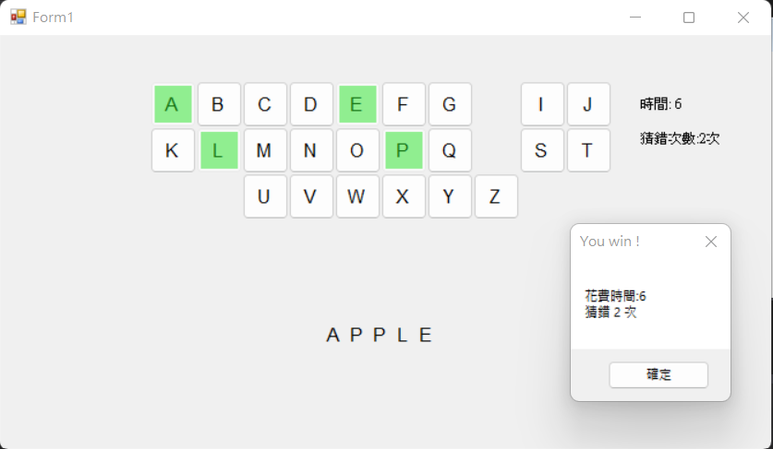
Win the Game
If you guess the letters wrong less than 6 times and reveal the word, you win the game!
The timer will stop, and the total time you spend and the times you guess wrong will be shown in a MessageBox.
When you close the MessageBox, you can go back to the initial screen.

Slide 10
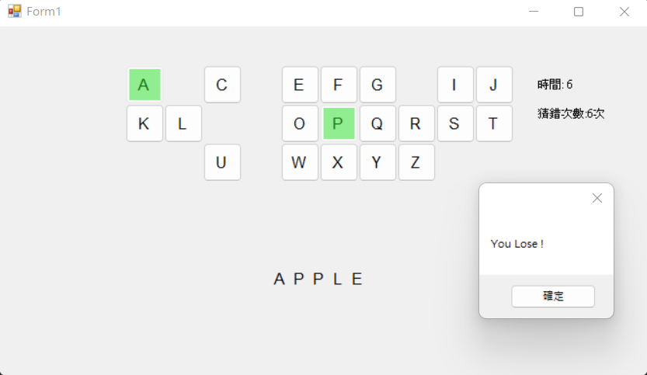
Lost the Game
If you pick the letters wrong more than 6 times, the game is lost.
Timer will stop and the answer will be shown.
When you close the MessageBox, you can go back to the initial screen.

Slide 11
Hint
After pressing “START”, you should make the items on the home screen ”Visible=false” and disable all the interactive items like the button and textbox. Otherwise, your game may only focus on those items and cannot get the keyboard input.
You can use Button array to implement 26 letter keys, and use Controls.Remove() and then Object.Dispose() to remove unnecessary items to reset.

Slide 12
Practice 5 - 2
Easy Version of 2 Players Wargame

Slide 13
Rules of Game
Turn-based simple war chess
There are two players, P1 and P2
On the chessboard of 7x6, the two players each hold three occupation pieces and play against each other
The attack method and range of each occupation are different. The target must be within the range to be attacked.
The game is divided into preparation phase and battle phase.
Once one party has all his/her chess turn 0, the player loses.

Slide 14
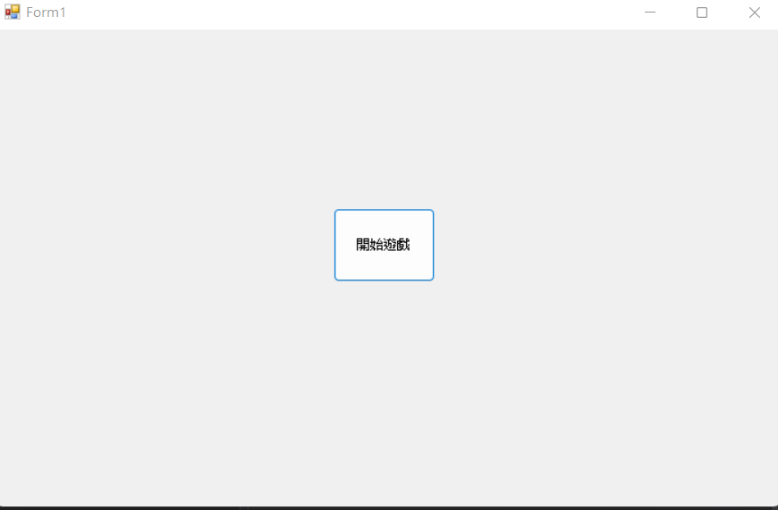
Rules of Game
There will be a “Game Start” bottom on the initial screen. Press it to enter the preparation phase.

Slide 15
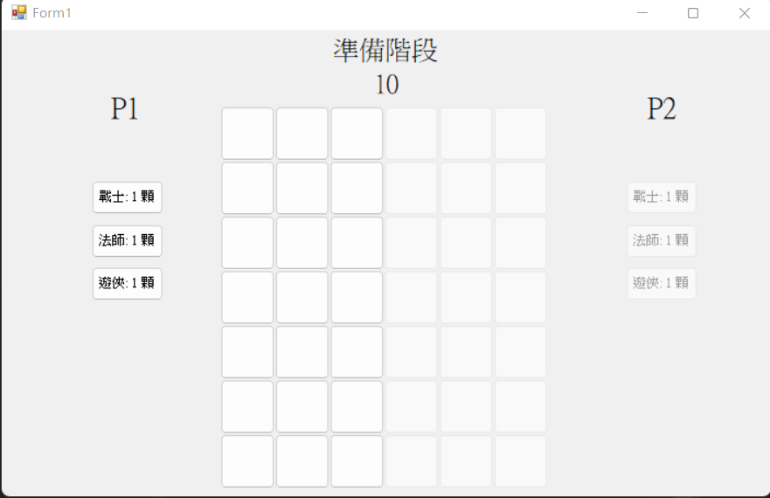
Preparation Phase
The preparation time is shown at the top of the window: 10 seconds
The checkerboard is displayed in the middle. P1’s status bar is shown on the left, while P2’s is shown on the right.
When P1 gets ready, the right half of the checkerboard should be disabled. When P2 gets ready, the left half of the checkerboard should be disabled as well.
The character classes of chess should be displayed in the status bar. The three buttons correspond to three character classes of chess. Press the button to choose the chess you want to use. The button shows the character classes and the chess you do not have should be disabled. (RadioButton can also be implemented.) If the player does not choose the character they want to use, the default character would be Warrior.
When it’s P1’s turn, the buttons of P2’s chess should be disabled and vice versa.

Slide 16
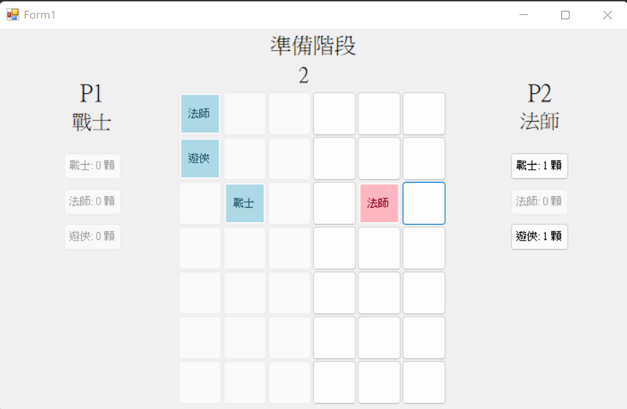
Preparation Phase
The color of P1’s chess is Color.LightBlue, and P2 is Color.LightPink
The placed pieces should have their occupation shown and the spot disabled.
If the countdown is over and all the pieces have not been placed, P1 will default the remaining pieces in the control position on the 1st row, and P2 will be placed in the vacant position on the 6th row.
Preparation phase
1 2 3 4 5 6
warrior
wizard
ranger

Slide 17
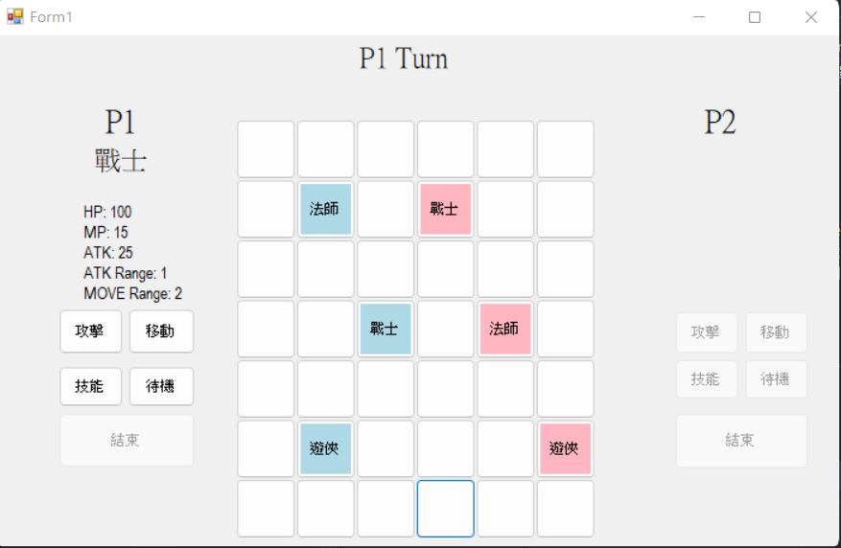
Combat Phase
Control Sequence: Warrior -> Mage -> Ranger
P1’s status bar is shown on the left, and P2’s is shown on the right.
The status bar shows the player's chess status. There are some movement buttons that can choose each turn (choose one only). Press the button to executive the movement and then click the target on the checkerboard. After the execution is complete will be another character class's turn.
After ranger executive the movement, the 4 movement buttons should be disabled and the end button should be enabled.
When it’s P1’s turn, the buttons of P2’s chess should be disabled and vice versa.

Slide 18
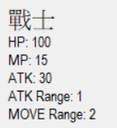
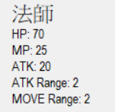
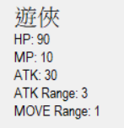
Parameter
The following is the power value of each occupation
10 points of MP will be used each time using a skill. If MP is used up, no action can be taken.
When the HP of the chess turns 0, the chess will disappear from the chessboard, and the spot will be vacant. From there, every round of that chess will be skipped.

Slide 19
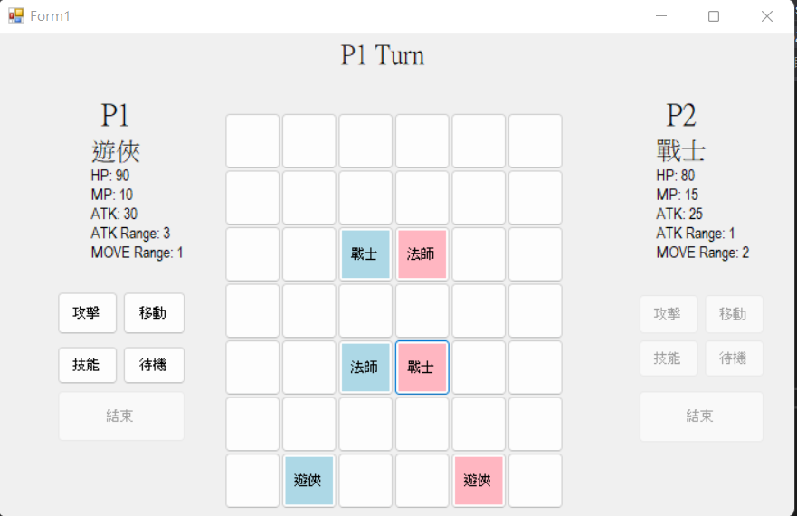
Combat Phase - Executive Movements
Attack: Deal damage to the target. The target should be in the attack range.
Move: Move to the position that you click. The position should be in the moving range.
Stand by: Do not make any movement and wait for your turn again.
As shown below, P1’s mage attacks P2’s warrior. P2’s warrior HP = 100 – 20 = 80

Slide 20
Combat Phase - Executive Movements
Skills
Warrior: They can deal damage to the target and regain HP half the amount of the damage.
Mage: They do 2X more damage to the target.
Ranger: Their attack range includes one more target and can choose one target to attack.
Pick the skill you want to use and choose the target. Notice: The target should be in the attack range.

Slide 21
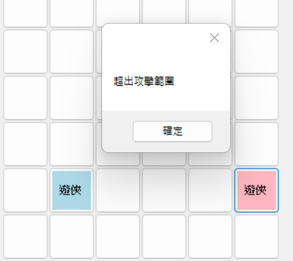
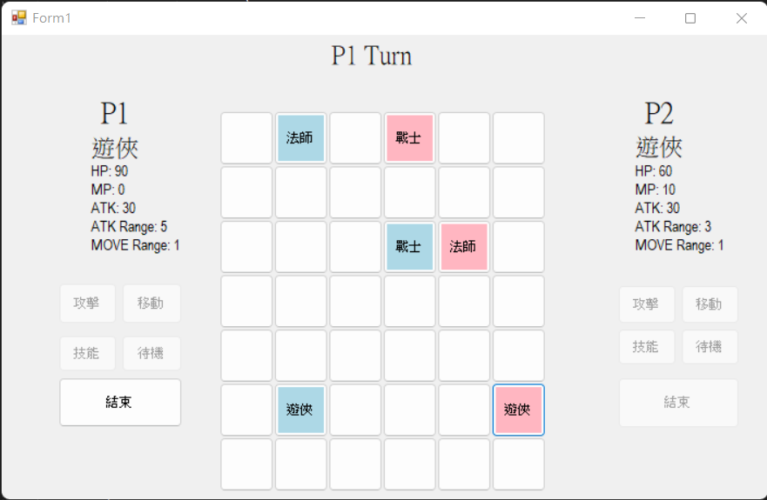
Battle Phase - Execution
Skill
The image below shows an example. Before P1 ranger uses the skill, ATK Range is 3, which means P2 ranger can not be attacked. Once P1 ranger uses the skill, ATK Ranger +1, and the attack is successful. P2 Ranger’s HP drops from 90 to 60.
After using the skill
ranger
Exceed the attack range
confirm
attack
move
skill
Sleep mode
ranger
end

Slide 22
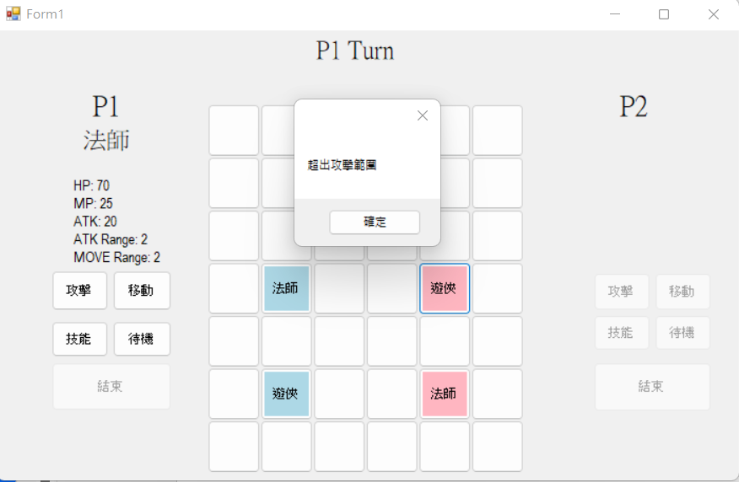
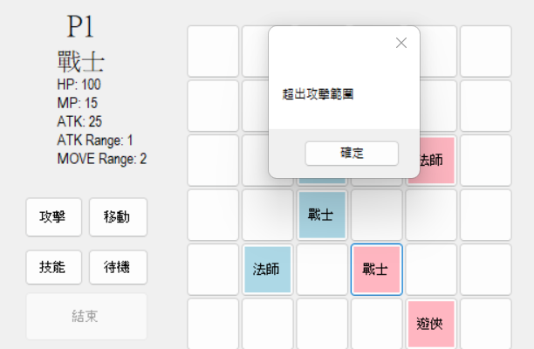
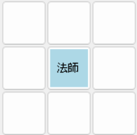
Combat Phase - Executive Movements
Players can only move to or attack from 4 directions (front, back, left, and right) centered on the piece.
If the target is out of range, the MessageBox should display to inform the player.
Players can change their movement or target after clicking “OK”.

Slide 23
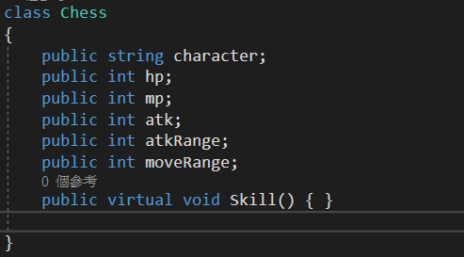
Requirement
These three occupation pieces should be completed by inheritance
It is allowed to use Constructor to initialize items of the occupation
Please use Button array to create the chessboard. The size of each Button is Size(50,50), and there is no space between each Button, so the size of the entire chessboard is 350*300.

Slide 24
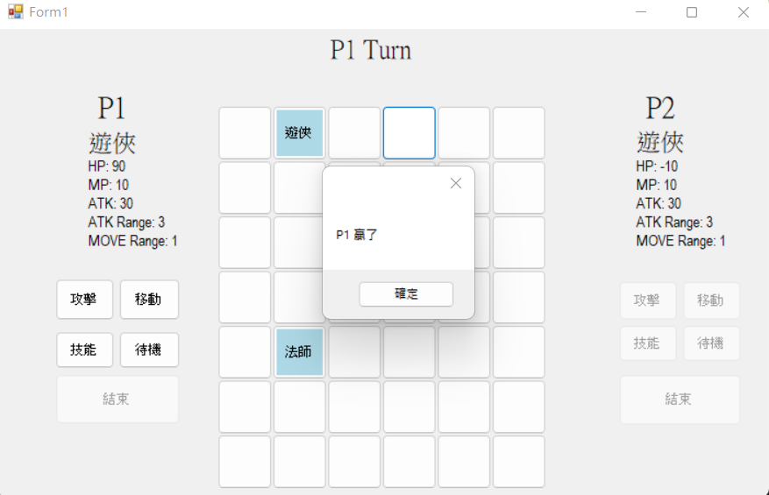
Game is Over
When the player has no chess to choose, the player is lost.
The Messagebox should show which player wins the game and the game will be turned off after closing the MessageBox.

