Slide 1
Practice 3
Window Program Design

Slide 2
Practice 3-1
Password Administrator

Slide 3
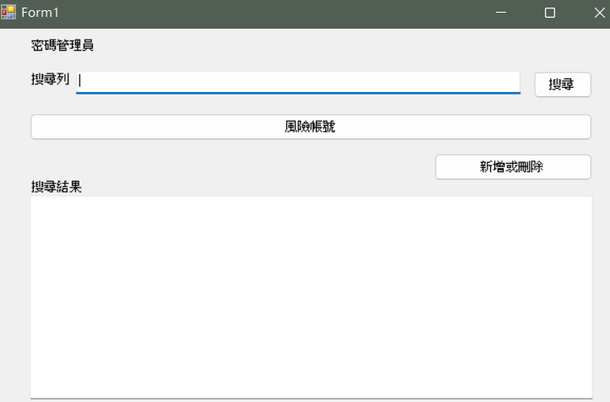
Introduction
Password administrator
Password administrator allows you to save multiple accounts.
Each account consists of “link”, “user”, and password.
The program must ensure there is no same “user” under each “link”, which means that two accounts wouldn’t have the same link and user.
The image on the left should be shown when opening the program (menu).
Search bar
Search
Risky account
Search results
Add or delete

Slide 4
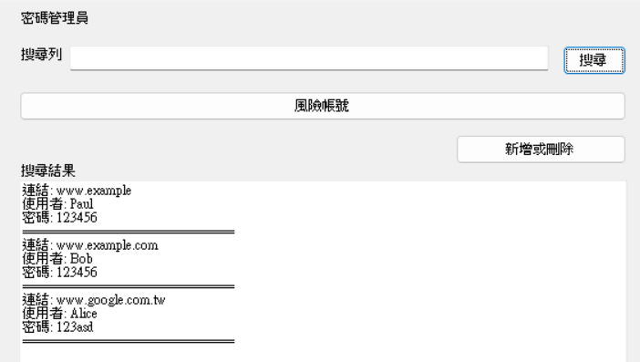


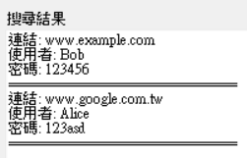
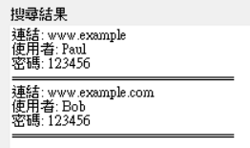
Search Bar
Enter the link in the “search bar”. Click “search” to print out the “search result”.
“Search result” is the “substring of the link” == all accounts of the “search bar”.
When the search bar is empty, show all accounts saved, which is the result on the left image, not required to be in order.
Example1
Example2

Slide 5
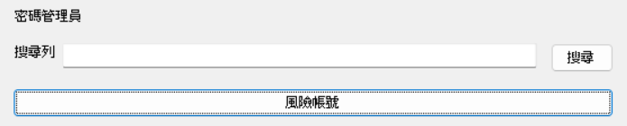
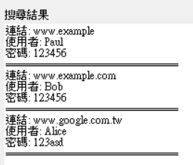
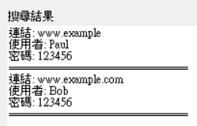
Risky Account
Click “risky account” to print out all accounts with the same password, not required to be in order. Accounts[i] is a dangerous account ⬄ Accounts[i].password == Accounts[j].password, i != j
All accounts
Risky accounts
Click “risky account”

Slide 6
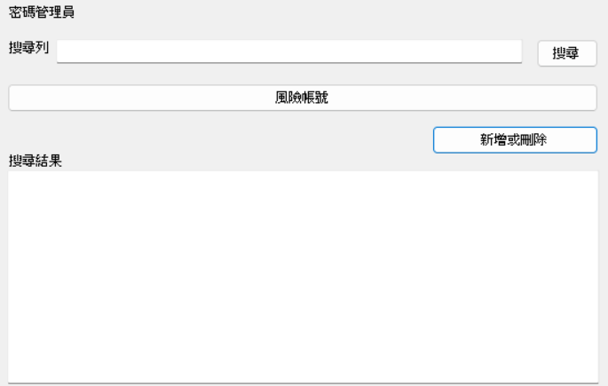
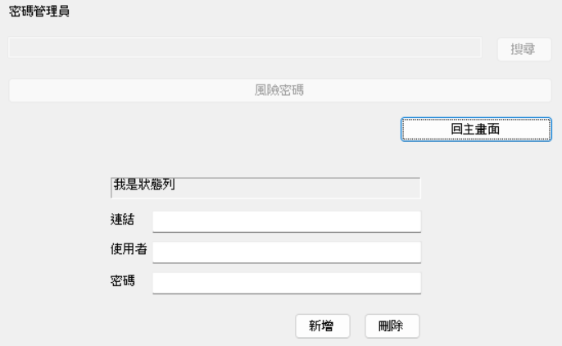
Switch Mode
Click “add and delete” to add and delete accounts. “Return to menu” goes back to the menu.
After switching, all input and output bars should be cleared.
No need to automatically start the search after returning to menu for adding and deleting accounts.
Please note those controlled by “Enabled=false” and “Visible=false”.
Menu(search)
Add and delete
Add or delete
Return to menu
Status bar
Return to menu
link
user
password
add
delete

Slide 7
Add or Delete
The following slides will only focus on the window above.
The input are link, user, password, but the results vary according to what you clicked, add or delete.

Slide 8
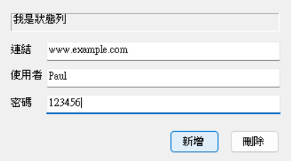
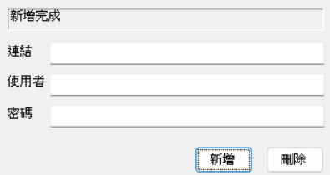
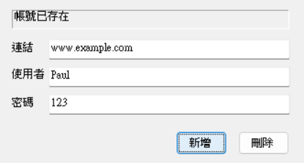
Add Account(Partial Images)
Enter link, user, password, and click “add” to add a new account.
Please note messages on the “status bar”.
Note whether the field is cleared. If it was a success, clear it, keep it if it was a failure.
Success
Add
Failure
Added successfully
Account already exists
The same account exists
Add after entering

Slide 9
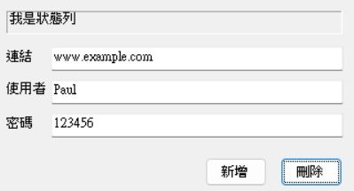
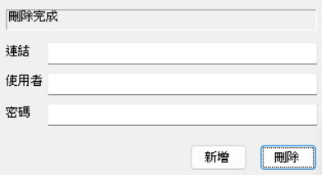
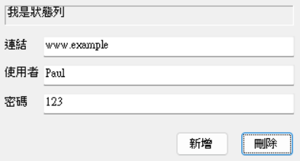
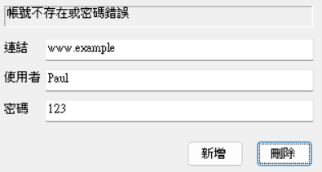
Delete Account(Partial Images)
Success
Status bar
Deleted successfully
Scenario 1
delete
The account above already exists
scenario2
Failure
Account doesn’t exist or incorrect password
delete
The link, user, and password must be correct to delete.

Slide 10
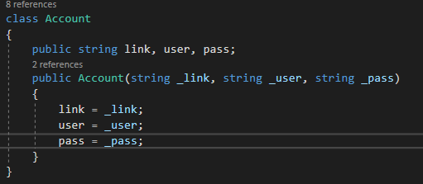
Account Class
Use Account class。
Use List<Account> to manage all accounts.
You can use other methods.

Slide 11
Practice 3-2
Stacking Game

Slide 12
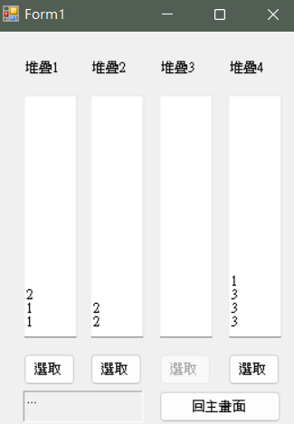
Game Rules
In the beginning, there are three 1s, three 2s, and three 3s allocated to 4 stacks. Each stack as 4 numbers at most.
You can pull out the number on the very top of the stack each time and toss it to other stacks.
Your goal is to stack all 1s together, all 2s together, and all 3s together.
stack
select
Return to menu

Slide 13
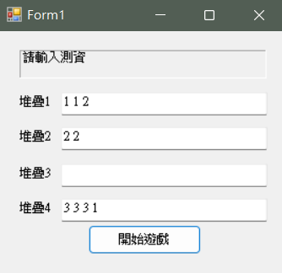
Switch Screen
Menu
Game screen
Start game
Return to menu
Starting the game will generate a game based on the online judge.
Returning to the menu returns to default online judge (as seen above).

Slide 14
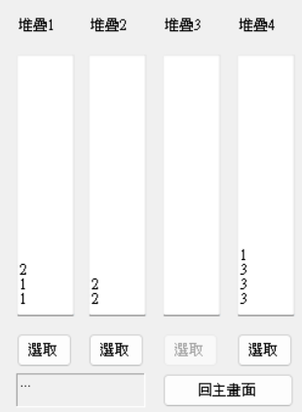
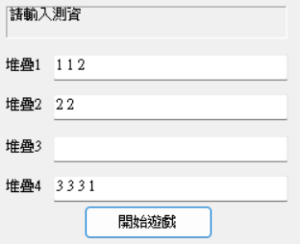
Correct Online Judge
status
Separate numbers using a blank space, and no blanks at the front and end.
Blank columns are allowed.
The online judge must follow the rules.
The online judge is read from left to right and output from bottom to top.
Start game

Slide 15
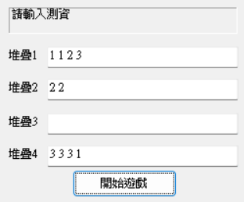
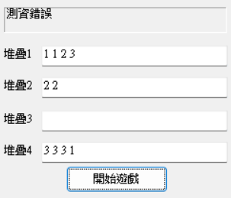
Incorrect Online Judge
status
Status bar shows “incorrect online judge”
Start game

Slide 16
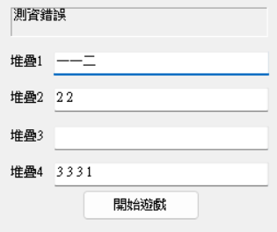
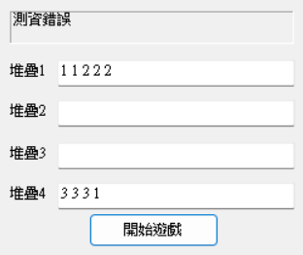
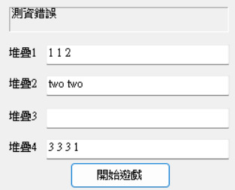
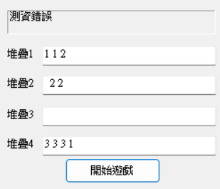
Incorrect Online Judge Example
One extra 3
Chinese numbers
Stack 1 has over 4 numbers
English numbers
Stack 2 has a blank space at the front

Slide 17
Game Screen
Stack number
Stack content
The 4 select buttons to stack, they should be in select in the beginning
Status bar
The button that returns to menu anytime

Slide 18
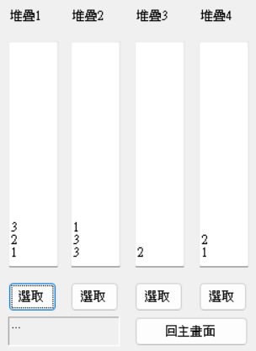
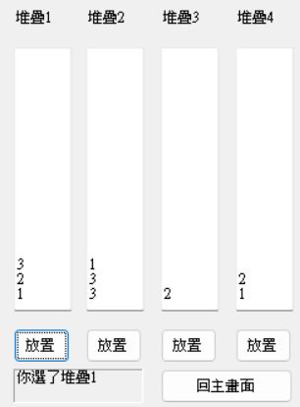
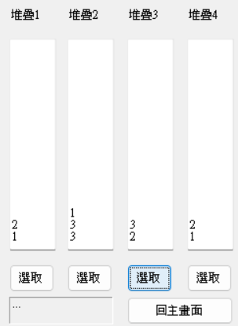
Implementation
select
Stack 1
Place
Stack 3
The status bar shows that you’ve selected the stack.
You can “return to menu” any time during the game.
Please note changes in the words on the button.

Slide 19
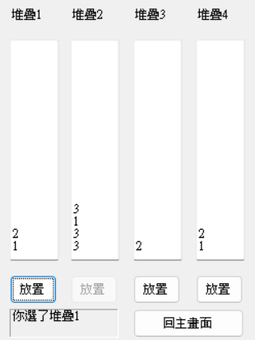
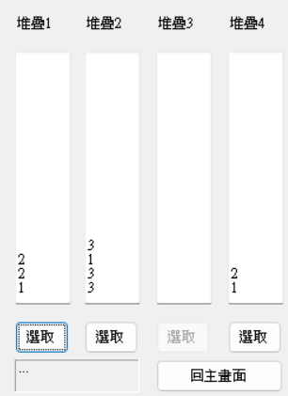
Foolproof
By modifying Enabled, prohibit users from implementing anything that cannot be done.
You selected stack 1
It cannot be placed once a specific stack has more than 4 numbers.
When a stack is empty, it cannot be selected.

Slide 20
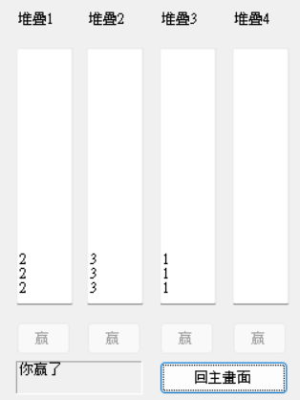
You won
1s are in one stack, 2s are in one stack, and 3s are in one stack. There will be an empty stack to win the game.
Forbid all buttons except for the “return to menu”.
Note changes in the button and the status bar
You won

Slide 21
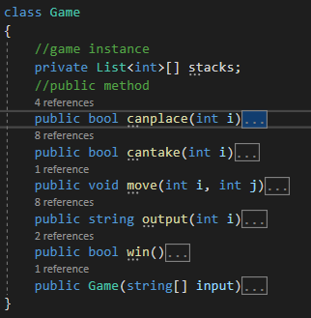
Game Class
You must create Game class (The template on the left is for your reference) stacks save 4 stacks canplace to see whether there aren’t already 4 numbers cantake to see whether it isn’t empty move to implement (select and place them together) Constructor to initialize the game win to see whether you won output to convert stack to string and output it
A new game needs creating a new Game instance. After clicking start game and before the constructor is complete, initialize the game.
Don‘t send the widgets into the Game
Public member should not appear.
Use private member to realize 4 stacks. Do not use shallow copy to modify.

