Slide 1

Sorting Algorithms
Aashish Gopali

Slide 2
Sorting
Vital thing in our day-to-day life
Manages ever things in order
Example dictionary
Makes managing and searching easier

Slide 3
Sorting Algorithms
Computer algorithm to sort
Used to manage data
Helps in working with data
Unable to think searching in data not sorted
Have several different sorting algorithms
Have several criteria to compare those algorithms

Slide 4

Criteria
Time Complexity
Stability
Memory Usage

Slide 5
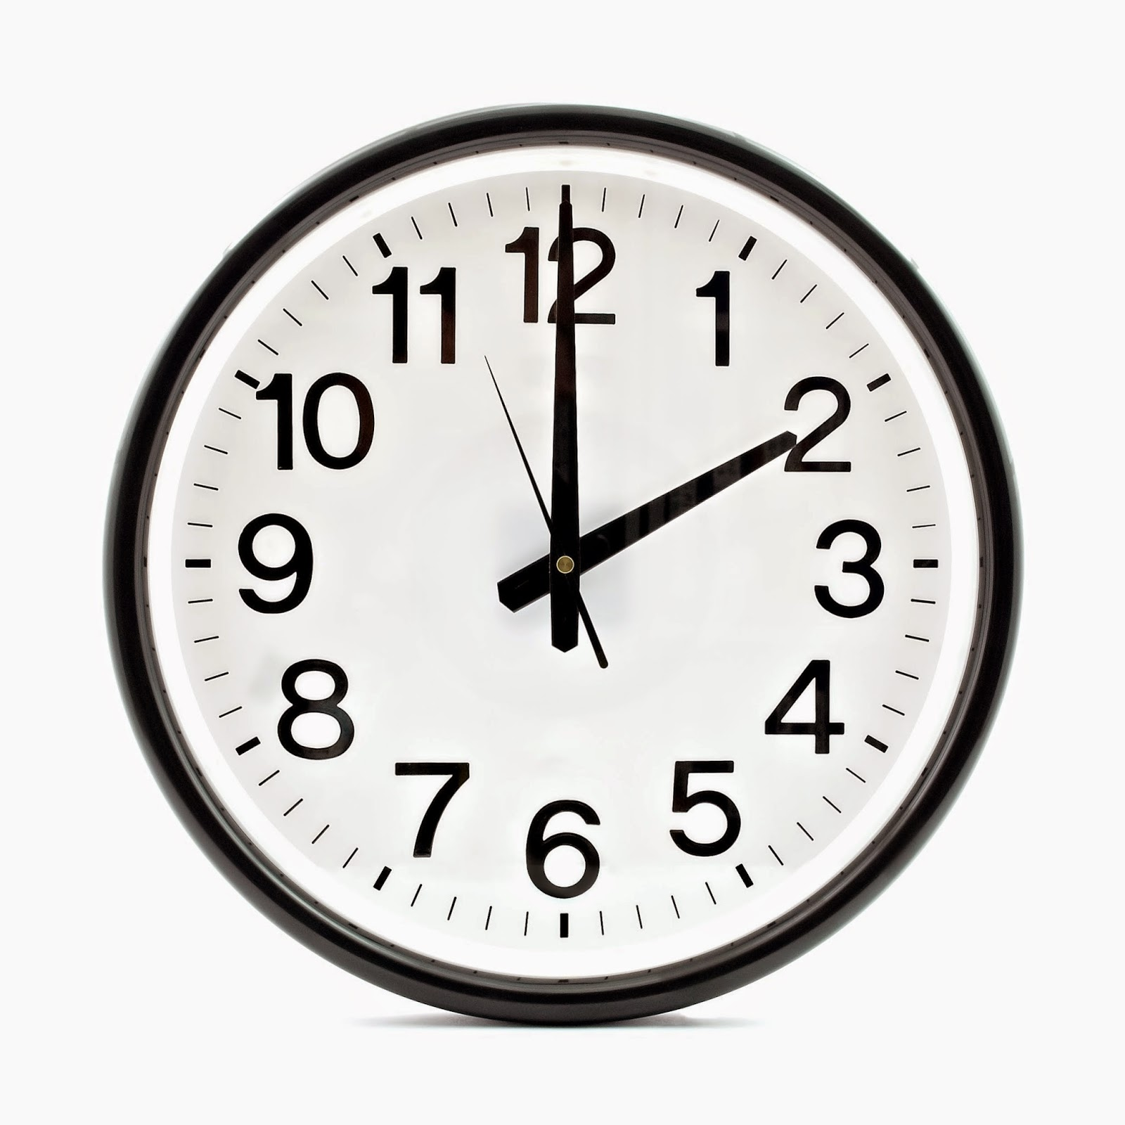
Time Complexity
Computational complexity
Time taken for a certain code to be compiled
Nanoseconds make a matter
Used to compare a lot of programs
One criteria to compare programs and code

Slide 6
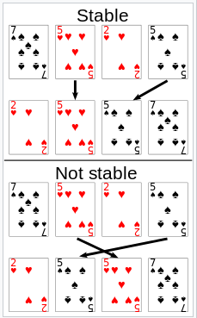
Stability
What happens when same data?
Is when have two data with equal keys
Sort needs to depend on input
Can same data who appeared first appear later when sorted
Equivalent elements retain relative positions.

Slide 7
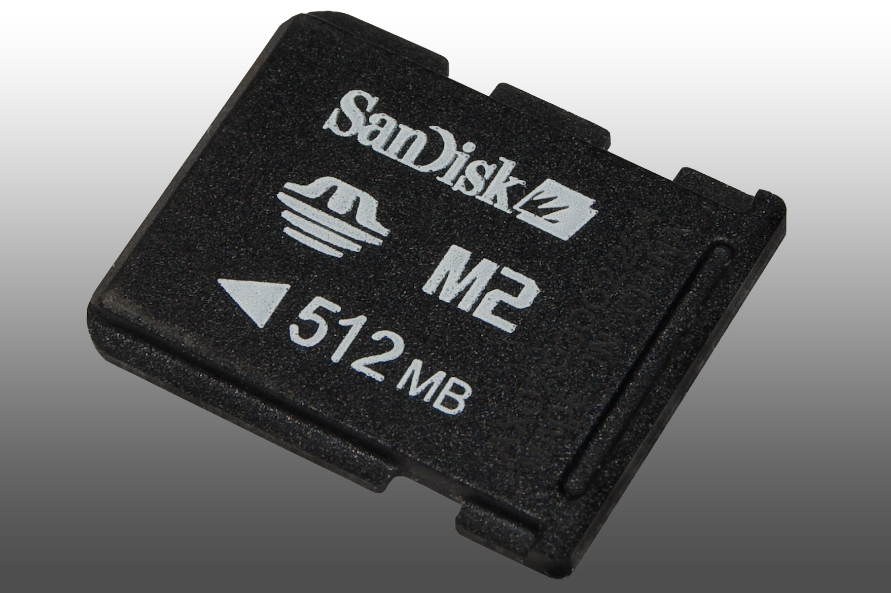
Memory Usage
How much memory used
Not vital now
As abundant memory
Before there were no abundant memory
Possible loss of data.

Slide 8
5 sorting algorithms
Quick sort
Merge sort
Heap sort
Radix sort
Bubble sort

Slide 9
Quick sort
Divide and conquer method
Developed first in 1959 by Tony Hraore
Use an element known as pivot
Partition list with pivot into sub arrays
Recursive till complete list is sorted.

Slide 10
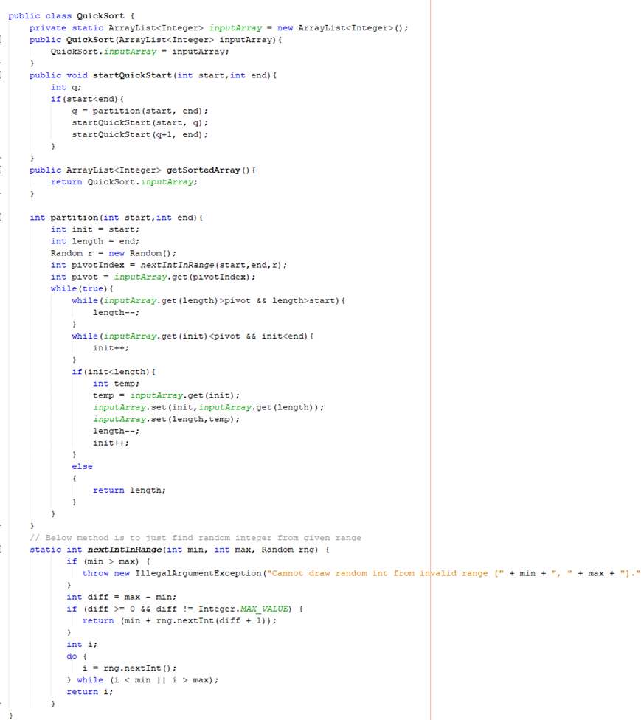
Source Code

Slide 11
Merge sort
Divide and conquer algorithm
Invented by John Van Neumann
1945
Divides array into two halves
Divides more until cannot be divided again.
Then merges all array.

Slide 12
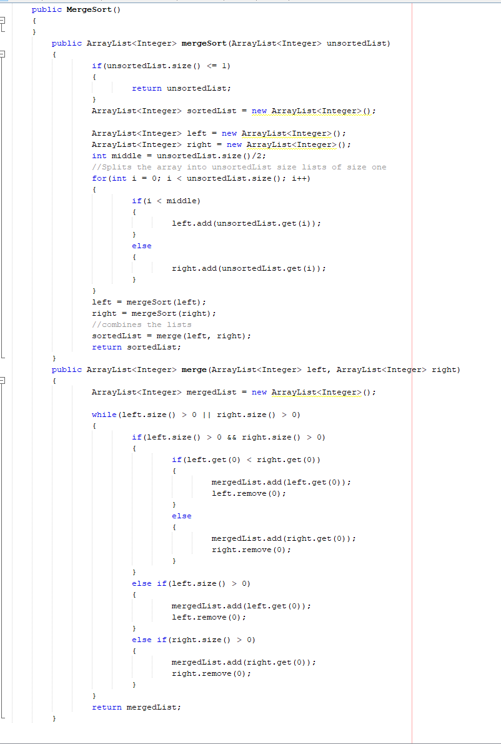
Source Code

Slide 13
Heap sort
Comparison based sorting algorithm
Based on Binary heap data structure.
Invented by WJ Williams in 1964
Gave birth to heap
Compares element by element

Slide 14
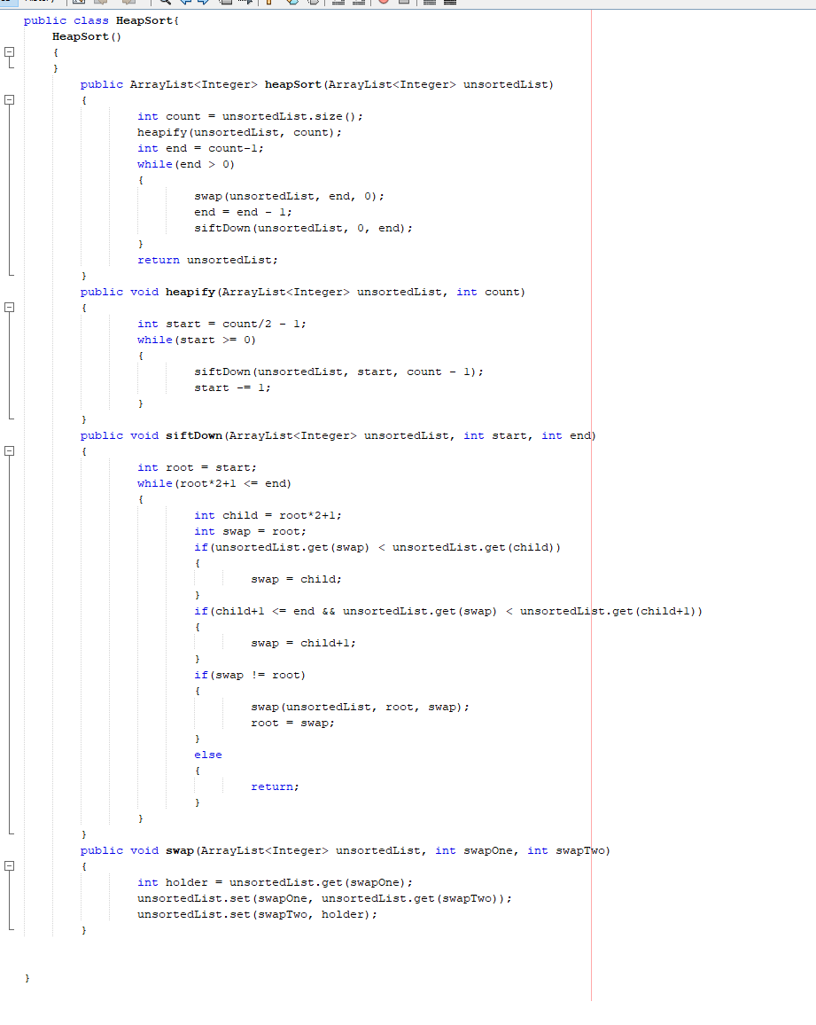
Source Code

Slide 15
Radix sort
Non comparative algorithm
Avoid comparison by creating and distributing into buckets
Dates to 1887
First used in linear scan

Slide 16
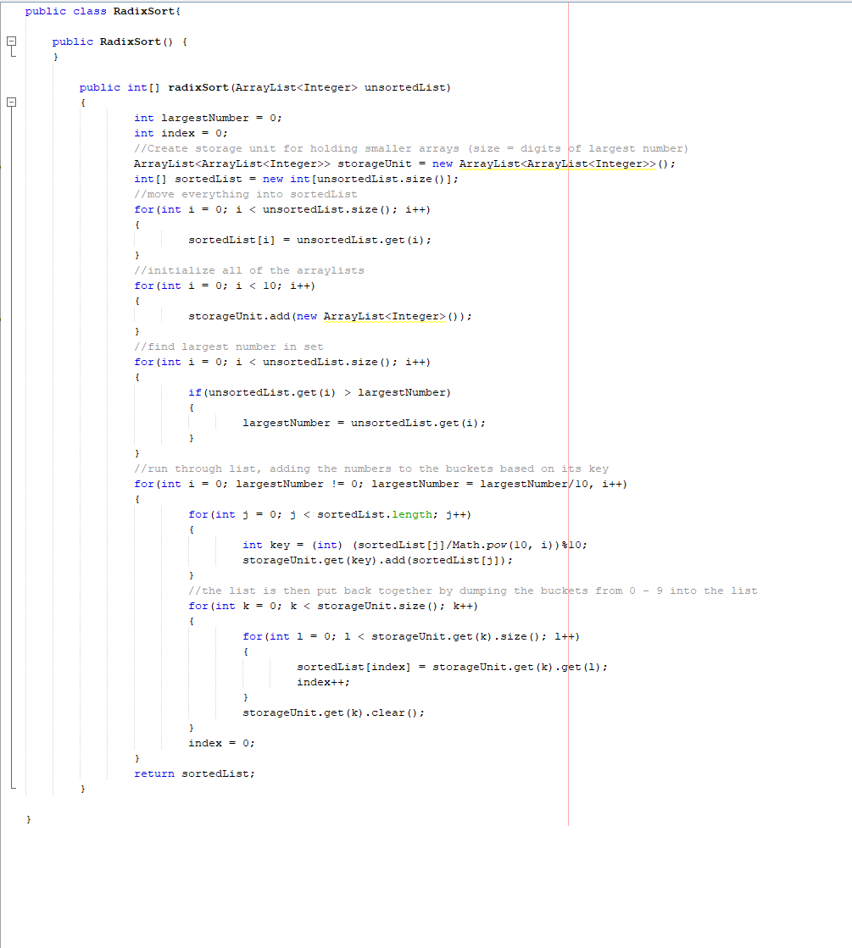
Source Code

Slide 17
Bubble sort
Known as sinking sort
Iverson created it in 1962
Known as Exchange sorting before
Steps through the list
Swaps them if they are in wrong order.

Slide 18
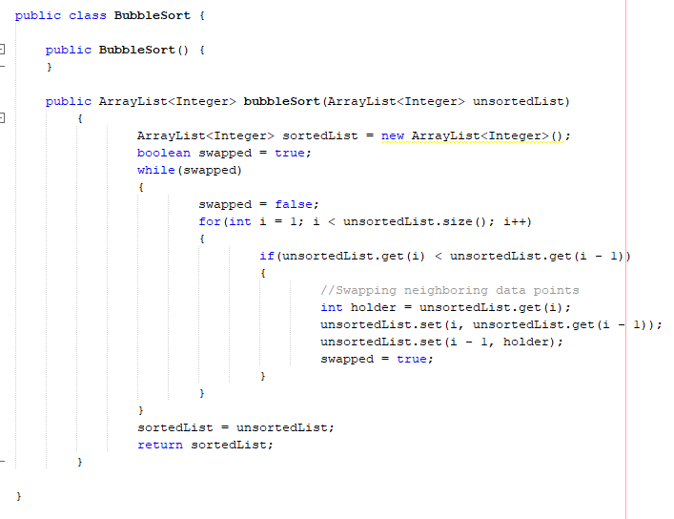
Source Code

Slide 19
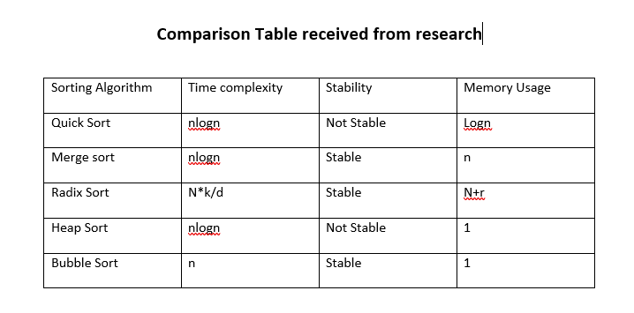
Research data found

Slide 20
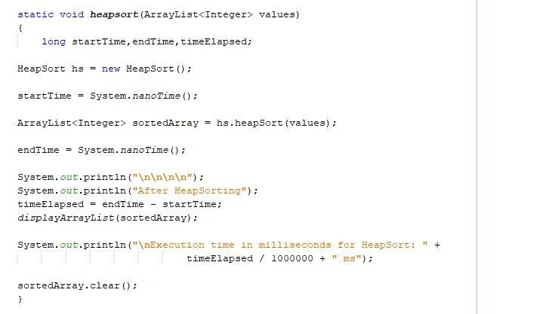
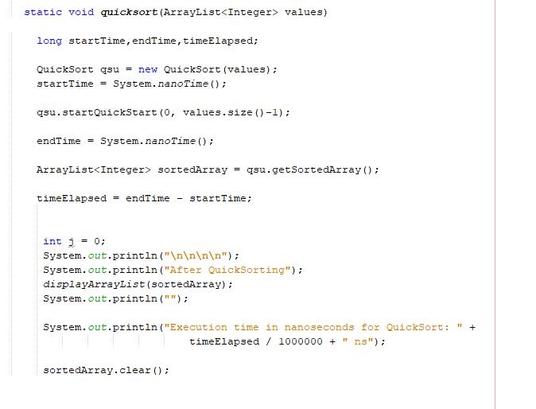
Functions in Main

Slide 21
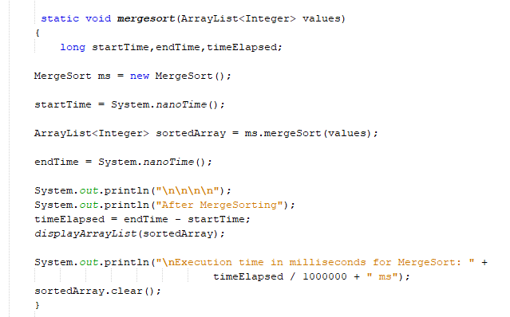
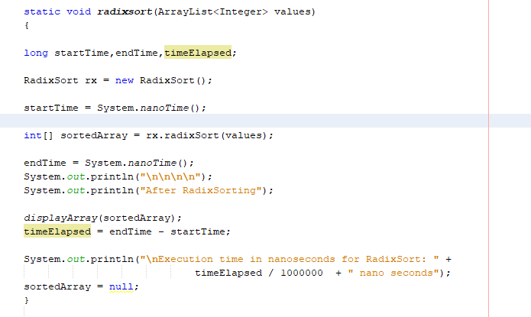
Functions in Main

Slide 22
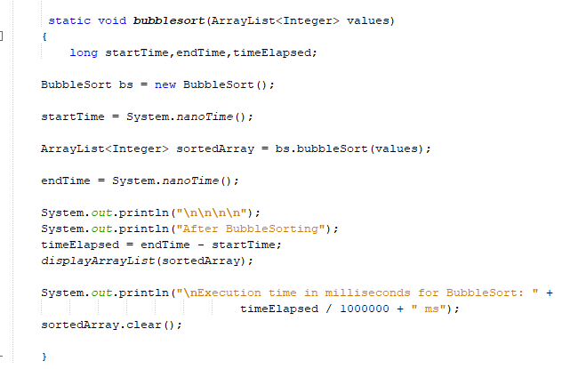
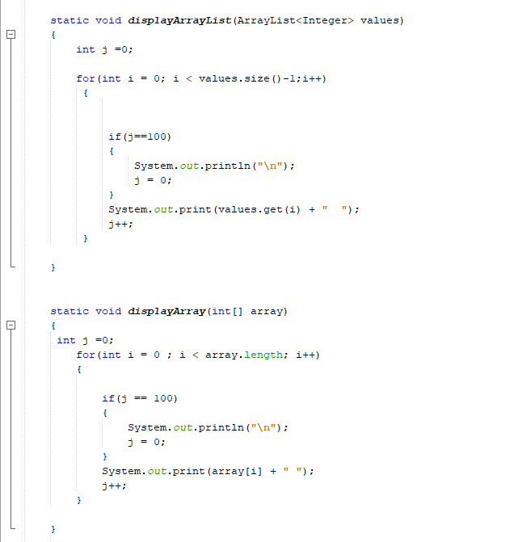
Functions in Main

Slide 23
Functions in Main

Slide 24
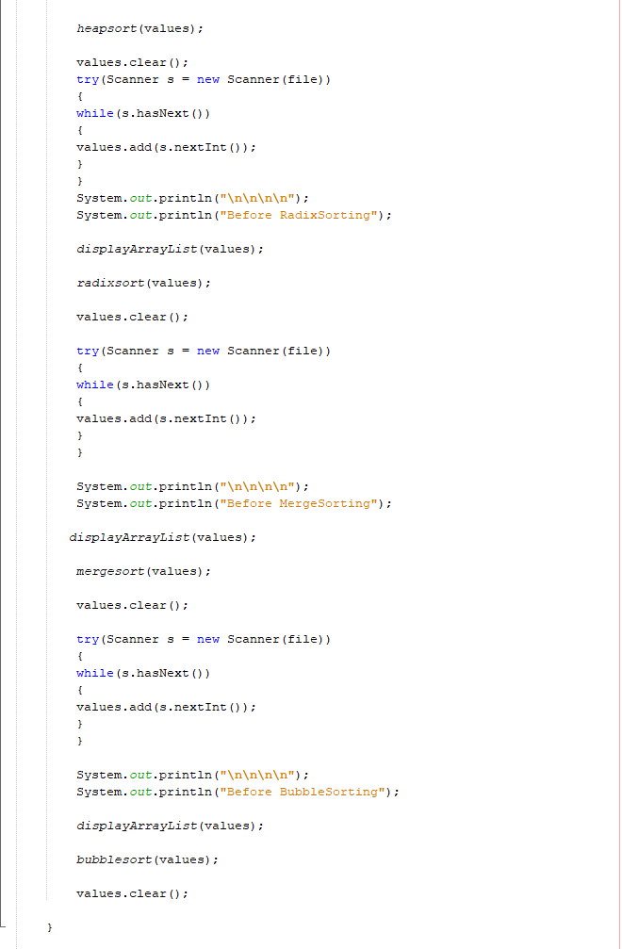
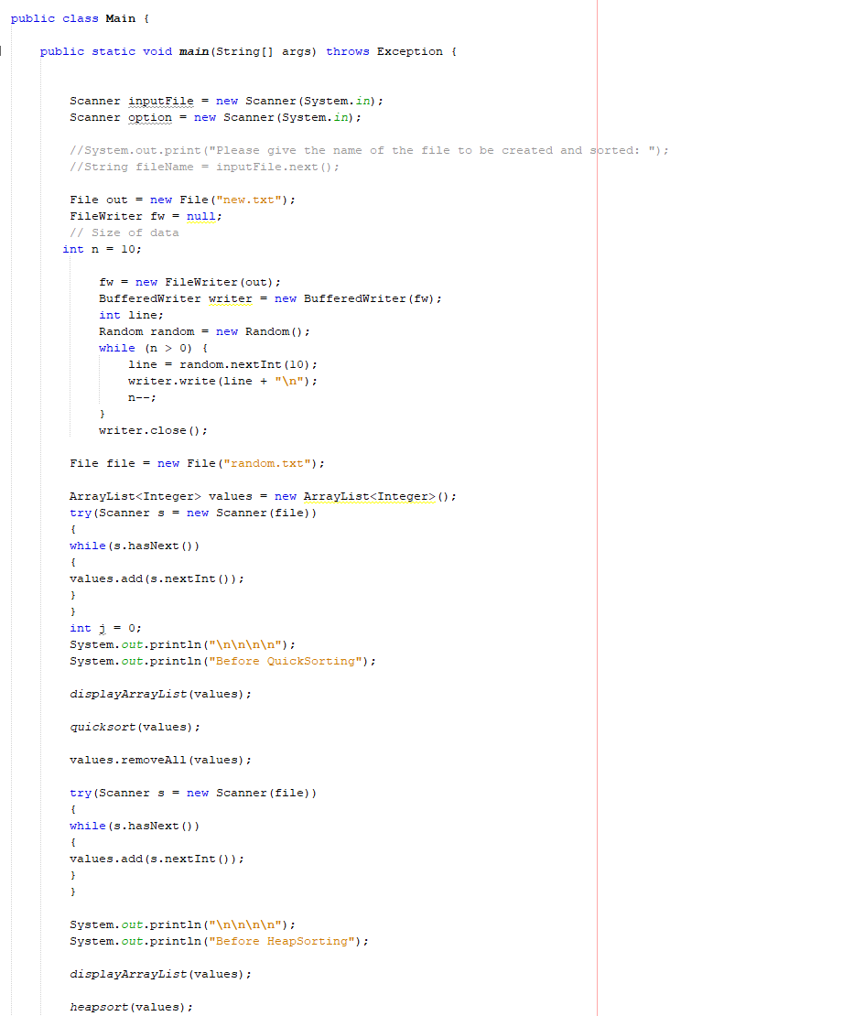
Main

Slide 25
Output
Size of array used: 1000000
Time taken by each sort
Random function to create random numbers
Write the number on file
Show sorted array and time.

Slide 26
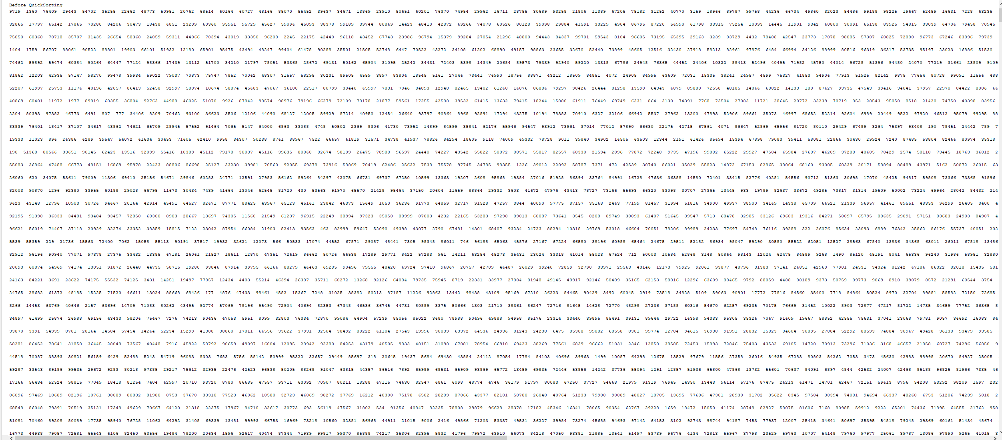
Output

Slide 27




Output

Slide 28
Conclusion
Merge, radix and quick
Merge was stable
Bubble and heap no stable less memory used.

