Slide 1
Electroplating and electroless
第13組:
學號：B083022053 姓名：黃啟桓
學號：B093021020 姓名：黃啟源
學號：B093021021 姓名：吳振廷
學號：B083022005 姓名：林宏駿

Slide 2
Content
Introduction
Application
Improvement
Future work

Slide 3
Introduction

Slide 4
electroplating process
The electroplating process utilizes a battery or rectifier to supply an ionic metal with an electric charge. This charged metal is then deposited on a substrate to form a non-ionic coating.
A common setup for this type of plating involves a chemical solution that contains the metal in an iodized form. A positive charge is supplied to the metal part via an anode and a negative charge from a cathode. This supplies an electrical current that shifts the chemical composition of the part and delivers a firm and resistant coating to the surface of the metal. You can reach desired levels of thickness through multiple applications.
Electro-plating requires careful procedures as it employs potentially dangerous equipment and complex filtration systems.

Slide 5
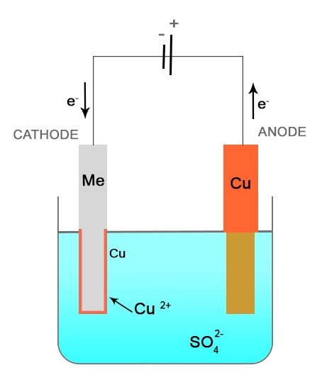
electroplating process

Slide 6
Electroless Plating Process
Electroless plating process is much simpler as it use no electricity and requires no extra equipment. In the electroless plating process, the part or substrate receives it’s deposit via an auto catalytic reaction via a reducing agent. The reducing agent interacts with the metal ions making the deposition possible. The process is completed with an application of anti-oxidation chemicals with improves the parts resistance to corrosion and friction prolonging its life.
Mid Atlantic has been providing electro plating and electroless nickel plating services for over 40 years. We are dedicated to quality and precision. We service the aerospace, RF microwave communications sectors as well as the defense and medical fields.

Slide 7
