Slide 1

  annotation:
  A label for: a variable, a class attribute, a function parameter, or a function return value. By convention, often used as a type hint.
  type hint:
  An annotation specifying the expected type for a variable, a class attribute, or a function parameter or return value.
  Type hints are optional and are not enforced by Python.
  (But they can be enforced by 3rd-party type checker programs.)
  wrapper function:
  A function whose main job is to call another function.
  boilerplate code:
  Sections of code that repeat in many places with little variation. Boilerplate can be reduced by:
  having Python automatically insert the needed boilerplate code,
  providing some mechanism to use reasonable default settings.
syntactic sugar:
Syntax added for convenience, but not affecting functionality.

Slide 2
Function Annotations
  >>> def f(x:float): return x #an annotated parameter
  ...
  >>> #It gave no error message, so this syntax is OK.
  >>>f(1+2j)#What happens if the parameter isn't a float?
  (1+2j)
  >>> def f(x)->int: return x #annotated return value
  ...
  >>> #It gave no error message, so this syntax is OK.
  >>> f(4.1) #Will it return an int?
  4.1
  >>> def foo(a:int,b:expression):return a+b#multi
  ...
  >>> def foo(a,b:expression=5):return a+b#default
  ...
  >>> def f(x:'what', y:'ever')->str: return x
  ...
  >>> #So what did we learn? Annotations are legal & useless.
  >>> f.__annotations__#Well, useless unless you use them:
  {'x': 'what', 'y': 'ever', 'return': <class 'str'>}
  >>>
  >>>
  >>>
  >>>
  >>>
  >>>
  >>>
  >>>
  >>>
  >>>
  >>>

Slide 3
Function Annotations
  >>> def f(x:float): return x #an annotated parameter
  ...
  >>> #It gave no error message, so this syntax is OK.
  >>>f(1+2j)#What happens if the parameter isn't a float?
  (1+2j)
  >>> def f(x)->int: return x #annotated return value
  ...
  >>> #It gave no error message, so this syntax is OK.
  >>> f(4.1) #Will it return an int?
  4.1
  >>>
  >>>
  >>>
  >>>
  >>>
  >>>
  >>>
  >>>

Slide 4
Function Annotations
  >>> def f(x:float): return x
  ...
  >>>
  >>>f(1+2j)
  (1+2j)
  >>> def f(x)->int: return x
  ...
  >>>
  >>> f(4.1)
  4.1
  >>>
  >>>
  >>>
  >>>
  >>>
  >>>
  >>>
  >>>

Slide 5
  annotation:
  A label for: a variable, a class attribute, a function parameter, or a function return value. By convention, often used as a type hint.
  type hint:
  An annotation specifying the expected type for a variable, a class attribute, or a function parameter or return value.
  Type hints are optional and are not enforced by Python.
  (But they can be enforced by 3rd-party type checker programs.)
  wrapper function:
  A function whose main job is to call another function.
  boilerplate code:
  Sections of code that repeat in many places with little variation. Boilerplate can be reduced by:
  having Python automatically insert the needed boilerplate code,
  providing some mechanism to use reasonable default settings.
syntactic sugar:
Syntax added for convenience, but not affecting functionality.

Slide 6
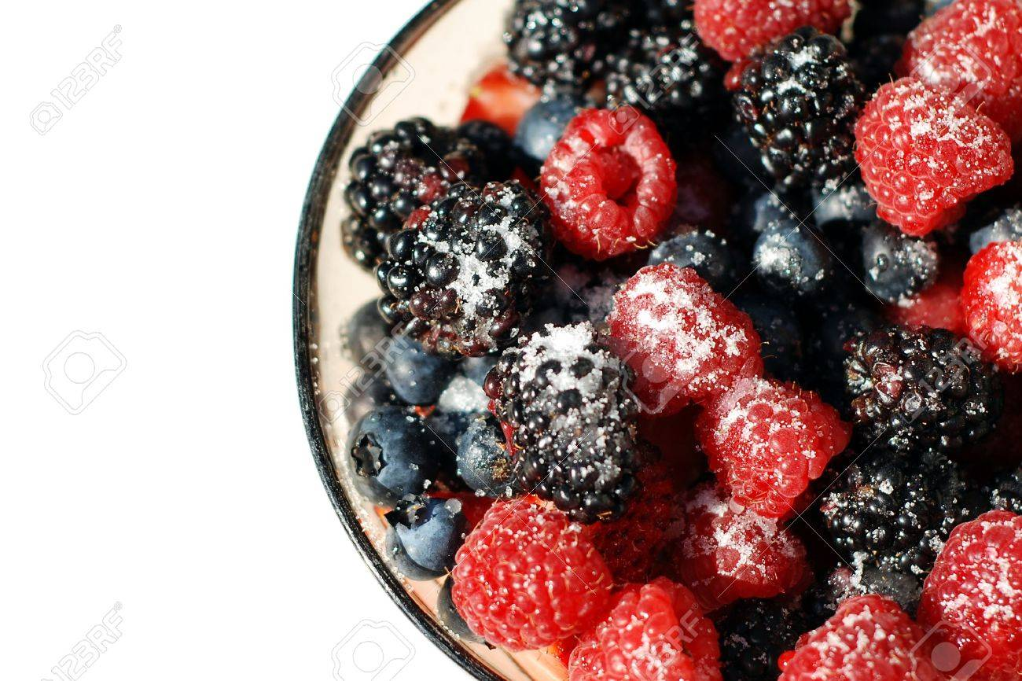
语法糖（Syntactic sugar），也译为糖衣语法，是一个术语，指计算机语言中添加的某种语法，这种语法对语言的功能并没有影响，但是更方便程序员使用。 通常来说使用语法糖能够增加程序的可读性，从而减少程序代码出错的机会。
Syntactic sugar is a term that refers to a grammatical feature of a programming language that:
Has no effect on the functionality of the language.
But is more convenient for programmers to use.
If you sprinkle sugar
on a bowl of berries,
they are still berries.
The only change is that they taste sweeter.
(I think this analogy is where the term originates.)

Slide 7
语法糖（Syntactic sugar），也译为糖衣语法，是一个术语，指计算机语言中添加的某种语法，这种语法对语言的功能并没有影响，但是更方便程序员使用。 通常来说使用语法糖能够增加程序的可读性，从而减少程序代码出错的机会。
Syntactic sugar is a term that refers to a grammatical feature of a programming language that:
Has no effect on the functionality of the language.
But is more convenient for programmers to use.
A simple example of syntactic sugar is "+=". Compare:
total += 1 versus total = total + 1
Notice that the += form is:
Shorter (so += is more convenient for programmers to use).
Functionally equivalent to the longer form (so += has no effect on the functionality of the language).

Slide 8

Wrapper functions do little but to just call another functions.
(Consider how the wrapping paper decorates the gift, below:
The paper is just a thin sheet. Its only job is to cover the box.
The paper wraps around the box. So, to get to the box, you will have to get through the paper.)

Slide 9
The Python decorator (@)
The Python @ operator is syntactic sugar.
It can simplify how you define certain methods.
  But, being syntactic sugar, you could still define those methods without using @.
It can also be confusing to new programmers.
  So we have to build an understanding, step-by-step, of what exactly the decorator does.
    This starts by reviewing how Python treats function objects.
For more advanced applications, see:
https://realpython.com/primer-on-python-decorators/

Slide 10
Functions can be passed around and used as arguments, just like any other object (string, int, list, etc.). Consider:

Slide 11
Functions can be passed around and used as arguments, just like any other object (string, int, list, etc.). Consider:
>>> def say_hi(name): #Receives a string-type
>>> def say_hi(name):
... return "Hi "+name
...
>>>

Slide 12
Functions as passed-around objects
Functions can be passed around and used as arguments, just like any other object (string, int, list, etc.). Consider:
>>> def say_hi(name):
... return "Hi "+name
...
def greet_bob(greeter_func): #Receives a function
>>> def say_hi(name):
... return "Hi "+name
...
def greet_bob(greeter_func):
... return greeter_func("Bob")
...
>>>
>>>

Slide 13
Functions as passed-around objects
Functions can be passed around and used as arguments, just like any other object (string, int, list, etc.). Consider:
>>> def say_hi(name):
... return "Hi "+name
...
def greet_bob(greeter_func):
... return greeter_func("Bob")
...
greet_bob(say_hi) #passing a function argument
'Hi Bob'  How did it know to greet “Bob”?
say_hi("Alice")#a normal call to a normal function
'Hi Alice'
def say_bye(name): #Let’s make different function
... return "See you later, "+name
...
greet_bob(say_bye) #And pass in that new one
'See you later, Bob'
greet_bob(print) #How about a built-in function?
Bob  You executed “print('Bob')”
greet_bob(float)
Traceback (most recent call last): …
ValueError: could not convert string to float: 'Bob'
>>>
>>>
>>>
>>>
>>>
>>>
>>>

Slide 14
Functions as passed-around objects
>>> def say_hi(name):
... return "Hi "+name
...
def greet_bob(greeter_func):
... return greeter_func("Bob")
...
greet_bob(say_hi) #passing a function argument
'Hi Bob'  H
greet_bob(say_hi())#say_hi( ) needs an argument
Traceback (most recent call last):
File "<stdin>", line 1, in <module>
TypeError: say_hi( ) missing 1 required positional argument: 'name'
greet_bob(say_hi('Bob'))#Doesn’t pass a function
Traceback (most recent call last):
File "<stdin>", line 1, in <module>
File "<stdin>", line 2, in greet_bob
TypeError: 'str' object is not callable
print(callable(say_hi('Bob')),callable(say_hi))
False True
>>> # Do you understand all the above behaviors?
>>>
>>>
>>>
>>>
>>>

Slide 15
Functions defined inside other functions
>>> def parent():
... print("Prints in the parent() function")
... def child1():print("Prints in childONE()")
... def child2():print("Prints in childTWO()")
... child1()
... child2()
...
parent()
Prints in the parent() function
Prints in childONE()
Prints in childTWO()
child1()#We know it won’t work (slide #176 of Lect 5)
Traceback (most recent call last):
File "<stdin>", line 1, in <module>
NameError: name 'child1' is not defined
parent.child1() #This won’t work either
Traceback (most recent call last):
File "<stdin>", line 1, in <module>
AttributeError:'function' object has no attribute 'child1'
>>>
>>>
>>>

Slide 16
Defining a Function
Lecture 5
Slide 176
Functions can be defined almost anywhere:
  In between top level code sequences.
  After other functions have been defined that call them.
  Inside of another function:
>>> def f():
... def g():
... print("Defined!")
... g() #Call from inside an enclosing function
...
>>> f() #See. It worked:
Defined!
>>> #This approach can be useful in scoping
>>> #rules to access nonlocal values
>>> g() #It's also used to limit who can call g():
Traceback (most recent call last):
File "<stdin>", line 1, in <module>
NameError: name 'g' is not definedvariable 'g' t

Slide 17
A way to be able to call them from outside
>>> def parent(num):
... print("Prints in the parent() function")
... def child1():return "Hi, I’m Alice!"
... def child2():return "Hi, I’m Bob!"
... if num == 1: return child1 #Notice: we do
... else: return child2 #not use a ()
...
first=parent(1); second=parent(2)
first; second #Notice the way these display:
<function parent.<locals>.child1 at 0x6ffffd92b70>
<function parent.<locals>.child2 at 0x6ffffd92d90>
first(); second() #Of course we can run them:
'Hi, I’m Alice'
'Hi, I’m Bob'
child1() #Recall from the previous slide:
Traceback (most recent call last):
File "<stdin>", line 1, in <module>
NameError: name 'child1' is not defined
>>>
>>>
>>>
>>>
>>>

Slide 18
Putting it all together
>>> def my_decorator(func):
... def wrapper():
... print('Something before function call')
... func()
... print('Something after function call')
... return wrapper
...
>>>
>>> def say_whee(): print("Whee!")
...
say_whee
<function say_whee at 0x6ffffd92ea0>
say_whee = my_decorator(say_whee) # What?!?!
say_whee
<function my_decorator.<locals>.wrapper at 0x6ffffd92e18>
say_whee()
Something before function call
Whee!
Something after function call
>>>
>>>
>>>
>>>

Slide 19
Putting it all together
>>> def my_decorator(func):
... def wrapper():
... print('Something before function call')
... func()
... print('Something after function call')
... return wrapper
...
>>> @my_decorator#Wha-wha-what?!?!
... def say_whee(): print("Whee!")
...
say_whee
<function say_whee at 0x6ffffd92ea0>
say_whee = my_decorator(say_whee) # What?!?!
say_whee
<function my_decorator.<locals>.wrapper at 0x6ffffd92e18>
say_whee()
Something before function call
Whee!
Something after function call
Redo from slide #6
>>>
>>>
>>>
>>>

Slide 20


Who is the wrapper?
“I love wrapping gifts myself.
Bob will love this say_whee() fuction that I worked to wrap all by myself!”
>>> def say_whee(): print("Whee!")
. . .
say_whee = my_decorator(say_whee)
“I don’t have time for this! Hey store, can you gift-wrap this say_whee() function for me?”
>>> @my_decorator
. . . def say_whee(): print("Whee!")
. . .

Slide 21


